Slide 1
FAFSA Data Sharing Agreement For Districts
Andrea Donegan
School Counseling Consultant, DPI

Slide 2
What is the FAFSA Data Sharing Agreement?
The U.S. Department of Education gives states limited accessibility to data on the FAFSA application status of high school students.
FAFSA data does not belong to the Wisconsin Department of Public Instruction.
FAFSA data belongs to the US Department of Education and is licensed to the Wisconsin Higher Education Aids Board (HEAB).
Data is passed onto districts through WISEdash for districts upon receipt of a Data Sharing Agreement from the requesting district.

Slide 3
Purpose of the Data Sharing Agreement
To provide school districts with up-to-date data on the FAFSA completion status of 12th grade students entering post-secondary education
To allow school personnel to encourage and help students submit the FAFSA

Slide 4
Steps to Access the FAFSA Completion Status Data
Complete the Data Sharing Agreement on WISEdash (FOR DISTRICTS) FAFSA® Dashboard
Return the form to dpisspw@dpi.wi.gov
The district’s WISEdash Application Administrator or designee will assign users
If you do not yet have access to WISEdash, use the “Request Access to WISE Application”

Slide 5
Resources for Data Sharing Agreement
Resources can be found at “WISEdash (FOR DISTRICTS) FAFSA® Dashboard”
FAFSA Data Sharing Agreement
WAMS Quick Start Guide
FAQ
WISEhome Login

Slide 6
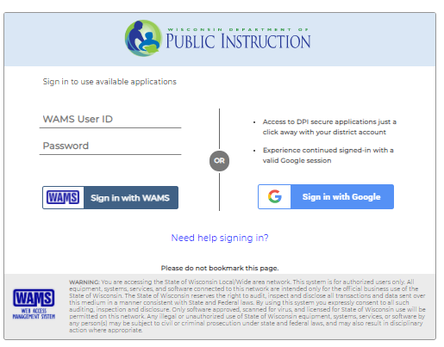
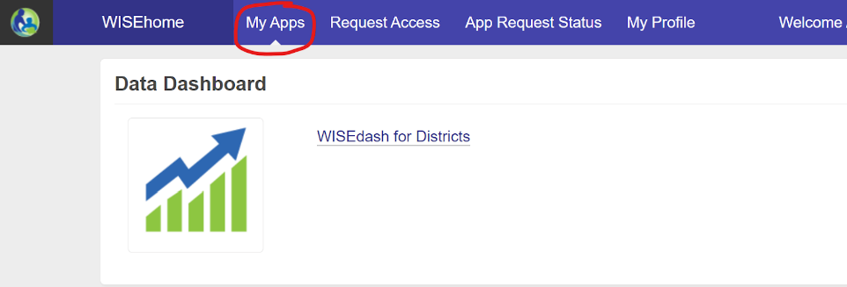
Accessing District Data
Sign in to WAMS Sign In
WISEdash will appear as a link on the My Apps page Click the link for the application.
Notes:
My app shows up once you have access to an application in WISEhome.

Slide 7
Finding FAFSA Completion Status
Click the “waffle” in the top left corner of your browser.
Hover and select “topics.”
Select “Graduation” in the top row
Select “Post-secondary” in row 2
Select “FAFSA Completion Status by Subgroup” in the dropdown menu that appears.
Notes:
The latest FAFSA Update indicating when the system last updated will be displayed.

Slide 8
Disaggregating the Data
Filter data to sort by various subgroups:
School
Disability
Gender
EL Status
Race/Ethnicity
Notes:
NOTE: If WISEdash incorrectly shows the student’s FAFSA as “Not Started,” this happens when there is not a perfect match between what name and birthdate the student enters on the FAFSA and what is on file with the Social Security Administration. Additionally, the student must have selected WI as the legal residence.

Slide 9
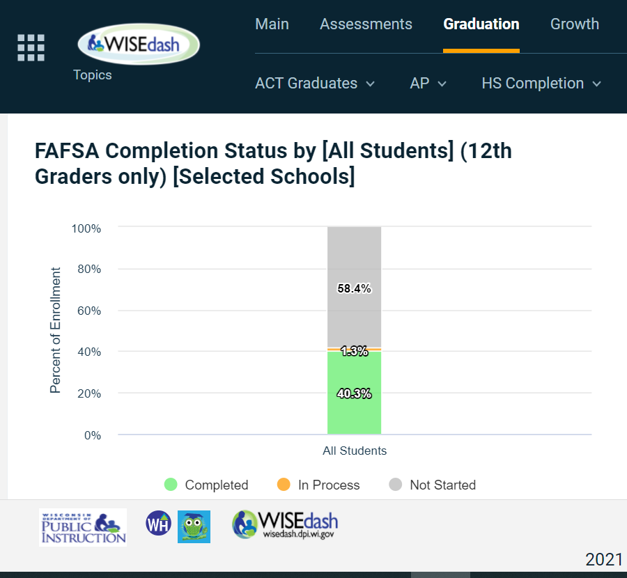
Completion Status Data
Click on the gray portion of the bar graph titled, “FAFSA Completion Status to see students who have not started the FAFSA.
Click the green portion of the bar graph. to view students who have completed the FAFSA.

Slide 10
Data Export
Click on the arrow in the right hand corner of the screen to export the student list to an excel spreadsheet or report.

Slide 11
Contact Information
Andrea Donegan
School Counseling Consultant
andrea.donegan@dpi.wi.gov
(608)224-6175

