Slide 1
Notes:
Welcome to the Wisconsin Statewide Parent Educator Initiative whose mission it is to “Develop Strong Relationships and Build Effective Partnerships” as well as to further the efforts of achieving the vision that “All families and school communities have the beliefs, knowledge, and skills to meaningfully engage in effective decision making to improve outcomes for students of all abilities”.

Slide 2
WSPEI Overview
Support district teams with strategies
Build the necessary relationships to work collaboratively
Create a welcoming, respectful and supportive culture
Notes:
WSPEI helps families and educators build positive working relationships that lead to shared decision making and increased outcomes for all students with IEPs. WSPEI CESA Coordinators support district teams with strategies to implement that can become systemic, integrated, and sustained so that they can build the necessary relationships to work collaboratively towards improved outcomes for children with IEPs and to create a welcoming, respectful and supportive culture within the school.
Children with engaged parents are more likely to:
Earn higher grades or test scores
Graduate from high school and attend post-secondary education
Develop self-confidence and motivation in the classroom
And have better social skills and classroom behavior
They are also less likely to:
Have low self-esteem
Need redirection in the classroom
Or develop behavior issues

Slide 3
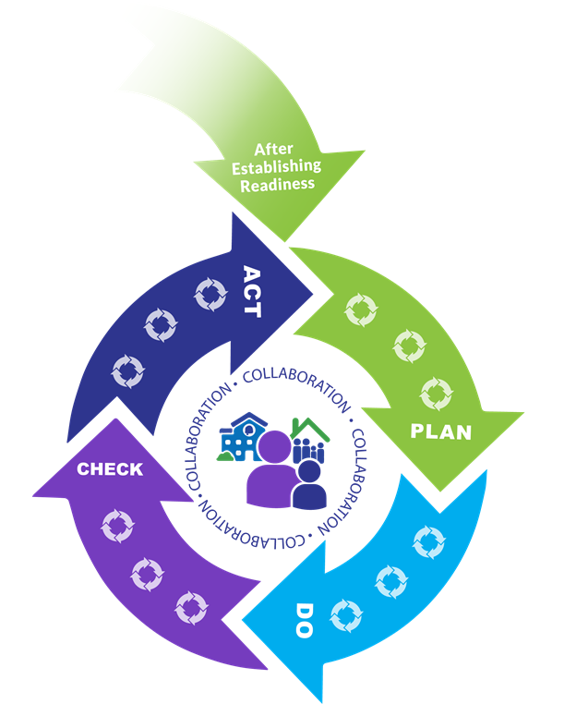
Connections to Continuous Improvement
Systematically supporting each other makes big goals possible
We can multiply the impact of each other's improvement efforts by functioning as a coherent educational system.
For more information on continuous improvement see https://dpi.wi.gov/continuous-improvement
Notes:
When a district engages in a rigorous continuous improvement process, a thorough data inquiry and needs assessment should lead a team to engage in analysis of root causes that surface opportunity gaps for specific student groups. In order to address those gaps, a district will then identify evidence-based improvement strategies to close those gaps. WSPEI Coordinators work with district teams to assess and plan for family engagement by supporting the development of a plan including strategies and methods for engaging all families. WSPEI continues to support districts with a system for monitoring implementation of strategies, including evidence and data collection, and on-going problem-solving. These efforts assist district staff in establishing relationships with all families in order to support learning that leads to improved outcomes for children. This work also allows districts and schools to build a culture of trust and understanding. Additionally, WSPEI provides support to educators and families through Statewide Phone Support and Local Coordinator Support where resources and guidance in family engagement capacity building are provided.
For more information on continuous improvement visit https://dpi.wi.gov/continuous-improvement

Slide 4
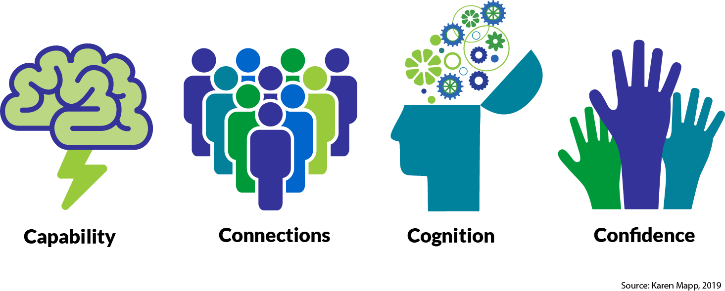
Building Capacity of Educators and Families
- To increase Capabilities, Connections, Cognition, and Confidence
Dual Capacity-Building Framework
Notes:
WSPEI connects families to community organizations and helps them understand their role as parent in the IEP process.
WSPEI helps districts find and implement linked-to-learning strategies to reach families of students who have traditionally been unreached or underserved.
Students’ academic outcomes improve
-When schools reach each and every family
-When educators build effective partnerships with families
-And when families are given linked-to-learning strategies
If district leadership and staff members implement family engagement strategies and methods that become systemic, integrated, and sustained in the district, they will, in turn, learn how to develop partnerships, cultivate and sustain positive relationships with all families which leads to improved outcomes for the children with which they work.
The capacity of educators and families increases in the areas of Capabilities, Connections, Cognition, and Confidence, so that they can better support learning that leads to improved outcomes.
More information can be found in the Dual Capacity-Building Framework resource, linked on the bottom of this slide.

Slide 5
Contact Information
Caroline Rossing
WSPEI Grant Coordinator
crossing@cesa3.org
Check out our website at: wspei.org
Notes:
For more information, please contact Caroline Rossing- WSPEI Grant Coordinator or check out our website at: wspei.org

