Slide 1
Notes:
The Wisconsin Department of Public Instruction has created a systems-change initiative to support Universal Design for Learning as a means to improve student outcomes. Since 2014, all 12 CESAs and partner schools have created a community of practice to expand, advance, and amplify UDL in Wisconsin through a start-up and scaling up grant.

Slide 2
We need to recognize
barriers and design differently so that every
learner can experience
high levels of school success.
Notes:
The UDL grant addresses systems change efforts through the CESAs and partner schools to better serve students with disabilities. UDL operationalizes equity and makes an impact on outcomes because it targets improving learning so that each and every student has what they need, when they need it.

Slide 3
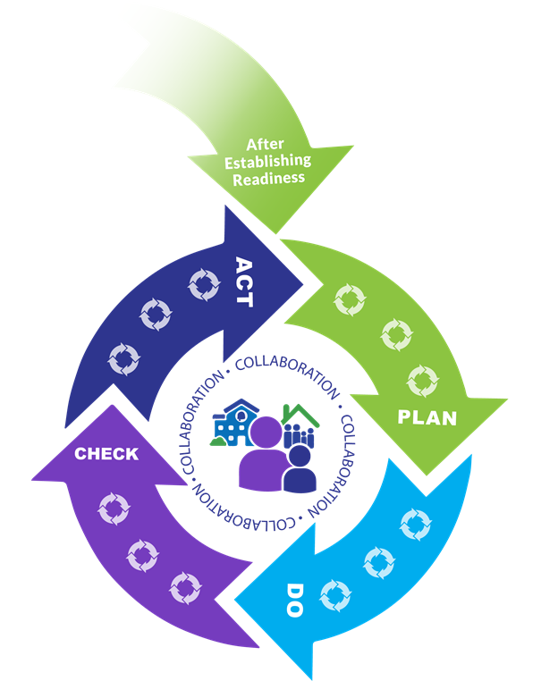
Connections to Continuous Improvement
UDL helps multiply the impact of our improvement efforts.
For more information on continuous improvement visit: https://dpi.wi.gov/continuous-improvement
Notes:
When a district engages in a rigorous continuous improvement process, a thorough data inquiry and needs assessment should lead a team to engage in analysis of root causes that surface opportunity gaps for specific students. In order to address those gaps, a district will then identify evidence-based improvement strategies to close those gaps.
Implementing UDL as a systems-change improvement strategy means using data about the impact of teaching on learning, and connecting teams to effective practice through progress monitoring and responsiveness to learner needs. UDL drives achievement because it puts into action an equitable multi-level system of support, informs educator effectiveness, supports inclusive environments, and allows for flexible use of high quality standards-referenced materials. UDL multiplies the impact of improvement efforts and brings a focus to the work.
For more information on continuous improvement visit: https://dpi.wi.gov/continuous-improvement

Slide 4
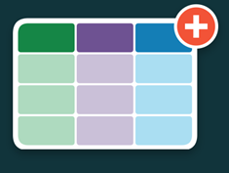
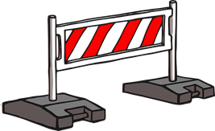
Learning by design
Notes:
When schools use UDL as a continuous improvement strategy, educators can set relevant learning goals, anticipate and identify barriers, design for learner variability, and create more inclusive and equitable learning opportunities. The UDL framework offers a way to think about learning, and a set of research-based teaching practices that are flexible in meeting the needs of a full range of learners. The UDL design considerations mean equitable learning that is accessible, usable, and beneficial to each and every person.

Slide 5
Contact Information
Jayne Bischoff- WI DPI UDL Consultant
https://dpi.wi.gov/sped
https://dpi.wi.gov/universal-design-learning
CESA UDL Contacts
http://tinyurl.com/UDLCESAContacts
Notes:
For more information contact your local CESA UDL contact or Jayne Bischoff at the Wisconsin Department of Public Instruction.

