Slide 1
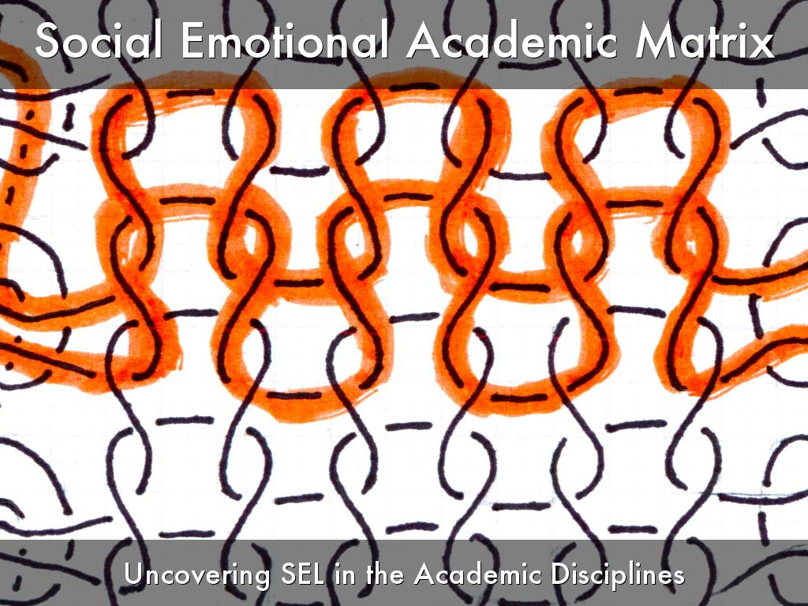
Tyrone Martinez-Black Policy and Practice Specialist
Collaborative for Academic, Social, and Emotional Learning
Photo by fuzzyjay - Creative Commons Attribution-NonCommercial-ShareAlike License https://www.flickr.com/photos/87962300@N00
Created with Haiku Deck

Slide 2
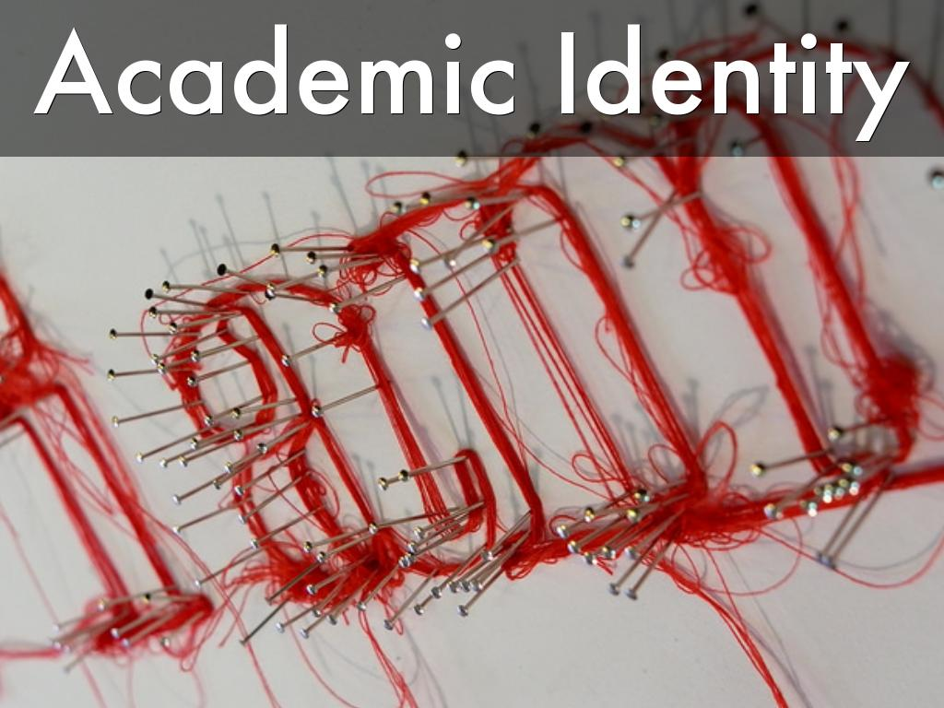
Photo by tombeardshaw - Creative Commons Attribution-NonCommercial-ShareAlike License https://www.flickr.com/photos/85556532@N00
Created with Haiku Deck

Slide 3
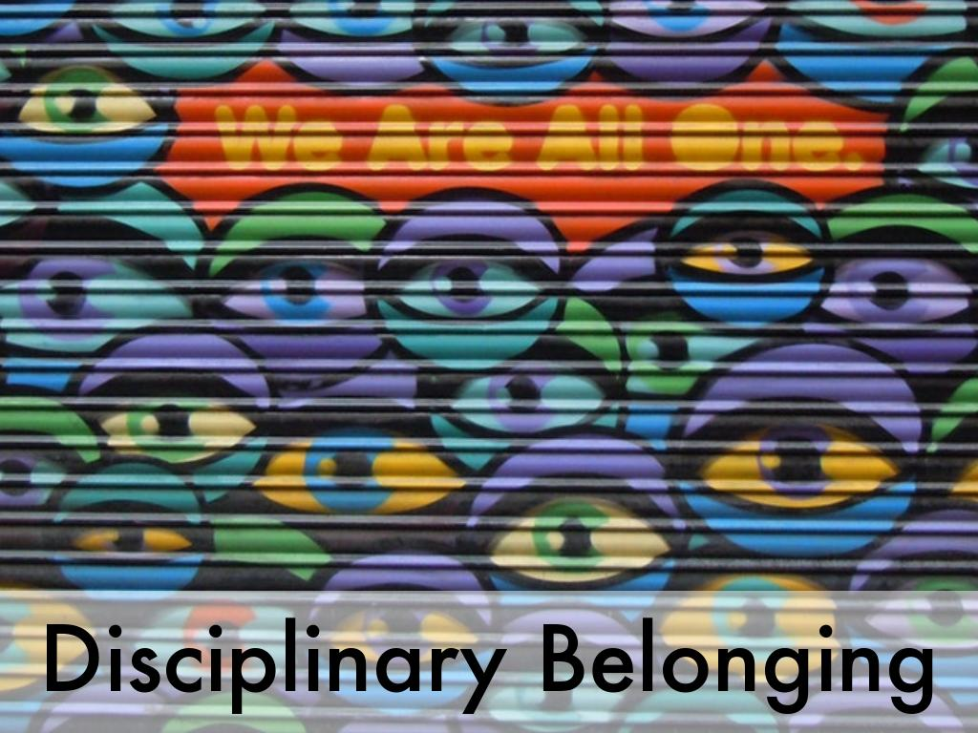
Photo by Daniel Thürler - Creative Commons No known copyright restrictions https://unsplash.com/@drivemyart?utm_source=haikudeck&utm_medium=referral&utm_campaign=api-credit
Created with Haiku Deck

Slide 4

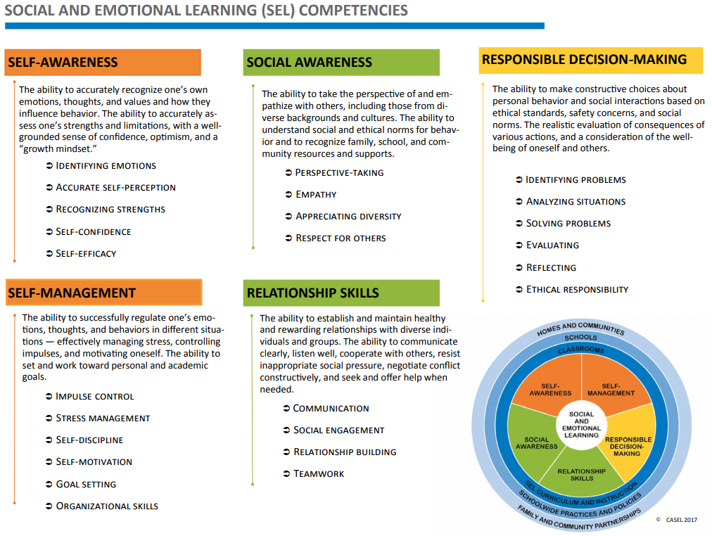
Does that sound like SEL?
Photo by JD Hancock - Creative Commons Attribution License https://www.flickr.com/photos/83346641@N00
Created with Haiku Deck

Slide 5
Impact of SEL Is Long-Lasting—and Global
A major new research study finds that social and emotional learning (SEL) programs benefit children for months and even years.
82
Effects assessed
6 months–
18 years
after programs completed
different programs reviewed
(38 outside U.S.)
Involving more than 97,000
students, kindergarten through middle school
SEL Students Benefit in Many Areas
Mean advantage for SEL participants compared
to control groups across all studies
HIGHER… | Percentile Points
Academic performance | 13
SEL skills | 9
Attitudes | 5
Positive social behaviors | 5
LOWER… | Percentile Points
Conduct problems | 6
Emotional distress | 6
Drug use | 6
(based on 8 studies)
(34 studies)
(29 studies)
(35 studies)
(26 studies)
(28 studies)
(28 studies)
Higher social and emotional competencies among SEL students at the end of the initial intervention was the best predictor of long-term benefits.
Benefits were similar regardless of students’ race, socioeconomic background, or school location.
Additional details at http://www.casel.org/2017-meta-analysis/
Source: Child Development (July 2017). “Promoting Positive Youth Development Through School-Based Social and Emotional Learning Interventions: A Meta-Analysis of Follow-Up Effects”

Slide 6
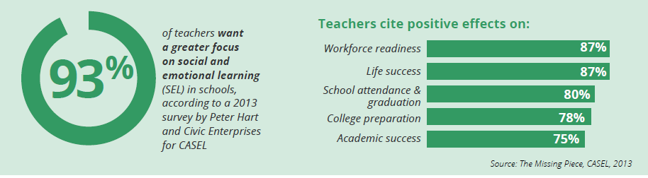
Teachers value SEL
of teachers want a greater focus on social and emotional learning (SEL) in schools, according to a 2013 survey by Peter Hart and Civic Enterprises commissioned by CASEL
Notes:
6
In addition, Principals and Administrators surveyed as well. Greater than 90% also believe SEL is worth investing in and that teachers can pull it off with professional learning and support. <<link for missing piece and principal survey>>

Slide 7
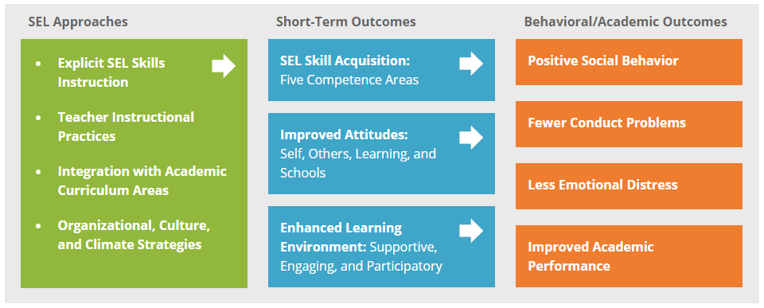
https://casel.org/what-is-sel/approaches/

Slide 8
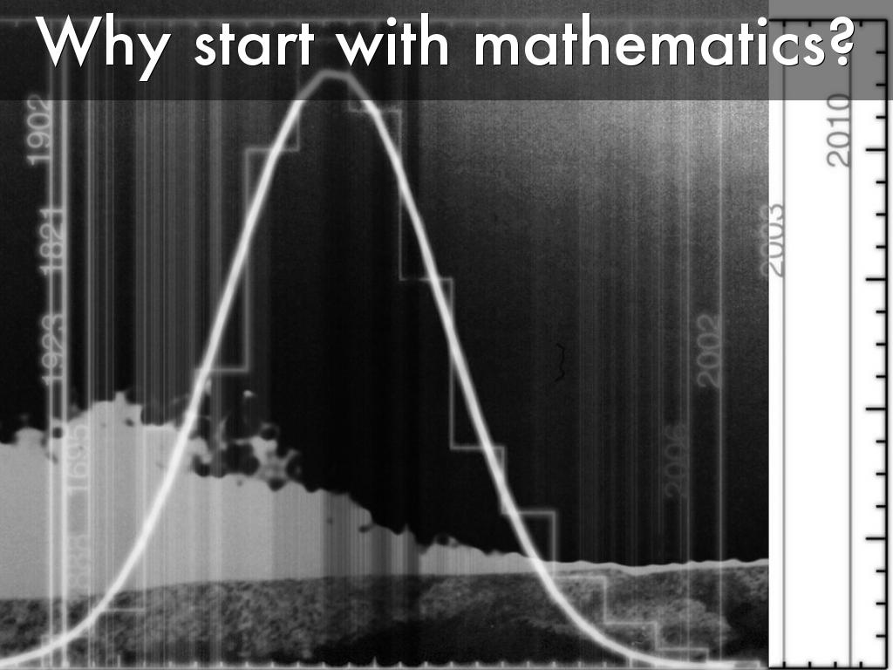
Photo by monkeyinfez - Creative Commons Attribution-NonCommercial-ShareAlike License https://www.flickr.com/photos/41975603@N00
Created with Haiku Deck

Slide 9

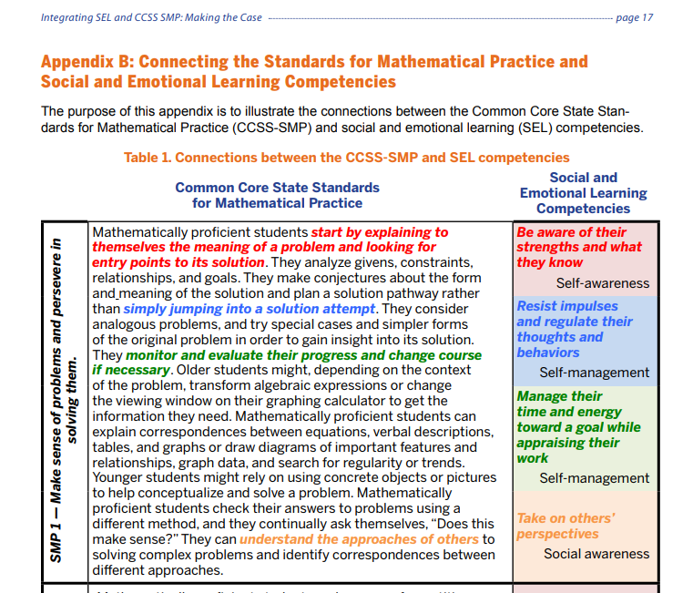
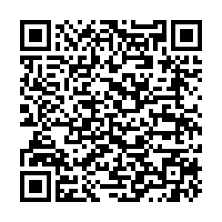

Slide 10
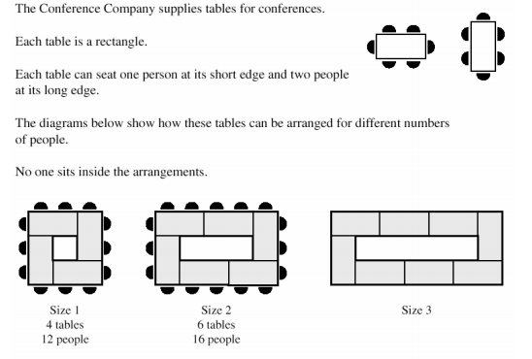
Examining a Task
Notes:
Size 3? Size 7? Rule?

Slide 11

Photo by luc legay - Creative Commons Attribution-ShareAlike License https://www.flickr.com/photos/49503019876@N01
Created with Haiku Deck
Notes:
Is it the content alone? How do we include the social and emotional range that is provoked by scholarly pursuit?

Slide 12
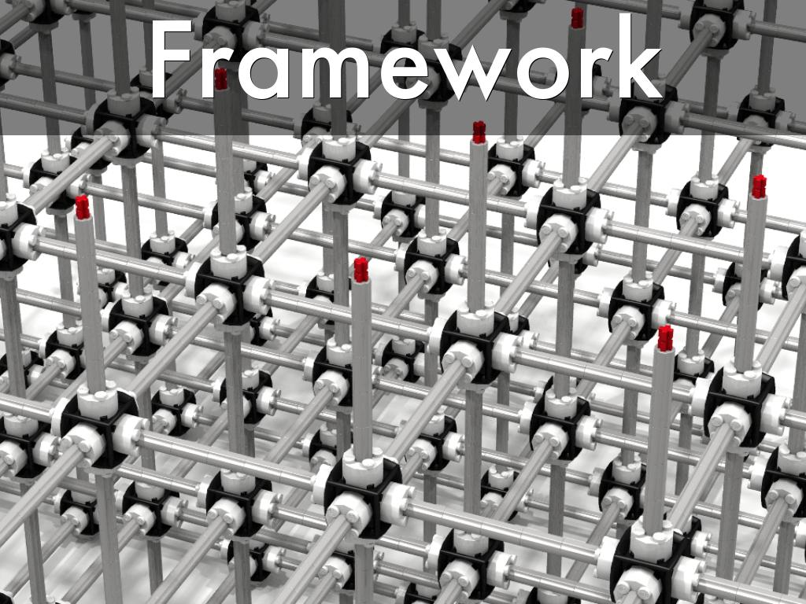
Looking for patterns of language that synchronize with the core compentencies.
Photo by dluders - Creative Commons Attribution License https://www.flickr.com/photos/42988571@N08
Created with Haiku Deck

Slide 13
Examining Standards
Minnesota State Academic Standards
https://education.mn.gov/MDE/dse/stds/
Minnesota State SEL Standards
https://education.mn.gov/MDE/dse/safe/clim/social/imp/

Slide 14

Photo by Aron - Creative Commons No known copyright restrictions https://unsplash.com/@aronunsplash?utm_source=haikudeck&utm_medium=referral&utm_campaign=api-credit
Created with Haiku Deck

Slide 15
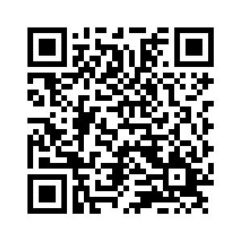
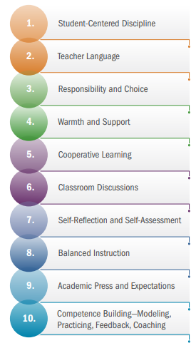
Teaching the Whole Child // The center on Great Teachers and Leaders
https://gtlcenter.org/sites/default/files/TeachingtheWholeChild.pdf
Notes:
https://gtlcenter.org/sites/default/files/TeachingtheWholeChild.pdf
The Center on Great Teachers and Leaders is based at American Institutes for Research

Slide 16
Teaching the Whole Child // The center on Great Teachers and Leaders
https://gtlcenter.org/sites/default/files/TeachingtheWholeChild.pdf
Notes:
https://gtlcenter.org/sites/default/files/TeachingtheWholeChild.pdf
The Center on Great Teachers and Leaders is based at American Institutes for Research

Slide 17
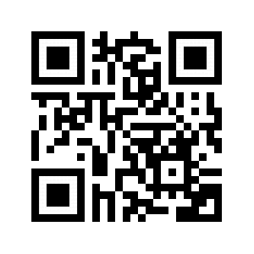
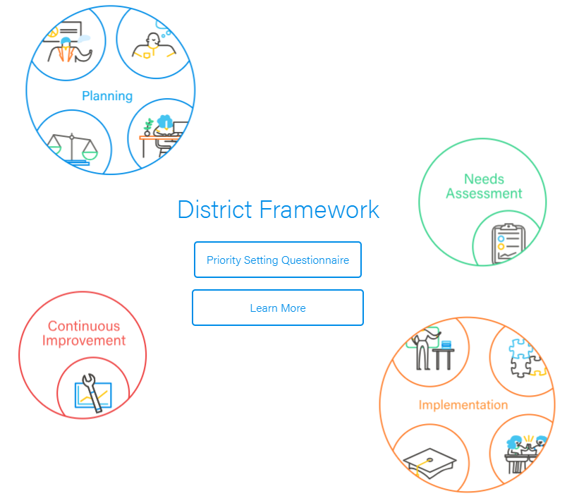
CASEL District Resource Center
https://drc.casel.org/

Slide 18
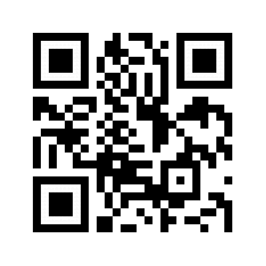
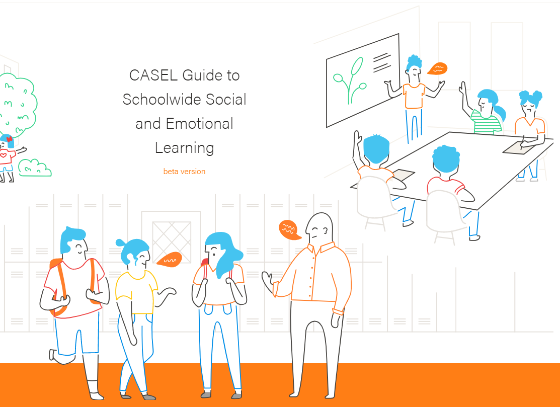
CASEL School Guide
https://schoolguide.casel.org/

Slide 19
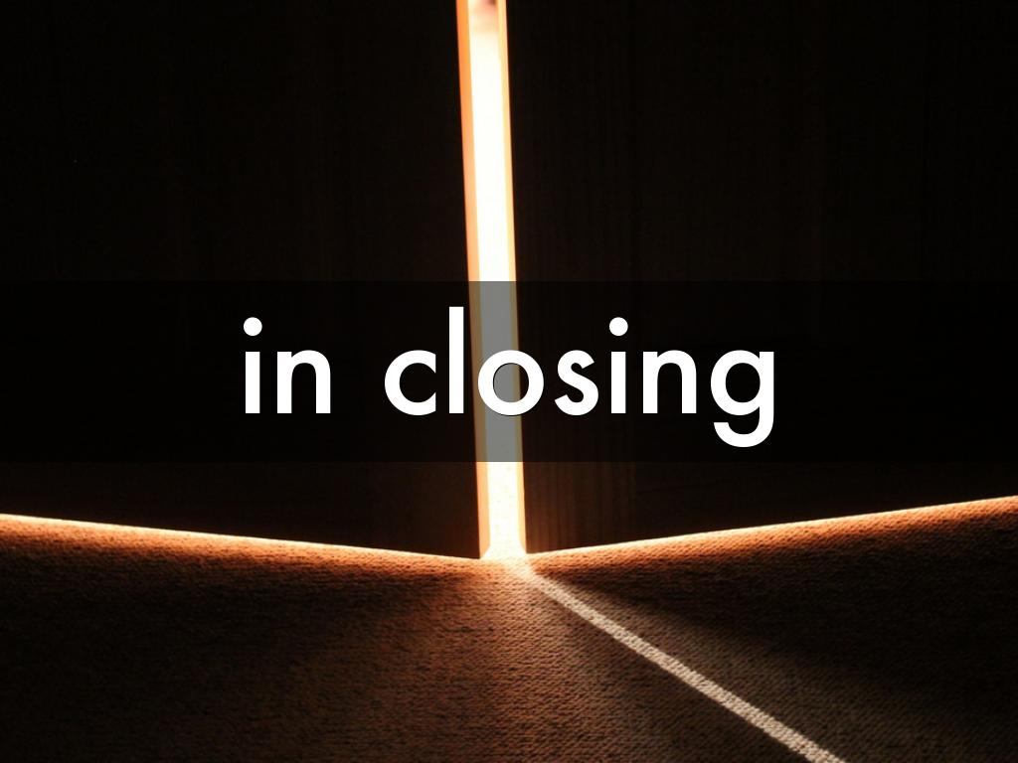
Additional questions or considerations
Tyrone Martinez-Black
Policy and Practice Specialist
tmblack@casel.org
Photo by colin.jagoe - Creative Commons Attribution-NonCommercial-ShareAlike License https://www.flickr.com/photos/36919509@N03
Created with Haiku Deck

Slide 20

What Does SEL in Schools Look Like?
Elementary whole school
  https://www.youtube.com/watch?time_continue=1&v=NJj2Nlp3J2w
Early Learning
  https://www.youtube.com/watch?time_continue=1&v=ohzEujRKtLg
Case studies https://dpi.wi.gov/sspw/mental-health/social-emotional-learning
  https://dpi.wi.gov/sites/default/files/imce/sspw/selcasestudy-mequon-thiensville.pdf
Dedicated Class HS
  https://youtu.be/Yz4NWtsQm1w
Advisory HS
  https://youtu.be/KyoAFpEzXCY
Academic integration-Middle School
  https://www.teachingchannel.org/video/social-skills-goals
HS https://docs.google.com/presentation/d/1ZvoulDkE2VdBboGJ45McezIcezF-WGj1L9sykKnk1Ug/edit?usp=sharing
Notes:
Gregg
3 case studies

