Slide 1
Keys to Monitoring CCR IEP Goal Progress
An Overview
Digging Deeper: Level 1
Barb Novak
Daniel Parker
Tim Peerenboom
Micaela Smith
Paula Volpiansky
Notes:
The information in this presentation is part of a Digging Deeper: Special Topics CCR IEP Learning Resource module. This slide deck and accompanying handouts for training are available at https://dpi.wi.gov/sped/college-and-career-ready-ieps/learning-resources.
Description: IDEA requires progress towards annual goals be measured and periodically reported to parents. To do so, ongoing progress must be monitored from baseline towards specified level of goal attainment. IEP progress data is also key to reviewing the effectiveness of IEP services and supports, and for developing subsequent ambitious and achievable goals. This webinar will provide an overview of the relationship between IEP goal development (Step 3) and monitoring progress in the context of the CCR IEP process. Examples will be used to illustrate key considerations for developing and describing procedures for measuring student’s progress.
Presenters and Authors of this slide deck:
Daniel Parker, Asst. Director Special Education Team, WDPI
Paula Volpiansky, Ed. Consultant/Technical Writer, Special Education Team, WDPI
Barbara Novak, Literacy Consultant, Literacy and Mathematics Team, WDPI
Tim Peerenboom, School Psychology, Student Services/Prevention and Wellness Team, WDPI
Micaela Smith, Certified Orientation and Mobility Specialist, St. Paul Public Schools
We also thank the following for their assistance in the development of this content:
Gail Anderson, WDPI Title I Team (previously CESA 2 RSN)
Cheri Sylla, Family Engagement Coordinator, WI Statewide Parent-Educator Initiative (WSPEI)
WDPI Special Education Team IEP Support Workgroup
WDPI Special Education Team Compliance Workgroup
WI Regional Special Education Network Directors (RSN)
Scott Brown, Statewide CCR IEP Training & Implementation Coordinator, CESA 2
Presentation Slide Timing -90 min)
3:30 -3:35 1-2 Welcome and Intro
3:35-3:40 3-12 Caveats, Links to IDEA and CCR IEP
3:40-3:55 13-20 Definitions and Wordle Activity
3:55-4:10 21-30 Key #1 & Activity
4:10-4:20 31-35 Key #2 and Activity
4:20-4:30 36-41 Key#3 and Activity
4:30-4:35 42 Summary
4:35-4:50 43-55 Applied Example from the Field
4:50-5:00 56-end Final Thoughts, Resources

Slide 2
Slide Icons used in this presentation
Look for the following slide icons:
Information link to webpage or outside resource
Link to handout or WI DPI document
Quiz and quiz answers
Suggested discussion topic
For further thought
Notes:
You will find icons on some of the slides in this presentation. The information
and document icons have hyperlinks to related website pages and handouts.

Slide 3
Learning Objectives
This session will help you build upon your capacity to:
Develop IEP goals that can be reasonably monitored (CCR IEP Step 3)
Identify procedures for measuring progress appropriate to the target skills identified in IEP goals (CCR IEP Step 3)
Understand the role of IEP goal progress data in Step 5 (Analyze Progress) of the CCR IEP process
Notes:
QR Code Generator for direct training
https://www.qr-code-generator.com/
Here are our learning objectives for this module
By the end of the session, we hope you will increase your awareness of how to approach planning for monitoring progress toward IEP goal attainment. This module is intended to help you stretch your understanding and potentially think differently about the IDEA requirements related to this topic
Even if you are an experienced educator, this session should reinforce, and potentially provide some new insights on what you already know.
This introductory session provides an overview of guidelines to consider when planning for and documenting how progress will be monitored. Future modules will elaborate on the application of these guidelines.

Slide 4
Caveat Emptor
This session will not address:
Assessment Literacy
How to implement measurement methods used to monitor progress
How to organize, analyze, display, or share progress data
Using progress data to make instructional and IEP review/revision decisions
Notes:
This is a really complex topic. We are only scratching the surface today.
This session was developed to provide a Big Picture Overview of monitoring IEP goal progress. It is the first of a series of learning resources on this topic. Is it not intended to provide a “deep dive” into the specifics of progress monitoring.
Subsequent “dig deeper” learning modules are being developed to address more specific topics related to conducting progress monitoring and using progress data.

Slide 5
Caveat Emptor
We will not address the use of “progress monitoring” to determine:
Response to interventions outside the IEP; i.e. the effectiveness of universal instruction not directly related to target skills addressed by IEP goals
Special education eligibility, including, but not limited to initial identification of specific learning disabilities (SLD)
Notes:
We know some of the terminology we use in this presentation, are used in other contexts.
We have found when folks hear we are discussing “progress monitoring” there is a tendency to jump immediately to thinking about the SLD rule.
We want to reinforce that our use of the terms “monitoring progress or “progress monitoring” during our presentation today is limited to the monitoring IEP goal progress.
While progress monitoring methods and tools for making formal response to Intervention (RtI) decisions (such as those required for initial SLD eligibility), can also be used for monitoring IEP goal progress, especially for reading decoding and fluency, it is the department’s position that the rules for using progress data to determine eligibility for SLD are not required, nor necessarily appropriate for monitoring progress of all IEP goals.
Data collection for monitoring IEP goals progress IS NOT the same as assessment for eligibility.
That said, we still expect monitoring of IEP goal progress to be systematic and rigorous.
Enough said about SLD- The rest of this presentation will focus in only on monitoring IEP goal process.

Slide 6
Legal Foundations and Linkages to CCR- IEP Process
Notes:
Lets move onto the legal requirements related to monitoring IEP progress as well as linkages to our CCR IEP initiative

Slide 7
CCR IEP 5 Step Process
Notes:
We are grounding ourselves in the CCR IEP 5 Step process.
We are assuming most of you are familiar with the CCR IEP content and terminology. You can find more information about the CCR IEP process on the DPI website. There is an information link to the webpage on upper right hand corner of this slide https://dpi.wi.gov/sites/default/files/imce/sped/pdf/rda-ccr-iep-five-step-process.pdf
Progress monitoring is important to all 5 steps. Planning, Deciding and Documenting how progress will be measured and reported; as well as the use of progress data during IEP review and revision are specific parts of CCR IEP steps 3 and 5.
By and large, the actual act of monitoring progress toward IEP goals occurs outside of IEP development and review. Data from ongoing progress monitoring is collected during the student’s school day, usually while the student is engaged in instruction or other school activities.

Slide 8
Progress Monitoring is Required (CCR IEP Step 3)
The IEP must include a description of
How the (student's) progress toward meeting the annual goals will be measured; and
When periodic reports on the progress the (student) is making toward meeting the annual goals (such as through the use of quarterly or other periodic reports, concurrent with the issuance of report cards) will be provided (to parents)
34 CFR 300.320 (a)(3)
Notes:
Even though there are no specific regulations for progress monitoring procedures, progress monitoring is required under IDEA.
Every IEP must include a description of:
How the (student's) progress toward meeting the annual goals will be measured; and
When periodic reports will be provided to parents on the progress the (student) is making toward meeting the annual goals
These two requirements are documented on DPI Sample IEP Form I-4 in the goals section.
IEP progress is reported to parents using and Sample forms I-6 and I-5 (interim and annual report forms)
Links to these forms are included on a resource slide at the end of the presentation.

Slide 9
Progress Monitoring is Required (CCR IEP Step 5)
IEP must be reviewed periodically. At least annually, IEP team must meet to formally review progress toward all IEP goals and revise IEP as appropriate to address (in part):
The student’s disability-related needs
Any lack of expected progress toward IEP goals
Any lack of expected progress in the general education curriculum
How IEP goals and services support student progress
34 CFR 300.324 (b)
Notes:
IEP Review is another requirement that uses progress data. At least annually, the IEP team must meet to formally review IEP goal progress and revise the IEP as appropriate in response.
During the annual review, the IEP team uses the information collected and already reported to the parent during interim review(s) of progress, AND any other relevant information, to decide if IEP goals have been met and if special education services are effectively meeting the student’s needs. However, If the student is not making sufficient progress upon interim review, one should not wait for an annual review; immediate action should be taken such as adjusting teaching and support strategies OR, if more significant changes are needed such as the type, amount or frequency of services, an IEP team meeting should be scheduled to review and revise the IEP.
-------------------------------Additional information----------------------------------------------
The prompt on the sample IEP linking form calls for a “description of the procedures used to measure progress.” Historically, we have accepted a brief list of progress monitoring methods or tools as being minimally sufficient for meeting this procedural requirement. Today, we are asking you to think about this more as the department’s guidance has been evolving. (See PCSA items IEP 9, 10, 11 and IMP 4)
Current Procedural Compliance Self Assessment (PCSA) standards require goals clearly include measurable baselines and level of attainment and that the methods used to measure progress be appropriate to the goal and consistent with the baseline and LOA. (ITEMS IEP 9, 10, 11).
Furthermore, PCSA standards require actual progress data be reported to parent. “The reports must provide sufficient information so the parent can determine the degree to which the student has made progress toward meeting each goal” It is not enough to simply state that the student is or it no making sufficient progress. (ITEM IMP-4)

Slide 10
Interpretation of Federal Law Endrew F. v Douglas County
To meet its substantive obligation under the IDEA, a school must offer an IEP reasonably calculated to enable a child to make progress appropriate in light of the child’s circumstances.
Educational benefit must be more than de minimis
Importance of implementing the IEP
Importance of making progress on IEP goals
Resource: USDE Q & A Document
Notes:
Recent court ruling have further prompted a renewed look at the IDEA requirements around monitoring progress. You may have heard of the Endrew F case. This very important 2017 Supreme Court Ruling (March 22, 2017)- emphasizes “progress.”
The Court in Endrew F. held “To meet its substantive obligation [to provide a Free Appropriate Public Education (FAPE)] under the IDEA, a school must offer an IEP reasonably calculated to enable a child to make progress appropriate in light of the child’s circumstances.” (Endrew F., 2017, p. 16) . The court explicitly rejected the merely more than de minimis, or trivial, progress standard.
Although the Court did not determine any one test for determining what appropriate progress looks like for every child, the court decision means IEP Teams must implement policies, procedures, and practices relating to measuring progress (see DOE Q 18)
We have done this with our updated Procedural Compliance Self Assessment (PCSA) standards used when we monitoring districts for IDEA compliance.
--------------------------------------Supplemental Information -------------------------------------------------
Other relevant quotes from Endrew-
“The IEP must aim to enable the child to make progress. After all, the essential function of an IEP is to set out a plan for pursuing academic and functional advancement.” Endrew F., 2017, p. 11
“If a child is not making expected progress toward his or her annual goals, the IEP team must revise, as appropriate, the IEP to address the lack of progress” Dept. of Education’s FAQ- Endrew F., #15
“A student offered an education program providing ‘merely more than de minimis' progress from year to year can hardly be said to have been offered an education at all.” Endrew F, 2017, p. 14
IEP Teams and other school personnel should be able to demonstrate that, consistent with the provisions in the child’s IEP, they are providing special education and related services and supplementary aids and services; making program modifications; providing supports for school personnel; and allowing for appropriate accommodations that are reasonably calculated to enable a child to make progress appropriate in light of the child’s circumstances and enable the child to have the chance to meet challenging objectives. DOE FAQ Question # 18
Link to PCSA Standards and Directions: https://dpi.wi.gov/sped/educators/rdapcsa/standards

Slide 11
CCR IEP 5 Beliefs
High Expectations
Culturally Responsive Practices
Student Relationships
Family and Community Engagement
Collective Responsibility
Systems that support CCR IEP Beliefs, remove barriers to access, engagement and progress
Notes:
Before we continue, We would be remiss if we didn’t reinforce the idea that CCR IEPs and all our actions related to their development and implementation are grounded in our CCR IEP beliefs. It is important to keep these Beliefs in mind when completing each step of the IEP development process.
For example, having high expectations leads to developing ambitious and achievable goals, which in turn, serve as the basis for monitoring student progress. Likewise, effective progress monitoring is a collective responsibility, involving multiple educators, students and families. Student progress is best realized when special and general educators as well as students and families share collective responsibility for monitoring progress and using progress data to make instructional decisions.
For more information on the 5 Beliefs, visit our CCR IEP Resources webpage. A handout of the 5 beliefs is available on the DPI website. You can get to it by clicking on the link icon on this slide: https://dpi.wi.gov/sites/default/files/imce/sped/pdf/rda-ccr-iep-five-beliefs.pdf
------------------------------------------------- Supplemental Information -------------------------------------
Some of you may have seen the graphic on the right. It has frequently been used to talk about culturally response practices. Today we will use it to talk about CCR-IEPs. It represents all the CCR-IEP beliefs and what we hope to achieve w/ the CCR-IEP process. It shows three different scenarios-
In the first, each student is given the same/equal supports. This equal distribution of support works for some students but does not work out so well for others (i.e. equal is not always fair, especially for students with IEPs).
In the second scenario, the resources allocated to each student is based on what students needs. One might say this is what IEPs do for students. They provide students with the supports that students need to access, engage, and make progress in grade level general education curriculum, instruction, and environments. Special ed staff are often the “box builders” for students with IEPs; They give students what they need to deal with the barriers these students often encounter.
In the third scenario, we have identified that barriers, that if removed, might provide all students with the same ability to access and engage in their education so they can all benefit and make progress. While this may not always be fully possible, this is what we should strive to accomplish with the IEP process; figuring out what is needed to remove barriers such as:
Increase student skills (to address achievement/functional skill gaps) via effective instruction/intervention/specially designed instruction
Improve instructional supports
Improve environmental supports
Change what staff do, i.e. change in staff behavior and practices
Change beliefs
Resource: Picture Adapted from Center for Story Based Strategy and Interaction Institute for Social Change

Slide 12
Engaging Families and Students
Contribution and participation is valuable and essential
Keep communication lines open between IEP team meetings
Provide student participation options
Consider student led IEPs
Encourage “Principle of Partial Participation” (as appropriate)
Involve students in monitoring their own progress
Notes:
Collective responsibility depends on engaging families and students. Open, two way communication provides opportunities for parents and students to share concerns, answer questions, and provide input during all stages of IEP development, implementation and review, including planning for and conducting ongoing monitoring of student progress, making decisions about whether progress is sufficient, and considering what to do when progress is insufficient. And remember, the way in which you verbally and non-verbally interact, communicates to students and families your attitude about their participation.
The last bullet is especially important. There is evidence that when students are involved in monitoring and analyzing their own progress toward achieving IEP goals, they feel more ownership over their learning, are more motivated, and have higher rates of achievement. A student who monitors their progress understands how they learn best, and strengthens their ability to articulate their learning needs. Parents and educators can help by asking their student on a regular basis how satisfied they are with their progress, and what kind of help they might need to be more successful.
-------------------------------------------Supplemental information -------------------------------------
Participation options/Principle of Partial Participation
Even students with “the most significant cognitive disabilities’ can participate in their IEP meeting in a meaningful way and provide information. The IEP team should consider the Principle of Partial Participation. It is better to work to try to include the student as much as possible than not to include them in the process at all.
For example, a student who uses a picture based communication system as a primary mode of communicating with others, can be asked questions related to their interests and ideas and then respond based on the choices provided. (The choices might be picked by someone who knows the student well, based on previous experiences the student has had, or based on age appropriate things their peers may be interested in).

Slide 13
Definitions
Notes:
The next few slides provide some definitions and context for the Key Considerations for Planning for Progress Monitoring.

Slide 14
Monitoring Progress, Progress Monitoring What is the Difference?
For our purposes today, we will use these terms interchangeably to refer to systematic and planned methods used, over time, to determine whether a student is making intended progress and benefitting from education strategies linked to an IEP goal
Notes:
So, What does it mean to “monitor progress”?
Monitoring student progress is a process linked to ongoing instructional planning; not just a series of data collection events.
It occurs during the student’s school day;
Progress is measured over time; not just when progress reports are provided to parents or when the IEP team meets.
Some people make a distinction between the terms, “monitoring progress” and “progress monitoring” . For our purposes, we will use the terms “monitoring progress” and progress monitoring interchangeably to refer to
Systematic and planned methods. Again, an ongoing process; not just a series of events.
Procedures for how progress will be measured, by whom and where/when is planned at the time when the IEP goal is developed
Used to determine whether a student is benefitting from the educational services and supports linked to IEP goals (including specially designed instruction, related services, and other supports and strategies used in special and general education settings.
-------------------------Supplemental Notes--------------------------
All teachers formally and informally monitor their students’ progress throughout the year, using a variety of strategies. However, these strategies may vary greatly in quantity and quality. Additionally, the data/information gained is not always recorded and are sometime only used to adjust instruction “in the moment” (e.g. when teachers use questioning techniques during instruction to evaluate if students are understanding the lesson).
The term “Progress Monitoring” came into common use with the rise of “Response to Intervention (RTI); For many educators, the term Progress Monitoring (PM) refers to a formal scientifically- based practice used to assess students’ academic performance and evaluate the effectiveness of instruction.
The term “monitoring progress” is generally used to describe instructional practices that include a variety of types of formative assessment, questioning, feedback, and similar strategies.
For our purposes, we are using these terms interchangeably to refer to ongoing systematic methods to monitor a student’s response to services in relation to targeted skills and behaviors.
Our working definition is closely related to that used by the National Center on Response to Intervention, Progress monitoring is used to assess students’ performance over time; to quantify student rates of improvement or responsiveness to instruction; to evaluate instructional effectiveness; and…., to formulate effective individualized programs. National Center on Response to Intervention.

Slide 15
What is Progress Monitoring? Wisconsin Definitions
A process used to assess students’ academic and behavioral performance, to measure student responsiveness to interventions/ challenges, and to evaluate the effectiveness of interventions/challenges
WI RtI Center Glossary
A scientifically−based practice to assess pupil response to interventions
PI 11.02(10)
Notes:
Here are some definitions from Wisconsin sources.
As you review the additional definitions on this slide, recognize that progress monitoring is directly linked to making decisions about the effectiveness of instruction and supports.

Slide 16
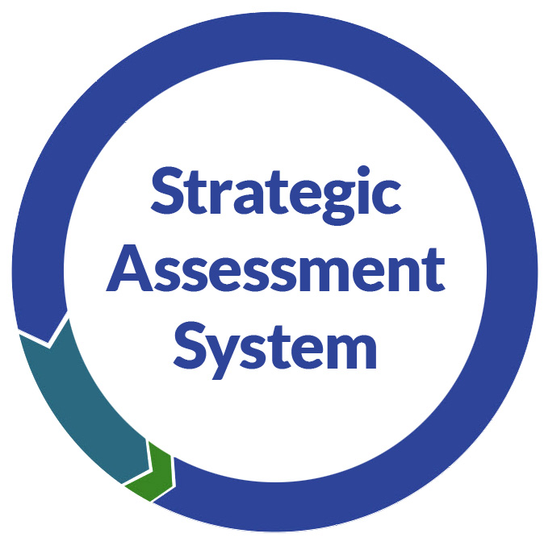
Monitoring IEP goal progress fits within an Equitable MLSS using Strategic Assessment Systems
Monitoring IEP Goal Progress
Notes:
Our working definition of monitoring progress also fits within our state’s vision of an Equitable MLSS and the use of strategic assessment systems within an MLSS.
The strategic assessment system captures all assessment in which an individual student is involved. Data within this system is already being used for general education student progress monitoring. IEP teams should consider existing sources of progress data when designing progress monitoring procedures specific to individual students’ goals.
Click on the icons on this slide to link to more information about MLSS and Strategic Assessment System
--------------------------------------------------------------------------------------------------------------
From https://dpi.wi.gov/sites/default/files/imce/strategic-assessment/SAS_Terms_RVSD9.17.19.docx Wisconsin's Strategic Assessment Systems (SAS)

Slide 17
Screening vs. Progress Monitoring
For Identifying Risk
Groups/Cohorts
Broad Sample of Skills
For Measuring Growth
Individualized
Targeted Skills
Screening
Progress Monitoring
Brief
Technically Sound
Strategic Use of Data
Notes:
One final point about definitions: Monitoring Progress is not the same as screening. The purposes of these two types of assessment are different.
The purpose of screening is to identify or predict potential for poor outcomes. Educators use screening to identify students who may be at risk for not meeting general education standards and expectations.
Most schools screen students for various risk factors (reading or math achievement, mental health issues, etc.) one to 3 times per year.
Students identified as “at risk” are usually provided with some level of general education intervention.
The purpose of monitoring IEP goal progress is to measure growth.
Both screening and progress monitoring tools should be technically sound and brief. However, progress monitoring tools must be able to measure small changes in specific targeted student skills or behaviors related to individual student needs. With respect to monitoring IEP goals, the progress data used to make ongoing adjustments to instruction and support is also used to make decisions about whether progress is sufficient and whether IEP services and supports are effective in addressing a student’s disability related needs.
While, the data used for monitoring progress does not have to be as rigorous as data used to make eligibility decisions, it is more rigorous than the data used to make screening decisions. The important point is that progress monitoring must be specific to the target skills or learning behaviors specified in the goal.

Slide 18
So… WHY do we collect data to monitor progress ?
Comply with state and federal law
Guide instructional decision-making
Motivate student learning; help students “see” progress
All involved in student’s education (educators, family, student, support staff)
Have input into planning for progress monitoring
Share data widely in understandable format
Know effects of instruction and supports they provide on access, engagement and progress in general education
Collaborate when making important decisions
Notes:
To summarize, Why are we really collecting progress data?
Of course, we want to comply with state and federal law, but there are also other reasons:
Instructional decision-making: adjust instruction/supports
Motivate student learning/help them “see” progress
To support collaboration through collective responsibility. Within a system that supports and emphasizes collective responsibility, all stakeholders involved in student’s education (educators, family, student, support staff)
Have input into planning for progress monitoring
Share data widely in understandable format
Know the effect of their efforts to provide instruction and supports on access, engagement and progress in general education
Be more likely to collaborate when making important (“high stakes”?) decisions that affect FAPE and LRE- e.g. IEP goal and service changes, placement decisions, etc.
And we should not forget that progress monitoring is one way to advance equity. Monitoring progress will help us reflect on student achievement in relation to ambitious and achievable goals with the desired outcome being access, engagement, and progress in general education instruction, activities, and environments for ALL students with IEPs

Slide 19
Challenges
Professional responsibilities and demands
Selecting optimal target skills
Avoiding tendency to work backwards
Goals are fit to student-specific DRN rather than selected from list derived from curriculum in-use or restated universal grade level standards
Having enough reliable and right type of data
Making ongoing progress monitoring a habit
Notes:
Before we continue, we want to let you know we understand that monitoring the progress of IEP goals, as we are defining it, may feel like a “big ask”.
We understand and recognize the challenges you and other educators face. We understand
Educators have many demands placed them.
You deal with students with many needs
Challenged by the amount of assessment asked of you
allocating time within an educator’s daily work repertoire to planning and systematic monitoring of IEP goal progress may be difficult at first.
To be effective PM of IEP goals should be done collaboratively and we understand collaboration takes time.
Some ideas we have received for removing barriers to implementing a good system of progress monitoring
Incorporate IEP goal progress monitoring activities into regular instructional plans and student and teacher schedules. This will make needed data easily available for reporting progress to parents and for use during IEP team review and revision meetings
Get good at it. Having adequate and reliable progress data
makes analysis and hard decisions more efficient (e.g. shorter IEP team meetings!)
supports the cycle of instructional decision-making and improvement.
Makes better use of collaboration and planning time so minor adjustments to instruction and supports can be made expeditiously.
Putting the work in at the front end should increase efficiency and effectiveness. Focusing more deliberately on the relationship between instruction and the development of skills needed for school achievement is necessary if we want to meet the student achievement needle.

Slide 20
Pause and Reflect
Given this context, has anything solidified or changed about your views of today’s topic?
What one word comes to mind when you hear the term “monitoring IEP goal progress”?
Login to www.menti.com and use the code: xx xx xx Enter your word
Notes:
This activity is appropriate for use when these slides are used for a group presentation.
Lets take a moment to reflect on what you are thinking at this time.
When you hear the term” monitoring IEP goal progress” what one word comes to mind.
Go to menti.com and end the code on the slide (with spaces). You can enter 1, 2, or 3 words.
PRESENTER: Log on to https://www.mentimeter.com/ and check/reset as needed (link good for two days) and select present- DPI Presenters may use their DPI Username and password and use Google to login.

Slide 21
Planning for Monitoring IEP Goal Progress KEY CONSIDERATIONS
Measurable target skill(s)
Baseline and level of attainment
Progress monitoring procedures, methods, tools
Notes:
Now that we have provided some context, we now turn to the prerequisites necessary to effectively plan for using systematic and planned methods for measuring student progress from baseline towards the level of attainment (LOA) specified in a student’s IEP goal.
We will go over the three Key Considerations listed here on the following slides.
Measurable target skill(s)
Baseline and level of attainment
Progress monitoring procedures, methods, tools

Slide 22
Measurable Annual Goals
Baseline
Report Progress to Family
Target Skill
Procedures for Measuring Progress
Level of Attainment
Notes:
We are assuming most of you are familiar with these components of the IEP goal page. These are not new.
This graphic shows the components of an IEP goal and how they are aligned.
We should always keep in mind that the primary purpose of IEP goals is to address student needs that result from the student’s disability, so the student can better access, engage and make progress in general education instruction, activities, and environments.
Every annual IEP goal incorporates progress monitoring
The terminology you use in the goal determines the type of data you will collect AND what methods will be appropriate for collecting the data.
--------------------------------------------Supplemental Notes------------------------------------------------
NOTE to reviewers- FYI these speaker notes have been substantially updated from those in original step 3 training materials (remove this note before final posting)
Assumption is audience had Step 3 training and is familiar with these terms
As has always been the case when developing a measurable annual goal, you must include:
Target Skill: The skill (or behavior) targeted by the goal related to an identified disability related need. What the student will do (e.g., increase reading fluency, develop organizational skills). The target skill must be measurable (i.e. must be able to see it/hear it). Identifying an appropriate target skill or learning behavior is central to goal development.
Baseline: The student’s target skill performance level at the time of the IEP meeting. This is related to information about the student’s current level of performance of the target skill or behavior as described in CCR IEP Step 1.
Level of Attainment: The amount of growth in the target skill anticipated within a year (or the specified duration noted).
Procedures for Measuring Progress: The process or methods used to assess a student’s academic and functional performance during the school year for the purpose of analyzing the student’s response to special education services. Specific to goal development, the process or methods used to track growth in the goal’s target from baseline to level of attainment. Procedures must be specified for each goal.
When progress will be reported to parents. Progress on annual goals must be periodically reported to parents. Many IEP teams decide to report progress on the same schedule as general education progress reporting. A statement of when progress will be reported must be included with each IEP goal.

Slide 23
Quick Reminder
IEP Goal= What you want the student to do and how well
Procedures for Measuring Progress= How you will know how well the student is doing at any given time, and when the student has met the goal
Notes:
This is a restatement of what we have been saying in more user friendly terms.
Again, the main idea is that the foundation for Progress Monitoring is in the IEP goals.

Slide 24
Monitoring Progress of IEP Goals
1
The IEP goal statement must include a measurable target skill
AND
The skill targeted by the goal must address student-specific disability related need (DRN)
Notes:
So, now onto three key considerations essential to planning for effective monitoring of IEP goal progress. After each is presented there are some examples and an opportunity to check your understanding.
Before educators can start monitoring progress, they must master some important prerequisites. We understand you may already be familiar with these, and some of you may be accomplished progress monitors. For you, this should be a good refresher and may provide you with some new content for mentoring others.
The first key is:
The goal statement must include a measurable* target skill or behavior (Link to Step 3)
AND
The target skill must address a student-specific disability related need (DRN) based on an analysis of effects and root causes (Link to Steps 1 and 2) aimed at improving the student’s access, engagement, and progress in general education
The term “measurable” is critical
*What is measurable? Something that can be quantified (Oxford English Dictionary). i.e. You much be able to “count” it.
If you can observe or hear it, you can count it
So, a measurable target for an IEP goal must be a skill you can objectively “count” (or tally, or score or rate….).
-----------------------------------------------------Additional notes------------------------------------------------
While some “non-measurable goals” may be worthy and important, they may also be vague. When used, they often result in difficulty identifying how and when a desired goal has been met. Non-measurable “goals” should not be used in IEPs. Instead, teams should hold additional discussion to further clarify effects, root causes and disability related needs so more specific and measurable targets can be addressed, monitored, and achieved.

Slide 25
Effect Root Cause DRN Goal
Think: The student… observed effect(s) …because root cause(s)
Example: The student does not fluently read grade-level text (effect) because of inefficient decoding skills (root cause)
DRN= The student needs to develop, increase or use area/skill (related to root causes), so the student can… (related to effect on access, engagement, progress) [ and outcomes (age/grade standards and expectations) will improve.]
Example: The student needs to improve decoding skills (root cause) so the student can fluently read grade-level text (effect) … [and, as a result, will meet grade level reading standards]
Notes:
During CCR IEP Step 2 training (link on slide), we provide guidance on the requisite discussion needed to develop a measurable annual goal (Step 3) that addresses a student’s disability related need.
Lets go over this guidance as a refresher to thinking about identifying a measurable “TARGET” which is the heart of the IEP goal.
The sentence stems on this slide have been provided to help think about the relationship between the effects of disability, root causes, and disability related needs. This, in turn, is the basis for making decisions about IEP goals and services.
Lets walk through these stems using an example
Think: The student does… observed effect(s) …because of root cause(s)
Example: The student does not fluently read grade-level text (effect) because of inefficient decoding skills (root cause)
And now we can move to identifying a disability related need:
DRN= The student needs to develop/increase area/skill (related to root causes), so the student can… (related to effect on access, engagement, progress) . In turn, it is assumed the skill improvement will have an effect on the student’s general education access, engagement and progress, and in turn, the student should meet age or grade level standards and expectations. (i.e. lead to improved educational outcomes).
Example: The student needs to improve decoding skills (root cause) so the student can fluently read grade-level text (effect) … and, as a result, will meet grade level reading standards (age/grade level standard or expectation outcome)
We will go over some more examples in a bit

Slide 26
Effect Root Cause DRN Goal
Think: IEP goals address DRN related to “why” (i.e., root causes) the student is not meeting early childhood/ grade-level standards or expectations (i.e. effect)
A well developed goal statement specifies the target skill (related to root cause/s) to be developed or increased; not just an effect or symptom
Short term objectives (STOs) may be used when the target skill has multiple components or when the team wants to identify specific interim growth targets
Notes:
This is very important: By connecting IEP goals to the disability-related need, the IEP team ensures each IEP goal targets at least one root cause of “why” the student is not meeting early learning/grade-level standards or expectations and has challenges accessing, engaging and making progress in general education.
Focusing on observed effects and root causes should also limit the number of IEP goals to those really needed to address a student’s individual DRNs
To reinforce what is shared on the prior slide, our assumption is that if we can address the root cause, we will improve the student’s access, engagement and progress in general education instruction and other activities across general education environments; and as a result, enable the student to meet general education standards and expectations for the student’s age/grade.

Slide 27
Example of Disability-Related Needs (refined with link to effects)
Effect and Root Cause Analysis “What and “Why” | Disability-Related Needs “Summarize”
Effect: Does not read grade-level materials independently… WHY? Gets frustrated when required to read independently; When text read aloud or using a text reader, can access & comprehend Has trouble gaining meaning from gr. level text when reading independently Reading fluency is insufficient to efficiently read grade level written material on own Difficulty with segmentation and morphology affect decoding and fluency; makes it hard to read efficiently and thus, understand text | Improve decoding skills (including segmentation and morphology) (so the student can more fluently and independently read and gain meaning from grade level text) Develop and use strategies to reduce frustration, improve engagement in reading activities, and independently access grade level text (so the student can better access & engage in text-based learning activities)
Notes:
Before we show you some example goals, lets look at a more complete summary of one IEP team’s analysis of effects and root causes so you can see how an IEP team arrived at the target skill for the goal. (This analysis is the product of Steps 1 and 2 of the CCR IEP process).
FYI- This example is a modification of the example used in CCR IEP training you may have participated in.
In this example, we can see how the team analyzed why the student does not read grade-level materials independently; an observed effect of the student’s disability which also relates to why the student is not meeting some grade level academic standards and expectations.
By asking “why” the student was not independently reading grade level text, the team identified two disability related needs.
Improve decoding skills (including segmentation and morphology) (so the student can more fluently and independently read and gain meaning from grade level text)
Develop and use strategies to reduce frustration, improve engagement in reading activities, and independently access grade level text (so the student can better access & engage in text-based learning activities)
------------------------------------- Supplemental Information -------------------------------------------
Effects are what we may see or hear as a result of the student’s disability. These observable aspects of the student’s disability, are how the student’s disability effects access, engagement and progress in general education instruction and other activities as well as within various general education environments.
Root causes help explain WHY we are seeing the effects of the disability. Our assumption is that if we can address the root cause, we will improve the student’s access engagement and progress in general education instruction and other activities within general education environments. Trying to only address an effect (rather than improving student skills), may not lead to lasting improvement or generalization of skills or learning behaviors
The disability related need (DRN) reflects the culmination of the IEP teams analysis before moving on to develop goals and align services. The DRN describes the area(s) of skill or behavior the student needs to develop, increase, or generalize. The DNR links both the effect and root cause to a target skill that can be addressed with an IEP goal and/or special education services and supports.
Goals are written to explicitly address student specific root causes to reduce or remove barriers caused by the effects of the student’s disability.

Slide 28
Examples of Goal Statements Linked Directly to DRN
The student will improve reading fluency and decoding accuracy by increasing reading speed and the number of words read correctly in grade level narrative text
The student will reduce frustration, and increase engagement and independence in grade level reading activities by developing and using specific reading fluency and decoding strategies (including segmentation and morphology) and frustration management strategies
Notes:
This slide has some examples of possible goal statements linked directly to the student’s disability related needs. It does not yet show baseline or expected level of attainment, only measurable target skills. We will add baseline and level of attainment next.
The first goal target, to increase reading fluency (i.e. reading rate, accuracy and proper intonation/expression (prosody), is based on the student’s need to improve decoding skills) so they can read grade-level materials more fluently and independently (effect of disability).
It is not surprising that having difficulty reading grade level materials with sufficient fluency creates functional as well as academic barriers to access, engagement and progress in general education. So, the IEP team decided to add a second goal.
The second goal target relates to the student’s need to develop social emotional learning and academic strategies to more effectively engage and participate in academic learning that requires reading. We would assume this second goal would likely include objectives or benchmarks or, at the least, specify a list of strategies we anticipate the student being taught and using
There is a social emotional focus example in the resource slides at the end of the presentation and the real life example that will be shared a bit later, has a behavior focus as well
---------------------------------------------Supplemental Information-----------------------------------
Goals targets are related to STUDENT SPECIFIC effects, root causes and DRNs. They are individualized to the student, not on curriculum in use; not restated universal standards that apply to all students; not the same goals for all students in a grade
Goals are strength-based. They address what the student will accomplish…
IEP goals address what a student will learn (i.e. about skills, not just effects or symptoms).
A well developed goal specifies the target skill (related to root cause) to be developed/improved; rather than the effect or symptom to be changed
For face to face training tell a story about how to get to a measurable target skill. For e.g. share goal targets inappropriately focused on leaving class, completing assignments, or others addressing only effects or negative behaviors or skill deficits, rather than a root cause focused on improvement of academic or functional skills such as prosocial behaviors. The point should be that a measurable target skill should be focused proactively on increasing skills and behaviors, rather than reducing unwanted or ineffective academic or functional skills.
Example (from prior training): A student refused to change clothes for gym and became argumentative when asked to do things the student “didn’t want” to do. The original IEP goal was directed at reducing behaviors (refusals, failure to comply, yelling, leaving class, etc.). Staff described the student as “oppositional”. There were frequent power struggles, often resulting in disciplinary removals. In truth, there were other reasons for the student’s responses. The CCR IEP process helped clarify that the original goal was mostly about addressing unwanted effects, rather than the student’s DRNs. Discussion about why the student refused to change clothes and did not comply with some instructions clarified root causes. The team ended up focusing a new goal on the student’s need to improve prosocial skills and behaviors including the student communicating their needs and improving frustration tolerance. The team also realized the student needed more opportunity to be invited to make decisions, and needed space and quiet rather than confrontation when they became frustrated. They also agreed changing into specific gym clothes was not important given the student’s level of self-consciousness and trust issues

Slide 29
Measurable or Not Measurable?
Which of these are measurable target skills?
Response Options: Yes, No, Not Sure
Improve reading fluency by increasing decoding accuracy and rate
Show respect for school property
Increase time on task during independent seatwork
Use math strategies to make sense of and independently solve math problems
Meet grade level reading standards
Notes:
Let’s stop and do a quick check for understanding
Which of these are measurable target skills or behaviors?
Response Options: Yes, No, Not sure
Please note: we understand that baselines and levels of attainment are not yet included. For this activity, we are only asking it it would be possible to directly measure the skill.
For each example, ask yourself,
“Can we measure this skill”?
“Can one see or hear it”?
“Can it be counted”?
Improve reading fluency by increasing decoding accuracy and rate
Show respect for school property
Increase time on task during independent seatwork
Use math strategies to make sense of and independently solve math problems
Meet grade level reading standards
Suggested answers are on the next slide

Slide 30
Measurable or Not Measurable? Suggested Answer Key
Improve reading fluency by increasing decoding accuracy and rate
Show respect for school property
Increase time on task during independent seatwork
Use math strategies to make sense of and independently solve math problems
Meet grade level reading standards
Yes
No
cannot measure “respect”
Yes
and tells you when
Yes, but
could improve by naming strategies
No
Too many to measure, not student specific
Notes:
Here are suggested answers to the quiz on the prior slide.
Improve reading fluency
Yes AND since reading fluency is a multifactor skill, it may be important to stated a specific skill or skills that the student would demonstrate to show improved reading fluency. In this example, it is decoding accuracy and rate. Both skills would need to be measured.
Show respect for school property
No. What is the observable target skill you would measure? You can not directly observe or measure “respect”. The team should spend some more time discussing what “show respect for school property” looks like and refocus the discussion on “why” the student may be having difficulty demonstrating such behaviors. Only then will the team be able to identify a disability related need and the skill(s) the student needs to develop to address the need. In addition, when exploring this concern, the team should discuss how “respect” is a socially constructed term and what “respect” looks like, may vary across race, culture, abilities, gender, or national origin. In addition, when exploring this concern, the team may also identify environmental factors that can be adjusted to support prosocial behavior.
Increase time-on-task during independent seatwork
Yes AND in this example, the target skill also provides some context (conditions) for when you will want to see and measure the skill; during independent seatwork
Use math strategies to make sense of and independently solve math problems
Yes AND This statement would be improved by including some examples of math strategies you are expecting the student to use. This statement also clarifies that the goal will be to have the student independently apply math strategies (i.e. without adult prompting or direct assistance).
Meet grade level reading standards
NO. This is not a reasonable target skill. How would you frequently measure progress toward meeting all the reading standards for a grade? It is a broad expectation for all students, not individualized. There are a large number of subskills and learning behaviors one would need to measure to track ongoing progress toward “Meeting grade level reading standards”; this is not a skill or set of skills that can easily and efficiently be monitored. The team will need to identify standards the student is and is not meeting and then identify root causes before pinpointing the skills the student will need to improve to meet standards targeted by the goal.

Slide 31
Progress Monitoring of IEP Goals
2
Baseline and Level of Attainment (LOA)
Student’s expected level of performance (LOA) at the end of the IEP period (or other time frame, if specified)
Must be consistent with baseline measure
Must reflect progress in the target skill from stated baseline
Should reflect ambitious and achievable progress
Will be linked to the method of measuring progress
Notes:
Lets move on to the second key consideration related to planning for monitoring IEP goal progress.
This key point is about What we are measuring and relates to how the goal is written.
We need to know these things before we provide instruction and supports to address a student’s need:
We must have a clear baseline and a clear level of attainment(LOA) for the end of the IEP duration (usually one year). If I were to ask you to run a race, you certainly would want to know where the starting line and finish lines are.
The LOA should be ambitious and achievable in light of the student’s circumstances (Endrew F)
The measures we use for the baseline and LOA must be the same – (apples to apples vs apples to oranges).
The methods used to measure should be appropriate to the goal (i.e. don’t put the cart before the horse. While you should consider the types of progress monitoring already being done in the school, avoid the temptation to write a goal based on what is easy to monitor or on progress monitoring tools that happen to be available or easy to use. Always start with a student’s disability related need.
How you write your goal, including the type and unit of measure used for baseline and LOA, defines how you will monitor and report progress. There are often several appropriate ways to measure a particular target skill.

Slide 32
What will you be progress monitoring?
Goal statement with baseline and LOA
The student will improve reading fluency and decoding accuracy as measured by increasing reading speed and the number of words read correctly in 4th grade level passage from X to X (so they can more independently complete classwork)
Notes:
The wording of each goal should include enough detail to allow those implementing the IEP to know what skills are being targeted, AND determine when the student has met the goal.
Additionally, the wording of the goal must provide clear guidance for measuring interim progress from baseline toward goal attainment. This is necessary for educators to use the progress data to make timely instructional adjustments as well as regularly providing parents with progress reports.
Finally, what you measure must be able to “stand in” for the target skill. i.e. your measure must be valid for measuring change in the target. It is usually not enough to only measure the effect (such as assignment completion or remaining in class) because this does not address the root cause as to “why” the student is not completing assignments or remaining in class to the degree expected.
In this example the student’s disability related needs are Reading fluency and decoding
Reading speed and decoding accuracy of text at 4th gr reading level are the skills that will be measured to indicate improved fluency and decoding.
In short, reading speed and accuracy stand in as “measures” of reading fluency and decoding.

Slide 33
What will you be progress monitoring?
The student will improve anxiety and frustration management so to increase time engaged in academic instruction from an avg. of X min. to x min. per class by demonstrating the following:
Increase accurate identification of sensory and emotional triggers before escalation from 0 to 70% of the time when prompted.
learn strategies to manage anxiety and frustration by independently and accurately selecting and demonstrating at least two possible strategies from a list of 10 strategies during simulation exercises two times per week.
Use the management strategies to remain/reengage in general education classroom activities with reduced prompts from an average of 4 to 1 prompt per incident by 4th quarter.
Notes:
This social emotional learning example is more complicated.
Here, multiple types of data may need to be collected to monitor progress related to the student’s disability related need (DRN) of improving anxiety and frustration management.
The team that created this goal wanted to measure the effect of the disability that led to the identification of this DRN: time engaged in instruction. But the team was also aware that the root causes needed to be directly targeted.
To do this, they developed several benchmarks or objectives that build toward the overall goal of improving anxiety and frustration management skills:
Accurate identification of triggers with prompts
Selecting and demonstrating strategies during simulation exercises
Using strategies in natural environments to remain engaged or reengage in general education classroom activities with faded prompts
Much of progress data related to this goal will be able to be collected during regularly scheduled specially designed instruction and in general education settings with relatively simple observation/checklist procedures.

Slide 34
What will you be progress monitoring?
The student will improve reading comprehension as demonstrated by, after reading a fifth grade level passage, identifying the main idea and answering 10 recall questions with 90% accuracy on five consecutive trials
Reading comprehension
Identifying main idea
Reading 5th grade text fluently
Answering recall questions
A and C
B and D
All of the above
Notes:
Now, you try one.
Read the goal statement on this slide. Please note, this statement includes a level of attainment, but not a baseline. Both will be needed in the final goal.
The student will improve reading comprehension as demonstrated by, after reading a fifth grade level passage, identifying the main idea and answering 10 recall questions with 90% accuracy on five consecutive trials.
Can you find the disability related need being addressed?
What skills will be measured to indicate improvement in the area of need?
There are choices on the slide.
Suggested answers are on the next slide.

Slide 35
What will you be Progress Monitoring Suggested Answer Key
The student will improve reading comprehension as demonstrated by, after reading a fifth grade level passage, identifying the main idea and answering 10 recall questions with 90% accuracy on five consecutive trials
Answer is B & D- Identifying main idea and answering recall questions after reading 5th grade text
Notes:
In this example, the area of disability related need is reading comprehension.
However, reading comprehension is a relatively complex skill and fairly general. Outside of usual school screening, meaningfully measuring interim growth in reading comprehension usually involves breaking this skill into observable (i.e. measurable) behaviors.
For this student, the target skills of identifying “main idea” and “answering recall questions” is how improved reading comprehension will be demonstrated by the student. So these two skills will need to be measured to show growth (or progress) in reading comprehension
The assumption here is that the IEP team identified these particular reading comprehension skills to target during their root cause analysis because these skills significantly affect this student’s reading comprehension.
Again, what you measure represents or “stands in” for the target.

Slide 36
Monitoring IEP Goal Progress
Progress Monitoring Procedures, Methods & Tools
Methods directly measure goal target skill
Allow for ongoing data collection
Provide sufficient and reliable data for analysis and reporting
Are efficient; To the greatest extent possible, data can be collected in context of typical teaching/learning activities
ARE PLANNED
3
Notes:
OK, so now we have our goal statement that includes a baseline and level of attainment. Our final key consideration is HOW we go about measuring progress.
Here is the final key consideration- and the one we know needs more attention in future modules.
This Key is about HOW we measure progress
We will explain this on the next two slides
Note to Presenter: You DON’T NEED TO EXPLAIN BULLETS HERE- Notes are incorporated into next two slides. Bullets are just here as quick summary

Slide 37
Progress Monitoring Process Steps Develop progress monitoring procedures for each goal
Verify target target(s) in IEP goal
Identify progress monitoring methods & data collection tools(match target)
Determine progress monitoring schedule and data collection details
Who will collect data
How data will be recorded
How often and where will data be collected
How often will data be analyzed
How data will be readily available and explained to families & students
How and when will data be used to make decisions
How and when progress will be reported
Begin monitoring progress according to plan
Compile and analyze data
Use data for decision making
Notes:
The first part of this key consideration is PLANNING.
This slide outlines a general process to guide teams in the development of procedures to monitor IEP goals. We recommend IEP teams consider these six steps when planning for progress monitoring. Putting some time into the first 3 steps can improve the ease and efficiency of completing the last 3 steps.
Verify target target(s) in IEP goal; That is, each team member needs to be clear on what are the targeted skill(s)
Identify progress monitoring method/tool(s) to collect data . Be sure to match the method to the target to ensure you are actually measuring change in the target skill.
Determine progress monitoring schedule and data collection details
Who will collect data
How data will be recorded
How often and where will data be collected
How often will data be analyzed
How will data be explained and made readily available to families & students
How and when will data be used to make decisions
How and when progress will be reported
It is important that educators who will be asked to collect progress data be able to deliberately plan for this important responsibility. Educators responsible for student progress should be able to schedule data review time into their weekly calendar. In addition, there should be a plan for regularly sharing progress information with families and students; and when periodic IEP progress reports are sent, for following up with the family to see if they understand the report or if they have any questions or concerns.
While not required, we encourage teams to consider providing a brief summary of how often progress data will be collected and the environments in which data will be collected on the IEP form. How often progress is reported to families is already required.
Steps 1-3 occur during the development of the IEP. Steps 4-6 occur during IEP implementation
Begin monitoring progress according to plan
Compile and analyze data
Use data for decision making (instructional adjustment, IEP team meeting needed?)
As a starting point, you may want to try using these process steps to self-assess your current local progress monitoring practices.

Slide 38
Characteristics of Effective IEP Progress Monitoring Procedures and Tools
Accurate (valid+reliable): Consistently measures target target outlined in the goal
Sensitive: Tools used are sensitive to growth; small changes in performance
Frequent: Regular and frequent data collection
Simple: Easy to implement, quick to administer, easy to “score”
Brief: Takes only a short amount of time or embedded in instruction
Notes:
Here is a summary of characteristics if effective IEP progress monitoring procedures and tools.
Accurate (valid+reliable): Consistently measures the target target outlined in the goal- needed to make sure we are assessing the right thing
Sensitive: Tools used are sensitive to growth; small changes in performance
Frequent: Regular and frequent data collection
Simple: Easy to implement, quick to administer, easy to “score”
Brief: Takes only a short amount of time or embedded in instruction
We would encourage you to try this list as a checklist for reviewing IEP goals and descriptions of how progress is measured in some of your current IEPs and when the IEP team develops new or revised goals.
WE anticipate developing multiple modules addressing the information on these last two slides in further depth
For now, we have shared a draft handout with you in the webinar Google folder. Click on the icon at the top of this slide to get to the handout. The handout includes some proposed checklist items that we will be using to develop future training resources. Please feel free to provide feedback to us using the link on the handout.

Slide 39
Which of these should not be used to monitor IEP goal progress?
Yes, No, Maybe
Daily behavior checklist
Annual statewide achievement exam
Unit quizzes from grade level curriculum
Grade-level screener administered 1-3x per yr
Writing rubric scores
Published CBM probes administered weekly
Running records
Notes:
Now you can try applying these characteristics.
Activity Instructions:
Refer to the characteristics of effective progress monitoring procedures and tools on the previous slide as you read each of these potential methods or tools for monitoring IEP goal progress.
What do you think?
Which of these could be used for monitor IEP goal progress?
Response Options: Yes, No, Maybe
Suggested answers are on the next slide

Slide 40
Can these be used to monitor IEP goal progress? Suggested Answer Key
Daily behavior checklist
Annual statewide achievement exam
Unit quizzes from grade level curriculum
Grade-level screener administered 1-3x per yr.
Writing rubric scores
Published CBM probes administered weekly
Running records
Maybe, if includes target(s)
No, not sensitive, frequent or brief
Maybe, if enough items measure target and frequently enough- hard to control content
No, not frequent, not likely sensitive enough
Maybe, if includes target(s)/ used frequently
Maybe, must measure target and use frequently
Maybe, if target(s) recorded, frequent, controlled text at reading level appropriate to LOA
Notes:
Answer/Explanation Key
Daily behavior checklist- YES, as long as aligned w/ target skills or behaviors in goal
Annual statewide assessment exam (e.g. Forward Exam)- NO- 1x per year does not allow for monitoring progress; Exam does not generally isolate target skills, only general domains; No= not sensitive to small changes in performance
Unit quizzes- It Depends (how often are they given? Do the quiz questions adequately measure the target skill(s)? )
Grade level (or district level) screener administered 1-3 times a year (e.g. MAP/STAR). No- too infrequent and not likely to be sensitive enough to measure target skill in goal. However, could be used along with other, more sensitive measure. These types of instruments are best used for Current Level statements rather than for progress monitoring.
Writing Rubric scores Yes, but… It depends on how often it will it be used and if it specifically measures target skill named in goal is measured?
Published CBM probes (e.gs Aimsweb+, FastBridge, SpringMath probes)- YES as long as probe measures skill- But- What if it was only administered a few times a year. Must be administered frequently enough AND skill measured by probe MUST align with target skill in goal. Recommend at least weekly
Running Records – Yes, but..Depends on frequency, what specifically is tallied, and whether running record is on reading level appropriate to LOA

Slide 41
Some Progress Monitoring Methods
Structured observation using tally, duration recording, interval recording, time on task
Structured work samples, task or behavior analysis using checklists, rating rubrics, running records, etc.
Curriculum-Based Assessment
Formative curriculum-based assessments including teacher-made or published quizzes/tests from curriculum in use
Curriculum Based Measures (CBMs)
Probes
Other: Attendance data, disciplinary removals, etc.
Note: when a student has a BIP, data collection will likely be aligned and used to monitor effectiveness of positive behavior supports as well as related IEP goals
Notes:
Here are some commonly used progress monitoring methods. We are not going to get into detail about HOW to select or use these methods during today’s session, but do want to share the list with you. Future training modules will be needed to address the use of these methods and the tools used to implement them.
-----------------------------Supplemental Notes---------------------------------
Structured observation-Tally, duration recording, interval recording, time on task. Observation data aligned with target skill(s) specified in the goal collected and recorded so it can be systematically analyzed and charted or graphed.
Structured work samples, behavior analysis or task analysis using checklists, rating rubrics, etc. : Analysis of work samples can be used to analyze error patterns in student work such as # and type of grammar or punctuation errors in writing. Running records during oral reading can help determine reading rate, # of reading miscues, and reading prosody errors (reading with appropriate phrasing and expression). Task or behavior checklists can provide data about the degree to which a student is following specific steps (e.g. long division, anxiety reduction technique). For monitoring IEP goal progress, data specific to the target skill(s)must be recorded so it can be systematically analyzed and charted or graphed.
Curriculum Based Assessment (CBA)-CBA refers to assessments aligned with curriculum in use, in which measurement occurs frequently and assessment data is used to make instructional decisions. CBA may be appropriate for monitoring IEP goal progress when the content aligns with the target skill and when the data collected can be compiled and used to track progress from specified baseline to level of attainment.
Formative assessments including teacher-made or published quizzes/tests from curriculum in use
Curriculum Based Measures (CBMs)* A distinctive form of curriculum-based assessment defined by an efficient set of standard procedures that allow for comparison of students to peers and to grade-level benchmarks. CBMs include alternate equivalent measures allow for repeated measurement, that are sensitive to small changes and show student growth over time.
**Probes- Progress monitoring probes can be powerful tools for measuring some types of academic skill progress. Those of you who participate in IEP team evaluations, may be familiar with the required use of probes when considering initial SLD eligibility. We recommend IEP teams consider the use of probes when developing goals to address academic skill needs, particularly in the area of reading, for students with any impairment (not just SLD). IEP teams may, but are not required to, use probes when monitoring IEP goals in areas which probes are available.
Other: Attendance data, disciplinary removals, etc.
Note: when a student has a behavior intervention plan (BIP), data collection will likely be aligned and used to monitor the effectiveness of positive behavior supports as well as related IEP goals.
A note about Anecdotal Notes as a progress monitoring tool- Anecdotal notes, may generally not be used to measure student progress toward an IEP goal. While anecdotal notes can be very helpful in adding to the understanding of a student’s progress, by themselves, notes from anecdotal observation are generally not systematic enough to be used to track a student’s progress from baseline to level of attainment. This said, the use of anecdotal notes are encouraged as a supplement to “countable” data.
*See CBM Resources at https://www.rti4success.org: https://rti4success.org/sites/default/files/curriculumbasedmeasurement.pdf
and https://rti4success.org/resource/curriculum-based-measures-development-and-perspectives
** PI 11.02 (9) “Probes” mean brief, direct measures of specific academic skills, with multiple equal or nearly equal forms, that are sensitive to small changes in pupil performance, and that provide reliable and valid measures of pupil performance during interventions.

Slide 42
Keep in mind
When developing goals, IEP teams should consider the method of measurement used to determine the baseline performance and the expected level of attainment
The method of measurement used for the baseline and goal criterion will determine the data collection methods used for progress monitoring
Notes:
As a summary, here are two important points we would like to repeat.
When developing goals, IEP teams should consider the method of measurement used to determine the baseline performance and the expected level of attainment
The method of measurement used for the baseline and goal criterion will determine the data collection methods used for progress monitoring
Now that we have finished with our content for this session, we would like to share a real life applied example with you. As the department has been developing guidance in this area, we have had the great pleasure to work with a number of stakeholders. We learn so much from our collaboration with those who have “boots on the ground” . The next section was developed by one of these stakeholders, Micaela Smith.
Micaela Smith is has been serving as an itinerant teacher for over a decade in the roles of teacher of the visually impaired, certified orientation and mobility specialist, and travel instructor. Her educator experiences range from Birth to 3 through adulthood and expand into administrative leadership and management. She is a DPI recognized mentor for newly -licensed Teachers of the Visually Impaired and Orientation & Mobility and is active within statewide professional organizations. Micaela’s professional vision is to develop personalized success for all students through continuous pursuit of collaboration and incorporation of student voice. She currently serves as an Orientation and Mobility specialist in the St. Paul MN school district.

Slide 43
Itinerant Teacher Example Writing Collaborate Goals with Progress Monitoring from an Orientation and Mobility Perspective
Micaela Smith, TVI/COMS/TI
Notes:
This example lets you walk along through a modified, but true example of how to create collaborative goals with integrated progress monitoring procedures.

Slide 44
Here’s the story
5th grade student with multiple areas of need
SPED team: 5th gr. teacher, cross-cat, parents, DHH, OT, PT, S/L therapist, VI, O&M (I’m the O&M), & building principal
Notes:
This student is a 5th grader who has multiple areas of need. As is often the case with such students, the IEP team was quite large. The student has significant cognitive needs, BUT the truth is that the student’s limited communication opportunities affected our understanding of their true abilities.

Slide 45
IEP Driven Discussion
During IEP meeting, a common thread emerged……
Parents said refusals, yelling and self-injurious behaviors are more frequent and lasting longer when they are in unfamiliar areas.
SPED teacher stated student refuses to travel outside of classroom.
Service providers contribute that behaviors affect the student’s ability to participate in school activities due to the high frequency and time away from curriculum learning.
Notes:
Imagine you are at the IEP meeting for this student. As discussion occurs, a common thread emerges as the parents state that their child refuses, yells, and injuries themself when in unfamiliar areas. Others on the school team agree they see these same behaviors frequently and that the behaviors have an effect on the student being able to access and participate in learning.
But as a team, we did not just stop there and say let’s write a goal focused on the negative behaviors. We asked WHY?

Slide 46
PT & OT: fear of falling
SLP: Limited receptive & expressive communication to understand travel and express needs
Family: Student doesn’t want to
But Why??
Links to the student’s disability
(Root Cause Analysis)
VI/OM: Fear /anxiety because of limited understanding of environment
5th gr. teacher: Student behavior impacts participation
Notes:
To find the root cause of the behaviors members of the IEP team made suggestions. Family said “”. PT and OT stated “”. SLP “”. VI/OM””….
As the team continued to ask WHY, the responses led us back to communication and understanding.
We could now summarize and prioritize the student’s disability related needs
It is time for a collaborative, multidisciplinary goal!

Slide 47
Bringing it together
DISABILITY RELATED NEEDS
Student needs to become aware of receptive communication modes so they understand where they are going and the activity
Student needs to improve travel so increase instructional time
Student needs to increase regulated behaviors so barriers to participation in instruction and school activities are reduced
Student needs to use support tools so physical needs and safety needs are met
COLLABORATIVE GOAL
The student will improve receptive communication and travel by responding to cues and increasing distance traveled outside classroom with fewer refusals, yelling, or self-injurious behavior so that barriers to participation are reduced and access to instruction and activities are increased
Baseline: responds to 0 communication strategies: travels 30 feet w/ avg. 5 behavior stops
LOA: Responds to tactile sign or visual cues 2 times (communicate start/finish of travel) during 50 feet with no more than 1 behavior stop
Notes:
Here’s how we dug deeper in defining the student’s disability related needs, what we wanted the student to gain, and the goal representing it all. (Review Chart)
Goal: The student will ”improve receptive communication and travel (disability related need) by responding to cues and increasing distance traveled outside classroom with fewer refusals, yelling, or self-injurious behavior (the target skills related to the need), so that barriers to participation are reduced and access to instruction and activities are increased (the effect of the disability).”
We knew our first step was to start exposure… We decided to use non-verbal communication cues including visual cues, tactile cue cards, and tactile sign.
We were purposeful in our planning and collaboration and started with repetitive travel routines in multiple settings that linked both special education and general education. We started with travel between the special ed. class to specials (e.g. art, music, PE). Next, we used baseline information documenting the longest travel distances and behavior stops (i.e. when student stopped traveling and engaged in behaviors such as yelling, etc.).
It was hard to keep our end goal in mind because there were many barriers, but writing a goal with growth in mind was the key! We were setting the student and team up for success.

Slide 48
How to measure: Break it down
Need to document:
Communication Strategies
Communication Responses
Location of travel
Distance traveled
Number of behaviors
CHART IT!
Disability related need
The target skills related to the need
The effect of the disability
Notes:
The team then reviewed the goal and identified the target behaviors that we would need to measure so we could tell if the student was making progress toward the goal of improving receptive communication and travel.

Slide 49
What’s the Frequency of Data Collection and Analysis??
Data collected 3x per week on individualized chart by school staff supporting routine travel (i.e.. specials)
Data analyzed every 6 weeks and at end of each trimester. Progress reports shared with family 3x per school year including the IEP meeting.
Notes:
Next we defined the progress monitoring procedures we would use. READ BUBBLE. We knew we needed to collect enough data so we could review progress regularly, usually 12 or more data points.
Since the student’s daily performance could be variable, we decided to formally collect data 3x per week. The team identified consistent times of the day when the student was schedule to travel between classes. We identified “specials” (music, art, gym, and cooking classes). These were natural and routine parts of the day that could be monitored collaboratively. Many of these transitions were already supported by the students special education or general education staff.
The data chart was included in a binder with the student’s materials and each staff would observe and chart on Mondays, Wednesdays, and Fridays to keep it consistent.
As communication skills and travel distances increased, the number and variety of observers increased. The school united and all knew the goal and documentation system.

Slide 50
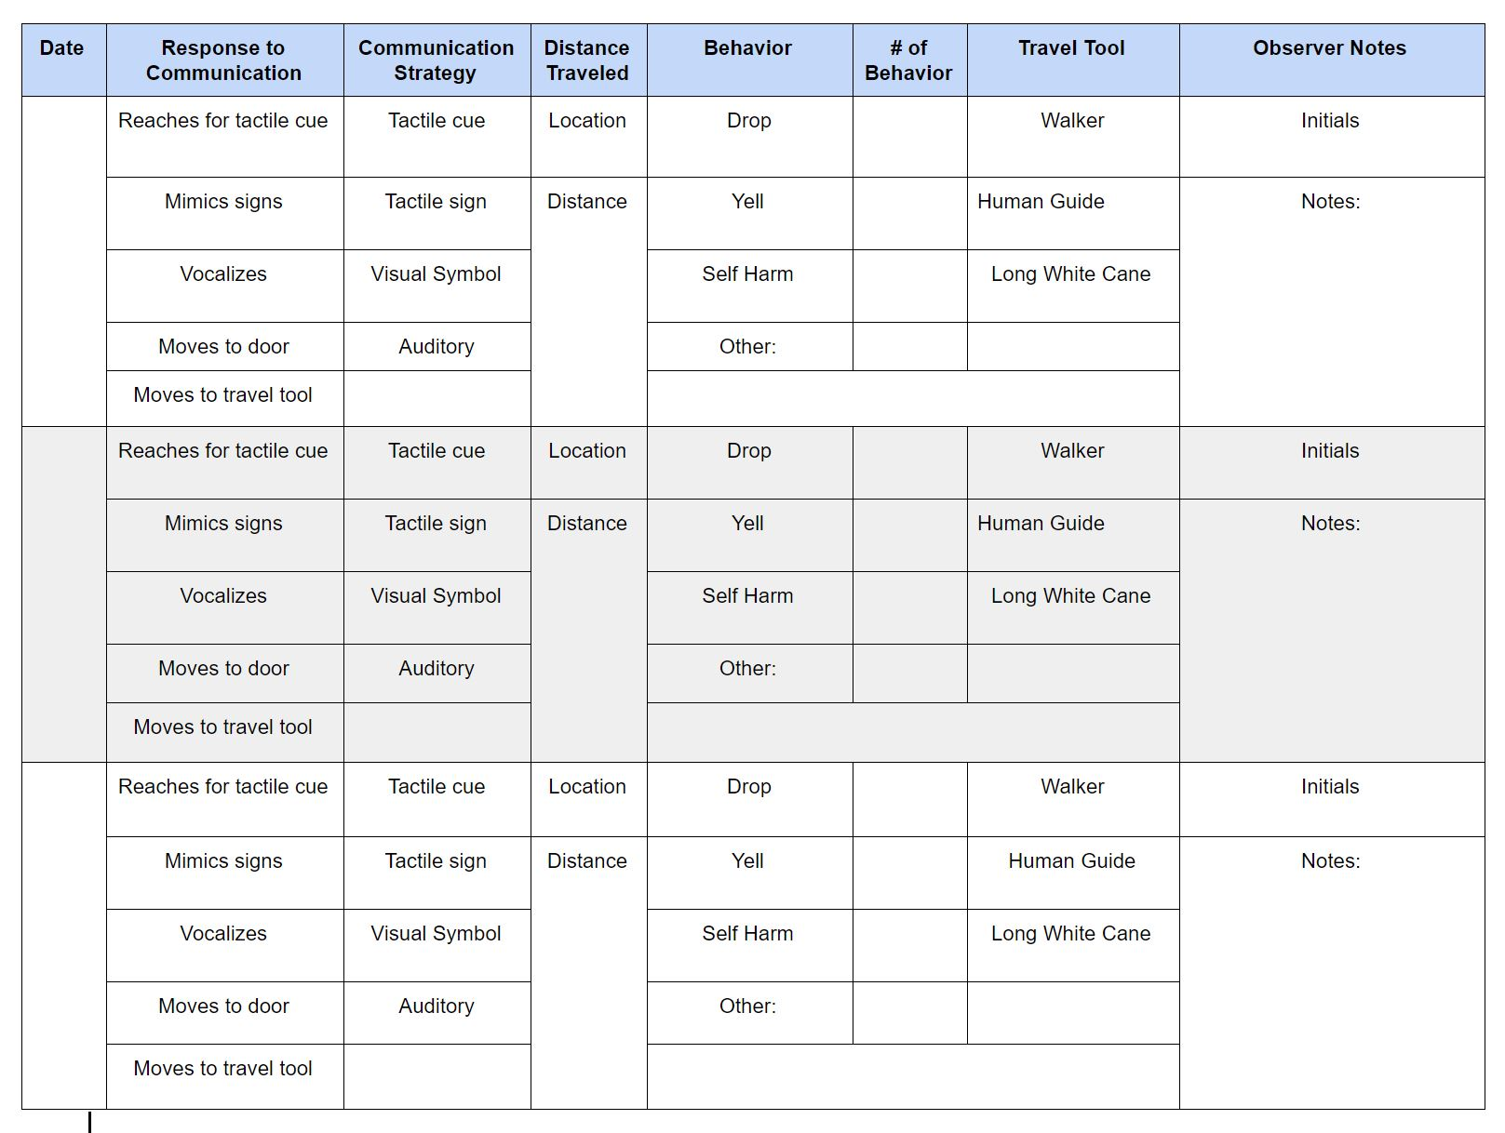
Music
II
MS
10/10
25 ft
Data Chart created
Notes:
This data chart is a model of the chart we used to gather our data. It was made to be quick, accurate, and used by all staff (teachers, aids, related services, gen ed., student teachers).
Staff members circled the responses, strategies, and tools. Locations were written in along with distances. Distances were marked in the hallway to different locations using electrical tape markers and by counting floor tiles. Behavior stops were tallied and other notes were documented which helped to track patterns. Whomever was working with the student could easily record data without much interruption in their regular schedule.
The data chart met the characteristics of an effective progress monitoring tool. Accurately measure targeted behavior. Sensitive. Frequent. SIMPLE. and Brief.

Slide 51
Final Goal
The student will improve receptive communication and travel by responding to cues and increasing distance traveled outside classroom with fewer refusals, yelling, or self-injurious behavior so that barriers to participation in instruction and activities are reduced. (I-4 B.)
Baseline: responds to 0 communication strategies: travels 30 feet w/ avg. 5 behavior stops (I-4a.) LOA : responds to tactile sign or visual cues 2 times (communicate start/finish of travel) during 50 feet with no more than 1 behavior stop (I-4 b.)
As measured by charted data collected 3x per week by School Staff supporting routine travel (ie. specials) (I-4 4.)
Data to be analyzed every 6 wks & end of each trimester and shared with family 3x per school year including the IEP meeting (I-4 5.)
Notes:
Here is a model of our final goal! It has a goal statement that is clear and states how the growth will positively effect the student’s academic performance.
The baseline is quantified and matches the skills in the goal.
The Level of attainment is quantified and clear and uses the same measure as the baseline.
It is clear that data would be collected 3x a week and reviewed every 4-6 weeks AND that all staff shared the role of data collection. We also decided the best time to conduct a deeper data dig and report findings would be at the trimester which is a natural time in the school schedule when all student families receive information about academic growth.
This is not just a mobility goal. This is not just a speech and language goal. This is a student goal that addresses the student’s disability related needs across settings. Everyone who works with this student, including their parents, shared a collective “buy-in” for this work.

Slide 52
Benchmarks/Objectives
From baseline: responds to 0 communication strategies: travels 30 ft. w/ avg. 5 behavior stops
To LOA: responds to tactile sign or visual cues 2 times (communicate start/finish of travel) during 50 feet with no more than 1 behavior stop
1. By end of 1st trimester, responds to 1 communication strategy and travel 30 feet with an average of 1 behavior stop
2. By end of 2nd trimester, responds to 2 communication strategies and travel 40 feet with an average of 1 behavior stop
3. By end of 3rd trimester, responds to 2 communication strategies and travel 50 feet with an average 1 behavior stop or less
Notes:
Our team decided to write benchmarks reflecting a period of time and documenting student responses, distance of travel, and behaviors.
This made reporting on progress clear and accurate, manageable due to simplicity and brevity, and truly connected to IEP decisions. PLUS, Because the school staff on the IEP team was sharing the responsibility of collecting the data and regularly reviewing the data, all staff who had access to the online IEP software could accurately report on the student’s progress. Our team reported that there was less professional stress, greater clarity on the outcomes we were working toward, and greater engagement from student, family, and staff.

Slide 53
OUTCOMES at Trimester 1
After communication, using of tactile cue, and sign, student initiated use of walker to travel
Student increased desired travel skills first trimester as demonstrated by traveling 25 ft with 1-2 behaviors.
The team continued with plan!
Link to example of a Google Form Data Recording Tool
Locations with highest increase of participation were the pool and cooking. Student preferred tasks.
YES! Increased student engagement due to improved communication and fewer behaviors!
Notes:
Our team also utilized a Google Form to record and manage the data we gathered. The form was able to show graphics of the bullets we listed above. The family was shown the graphics at school conferences and the details were also attached to the I-6 Interim Progress Report at the trimester

Slide 54
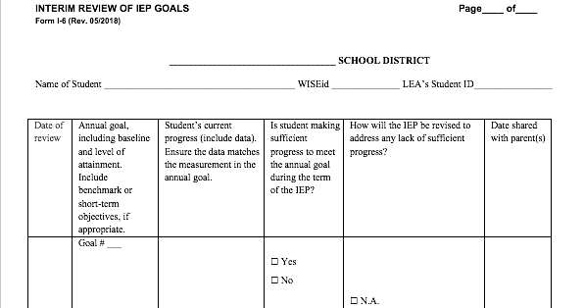
How Progress was Documented and Reported
Student responds to both tactile sign and tactile communication cues. Highest responses demonstrated by reaching for cue and moving towards classroom exit. Average travel distance is 24.5 feet with average # behavior stops of 1.9. Data reflects 29 data points during first trimester. Data reflects pattern of increased distance traveled and decreased behavior stops.
X
11/15 w/ attached data charts
Notes:
This was the information that was documented on the I-6 Interim Review of IEP Goals form within the CCR IEP.

Slide 55
Continued Planning...
Potential Needs extending from goal and data collection:
Increase orientation and independent travel skills with reduced adult supports
Increase school environmental vocabulary
Develop expressive communication skills with tactile sign and cues
Provide resources/supports to best unite the home setting with school setting
Notes:
After the first trimester, we discussed the scope and sequence of next steps in a variety of need areas. As a school team, we had decided to review the data within the first few weeks of the next school year and update the student’s CURRENT skills and identify continuing or new barriers.
Our team knows that the student’s needs, and thus their goals, will evolve over time but and we acknowledge that the collaborative approach is serving the student, family, and school staff well at this time.
Fun update: I am not the Orientation and Mobility Specialist this year for the student, but I was able to observe a video of the student just this past week. Student is currently reaching 5th grade classes with rare behavior stops.
The team continues to use a combination of tactile cues and schedules, tactile sign, and consistent language by all staff interacting.
The adult support is systematically being faded. The signing education assistant now walks ahead of the student 5-10 feet and gestures direction of travel need.
The student is developing both mobility and vocabulary skills as they continue to come into contact with objects during their travels due to this independence.
The student is vocalizing more words based on cue presentation. They are beginning to use the cues to communicate their wants by repetitively touching the cue that is preferred.
The barriers affecting participation and access to instruction and activities are continuously declining!
I was so excited to see that this process worked and was so easy to continue and build upon.

Slide 56
Final Thoughts and Resources
Notes:
The rest of the slides in this slide deck include some related follow-up activities and links to resources you may find helpful as you continue to think about CCR IEP development and monitoring IEP goal progress.

Slide 57
Final Thoughts
Monitoring IEP progress is a process; not an event
The ultimate reason we must make a commitment to systematically monitor progress is so we can know if instruction and supports we are providing to students is having the desired results: access, engagement and progress in general education instruction, environments and other activities
Notes:
Some final parting thoughts for you to consider as you reflect on the content of this presentation.
Monitoring IEP progress is a process; not an event
The ultimate reason each of us should make a commitment to systematically monitor progress is so we can know if the instruction and supports we are providing to students is having the desired results: access, engagement and progress in general education instruction, environments and other activities.

Slide 58
Monitoring IEP Goal Progress Things to come…
Digging Deeper: Level 2 Modules being planned
Matching measurement methods to target skills
Selecting measurement tools
Data recording methods
Compiling and Analyzing Data
Data display, sharing and reporting
Using IEP progress data to make instructional and IEP decisions
Notes:
Based on feedback we have been receiving, these are some of the follow-up modules we expect to develop.
We will also be compiling questions and developing an FAQ on this topic.

Slide 59
Resources

Slide 60
For Further Thought
How might you engage various educators in monitoring IEP goal progress?
Think of the student’s learning environments, and the various educators who work with the student
How might some of these educators be actively involved in collecting, analyzing, and/or sharing progress data?
Notes:
The next few slides include some discussion starters, examples and activities you might want to use with your colleagues in your district
------------------Supplementary NOTES RELATED TO THIS ACTIVITY------------------------------
Depending on the student’s needs and the goal, data may be collected in specific or varied environments
The goal identifies the target skill. Data may be collected whenever the conditions of the goal are met (e.g. if the goal is to increase reading fluency of certain gr level text, then data may be collected whenever the student is orally reading that level text. If the student participates in reading in both general and special education environments, data could be collected in either environment, by a general or special educator.
Any educator, who knows how to collect data related to a goal, may collect the data; it does not need to be a particular special educator.

Slide 61
For Further Thought
How might you engage students in monitoring their progress toward goal achievement (LOA)?
Think of a student and one of the student’s goals
How might they be actively involved in collecting, analyzing, and sharing their IEP progress data?
Notes:
We are always thinking of ways to involve students more in the IEP process.
Engaging students in monitoring their own progress can be a significant motivator; not to mention, a potentially good way to work on applied math and reasoning skills
Students can be taught to tally and chart their own progress.
Maintaining an IEP goal progress report binder with teacher notes and progress codes can help students take ownership of tracking their goal progress.
Sitting down with a teacher to review progress regularly can help students “see” the progress they are making. Reviewing progress with students, can also help the teacher understand what is working well for a student and what might be needed to maintain or accelerate progress.
Even students with more severe disabilities can be involved in monitoring and reflecting on their progress.
Consider these question and discuss them with your colleagues:
How might you engage students in monitoring their progress toward goal achievement (LOA)?
Think of a student and one of the student’s goals
How might they be actively involved in collecting, analyzing, and sharing their IEP progress data?

Slide 62
For Further Thought
How might you engage family members in the progress monitoring process?
Think about how families could learn about and understand the different ways progress will be monitored or tools used.
How might a family be actively engaged in the discussion of monitoring progress on IEP goals?
Notes:
Engaging families in the IEP process includes meaningful engagement in the progress monitoring process.
When families are involved in decisions about how IEP goal progress will be monitored; data is shared and the meaning of data clearly explained, and when their questions about the data or progress reports are solicited and answered, families are better able to understand and support educators efforts to implement student IEPs.
Communicating with families and reviewing student progress data can help families “see” the progress their student is making. Soliciting information about observed student progress from families can also help educators understand what is working well for a student and what might be needed to maintain or accelerate progress.
Consider these question and discuss them with your colleagues:
How might you engage family members in the progress monitoring process?
Think about how families could learn about and understand the different ways progress will be monitored or tools used.
How might a family be actively engaged in the discussion of monitoring progress on IEP goals?

Slide 63
For Further Thought
For those in leadership roles
What are the most important things you do (or can do), in your district, to support the capacity to
systematically monitor IEP goal progress,
analyze and share progress data, and
make instructional and IEP decisions in response to measurement of student progress?
Notes:
This slide includes a prompt for discussion about the leadership needed to promote effective monitoring of IEP goal progress.
For those in leadership roles
What are the most important things you do (or can do), in your district, to support the capacity to
systematically monitor IEP goal progress,
analyze and share progress data, and
make instructional and IEP decisions in response to measurement of student progress?
As you discuss this question consider the following:
Student needs should drive the process, not your IEP software system.
Do your teams have the tools (knowledge, skills, actual tools) to do this properly?
How do you balance efficiency (monitoring progress, progress reporting, collaboration/planning) with teaching and learning?
Are your teams putting the cart before the horse? (spending a lot of time developing goals based on anecdotal or weak data and then deciding the “methods for measuring progress” and “when it will be reported to parents”). Don’t get caught in an Endrew F situation. Progress monitoring is NOT an afterthought! You’d want your doctor to know if a medication was not working before or early on during treatment before symptoms got worse wouldn’t you?

Slide 64
Example of Disability-Related Needs (Social Emotional Behavior Focus, refined with link to effects)
Effect and Root Cause Analysis “What” and “Why” | Disability-Related Needs “Summarize”
Effect: Student leaves or is removed from class and misses instruction for short periods of time (1-5x daily for up to 15 min. each time)… WHY? Student often does not respond to questions during lg. group instruction and puts head down, plays with fidgets, or gets up and walks around room (academic skills are at or near gr. level) When prompted to respond or sit down, student verbally expresses frustration/anger and, if prompted again, escalates and may throw objects or leave room Student has difficultly modulating sensory information & becomes overwhelmed and anxious in large groups and high stimulus settings when demands are put on them | Student needs to increase awareness of sensory triggers, develop and increase use of strategies to manage anxiety and frustration, and increase effectiveness with which they communicating their needs, and request and accept support and assistance (so they can access and engage in general education classroom instruction and activities)
Notes:
Here is a Social Emotional Learning example
In this example we can see how the team analyzed one of the effects of the student’s disability that results in the student leaving or being removed from class. Removals for behavioral reasons is one of the most common reasons students miss instruction. For a student with a disability, even short removals can affect academic progress and social emotional development.
In this example, the IEP team identified that the behaviors that most often resulted in the student wanting to leave class or being removed, most often occurred when the student became overwhelmed by stimulation and in certain settings. When academic or social emotional demands were added to this, the student became even less able to access and engage in activities in the general education environment.
The IEP team determined the student needed to develop better skills to manage their awareness of and response to the types of stimulation they regularly encounter in general education.
One would also assume that in addition to directly working on the student’s skills, this student’s IEP would also specify supports in the classroom to reduce social emotional as well as environmental barriers to access and engagement.

Slide 65
Examples of Goal Statements Linked Directly to DRN (social emotional behavior focus)
The student will improve anxiety and frustration management to increase the amount of time engaged in classroom instruction by demonstrating the following:
Increase accurate identification of sensory and emotional triggers
Develop strategies to manage anxiety and frustration
Use anxiety and frustration management strategies to remain/reengage in general education classroom activities with reduced prompts
Notes:
Here is an example of possible target skills to address the disability related need presented on the prior slide.
Please note, this statement only identifies the target skill to improve anxiety and frustration management strategies) and related objectives. It is not a complete goal because it does not yet include baseline or LOA data. First, teams need to make sure they have identified target skill(s) that directly related to the disability relate need and that can be measured
In this example, the team decided objectives were needed to operationalize “improving anxiety and frustration management”. They knew that it was not enough just to measure increased time engaged in classroom instruction. They also wanted to make clear links between the root cause and the related disability related need (difficulty with anxiety and frustration management due to trouble accurately identifying triggers and developing and using management strategies, AND the effect of the disability (i.e. removal from class activities due to certain behaviors). You can see that the goal is stated in positive terms of what the student will do (i.e. functional skills that will be developed) vs. what the student won’t do (i.e. reduction in unwanted behavior). The assumption is if the student develops and uses these skills, less desirable behavior will be replaced.
------------------For FACE to FACE Training----------------------
Do you agree that someone could indeed observe and count the behaviors targeted by this goal? (Presenter may want to use Thumbs Up/Down and have some discussion on these IF enough time allocated. Participants may come up with alternatives or more efficient ways to address the need)
Identify sensory and emotional triggers?
Develop strategies to manage anxiety and frustration (note: the IEP team would want to list a few of these strategies here (such as…) or this information might be included in the baseline and LOA- We will see this later?
Use anxiety and frustration management strategies in general education
Increase amount of time engaged in classroom instruction?

Slide 66
Recommended Follow-Up Activity Application to Your IEP
Look at your IEP goals. For each goal ask yourself:
If we follow the “procedures for measuring the student’s progress toward meeting the annual goal….” as written, will we know if the student has made sufficient progress, and be able to report the degree of progress during each reporting period?
If we were to develop this IEP again, how might we revise the goal statement or stated progress measurement procedures to more effectively monitor ongoing progress toward IEP goal attainment?
Notes:
Try using the CCR IEP Step 3 checklists and Monitoring Progress draft checklists to reflect on your current IEPs and when drafting future IEP goals and progress monitoring procedures.
Be sure to start by reflecting on the target skill or behavior specified in the IEP goal and its link to a student’s disability related need(s).
Look at your IEP goals. For each goal ask yourself:
If we follow the “procedures for measuring the student’s progress toward meeting the annual goal….” as written, will we know if the student has made sufficient progress, and be able to report the degree of progress during each reporting period?
If we were to develop this IEP again, how might we revise the goal statement or stated progress measurement procedures to more effectively monitor ongoing progress toward IEP goal attainment?

Slide 67
Resources: Monitoring IEP Goal Progress
DPI CCR IEP Learning Resources
IRIS Center Links to a large number of valuable resources for improving education outcomes for all children, especially those with disabilities
IRIS Center Resource Locator (Select “Assessment” for modules and other resources related to progress monitoring)
Wisconsin RtI Center
Screening and Progress Monitoring (WI RtI Center)
Additional links to Resources
National Center for Response to Intervention Progress Monitoring page- Includes links to Academic and Behavior Progress Monitoring Tools, Related Guidance and Training Modules
Iowa Department of Education, Progress Monitoring Procedures

Slide 68
Additional Resources
National Center on Intensive intervention: https://intensiveintervention.org/
Wisconsin's Framework for Equitable Multi-Level Systems of Supports (MLSS) –includes links to resources
Culturally Responsive Practices- Student Services Team Resources
Wisconsin's Strategic Assessment Systems (SAS)
Notes:
Additional resources found at the National Center for Intensive Intervention link above:
Data Rich, Information Poor? Making Sense of Progress Monitoring Data to Guide Intervention Decisions https://intensiveintervention.org/resource/data-rich-information-poor-making-sense-progress-monitoring-data-guide-intervention
Using Academic Progress Monitoring for Individualized Instructional Planning (DBI Professional Learning Series Module 2)- https://intensiveintervention.org/resource/using-academic-progress-monitoring-individualized-instructional-planning-dbi-training

Slide 69
Related DPI Sample Forms
DPI Forms Page with links to sample forms and related guidance
DPI Sample Form I-4- Linking Present Levels, Needs, Goals, and Services Form (Section IV- Measurable Annual Goals)
DPI sample forms to assist IEP teams with goal reviews:
Interim Review of IEP Goals (I-6)
Annual Review of IEP Goals (I-5)
Notes:
DPI has developed 2 forms to help IEP teams with IEP goal reviews.
There are links to these forms on the slide.
LEAs may use Form I-6 to document Interim Reviews of IEP Goals and to document the required reports to parents on the student’s interim progress toward IEP goals.
Form I-5 is used to document the annual review of IEP goals that must be completed during an IEP team meeting at least annually.
Refer to the explanation in the DPI Forms Guide for more guidance on completing these two forms.

Slide 70
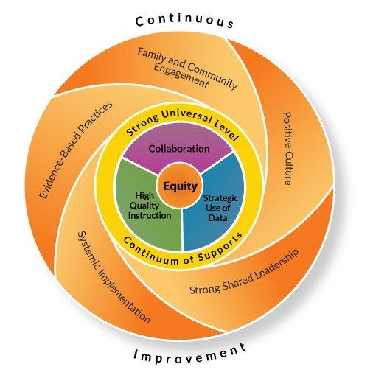
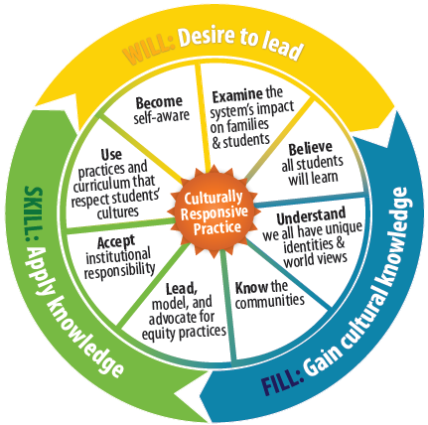
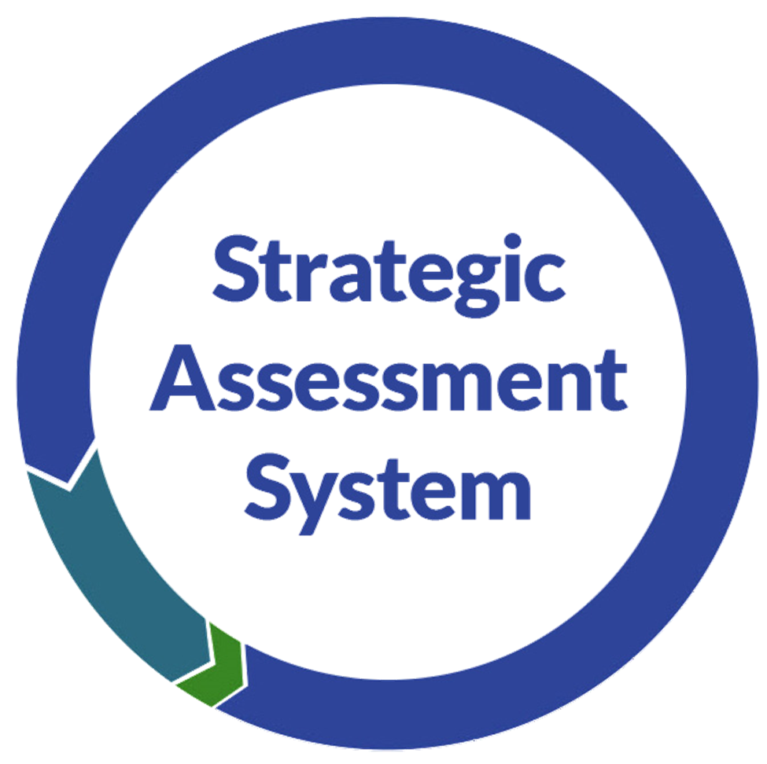
Related Statewide Initiatives
Notes:
On this slide are links to a number of related DPI initiatives aimed at these intents. When you click on each picture, it will take you to the webpage the initiative.

