Slide 1
April 2018
College and Career Ready IEPs (CCR-IEPs)
Improving Outcomes for Students Ages 3 through 21
The Five Step Process
Step 1: Understanding Achievement
Notes:
This is the first of a series of webinars on the 5 Step Process for developing College and Career Ready IEPs or CCR IEPs. During Step one the IEP team develops an understanding and discussion of the student’s present levels of grade level academic achievement and functional performance.
A version of this slide deck was presented as a webinar in April 2018 by Daniel Parker, Assistant Director of Special Education, WI DPI, Paula Volpiansky & Deb Heiss, Consultants on the Special Education Team, WI DPI and Cheri Sylla, WSPEI
The webinar was recorded and is accessible through the CCR IEP learning resources / CCR IEP Five Step Process / Step 1 web page. https://dpi.wi.gov/sped/college-and-career-ready-ieps/learning-resources
This webinar was re-formatted to be used for school, district, or regional trainings.

Slide 2
What is a CCR-IEP?
CCR-IEP = College and Career Ready IEP
An Individualized Education Program (IEP) developed to:
- meet the unique disability-related needs of the student and
- help ensure the student graduated ready for further education and the work place
Notes:
CCR IEP stands for College and Career Ready Individualized Education Program.
A CCR-IEP is an Individualized Education Program (IEP) developed to meet the unique disability-related needs of the student and help ensure the student graduates ready for further education and the workplace.
CCR IEPs are for all students in public school programs ages 3 through 21 who receive special education services. Thus, CCR IEPs are not just intended for high school students. Rather, CCR IEPs build knowledge, skills, and habits throughout a student’s public school experience, so when they graduate, they are college and career ready. This important foundation begins in early childhood.
Handout: https://dpi.wi.gov/sites/default/files/imce/sped/pdf/ccr-iep-overview-guide.pdf- link on slide

Slide 3
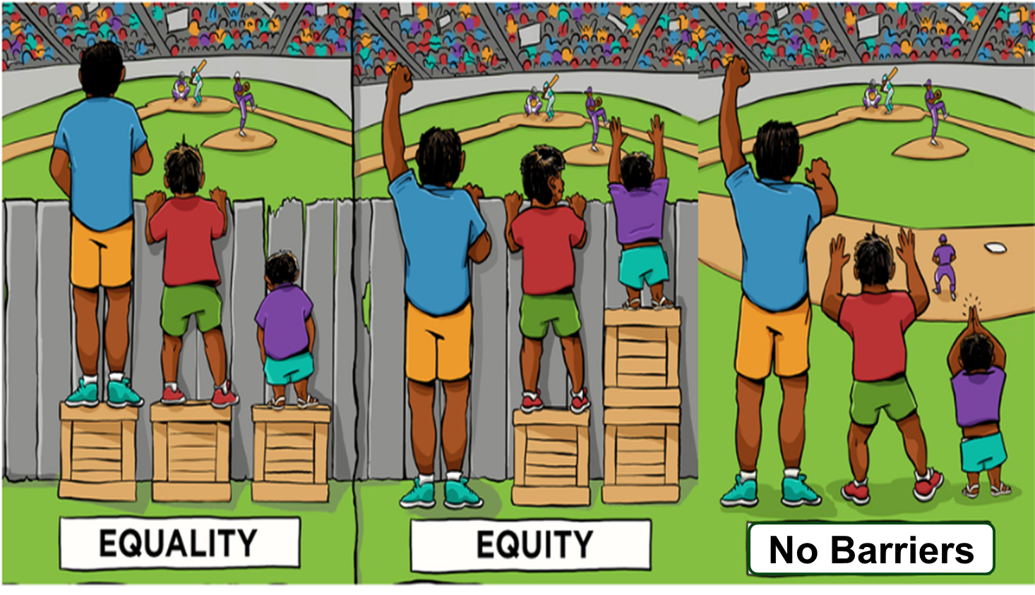
CCR-IEP 5 Beliefs
High Expectations
Culturally Responsive Practices
Student Relationships
Family and Community Engagement
Collective Responsibility
Notes:
Before we continue, I want to briefly mention the 5 Beliefs that are at the core of the CCR-IEP process.
The 5 core Beliefs are essential to developing IEPs that promote college and career readiness. The 5 Beliefs can have an important impact on the success of students with IEPs. Districts and IEP teams, including families, should consider and discuss these beliefs.
It is important to keep the 5 Beliefs in mind when completing each step of the IEP development process:
High Expectations/believing students with disabilities can meet early childhood/grade level academic standards and functional expectations or, for students with most significantly cognitive disabilities, alternate achievement standards aligned with grade level standards;
Culturally Responsive practices to honor and engage students;
Positive Student Relationships;
Family and Community Engagement; and,
Collective Responsibility for working together to support each student in addressing needs and achieving their IEP goals.
For more information on the 5 Beliefs, please visit our CCR IEP Resources webpage.
Handout- A handout of the 5 beliefs is available on the DPI website at - https://dpi.wi.gov/sites/default/files/imce/sped/pdf/rda-ccr-iep-five-beliefs.pdf (link on slide)

Slide 4
College and Career Ready IEP
5 Step Process
Step 1. Understand achievement of grade-level academic standards and functional expectations to identify the student’s strengths and needs.
Step 5. Analyze progress towards goals to evaluate what works and what is needed to close the student’s achievement gaps.
Step 2. Identify how the student’s disability affects academic achievement and functional performance.
Step 4. Align specially designed instruction, services, supports, and accommodations needed to support the goals and ensure access to the general curriculum.
Step 3. Develop ambitious and achievable goals that close achievement gaps and support the unique strengths and needs of the student.
Notes:
College and Career Ready IEPs are developed through a cyclical 5 Step Process in which each step informs the next. It is important to start at the beginning of the cycle with understanding the student’s present levels of performance.
As we go through the presentation today, keep in mind that the 5 Step Process is not about how to fill out an IEP form, but rather, provides a framework for having IEP team discussion about improving student outcomes while operationalizing special education legal (IDEA) requirements.
The outcome of the IEP team’s conversation and analysis using the 5 Step Process for developing CCR IEPs is documented on DPI’s sample IEP Linking Form (Form I-4). An online CCR IEP Discussion Tool has also been developed to help IEP team members prepare for these important conversations. More information about these and other resources is provided at the end of the presentation.
To learn more about all 5 steps, please refer to the resources on our CCR IEP Resources webpage. The link is on this slide and at the end of the presentation.
Handout- A handout on 5 Step Process is available on the DPI website at https://dpi.wi.gov/sites/default/files/imce/sped/pdf/rda-ccr-iep-five-step-process.pdf (link on slide)

Slide 5
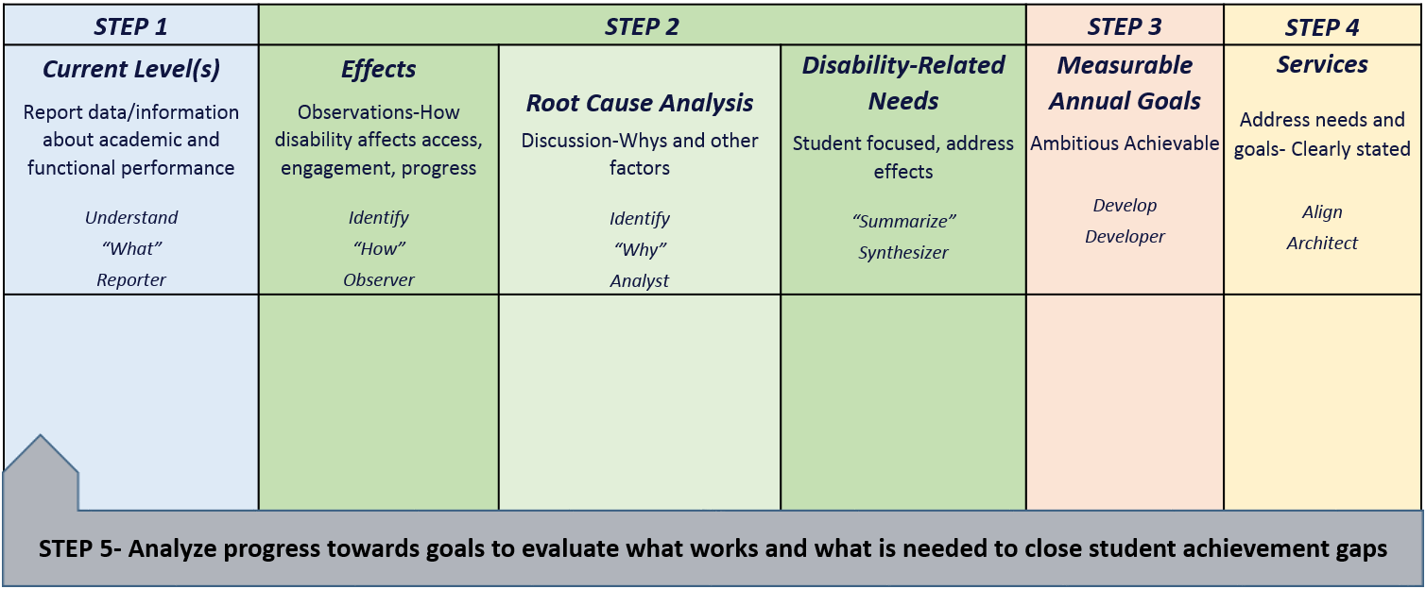
CCR-IEP Process Chart
Notes:
This chart was developed to help clarify the main purposes and linkages between the steps in the 5 step process as well as to highlight the roles IEP team participants play during each step.
On the CCR IEP Learning Resources page, you can download a CCR IEP Process chart with descriptions of each step on one side and a blank copy on the other. The chart can be used both as a training tool when explaining the steps as well as a place to take notes when developing or reviewing IEPs.
https://dpi.wi.gov/sped/college-and-career-ready-ieps/learning-resources/5-step-process
In Step 1 the IEP team’s Understanding of the student’s current levels of academic and functional performance reported during Step 1 provides IEP teams with quantitative information about the student’s skill and behavior at the time, or “the what” that is the basis for discussion in Step 2.
During Step 2, IEP team reflects on the current level and special factor information (if any) and Identifies how the disability affects the student’s access, engagement and progress based on observations, analyzes root causes of these affects (i.e. why the student has difficulty meeting standards and expectations), and finally synthesizes this information into summary statements clearly describing the student’s disability-related need(s). The student’s disability-related needs represent the areas or skills that should be addressed to address the effects of the disability and improve the student’s access, engagement and progress in general education curriculum, instruction, activities and environments.
These needs are the basis for Developing measurable annual IEP goals that are ambitious and achievable during Step 3.
During Step 4 the IEP team Aligns IEP Services that are directly linked to IEP goals and disability-related needs.
In Step 5, the IEP team Analyzes Progress of IEP goals to determine how IEP goals are supporting the student’s disability-related needs and improving the students present level of academic achievement and functional performance and addresses what works and what may need to change to close achievement gaps.

Slide 6
Step 1:
Understand Achievement
Understand achievement of early learning/grade-level academic standards and functional expectations to identify the student’s strengths and needs
Notes:
We will now focus on Step 1 for the rest of this presentation.
The purpose of Step 1 is to document the student’s current academic and functional performance related to access, engagement, and progress in the general education curriculum and environment. This includes documenting the student’s strengths in academic and functional performance.
During this step, the IEP team identifies, discusses, and documents the student’s current level of academic achievement and functional performance in relation to academic content standards and functional expectations for the grade in which the student is enrolled. The IEP team includes areas in which the student is meeting standards and expectations, and areas in which the student is not meeting standards.
For preschoolers, the IEP team will refer to the district’s early leaning standards when determining the child’s current level of pre-academic and age-expected functional skills.
Completing this step provides the IEP team with the “big picture” of the student’s current performance. It is important the team include information that reflects the family’s and student’s voices and points of view on strengths, interests that will engage the student in learning and skills.
Step 1 lays the foundation of data and information for the analysis that occurs during Step 2.
It is important that the IEP team compile sufficient data and information in preparation for the Step 2 discussion about the effects of the student’s disability and the student’s disability-related needs.

Slide 7
Key Ideas
Understand grade-level academic content standards and functional expectations
- For the grade in which the student is enrolled
For preschoolers, this is pre-academic and age-expected functional skills in relation to early learning standards
Describe student’s current performance compared to standards and expectations
- Include areas of strength
- Consider skills needed to access, engage and make progress in general education
Include general educators in discussion
Notes:
To complete the step, IEP team members must be familiar with the general education academic standards and functional expectations for the grade level in which the student is enrolled in order to compare the student’s performance to those standards and expectations.
For early childhood age students, IEP team members should be familiar with the early learning standards (either the Wisconsin Model Early Learning Standards or district developed early learning standards).
For students with the most severe cognitive disabilities, IEP team members should be familiar with the alternate achievement standards (Essential Elements) that are aligned with grade-level standards.
The student’s current academic and functional performance is then compared to the early childhood/ grade level standards and expectations. IEP documentation for this step incorporates both elements, current performance and the relationship of this performance to early childhood or grade level academic standards and functional expectations. For example, this step should include not only discussion of academic performance measures, but also information about functional skills related to access, engagement, and progress in general education, curriculum, instruction, and environments, such as attention, self-advocacy, and use of assistive technology.
It is very important to identify and document the student’s strengths in relationship to academic and functional areas during this step. This information will help the team
Consider the student’s interests / talents / passions.
Consider strengths in academic, vocational, extra-curricular areas.
Include strengths that are pertinent to engaging the student in their education.
When completing this step, be sure data and information are shared in meaningful ways so all IEP team members understand, including parents and the student (as appropriate). For instance, explain test scores in terms that describe what a student knows and is able to do compared to their peers. This discussion should be documented on the IEP Linking form.

Slide 8
Using Standards and Expectations
The student’s general education teachers are knowledgeable about standards and expectations and how the student is performing in relation to these standards:
- Information about performance related to standards may be summarized and brought to IEP team meeting.
- Highlight specific standards/expectations when describing current levels.
The discussion about standards and expectations occurs primarily during Step 1.
Notes:
The discussion about standards and expectations occurs primarily during Step 1.
This is how we ensure the IEP is standards-based and we have included standards-based IEP goals.
General education teachers are typically well versed in the academic standards for which they are responsible, so it is important to include these teachers when developing an understanding of the student’s present levels of academic achievement and functional performance in relation to grade-level academic standards and functional expectations.
General education teacher(s) are knowledgeable about the standards and how the student is performing in relation to the standards in their class(es).
This information is best summarized and brought to the meeting rather than having the IEP team try to review all standards for all areas during the meeting. The latter would not be reasonable. It would be good, however, to always have a copy of the standards at the meeting as a reference, particularly for parents.
Specific standards may be highlighted during the meeting when developing the current level statements and will lead to next steps.
Remember: For preschool aged children, you will be relating the student’s performance to the district’s early learning standards and expectations.
For students with the most significant cognitive disabilities, you will relate the student’s current performance to the alternate achievement standards.

Slide 9
Standards-Based IEPs
Completing Steps 1 & 2 of the 5-Step Process with fidelity will lead to development of goals aligned with grade-level standards and expectations in Step 3:
- Identify student’s current performance related to early childhood/ grade-level standards.
- Identify how the disability affects access, engagement and progress (effects).
- Discuss why (root causes) the student is not meeting grade-level standards and summarize disability-related needs.
- If goals address the whys and needs, the goal will be aligned with the standards.
Notes:
By focusing on the standards when reporting the student’s current levels of performance during Step 1, the goals will naturally be aligned with the academic content or early learning standards for the grade in which the student is enrolled.
Reminders:
The standards drive curriculum and instruction--- Must use assessment tools to measure the skills associated with the standards.
Students often are meeting some grade level standards across skills areas and not others (e.g., may be meeting grade level standard in some areas of reading comprehension, but not others).
For this reason, IEP goals are related to why the student is not meeting specific standards and are not a restatement of the standards that apply to all students.
Other reminders about meeting grade level reading standards vs. measures of “grade level performance”:
Saying a student is reading at “5th grade level” may not accurately reflect a student’s overall reading performance in relation to the standards
“Grade level” performance is usually related to an assessment score that falls in the average range for students of a certain age or grade or that meets an expected benchmark score for student in a specific grade.
When we refer to a student’s ”reading level” we usually are talking about a measure that represents a specific reading skill or skills such as a score on a reading skill screener, standardized test, benchmark assessment. Sometimes “reading level” may reflect data about a student’s comprehension or decoding accuracy or fluency/reading rate from a running record on a graded reading passage.
While it may be accurate to say a student is receiving instruction based on the 5th grade standards, saying a student’s reading achievement is at the “5th grade level” is not the same as saying the student is meeting “5th grade reading standards”.
A student who is “meeting reading standards” at a certain grade level, will have been assessed on the multiple reading skills representing the standards and determined to have met proficiency expectations for students in that grade.
Before referring to a student’s reading performance as “5th grade reading level” think of what you really mean and provide corresponding information in your documentation.
SEE EXAMPLE ON NEXT SLIDE

Slide 10
Example: Reading Achievement Data for a 5th grade student, mid year
Reading fluency benchmark score =102
- 102 is expected mid 3rd grade benchmark
- Grade level (mid 5th) benchmark score= 130
Independent reading level= M (from running records)
- Level M is considered mid third grade text;
- Grade level expectation = Level T
- Decoding and fluency errors/miscues affected comprehension above level M
Receptive language met gr. level expectations
Comprehension of gr. level text met expectations when using a text reader
Enjoys reading a variety of text at independent level
Notes:
Here is an example of some current level of performance information in the academic area of reading for a 5th grade student (mid year).
After reviewing the 5th grade standards, the IEP team determined the student was not meeting 5th grade standards in a number of areas. In particular, the student was having difficulty with skills related to the anchor standard, Range of Reading and Level of Text Complexity. This standard relates to skills required to read and comprehend complex literary and informational texts independently and proficiently. Some of standards the student was not meeting included:
The Foundational Standard : “Read with sufficient accuracy and fluency to support comprehension”
The Literature Standard: “By the end of the year, read and comprehend literature, including stories, dramas, and poetry, at the high end of the grades 4–5 text complexity band independently and proficiently.”
Please keep in mind these are excerpted examples specific to reading achievement. This is not meant to be an exemplar of a current level statement. In reality, the IEP team may have discussed the student’s performance in relation to more standards.
And, in the actual IEP document we would see more information about other areas of academic achievement as well as functional performance along with summary explanations of what the data means in reference to grade level standards and expectations.
There would also be additional information about student strengths. (Point out last three items are academic strengths related to reading.)
Additional note: Another term for receptive language is listening comprehension.

Slide 11
Expectations
Look For
Multiple sources of data and information
Data and information are current
Data on reading included
Student strengths in relationship to access, engagement and progress
Identification of areas student is and is not meeting grade-level standards/expectations
Interpretation of data provided
Avoid
Using ONLY data from eligibility decision/ checklist
Information cut and pasted from last evaluation with no new information included
Student strengths mentioned, but not helpful for educational purposes
Comparison only to “out-of-grade” standards/ expectations
Test scores without explanation
Notes:
As we conduct training throughout the state on the 5 Step Process of CCR IEP development, we are beginning to notice some common errors. This chart highlights things IEP teams should include in IEPs and things to avoid.
We have created a one-page document Step 1: Understand Achievement: At a Glance that includes these expectations, tips, and other key information about Step 1 for your reference. It is available as a handout for this webinar and on the department’s website under CCR IEP Resources.
It is important to discuss and include sufficient and meaningful information so that all IEP team members fully understand the grade-level standards and expectations and how the student is performing compared to their peers. Again, this process is not just about filling out an IEP form, but about improving student outcomes.
Handout- Step 1: Understand Achievement: At a Glance https://dpi.wi.gov/sites/default/files/imce/sped/pdf/ccr-step1.pdf
(link on slide)

Slide 12
Tips
Data sources may include classroom, grade, district, and statewide assessments, age-anchored assessments, IEP goal progress, structured observations and other information.
Review early childhood/grade level academic standards and social emotional learning standards or expectations.
Train all staff in grade-level content standards and functional expectations and strategies.
Train staff how to collect and share student data and how to conduct comprehensive special education evaluations.
Notes:
Before we move on and provide you with a bit of hands on practice, let’s review some helpful reminders and tips for IEP teams to keep in mind as they complete Step 1 of the 5 Step Process.
Data and information may include classroom, grade, district, and statewide assessments, age-anchored assessments, IEP goal progress, structured observations and other information
Review grade level academic standards, school code of conduct, district or school social emotional learning or behavior standards or expectations.
For preschool children, review early learning standards and Early Childhood Outcome Indicator 7 ratings.
For students with the most severe cognitive disabilities also review alternate achievement standards based on grade level standards (for example, Essential Elements).
Districts should make their academic, code of student conduct, social-emotional/behavioral standards (if they have them) publicly available.
Train all staff, including special educators, in grade-level content standards and functional expectations and strategies.
Train all staff how to collect and share student data.
Train staff how to conduct comprehensive special education evaluations.

Slide 13
Engaging Students in Step 1
Have a system for preparing the student to participate in the IEP team meeting.
Provide explanations of IEP terminology using language the student understands.
Encourage student to describe/give examples of their strengths, abilities, and needs, what supports and services are helpful, etc.
Consider student-led IEPs.
Notes:
Involving students in the development of their IEPs leads to greater student ownership and understanding of their educational program and its outcomes.
This applies to students of all ages and development levels. All students can and should have some role in their IEP.
Preparing students to participate in their IEP meeting can begin in seemingly small ways. For example, the student’s case manager or teacher can have the student be prepared to share one skill the student is good at and/or one thing they would really like to get better at when prompted during the meeting.

Slide 14
Engaging Families in Step 1
What Families Need to Know…
Grade level or early childhood standards;
Functional expectations (skills);
Explanations of IEP terminology (e.g., functional skills);
Understand where their child is performing (at, above, or below grade level).
Notes:
In order for families to be a part of the IEP team and process, families need to understand achievement – academically and functionally.
Families need to know about the grade level standards that their child is expected to be working towards. If the student is in the third grade, then the IEP team should share with the family what the 3rd grade standards are.
Families need to know what the functional expectations that help the student to access, engage, and achieve grade level standards. The skills could include: working independently, communicating with others, and organization.
Families need to understand the education terms and jargon that is used in IEP meetings.
Finally, families need to have data shared with them that tells them if their child is performing at grade level, above grade level, or below grade level.

Slide 15
Engaging Families in Step 1
Discussion Topics with Families …
What is your child good at? When are they at their very best and most happy?
What types of books, texts, movies, or other media does your child enjoy that could support their literacy or other instruction?
How are things going at home in relation to the information we have been discussing?
- Homework?
- How is your child off the bus?
- What supports work at home?
Notes:
What questions can we ask families as we work to develop the present level of academic achievement and functional performance that will help them share information with the team? The following questions will allow families to contribute to the conversation and what is shared can be linked to the academic grade level standards and functional expectations.
What is your child good at or when are they at their very best and most happy? This gets to a student’s strengths and interests and often times these can be leveraged in areas where the student may struggle.
What are your hopes and dreams for your child this school year? We want to encourage families to think about what their expectations are for their child’s future. High expectations can lead to more positive discussions.
What goals would you like to see your child achieve? This ties in well not only with academics, but could also lead to discussions around some of those functional expectations like having friends, working with others, etc.
What types of books, texts, movies, or other media does the student enjoy that could support literacy instruction for their child? Questions specifically focused on an academics area like reading can help identify student preferences and interest, generate possible ideas or ways to keep a student engaged.
What are three areas/skills the family would like their child to learn during the next school year? This could help to identify some areas of need or concern that the family feels they would like to address – for early childhood students it might be learning to tie their shoes, for older children it might be learn to use an iPad for communication.

Slide 16
Engaging Families in Step 1
Parents are their child’s first teacher and trust takes time to build.
Know the hopes and dreams of families for their child.
Explain data in understandable terms.
Give concrete example of student skills:
- Provide a book at student’s instructional level.
Multiple ways for families to provide input.
Look for ways to connect what the family shares to IEP development.
Notes:
Let’s talk about tips for school staff to help families understand achievement.
First, acknowledge that parents are their child’s first teacher and it’s sometimes difficult for families to trust that the information, observations, and perspectives shared by others really represents their child. It may take time for some families to understand and in some cases, accept, their child’s level of achievement. Families need to feel that you know their child and care before they can trust.
Explain data in the IEP in terms that everyone understands by avoiding jargon. Take time to check for understanding or asking the question, “Does this make sense?” will help. Have a list of acronyms or terms defined ready to go for the meeting.
Concrete examples of what achievement or expectations look like. Sharing a book that is the same Lexile score as what the student reads at is a good example.
Provide options for families to provide input and perspective about their child. Does a family like an input form with open-ended questions or a menu to check off items? Does a family want to share verbally? One size doesn’t fit all.
Look for ways to connect what the family shares about their child to what you notice in school. This validates the family’s contribution and helps to build confidence in the family – their ability to be a team member and their respect and trust in the rest of the team. We’re on the same team!

Slide 17
Step 1 Check
Are data on reading achievement and other academic areas included?
Is achievement related to grade-level content standards?
Are data on functional performance included?
Is performance related to grade-level functional expectations?
Are data understandable to all IEP team members?
Are standardized test scores/other formal test scores explained?
Are student’s strengths identified?
Are there academic and functional strengths that can be used to improve access, engagement, and progress?
Is there sufficient information about academic and functional achievement to use for discussion about effects and needs?
In what areas is the student performing at, above, or below grade-level standards and expectations?
Notes:
Here is the step-check for Step 1. You can use this step check when you develop and/or review the first section of your IEP document, “Student Strengths and Current Levels of Academic and Functional Performance”.
The step check asks you
If all the required information is included (strengths, current academic achievement and functional performance data);
if the information is documented in a way to it can be understood by all IEP team participants, including the student’s family;
if it is clear how the student’s performance compares to grade level or as appropriate, early childhood standards and expectations;
and finally whether there is enough current information provided to develop the rest of the IEP.

Slide 18
Step 1 Activity
Look at your IEP.
Find the section(s) that include statements of the student’s strengths and current academic achievement and functional performance.
Use the step-checks to decide if the IEP includes the necessary and pertinent information, or if more information is needed.
Notes:
Here is an activity you may want to use after the webinar to help you with Step 1.
Presenter note: If doing this as part of a face to fact training, this activity can be used as “table” activity. Allow 10-15 minutes for the activity with additional time for debriefing
Take an IEP you developed and review it with a partner or in a small group
Look at the Section(s) that include the statements of the student’s strengths and current academic achievement and functional performance. On the new I-4 form this would be Section I A and B.
Review the IEP at a Glance document and Use the Step Check (in the At A Glance Document, or on the previous slide) to decide if the IEP includes the necessary and pertinent information, or if more information is needed.

Slide 19
CCR IEP Learning Resources
Notes:
On this page, you will find links to all DPI CCR-IEP resources. Please check this page often as we will be adding new resources regularly

Slide 20
CCR IEP Discussion Tool
Notes:
We have developed an online discussion tool to help IEP teams prepare to develop a CCR IEP. This tool also supports the 5 step process. It provides guiding questions to consider when identifying the effects of disability, the root cause analysis and the summary of disability-related needs. We encourage you to explore this tool as you prepare for IEP team meetings. For example, some of the questions in the tool will be helpful to discuss during a specific student’s IEP meeting.
A link to the online tool is found on our website under CCR IEPs at https://dpi.wi.gov/sped/college-and-career-ready-ieps/discussion-tool
Presenter Note: Remind participants that this tool is intended to be used individually in preparation for a meeting or during an IEP team meeting. School staff should not meet as a group without the parent to draft the IEP prior to the IEP team meeting. If staff meet to substantively develop/draft parts of the IEP together as a group, it is considered an IEP team meeting and the parent should be invited.

Slide 21
CCR IEP Video
Notes:
We have a 5 minute video that describes the CCR IEP 5 Step Process at https://youtu.be/wRIyZoiHRdQ

Slide 22
Step 1 Additional Resources
Step 1 At a Glance
Wisconsin Academic Standards
Wisconsin Model Early Learning Standards
Alternate Achievement Standards: Essential Elements
Unpacking and Repacking Standards
Reading the Standards
Wisconsin Social Emotional Learning Competencies
The Wisconsin School Mental Health Framework
Teaching Our Readers When They Struggle
I’m Determined: self-determination & student led IEP meetings
WiTransition App
OSERS Policy Letter- FAPE and IEPs
OSERS Policy Letter- IEPs and Behavior Supports
Notes:
All of these resources are available from links on the DPI Website.

Slide 23
Additional Resources for Engaging
Families in Step 1
Wisconsin Statewide Parent Educator Initiative
http://www.livebinders.com/play/play?id=2191148
Positive Student Profile
Reading Survey for Families
Parents’ Guides to Success - PTA Guides
SPED Acronym List from DPI
Rising to High Expectations- Video
A Teacher’s Perspective: Setting High Expectations for all Students. Gates Foundation
Notes:
Here are some additional resources that may be particularly helpful for families. These and other resources for families on the 5 Step Process have been organized into a livebinder by our WSPEI staff.
The link to the WSPEI livebinder is on this slide: http://www.livebinders.com/play/play?id=2191148
We have also listed a few resources that help to engage families in identifying their child’s achievement and functional level.
The Positive Student Profile is an example of a questionnaire that a family member can fill out in advance of an IEP meeting. There are questions about the child’s strengths and interests, future hopes and dreams for the student, needs and supports, and others. WSPEI is currently adapting the original Positive Student Profile to align with the CCR IEP 5 Step process and 5 Beliefs.
The Reading Survey for Families was created by WSPEI as a survey tool for school staff to use to learn from families about reading at home and what families would like to see more of or learn more about in order to help their child.
The Parents’ Guides to Success from the National PTA is a wonderful resource for school staff to share with families. Guides for Kindergarten through 8th grade contain examples of standards that students would be working toward in ELA and Math. Each Guide contains conversation tips for families when they meet with teachers during conferences as well as home-based strategies that families could do at home to reinforce or practice the standards identified. There is a high school guide for ELA and Math as well. The high school guides are focused on college and career readiness.
The Acronym List from DPI contains frequently used special education terms and acronyms. Schools may want to use this as a starting point and add your own school district’s acronyms and terms to the list. Definitions might be helpful as well.
Two great videos.

Slide 24
Step 1 Debrief
Questions?
Comments
Notes:
Closing Comments:
Remember the 5 Step Process for Developing IEPs is a framework for the IEP team process.
The primary focus is on the content and structure of IEP team conversation, rather than on completing IEP forms
The conversation drives the IEP documentation, not vice versa.
What is documented on the IEP form should reflect the conversation.
The best way to ensure that there will be sufficient information in the student’s written IEP is to follow the 5 Step Process when preparing for and conducting IEP team meetings and for documenting discussion and IEP team decisions.

Slide 25
Thank you!

