Slide 1
April 2018
College and Career Ready IEPs (CCR-IEPs)
Improving Outcomes for Students Ages 3 through 21
The Five Step Process
Step 4: Align IEP Services
Notes:
This is the fourth of a series of webinars on the 5 Step Process for developing College and Career Ready IEPs or CCR IEPs. During Step four the IEP team aligns IEP services to support IEP goals, address disability-related needs, and close achievement and opportunity gaps that relate to a student’s academic achievement and functional performance.
A version of this slide deck was presented as a webinar in April 2018 by Daniel Parker, Assistant Director of Special Education, WI DPI, Paula Volpiansky & Deb Heiss, Consultants on the Special Education Team, WI DPI and Tim Borud, WSPEI.
The webinar was recorded and is accessible through the CCR IEP learning resources / CCR IEP Five Step Process / Step 4 web page. https://dpi.wi.gov/sped/college-and-career-ready-ieps/learning-resources

Slide 2
What is a CCR-IEP?
CCR-IEP = College and Career Ready IEP
An Individualized Education Program (IEP) developed to:
- meet the unique disability-related needs of the student and
- help ensure the student graduated ready for further education and the work place
Notes:
CCR IEP stands for College and Career Ready Individualized Education Program.
A CCR-IEP is an Individualized Education Program (IEP) developed to meet the unique disability-related needs of the student and help ensure the student graduates ready for further education and the workplace.
CCR IEPs are for all students in public school programs ages 3 through 21 who receive special education services. Thus, CCR IEPs are not just intended for high school students. Rather, CCR IEPs build knowledge, skills, and habits throughout a student’s public school experience, so when they graduate, they are college and career ready. This important foundation begins in early childhood.
Handout: https://dpi.wi.gov/sites/default/files/imce/sped/pdf/ccr-iep-overview-guide.pdf- link on slide

Slide 3
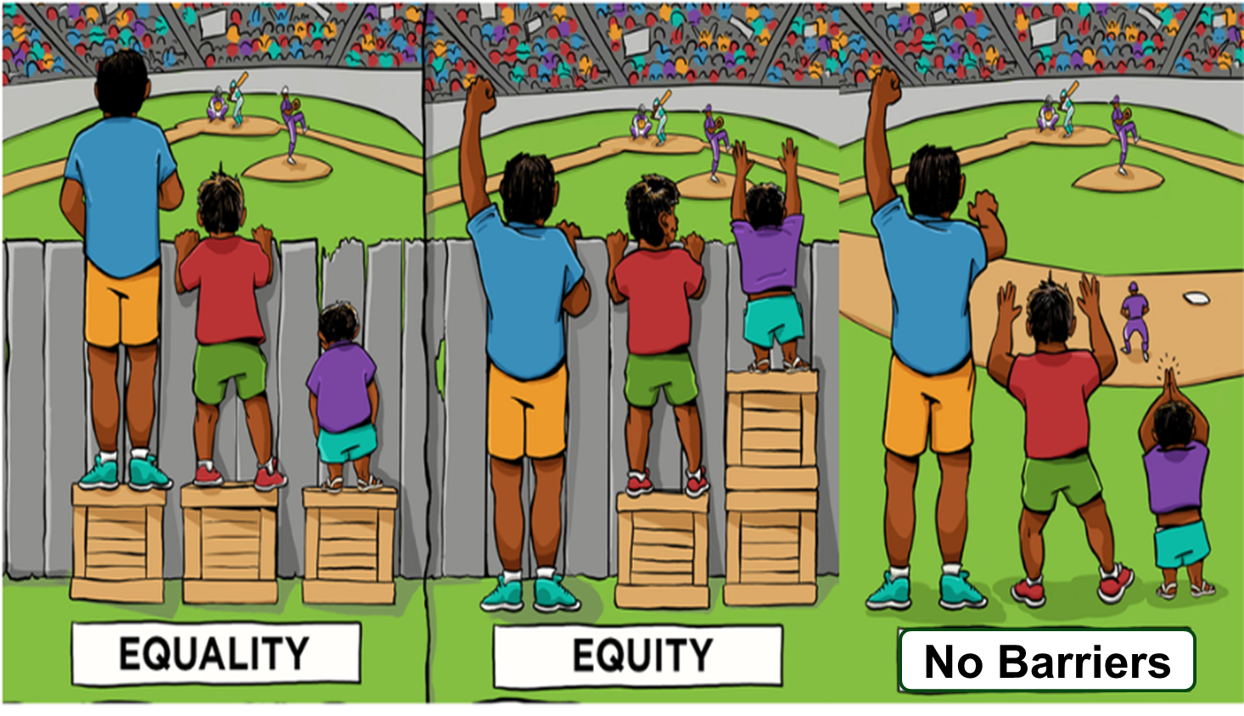
CCR-IEP 5 Beliefs
High Expectations
Culturally Responsive Practices
Student Relationships
Family and Community Engagement
Collective Responsibility
Notes:
Before we continue, I want to briefly mention the 5 Beliefs that are at the core of the CCR-IEP process.
The 5 core Beliefs are essential to developing IEPs that promote college and career readiness. The 5 Beliefs can have an important impact on the success of students with IEPs. Districts and IEP teams, including families, should consider and discuss these beliefs.
It is important to keep the 5 Beliefs in mind when completing each step of the IEP development process:
High Expectations/believing students with disabilities can meet early childhood/grade level academic standards and functional expectations or, for students with most significantly cognitive disabilities, alternate achievement standards aligned with grade level standards;
Culturally Responsive practices to honor and engage students;
Positive Student Relationships;
Family and Community Engagement; and,
Collective Responsibility for working together to support each student in addressing needs and achieving their IEP goals.
For more information on the 5 Beliefs, please visit our CCR IEP Resources webpage.
Handout- A handout of the 5 beliefs is available on the DPI website at - https://dpi.wi.gov/sites/default/files/imce/sped/pdf/rda-ccr-iep-five-beliefs.pdf (link on slide)

Slide 4
College and Career Ready IEP
5 Step Process
Step 1. Understand achievement of grade-level academic standards and functional expectations to identify the student’s strengths and needs.
Step 5. Analyze progress towards goals to evaluate what works and what is needed to close the student’s achievement gaps.
Step 2. Identify how the student’s disability affects academic achievement and functional performance.
Step 4. Align specially designed instruction, services, supports, and accommodations needed to support the goals and ensure access to the general curriculum.
Step 3. Develop ambitious and achievable goals that close achievement gaps and support the unique strengths and needs of the student.
Notes:
College and Career Ready IEPs are developed through a cyclical 5 Step Process in which each step informs the next. It is important to start at the beginning of the cycle with understanding the student’s present levels of performance.
As we go through the presentation today, keep in mind that the 5 Step Process is not about how to fill out an IEP form, but rather, provides a framework for having IEP team discussion about improving student outcomes while operationalizing special education legal (IDEA) requirements.
The outcome of the IEP team’s conversation and analysis using the 5 Step Process for developing CCR IEPs is documented on DPI’s sample IEP Linking Form (Form I-4). An online CCR IEP Discussion Tool has also been developed to help IEP team members prepare for these important conversations. More information about these and other resources is provided at the end of the presentation.
To learn more about all 5 steps, please refer to the resources on our CCR IEP Resources webpage. The link is on this slide and at the end of the presentation.
Handout- A handout on 5 Step Process is available on the DPI website at https://dpi.wi.gov/sites/default/files/imce/sped/pdf/rda-ccr-iep-five-step-process.pdf (link on slide)

Slide 5
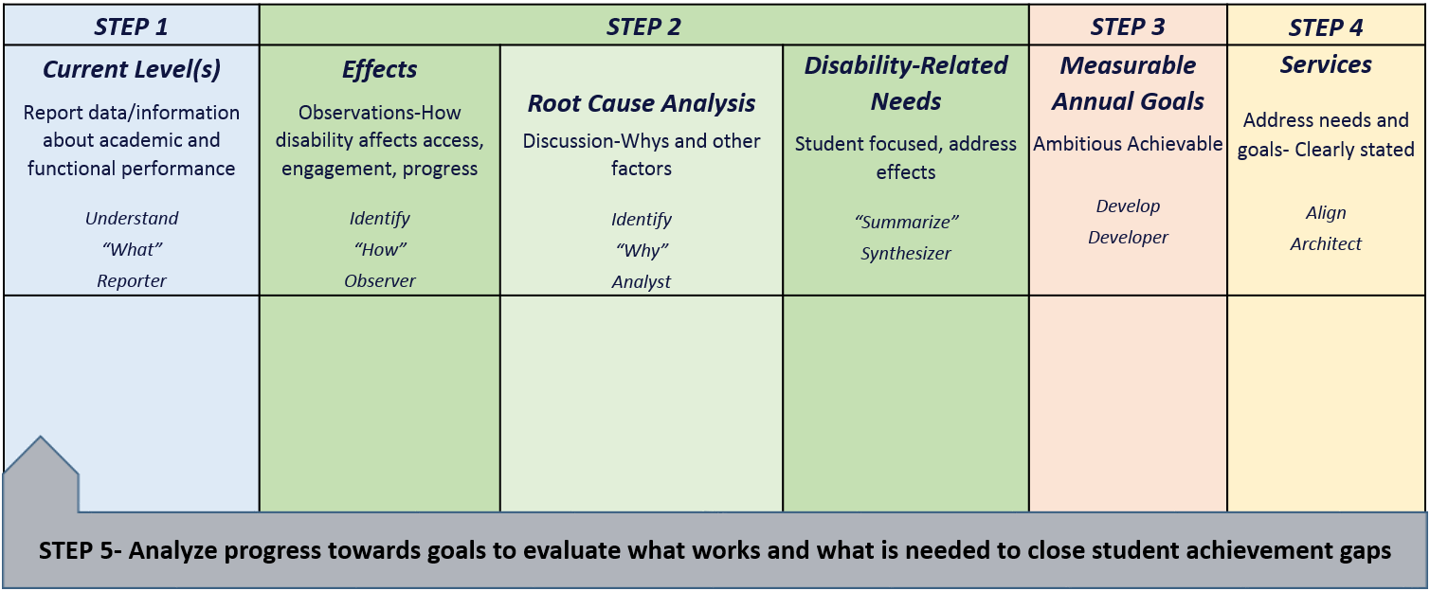
CCR-IEP Process Chart
Notes:
This chart was developed to help clarify the main purposes and linkages between the steps in the 5 step process as well as to highlight the roles IEP team participants play during each step.
On the CCR IEP Learning Resources page, you can download a CCR IEP Process chart with descriptions of each step on one side and a blank copy on the other. The chart can be used both as a training tool when explaining the steps as well as a place to take notes when developing or reviewing IEPs.
https://dpi.wi.gov/sped/college-and-career-ready-ieps/learning-resources/5-step-process
In Step 1 the IEP team’s Understanding of the student’s current levels of academic and functional performance reported during Step 1 provides IEP teams with quantitative information about the student’s skill and behavior at the time, or “the what” that is the basis for discussion in Step 2.
During Step 2, IEP team reflects on the current level and special factor information (if any) and Identifies how the disability affects the student’s access, engagement and progress based on observations, analyzes root causes of these affects (i.e. why the student has difficulty meeting standards and expectations), and finally synthesizes this information into summary statements clearly describing the student’s disability-related need(s). The student’s disability-related needs represent the areas or skills that should be addressed to address the effects of the disability and improve the student’s access, engagement and progress in general education curriculum, instruction, activities and environments.
These needs are the basis for Developing measurable annual IEP goals that are ambitious and achievable during Step 3.
During Step 4 the IEP team Aligns IEP Services that are directly linked to IEP goals and disability-related needs.
In Step 5, the IEP team Analyzes Progress of IEP goals to determine how IEP goals are supporting the student’s disability-related needs and improving the students present level of academic achievement and functional performance and addresses what works and what may need to change to close achievement gaps.

Slide 6
Step 4: Align Special Education Services
Align specially designed instruction, services, supports and accommodations needed to support the goals and ensure access to the general curriculum.
Notes:
During Step 4, the IEP team discusses and determines what types of special education services will be provided to support the student in meeting the IEP goals and addressing disability-related needs so the student will be better able to access and engage in curriculum, instruction, and activities and make progress towards meeting preschool/general education standards and expectations.

Slide 7
Step 4: Key Ideas
Services are aligned to address disability-related needs and support goal attainment
Enable the student to make sufficient progress towards the goals
Reduce barriers and support access, engagement, and progress in early childhood/ grade level standards-based curriculum and instruction, other activities, and environments
All disability-related needs must be addressed by services
Notes:
Identification of a student’s disability-related needs is critical to the linkage between services and the rest of the IEP.
During Step 4, services are aligned to address the student’s disability-related needs and directly support the student’s ability to meet the ambitious and achievable annual IEP goals.
IEP services are intended to assist the student to access, engage, and make progress in early childhood/grade level standards-based curriculum and instruction, other activities, and environments.
Each of the student’s disability-related needs must be addressed by at least one service. It is not unusual for a need to be addressed by more than one service.
This also means each IEP goal must be aligned with at least one service. It is also not unusual for an IEP goal to be supported by more than one service
Presenter Note: It may be helpful to reiterate that a disability-related need may address more than one IEP goal. In addition, more than one goal may address a single disability-related need. Likewise a special education service may address multiple needs.

Slide 8
Step 4: Key Ideas
Services may include supplementary aids and services, specially designed instruction, related services, and program modifications & supports for personnel
Specially designed instruction must be included
If a disability-related need affects reading, there must be at least one goal and service to support that need
Notes:
IEP Services include supplementary aids and services, specially designed instruction, related services, and program modifications and supports for personnel. All IEP services are provided to meet the unique needs of a child with a disability, and must be provided at no cost to the parents
Most of you are quite familiar with the special education service categories outlined in IDEA. Here are some quick definitions as a reminder.
Supplementary Aids and Services §300.42 –
Supplementary Aids and Services” are aids, services, and other supports provided in general education classes or in other education-related settings to enable a student with a disability to be educated with students without disabilities to the maximum extent appropriate. These may include things such as assistive technology and specific modifications that are made for a particular student in general education or other settings.
As with all services, the statement describing the type of supplementary aid and service should be clear. For example, we suggest you do not list “modified assignments” without describing exactly what are the needed assignment modifications. Accommodations are one type of supplementary aid and service that the IEP team discusses as part of the conversation about the special education services to address the student’s needs and goals.
§300.39 Specially designed instruction means adapting, as appropriate to the needs of an eligible child under this part, the content, methodology, or delivery of instruction-
It may be provided in any environment (gen ed, sped, community, etc.).
Specially designed instruction is provided to ensure access to general ed curriculum so students can meet standards that apply to all students as well as to address other disability related needs.
Specially designed instruction must be included in every IEP. If the student does not need specially designed instruction, the student is not eligible under IDEA.
If a disability-related need that affects reading is identified, there must be at least one goal and service to support that disability-related need.
§300.34 Related services. Related services means transportation and such developmental, corrective, and other supportive services as required to assist the student benefit from special education
includes speech-language pathology and audiology services, interpreting services, psychological services, physical and occupational therapy, recreation, including therapeutic recreation, early identification and assessment of disabilities in children, counseling services, including rehabilitation counseling, orientation and mobility services, and medical services for diagnostic or evaluation purposes. Related services also include school health services and school nurse services, social work services in schools, and parent counseling and training.
Whether a student needs a related service is an IEP team decision. There is no specific criteria for receiving these services (no eligibility criteria) beyond IDEA eligibility. However, an evaluation is required before providing OT or PT.
Program modifications and supports for School Personnel- are not specifically defined in IDEA - Like other services, these are provided “on behalf of the student to enable the student to --
(i) To advance appropriately toward attaining the annual goals;
(ii) To be engaged in and make progress in the general education curriculum in accordance with paragraph (a)(1) of this section, and to participate in extracurricular and other nonacademic activities; and
(iii) To be educated and participate with other children with disabilities and nondisabled children in the activities described in this section;

Slide 9
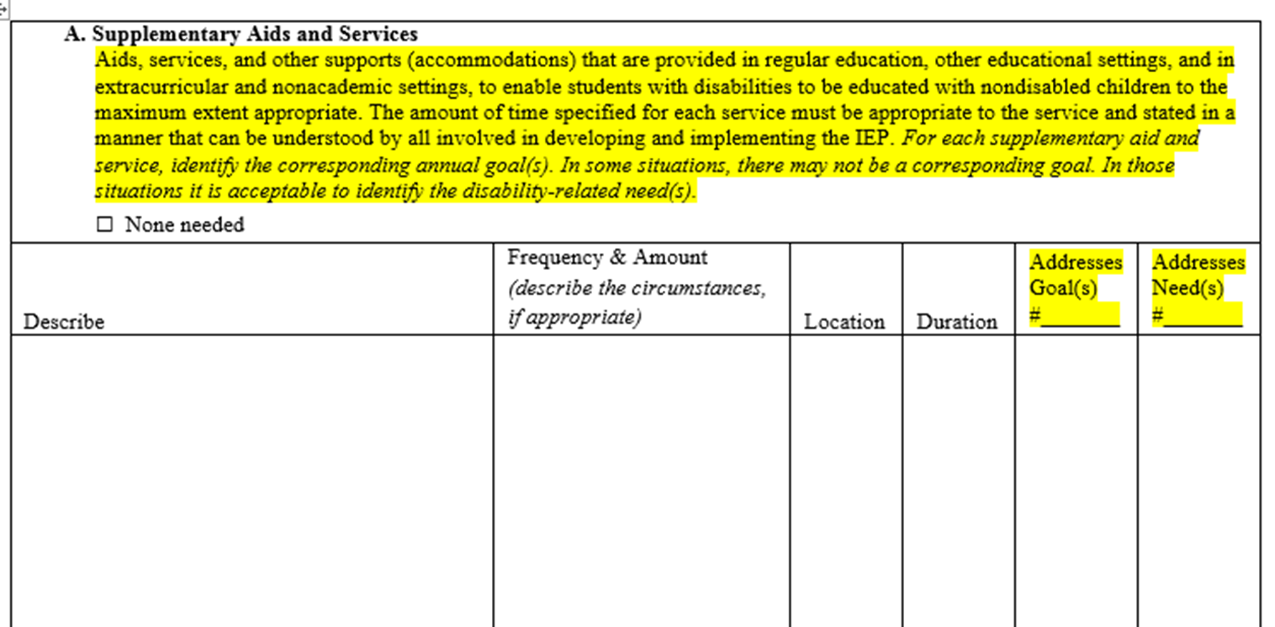
Individualized Education Program (I-4)
Program Summary
Notes:
This is an excerpt from the I-4 linking form program summary. A copy of the entire form is available on the DPI Website- (Search for special education forms). A link to the form is on this slide. The sample IEP forms clearly link together student needs, goals, and services.
In earlier sections, the IEP team will have summarized and numbered each of the student’s disability-related needs. The team will also have numbered each goal developed to address the needs.
After the needs and goals are identified, the team is then ready to align services and develop the program summary. It is very important to wait until Steps 1, 2, and 3 are completed before developing the program summary during Step 4.
Each service will include the number or numbers of the goal(s) or needs) that the services is intended to address. This linkage helps to ensure there is a special education service for each goal to enable the student to make sufficient progress toward the goal and that each need is supported with services.
There may be more than one service to address a goal or need, or one service may address multiple goals/needs.
You will notice Supplementary Aids and Services are considered first when aligning special education services with a student’s IEP goals. This reinforces the concept of least restrictive environment and the desire to first consider education in the regular education environment with supports.

Slide 10
Guidelines for all IEP Services
Based on the student’s unique needs
Service statements must clearly describe the LEA’s commitment of resources to the parents and all involved in developing and implementing the IEP
Each IEP service statement should be clear about the type of service to be provided
Least Restrictive Environment (LRE) requirements considered when making decisions about the location of services
Notes:
As we already mentioned, the student’s unique educational needs drive the IEP team’s determination of the services the student will receive.
The IEP must be written in a way that CLEARLY states the amount of time and resource committed to each service. The level of the LEA’s commitment of resources must be clear to the parent and all involved in developing and implementing the IEP.
When deciding where services will be provided (i.e. the location) , the IEP team must consider the IDEA least restrictive environment (LRE) requirements.

Slide 11
Least Restrictive Environment
To the maximum extent appropriate students with disabilities are educated with students who are nondisabled
Special classes, separate schooling, or other removal of students from general educational environments occur only if the nature or severity of the disability is such that education in general education classes with the use of supplementary aids and services cannot be satisfactorily achieved
Applies to decisions about academic, non-academic, and extra curricular activities
Notes:
This is a quick reminder of the LRE requirements.
When documenting decisions about service on the form, the IEP is required to describe the extent of removal from general education environments.
IEP teams should always first consider ways the student can be educated with peers in general education settings. This can often be accomplished with the use of accommodations and supports (supplementary aids and services). IEP teams should also consider that “push-in” specially designed instruction may be an appropriate alternative to such instruction provided in a special education classroom (for example providing specially designed reading instruction within the general education classroom at the same time as other students receive small group reading instruction).
Students with disabilities should only be removed from general education settings with their peers when the nature and severity of their disability is such that the student’s needs can not be met in such settings with the use of appropriate supports and accommodations.

Slide 12
Recent DOE Guidance on FAPE
Emphasizes access to challenging academic content standards and preparation for college, careers, independent living
FAPE is provided through an appropriately developed IEP which includes services designed to meet a student’s unique needs
Eligible students with behavior needs must receive FAPE and placement in the LRE
The provision of appropriate behavior interventions and supports ensures meaningful access to education
OSERS Policy Guidance on Free Appropriate Public Education (FAPE) , November 16, 2015
OSEP Dear Colleague Letter: Ensuring Equity & Providing Behavioral Supports to Students with Disabilities, August 1, 2016
Notes:
At this time we’d like to pause to briefly share information from two important guidance documents relevant to our discussion. Links to both are on the CCR IEP Resources page as well as on this slide. IEP teams should consider this information when linking IEP services to a student’s needs.
In order to make FAPE available to each eligible child with a disability, the special education and related services, supplementary aids and services, and other supports in the child’s IEP must be designed to enable the child to advance appropriately toward attaining his or her annual IEP goals and to be engaged in, and make progress in, the general education curriculum based on the State’s academic content standards for the grade in which the child is enrolled.
With respect to students whose behavior affects their academic achievement and participation in school activities, schools must provide positive behavioral supports to students who need them.
The provision of appropriate behavior interventions and supports ensures meaningful access to education and that eligible students with behavior needs receive FAPE and placement in the LRE.
Repeated use of disciplinary actions may suggest students may not be receiving appropriate behavioral interventions and supports.
There are links to these letters and a number of DPI resources related to this topic at end of this presentation (eg., DPI behavior and IEP Resource Page).
OSERS Policy Guidance on Free Appropriate Public Education (FAPE) , November 16, 2015
OSEP Dear Colleague Letter: Ensuring Equity & Providing Behavioral Supports to Students with Disabilities, August 1, 2016

Slide 13
Guidance for ALL Services
Service statements must clearly describe
Type of service appropriate to address disability-related need/goal
Amount of services (how much?)
Frequency of services (how often?)
Location of services (where will the service be provided?)
Duration of services (how long will the service be provided?)
Notes:
Now let’s talk a bit more specifically about the guidelines for IEP services. Even though these guidelines seem to focus on how services should be documented in IEP, the important take away is that these elements need to be discussed before they can be clearly documented.
On a related note, this part of the IEP process is the subject of large number of the IDEA complaints we receive every year. One of the most common IDEA complaint issues is failing to properly implement IEP services. One reason we often find violations related to this issue is NOT because the district didn’t provide services, but because the IEP didn’t clearly document the IEP team decision about services as understood by all. In other words, there was confusion about what exactly was intended in terms of type of service, amount, frequency, conditions, and location and, therefore, it was not clear how the services were to be implemented. Thus, an IDEA violation was found.
IDEA requires that service statements must include a description, appropriate to each service, of: the projected date for the beginning of the service, and the anticipated amount, frequency, location, and duration of the service.
Well developed service statements mean the same thing to everyone involved. To make sure this happens, a well developed IEP will have each type of service stated clearly.
For example, “specially designed reading instruction” vs. “special education resource”. The latter is more descriptive of the location than the type of service to be provided.
“Instruction on strategies for self-regulation and managing anxiety” (a special education service) vs. “verbal reminders and visual cues for behavior strategies” (a supplementary aide and service).
And the description of each service will clearly answer the following questions:
How much of the service will be provided (the amount)?
How often will the service be provided (the frequency)?
Where will the service be provided (the location)?
How long will the service be provided (the duration)?
One additional note- Licensed Reading teachers can provide specially designed reading instruction as per a student’s IEP. Want to add link to the relevant document here?

Slide 14
Which Description(s) of type of service are
well developed/appropriate?
Supplementary Aids and Services
Sensory breaks
Assistive technology
Planned seating on bus
Specially Designed Instruction
Small group reading fluency instruction
SLD resource
Social skills instruction in self regulation techniques
Related Services
Physical therapy
Occupational Therapy
Parent training in use of assistive technology
Program modifications and supports for Staff
Consultation
Training on behavior strategies
Co-teaching
Notes:
This is a tricky question- For now, just focus on the description of the type of service--- we will address amount/frequency and location in a bit. How many of these are well developed and appropriate to meeting a student’s disability related need? Think about why you think yes or no
Quiz Poll question- how many did you find?
Why did you think yes or no
Options: 1, 2, 3, 4, 5, 6, 7, 8, 9, 10, 11 , 12
Best Answer= 8
Discussion/Explanation:
1b- not specific enough;
2b- “resource” does not describe a service, but a location;
4 a- not specific enough--- consultation between whom?
4 c- co-teaching is not a special education service of any kind, but rather a type of general education service delivery model/strategy

Slide 15
Amount/Frequency or Conditions
Whenever possible, services should be described using daily allotments of minutes or hours
If it is not possible to describe the service with clear time allotments, the IEP must clearly describe the circumstances under which the service will be provided
Any extent of removal from instructional time or general education environments must be clear
Notes:
Whenever possible, the IEP should describe services using daily allotments of hours or minutes.
If the student’s unique needs are such that daily allotments are not appropriate, the IEP should describe services in weekly allotments of time.
If it is not possible to describe the service with clear time allotments, the IEP must clearly describe the circumstances under which the service will be provided.
Any extent of removal from general education must be clear.
The location of the services in the program summary should be consistent with the statements regarding participation in the regular education environment and extent of removal statement (i.e., based on consideration of LRE).

Slide 16
Considering Supplementary Aids & Services Accommodations and Supports
Increase access to general education standards, instruction, settings, or activities
Help the student be more independent
Improve motivation and engagement
Should reflect student choice and input
May be available to the student in future higher education or employment
Notes:
Accommodations are a kind of supplementary aid and service. Accommodations are supports that provide equitable access to grade-level content and allow students to demonstrate what they know. Accommodations are intended to reduce or eliminate the effects of a student’s disability that may result in difficulty accessing instruction and engaging in typical learning and other school activities. The use of accommodations does not reduce learning expectations and does not substantively change the content or the required skill level of a lesson, activity, or test.
Accommodations and other supplementary aids and services can serve multiple functions, all which help support the student on a pathway to college and career readiness. Accommodations and other IEP supports may be needed both to access and engage in specific academic tasks, as well as to support functional needs of students across various environments.
Accommodations should be based on the unique needs of each student with an IEP and should support the goals in the IEP.
The appropriate use of needed accommodations may:
Increase access, engagement, and progress in general education standards, instruction, settings, or activities.
Help the student be more independent.
Improve motivation and engagement (this also connects with Universal Design for Learning Guidelines).
Accommodations may also support the student by the following:
Provide Student Choice and Input that helps to foster self-determination.
Be Available to the Student in Future Higher Education or Employment.
Some accommodations and other supplementary aids and services provided in schools may be available in post-secondary educational programs, as well as jobs and careers. The types of accommodations available today for students in higher education and career are much more varied and expanded than in previous years. Because accommodations available in these settings are increasing, it is important for IEP teams to reach out to current employers and higher education resource staff to find out about the types of accommodations available.

Slide 17
Examples of Accommodations
Academic/Early Learning Skill Accommodations | Functional Skill Accommodations
Text in different fonts, size, color | Self-monitoring tools
Text reader/writer (assistive technology) | Home base
Note-taker, scribe | 5 point anxiety scale
Audio books or provision of text in alternate format (NIMAS) | Adaptive clothing, writing tools, utensils
Graphic organizers | Movement/sensory breaks
Visual schedules and supports | Visual schedules and supports
Math strategy cards | Coping cards
Notes:
This table provides just a few examples out of thousands of possible IEP accommodations and other supplemental aids and services students may require based on their individual needs. The purpose of this slide is to remind IEP teams that accommodations and IEP supports may be needed both to access and engage in specific academic tasks, as well as to support functional needs of students.
Common accommodations may include the use of assistive technology, accessible instructional materials, sensory supports and fidgets, provision of breaks to support student needs, and visual supports. Accommodations can also be used to vary the level of support needed by a student to access and engage in instruction, such as adult proximity during certain activities or to reduce response effort such as through the use of a scribe, word processor, text reader or text to speech software. The student still must understand the concept of what is asked in order to use these supports as accommodations.
e.g., If a student knows basic math facts or is not being tested on calculation, a calculator is an accommodation. If the student does not know facts, it may be considered a modification, and may change the nature of the expected task if the purpose of the activity is to demonstrate math calculation skills
It should be noted that accommodations should be based on a student’s present level of strengths and needs and NOT based on check boxes that are listed on IEP forms, lists of accommodations found online, or a list of accommodations typically made available to all students that is not needed by the student for whom the IEP is written. Only include supplementary aids and services that must be provided to address the student’s individual needs.
Presenter Note: Definition of accommodations adapted from DPI Accommodations Guide for Students with Disabilities 2011-12- This document is scheduled to be updated.

Slide 18
National Instructional Materials
Accessibility Standard (NIMAS)
Students who are blind or visually impaired or have other print disabilities, must timely receive accessible materials in the appropriate format
NIMAS establishes criteria for standardization of accessible electronic text files for eligible students
Materials sent to access center (NIMAC) by LEA request via Wisconsin Accessible Materials Portal (WAMP)
During Step 4, the IEP team considers if student requires instructional materials in a specialized format to address disability related needs
Notes:
A provision in the Individuals with Disabilities Education Act of 2004 (IDEA) establishes the NIMAS [34 CFR 300.172(a)(1).]
This Standard requires LEAs to ensure all students who are blind or visually impaired, and those with other print disabilities, receive accessible materials in an appropriate specialized format and in a timely manner (i.e. at the same time all other students receive their print materials.
The standard provides for consistent source files to be used to create specialized formats for students with print disabilities, including those who are blind and visually impaired.
Wisconsin School districts can access such materials for eligible students (blind, visually impaired, other print disabilities) from the National Instructional Materials Access Center (NIMAC). They do this by making a request through the Wisconsin Accessible Materials Portal (WAMP).
LEAs must also ensure student with IEPS who need instructional materials in accessible formats, but are not included under the definition of blind or other persons with print disabilities or who need materials that cannot be produced from NIMAS files, receive those instructional materials in a timely manner.
During Step 2, the IEP team should have already identified whether the student’s disability affects the student’s access to print materials and if there are corresponding disability-related needs that must be addressed to increase such access so the student can engage in instructional activities. If so, the team may decide goals are needed to address the access need.
In Step 4, when linking services to needs, the IEP team should consider if the student needs instructional materials in specialized format to address their disability related needs so they can meet their IEP goals AND access, engage and make progress in the general education curriculum.
Services related to this need would include the supplementary aid and service of accessible print materials and could include other services such as specially designed instruction on the use of such materials, as appropriate.
Specific guidance for districts can be found at: https://www.wamp.k12.wi.us/guidance-for-districts/ (Link on slide and at end of presentation)
Contact: Jayne Bischoff, UDL and AT Consultant

Slide 19
Example
Service Described Using Conditions
Type of Service | Frequency and Amount | Location
Comfort, sensory, or walk break | When the student becomes anxious or overstimulated and is unable to continue accessing or engaging in class activity, or when the student requests a break 3-4 times per day, 10 to 15 minutes each, no more than one break per class period | General education classrooms, hallways, library or gym
Notes:
Here is an example of a service described using conditions
Type of service: (The student will be given) a short comfort, sensory, or walk break (inside or out of classroom)
Frequency (Conditions): When the student becomes anxious or overstimulated and is unable to continue accessing or engaging in the class activity, or when the student requests a break
Amount: 3-4 times per day, 10 to 15 minutes each, no more than one per class period
Location: in or out of classroom
Quiz--- What kind of special education service is this?
Answer options:
A. Supplementary aids and services?
B. Specially designed instruction?
C. Program modifications and supports for Staff?
D. Related services?
Why?
A. - Intended to support the student’s ability to access and participate in general education activities

Slide 20
Examples
Specially Designed Instruction
Type of Service | Frequency and Amount | Location
Instruction to build reading comprehension strategies Pre-teach social studies and science vocabulary Small group instruction on social skills to build peer relationships and social interaction skills | 30 minutes 3x week 30 minutes 2x week 30 minutes 2x at the start of each unit/chapter 45 minutes 1x per week | General ed. classrm Resource Room Resource room Special Services Suite
Notes:
Here are some examples of specially designed instruction.
Note that the type of specially designed instruction, the amount/frequency, and the location are clear.
Reminder: The statement of service should pass the “stranger test” (i.e. someone who wasn’t at the meeting should be able to tell what the service is intended to provide and how much and how often it will be provided).
In addition, everyone who may be involved in implementing the student’s IEP must be informed of their specific responsibilities for implementing or supporting the implementation of IEP services.

Slide 21
Engaging Students in Step 4
Have a system for preparing the student to participate in the IEP team meeting
Provide explanations of IEP terminology using language the student understands
Ask students what they need to meet their goals? … participate more in class? …complete assignments?
Ask students if they already know how to use any proposed assistive technology devices or software or if they need help learning how to use such tools.
Consider student led IEPs
Notes:
Involving students in the development of their IEPs leads to greater student ownership and understanding of their educational program and its outcomes.
This applies to students of all ages and development levels. All students can and should have some role in their IEP.
Involving students in the development of their IEPs leads to greater student ownership and understanding of their educational program and its outcomes.
This applies to students of all ages and development levels. All students can and should have some role in their IEP.
Preparing students to participate in their IEP meeting can begin in seemingly small ways. For example, the student’s case manager or teacher can have the student be prepared to share one skill the student is good at and/or one thing they would really like to get better at when prompted during the meeting.
Here are a few ideas for engaging students in Step 4.
Can you think of others?

Slide 22
Step 4: What Families Need to Know
IEP language and vocabulary
Needs and IEP goals
The goal and service link
Universal Design for Learning
Notes:
Understanding IEP language and vocabulary can be difficult for some families. For example, the terms “supplementary aids and services”, or “accommodations, modifications and supports”, can be easily misunderstood and confusing for families. It is also important to consider the use of an interpreter in cases where English is not a first language for families.
Before being able to work as part of the IEP team to align services to goals and disability-related needs, families must first completely understand what those goals and needs are. This should occur naturally if the team has been using the 5 step process as a framework for the IEP team discussion. When a family understands their child’s grade-level standards and functional expectations (Step 1) , when they can identify how their child’s disability affects academic achievement and functional performance (Step 2), and when they can help develop ambitious and achievable goals (Step 3), they will be able to help make decisions about the services and supports that will best meet the needs of their child.
For the goal and service link, correspondence between goals and services does not need to be one-to-one. Oftentimes, families have misunderstood that if you have a goal, you have one specific service for it. Not all families are aware that goals and disability-related needs can have multiple services attached to them. Also, families should know that it is ok for one service to address multiple goals or disability-related needs.
Universal Design for Learning is something that many families may not have heard about. If you refer to Universal Design for Learning within the context of an IEP team meeting, be sure to share with the family some easy to understand language regarding Universal Design for Learning and, specifically, the role that Universal Design for Learning plays in improving outcomes for their child.

Slide 23
Questions to Ask Families
What do family members already do at home to support your child in meeting high expectations?
What aids, services, supports, and accommodations does the family feel have been effective in the past? Why?
How can we develop services and supports for your child in such a way that it supports and respects your family’s time and traditions?
Notes:
The first question is, “What does the family already do at home to support the student in meeting high expectations?” Parents are experts on their child. It is important to take the things that are already successful at home and have a discussion about using them to create supports at school that will yield positive outcomes for the child. A common example of this may be a certain type of exercise or activity within the day that helps to redirect and focus the child. Perhaps a similar exercise or activity could be built into the student’s school day to assist the student with focus.
The second question is, “What aids, services, supports, and accommodations does the family feel have been effective in the past? Why?” Keep in mind that the caregivers are the ones who can offer the consistency of a year-to-year view of the child’s progression. Often, educators see a child for a school year and then that child has a different teacher and/or paraprofessional the next year. It is important to find out from the family what types of services or supports have been effective in the past and also what types have not been effective. By continuing to address child-specific best practices, you will improve the outcomes for that child.
The third question is, “How can we develop services and supports for your child in such a way that it supports and respects your family’s time and traditions?” Addressing culturally responsive practices for a child allows the IEP team to create services, supports, and accommodations that are based on a level of comfort for the student and, therefore, increases the likelihood of positive outcomes for the child. As an example, there are cases where a student may have difficulty completing school assignments at home. If there are factors related to the child’s disability such as social/emotional needs, trauma, or illness that make it difficult to complete homework assignments, the family may want to request an amount of homework that will allow the child to complete it and have success. By respecting this value of time in the IEP and writing accommodations that meet the specific disability-related needs of the student in the home setting, the child will have more success at home and in school. An example may be an accommodation that states, “Only 20 minutes of cumulative homework to be assigned on a daily basis.” In this case, homework can still be a part of the child’s day but it is minimal and the family has more time to focus their attention on other aspects of the child’s disability.

Slide 24
Tips for Engaging Families
Write service descriptions clearly
Consider “achievement gap” as an “opportunity gap”
Discuss services that may be applicable to meeting student needs
Create a vocabulary guide
Use active listening to address concerns and answer questions
Notes:
Writing service descriptions clearly is critical for good communication between IEP team participants and also staff who are responsible for implementing the IEP. In the homework example used in the last slide, if the support was written as, “No more than 20 minutes of homework to be given nightly” each one of the child’s teachers may interpret that as they can give up to 20 minutes of homework. For a child in middle or high school with many teachers, this can add up to a couple of hours of homework. By writing the support as “Up to 20 minutes of cumulative homework may be assigned on a daily basis”, the word cumulative clears up any confusion about the amount and also encourages the teachers to collaborate to make sure this support is met.
Second, thinking of “achievement gaps” as “opportunity gaps” is one way for IEP teams to brainstorm the types of skills, supports, or services that can assist the student to improve access, engagement, and progress in preschool and grade school level curriculum and instruction. Aligning IEP services to teach a student new skills and providing a student with academic, environmental, and social-emotional supports allows them access to all learning opportunities needed to engage in preschool or grade-level academic instruction and other activities, and demonstrate understanding.
Third, discussing possible service options that could address the student’s needs is a good way to get reluctant families involved. Most families may not be aware of the different possibilities in terms of services and supports that could be used to address their student’s needs. Because of this, they aren’t able to help the IEP team make completely informed decisions from their perspective. If the families are fully engaged in this discussion and decision making they will feel more comfortable and able to share important and meaningful input about the services and supports they think will be most helpful for their child.
Creating a vocabulary guide for families is a good way to inform them without singling them out. Of course, we often use educational jargon or acronyms during IEP meetings. Many families don’t know these terms or acronyms. By giving them a copy of these terms and acronyms ahead of time, the family will know what is being talked about and feel more comfortable with sharing during the meeting.
Remember to use active listening to address concerns and answer questions. It is always important to do this so parents feel acknowledged and respected and help move the team to consensus decisions and mutual understanding.

Slide 25
Expectations
Look for
Services directly support goals/ disability-related needs
IEP team discusses if staff working with the student have information and training needed to implement services
Special and general education teachers, related service providers and others, work collaboratively to address student needs
Frequency, amount (or conditions), location, and duration of services are clearly written in objective terms
Avoid
Services based solely on student’s impairment area or preferred school program; not individualized needs
No program modifications/supports for staff included for staff who do not have sufficient knowledge or training to support disability-related needs
Educators plan and work in isolation when developing and providing services to students
IEP service statements subjective/not clear (e.g. “as needed”, “when requested”, “access to”)
Notes:
Each of our At a Glance documents describe what we would expect to see in practice and what we would hope not to see in practice.
Here are some expectations related to Step 4.
Read slide.
For example:
Do: Develop services specifically to support goals and needs. Wait to make decisions about IEP services after completing Steps 1-3.
Don’t: Determine services based on a student’s eligibility category or set school program (e.g., only students with EBD label can participate in specially designed social emotional learning instruction. All 3rd grade students with IEPs who aren’t meeting grade level expectations are provided 50 minutes of reading instruction in the resource room).
Do: Clearly describe the frequency, amount, location and duration of IEP services in objective terms, so it is clear how much, how often, when/under what conditions, where.
Don’t: Write IEP services where the frequency and amount is subjective (i.e. “when needed”, “when the student requests”, “when teacher deems necessary”, “student will have access to”). If one of the student’s needs is to improve self-advocacy skills by requesting accommodations, then this should be an IEP goal. The support needed to access instruction must be provided even if the student does not ask on their own.

Slide 26
Step 4: Service Summary Step-Check
Are all disability-related needs and IEP goals addressed by at least one service?
If disability affects reading, do services address related needs?
Are the services stated in a manner that can be understood by all?
Type of service; and clear and logical amount, frequency (or conditions), location, and duration?
Do supplemental aids and services provide needed support for access, engagement, and progress?
Do they address independence and use in school, community, and eventually, post-secondary settings?
Are there necessary supports for staff?
Notes:
The At A Glance documents also include Step-Checks that individuals or teams can use to review their IEPs.
Here is the Step 4- Step-Check:
Are all IEP goals and disability-related needs addressed by at least one service?
Is a clear description of the service provided?
Is a clear and logical amount, frequency, location and duration provided?
Are there procedures for verifying IEP implementation?
Do services support access, engagement and progress in the general curriculum and environment?
Are supports, such as training in literacy instruction, provided for educators?
Each of the At a Glance documents also include tips for IEP teams about each step. We have already gone over the tips for this step during the presentation. There is a link to the Step 4 At a Glance on this slide.

Slide 27
UDL and 5 Step Process
Consider how these UDL checkpoints may help guide service planning. What services might reduce
or eliminate barriers, support IEP goals and address the student’s disability related needs?
Notes:
Before we close, there is one additional area we suggest you consider as you make decisions about IEP services. These Universal Design for Learning (UDL) guidelines provide checkpoints for discussion and exploration related barriers to access and engagement that most students with disabilities encounter during their school career.
In relation to step 4:
Look over these guidelines. Review them with the lens of the students you work with and the guidelines as barriers that need to be reduced to improve learning.
Think about the discussion during steps 1, 2 and 3.
How does the student’s disability effect access, engagement and progress?
What barriers exist in general education curriculum, activities, environments that magnify the effects of disabilities?
How can these barriers be removed or reduced?
What services might reduce or eliminate barriers, support IEP goals, and address the student’s disability related needs?
There will be a module specifically developed to address the application UDL principles to the 5 Step Process in more detail. Until then, there are some excellent resources available from links on the DPI UDL page (link on slide and at end of presentation- https://dpi.wi.gov/universal-design-learning )

Slide 28
Which Service(s) is Linked to Each Need/Goal?
Need/Goal | Service Statement
N1: Improve phonology and decoding skills G1: Increase words read correctly per minute from 40 words on a 3rd grade passage to 100 words on 4th grade passage N2: Develop and use strategies to reduce frustration, improve ability to independently access text and engage in reading activities G2: Will identify and demonstrate 3 to 5 strategies to deal with frustration and anxiety given scenarios with typical triggers in 8 out of 10 trials (current=0 ) | Specially Designed reading instruction 20 minutes each day in special education classroom Adult prompts/reminders to use calming strategies or take break in all classes requiring reading Digital text or text reader (when AEM not available) for all independent reading assignments above independent reading level or greater than one page in length in all general and special education classes and home, when homework given Instruction in triggers and calming strategies 30 minutes 1x per week in special ed. classroom
Notes:
As a reminder, when linking services to needs, we think:
What kinds of services might be needed to address needs and goals?
How do the services address access, engagement, progress?
Specificity– type, frequency, amount or conditions, location duration?
How might multiple services providers address the same need/goal?
Here is a quick activity to check your knowledge of the key ideas in Step 4.
MATCHING ACTIVITY- Instructions:
Look the first item on the left- N1
Then look at the 4 services on the right (a, b, c, and d)
Which service or services might be appropriately linked to address this need? (can be more than 1)
Repeat with each goal or need.
There are no specific right or wrong answers for any particular student need or for students with any particular impairment. The answers come from the IEP team understanding of each student’s individual needs and how the service addresses the need.
Most likely responses:
N1- a, c
G1- a
N2- a, b, c, d,
G2- b, d
If using this during a presentation, Debrief: Discuss why participants selected various responses if different than suggested answers.

Slide 29
CCR IEP Learning Resources
Notes:
On this page, you will find links to all DPI CCR-IEP resources. Please check this page often as we will be adding new resources regularly

Slide 30
CCR IEP Discussion Tool
Notes:
We have developed an online discussion tool to help IEP teams prepare to develop a CCR IEP. This tool also supports the 5 step process. It provides guiding questions to consider when identifying the effects of disability, the root cause analysis and the summary of disability-related needs. We encourage you to explore this tool as you prepare for IEP team meetings. For example, some of the questions in the tool will be helpful to discuss during a specific student’s IEP meeting.
A link to the online tool is found on our website under CCR IEPs at https://dpi.wi.gov/sped/college-and-career-ready-ieps/discussion-tool
Presenter Note: Remind participants that this tool is intended to be used individually in preparation for a meeting or during an IEP team meeting. School staff should not meet as a group without the parent to draft the IEP prior to the IEP team meeting. If staff meet to substantively develop/draft parts of the IEP together as a group, it is considered an IEP team meeting and the parent should be invited.

Slide 31
CCR IEP Video
Notes:
We have a 5 minute video that describes the CCR IEP 5 Step Process at https://youtu.be/wRIyZoiHRdQ

Slide 32
Additional Step 4 Resources
Step 4: At A Glance
Universal Design for Learning
Teaching Our Readers When They Struggle
Reading Teachers and the Provision of Specially Designed Reading Instruction
OSERS Policy Letter- FAPE and IEPs
OSERS Policy Letter- IEPs and Behavior Support
OSERS Dear Colleague Letter- Preschool Least Restrictive Environments (LRE)
Notes:
Here are a few additional resources specific to Step 4. You can find links to these resources on Special Education Team Website.

Slide 33
Additional Step 4 Resources
Special Education Team Information Update Bulletins including:
Bulletin 10-07 Describing Special Education, Related Services, Supplementary Aids and Services, and Program Modifications and Supports
Bulletin 12-02 The Use of Telespeech as a Service Delivery Method for Speech and Language Services
Bulletin 13-02- Legal Requirements of Accessible Instructional Materials (AIM)
DPI NIMAS Page and Wisconsin Accessible Media Productions
Special Education Program Areas
DPI Resources Behavior and IEPs
Notes:
Many of our DPI bulletins address service implementation issues. These three are specifically related to content discussed today, but we encourage you to review others such as:
PE Bulletin
LRE
Shortened Day
Transportation
Extended School Year (ESY) and many more

Slide 34
Additional Resources for Family Engagement
http://www.livebinders.com/play/play?id=2191148
Assistive Technology 101
More Assistive Technology Info from CTD
A parent’s guide to Universal Design for Learning
Notes:
Here are some additional resources that may be particularly helpful for families. These and other resources for Families on the 5 Step Process have been organized into a livebinder by our WSPEI staff. The link to the WSPEI livebinder is on this slide.
http://www.livebinders.com/play/play?id=2191148
Assistive Technology Information
http://www.readingrockets.org/article/assistive-technology-101
Assistive Technology Information from the Center on Technology and Disability
http://www.ctdinstitute.org/sites/default/files/file_attachments/AT-IEP-English2_0.pdf
A parent’s guide to UDL
http://www.cpacinc.org/wp-content/uploads/2009/12/ParentsGuidetoUDL.pdf

Slide 35
Step 4 Debrief
Questions?
Comments
Notes:
Closing:
Remember the 5 Step Process for Developing IEPs is a framework for the IEP team process.
The primary focus is on the content and structure of IEP team conversation, rather than on completing IEP forms.
The conversation drives the IEP documentation, not vice versa.
What is documented on the IEP form should reflect the conversation.
The best way to ensure that there will be sufficient information in the student’s written IEP is to follow the 5 Step Process when preparing for and conducting IEP team meetings and for documenting discussion and IEP team decisions.

Slide 36
Thank you!

