Slide 1
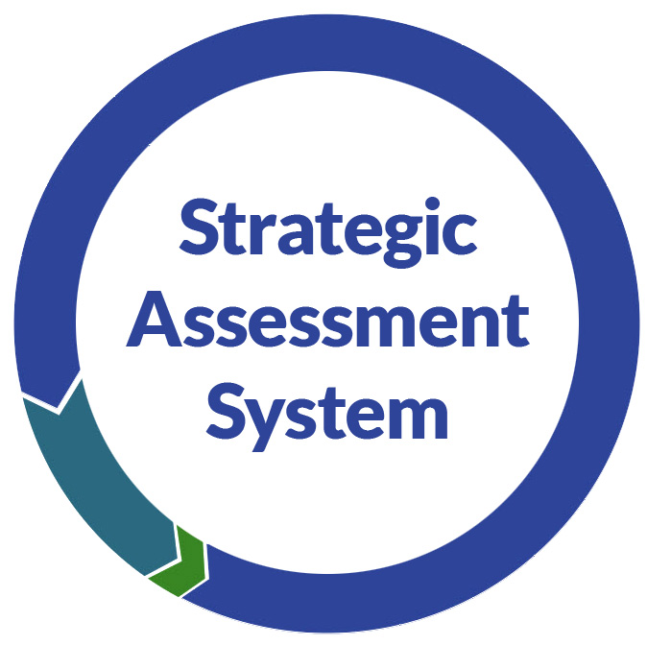
Science
ASSESSMENT PRACTICES
What does it mean to have a system of assessment for a district science education program?
Why it Matters
Administrators:
With assessments all aligned to standards and with each other, students have a greater chance of success. The Hypothesis (or “Theory”) of Practice is that student outcomes will improve.
Teachers:
Will have a better understanding of where students are at in their learning in relation to grade-level standards.
Will build stronger relationships with students to support rather than only monitor their learning.
Students, Families, and Communities:
Students and caregivers will have a better sense of what students know and don’t know, and what grades mean across classes.
Educators strategically use evidence from standards-aligned formative, benchmark, interim, and state-level assessment, along with student surveys, to reflect on their practice and the progress of students.
What are the opportunities and challenges?
Opportunity to solidify and collaborate on a vision for science learning
Opportunity to reframe assessment culture as a relationship—mentor and mentee support—rather than being about getting the “right” answer, accountability, or giving a grade
Opportunity to make assessment a meaningful part of student engagement, linking to their identities and interests
A challenge is finding structured time for educators to come together and develop tools and reflect on outcomes.
How does this connect to a vision for equity?
Collaborating around assessments solidifies what the vision is for all students and offers a guide for supporting all students. Authentic and varied assessments provide multiple means to demonstrate understanding.

Slide 2
Science
ASSESSMENT PRACTICES
What are some strategies for implementation?
Establish a clear vision for science learning and continually reflect on how well assessments provide data on progress toward that vision.
Determine a collaborative understanding of what makes a quality, standards-aligned assessment (example).
Districts offer learning opportunities for educators to collaboratively create assessments and structured time to reflect on student outcomes.
What are some good reflection questions to consider?
How are educators using assessment data from multiple sources to reflect on their learning and student learning?
How is data used to improve access to equitable opportunities for all students?
What do national professional groups or education researchers say on this topic?
National Academies report on assessment in science, chapters 6 and 7 particularly address systems
Nextgenscience.org resources on systems of assessment in science, including a guide for decision making
DPI Science Assessment website
DPI Strategic Assessment resources, including Ms. G’s year of science
Stanford NGSS Assessment Project
Stanford presentations on NGSS assessments and samples for a system
Further Resources
Administrators:
Education First Local Assessment Playbook – fewer and better assessments
Assessment Inventory Resource – WestEd tool to analyze current practice
Measured Progress infographic on elements of a balanced assessment system and their purposes
Article on science assessment systems
Teachers:
Sample assessments developed by Wisconsin educators and national groups
Stanford NGSS Assessment Project - samples
Students, Families, and Communities:
Be aware of how students are grouped (or tracked) in classes based on test scores; advocate for changes to this inequitable practice.
DPI assessment resources for families (ACT, Forward Exam, etc.).
For more information contact:
Kevin Anderson, kevin.anderson@dpi.wi.gov, Teaching and Learning Team, Division of Academic Excellence
June 2020 Wisconsin Department of Public Instruction
The Department of Public Instruction does not discriminate on the basis of sex, race, color, religion, creed, age, national origin, ancestry, pregnancy, marital status or parental status, sexual orientation or disability.

