Slide 1
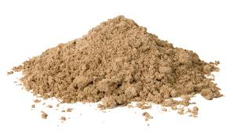
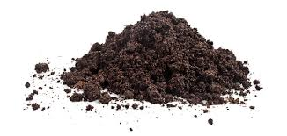
Soil and Sand
What are the earth materials made of?
Do they hold water?
Do they matter for different reasons?

Slide 2
What are they made of?
Look for
Abiotic (nonliving material)
Biotic (organic material)
Living
Dead

Slide 3
What did you notice?
Notes:
Water, organic material, air,

Slide 4
Questions
How are they made?
How do you think they got to be so different?
Do they do different things for the environment?
Do the materials help living things?

Slide 5
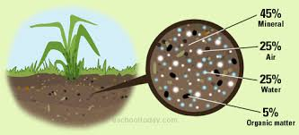
Soil

Slide 6
https://www.youtube.com/watch?v=VkrQ9QuKprE

Slide 7
What was surprising?

Slide 8
Soil and Sand
Do they hold water?
Do they matter for different reasons?

Slide 9
Do the materials hold water or let water pass through?
How can we find out?
What experiences do you have that would help you with this question?

Slide 10
Make a prediction
Write your prediction on a sticky note.
Write down, or draw your experience that helped you predict.

Slide 11
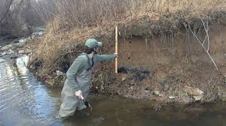
Investigate

Slide 12
How would adsorbing water or letting water seep through matter to the ecological system?
Why would a scientist care?
Why would an engineer care?
Notes:
Gus was right And Finn

Slide 13
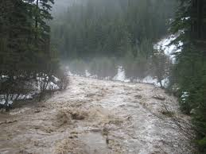
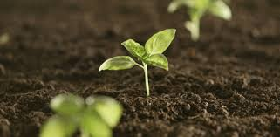
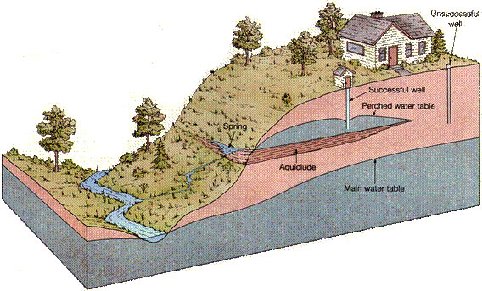
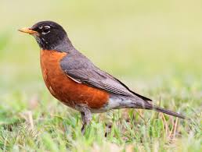
Notes:
Recharging the water table (quickly)

