Slide 1
What are the Differences between the Wisconsin Standards for Science (WSS) and Next Generation Science Standards (NGSS)?
Kevin Anderson
DPI Science Education Consultant
Notes:
Hello, I’m Kevin Anderson, the Science Education Consultant at the Wisconsin Department of Public Instruction. As you’ve probably heard, we have new science standards! [cow bell, woo-hoo] In this video I’ll provide an overview of our new standards, particularly in relation to how they’re different from the Next Generation Science Standards. Please, send me an email if you have any questions – there’s a link to do that at the bottom of this website.
No sound when I show the intro slide. Quick transition.

Slide 2
Establishing a Vision for Science Education
“[By] the end of 12th grade, all students have some appreciation of the beauty and wonder of science; possess sufficient knowledge of science and engineering to engage in public discussions on related issues; are careful consumers of scientific and technological information related to their everyday lives; are able to continue to learn about science outside school; and have the skills to enter careers of their choice, including (but not limited to) careers in science, engineering, and technology.”
Notes:
Our standards committee settled upon this statement for a vision for Wisconsin science education. It comes from the Framework for K-12 Science published by the National Academies.
What is your vision for students in your school or district? Having a vision is an important first part in the improvement process – it’s critical to know what you’re aiming for and how you’ll know when you get there.

Slide 3
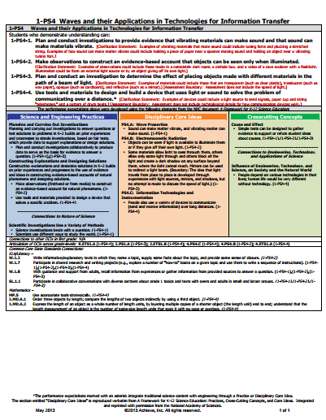
Quick Review - Basic NGSS Format
nextgenscience.org
Notes:
Before we dig into the Wisconsin Standards for Science, I’m going to briefly review the Next Generation Science Standards, as we used these standards and the Framework to develop our state standards. Additionally, over 80% of Wisconsin schools have been using the NGSS to some extent.

Slide 4
Quick Review - Basic NGSS Format
Notes:
You’ll see that at the top of an NGSS standards page there are a series of bold, black statements, which are the performance expectations. There are also some clarification statements and assessment boundaries in red along with them.
Notably, these performance expectations are not meant to prescribe instructional practice. They are examples of ways to bring the the practices, content, and crosscutting concepts together, not the only way. Many schools have been using them to guide instruction, which isn’t their purpose. For designing lessons and units, I would look at those blue, orange and green boxes – the three dimensions of the Next Generation Standards and our Wisconsin Standards for Science. I would start by considering the disciplinary core ideas, or content, in the orange box. In particular, I’d want to determine which phenomena students might investigate that relate to the content. I would then begin to consider how I’d want students to interact with, make sense of, and investigate this phenomenon in order to have them understand the content – So, I’d strategically select practices (in the blue boxes) to build that understanding. Finally, I would consider how I want students to be thinking about the content as they engage in the practices, using the crosscutting concepts (green box) to frame that thinking.
It’s also worth noting that at the bottom of the NGSS practice and crosscutting science boxes, there are connections to the nature of science and connections to engineering, technology and society ideas.

Slide 5
Quick Review - Basic NGSS Format
Notes:
Because our standards were based on the NGSS and Framework – you can really use either set of standards – the DCIs, practices, and CCCs will be essentially the same. The NGSS do have many resources we don’t – like the connections at the bottom of the page to ELA and mathematics – also the fact that every part of this standards page is a clickable link that takes you to more information on a topic or idea. Our Wisconsin standards do have some unique, helpful elements, which I’ll discuss further.

Slide 6
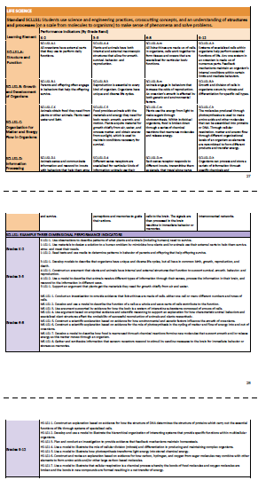
Differences in our Wisconsin Standards for Science
Split out the 3 dimensions into progressions.
dpi.wi.gov/science/standards
Notes:
Here’s an image of the NGSS next to a page of Wisconsin standards. Our state standards all have a consistent format that shows progressions of learning in grade-bands, K-2, 3-5, 6-8, and 9-12. Those progressions are useful tools in planning coherent and appropriate instruction and assessment. You’ll see that our Wisconsin standards don’t have all three dimensions on one page like the NGSS – this page, which is orange, is a page detailing disciplinary core ideas (the content). You’ll also see separate pages that provide progressions of the practice standards in blue and the crosscutting concept standards in green.

Slide 7
Differences in our Wisconsin Standards for Science
Performance expectations are de-emphasized.
Notes:
Another difference in the Wisconsin standards is that those bold performance expectations are not at the top of the page. We wanted to make it clear that those are sample connections across the three dimensions, so we noted those in a purple box below each orange disciplinary core idea section. In Wisconsin language, we also call those performance indicators as opposed to performance expectations. While these are noted as examples, it’s important to realize that these are used by the company creating our Forward Exam in science. They consider these statements as models to draw from for creating sets of test items.
We did make a few minor changes in the language of the NGSS performance expectations for clarity, such as removing the and/or and selecting either and or “or” -- the content, practice, or crosscutting concept wasn’t changed.

Slide 8
Differences in our Wisconsin Standards for Science
Students use science and engineering practices, crosscutting concepts, and an understanding of disciplinary core ideas to make sense of phenomena and solve problems.
Notes:
In the NGSS, all three dimensions are located on the same page, emphasizing they should all be used together to design instruction. Because we have separate pages for each dimension in our Wisconsin standards, we looked for a way to emphasize this importance for connecting the three dimensions. We landed on this phrase, “Students use science and engineering practices, crosscutting concepts, and an understanding of disciplinary core ideas to make sense of phenomena and solve problems.” You’ll find that on the top of each standards page. To become a performance indicator, the content from the individual boxes has to be place into this phrase. So, if you were looking at the practice of modeling, you say students develop and use models instead of just saying they use science and engineering practices. If you were studying heredity, you might say, “Students use science and engineering practices, crosscutting concepts, and an understanding that genetic variation can result from mutations to make sense of phenomena and solve problems.”

Slide 9
Differences in our Wisconsin Standards for Science
Higher level DCIs (not all details from NGSS orange boxes)
Notes:
Another different in our standards, is that we didn’t include every element of every disciplinary core idea. The content pieces we list are sometimes condensed versions of what’s possible. We didn’t want to have huge lists of content, which would have made this document dozens of pages longer. This higher level view of content provides districts more flexibility in relation to content taught – allowing districts and educators to go deeper based on your student interests and your community connections.

Slide 10
Differences in our Wisconsin Standards for Science
Addition: ETS3: Nature of Science and Engineering
Notes:
When I reviewed the NGSS page, I noted that there are sometimes connections to the nature of science and engineering, technology and society in practices and crosscutting concepts section. In the experience of the writing committee, these ideas often get overlooked – they’re not really seen as practices or crosscutting concepts. We decided to add another disciplinary core idea section to our standards that includes ideas from these areas and expands on them a little. So, we have a third section to our Engineering, Technology and Applications of Science Section, titled “The Nature of Science and Engineering.” This section includes an additional progression of understanding that should be part of instruction in science courses.

Slide 11
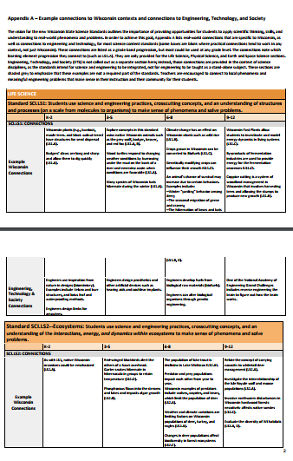
Differences in our Wisconsin Standards for Science
Helpful Appendices!
Notes:
The Next Gen has several useful appendices to support educators. We’ve also begun creating appendices for our Wisconsin Standards for Science. The first that has been released is a series of Wisconsin specific contexts connected to the content. While the ideas are connected to particular grade band standards, they can often be used at other grade levels. In addition to Wisconsin specific connections, there are also engineering project ideas linked to the science content. With engineering being a new subject for many teachers, we felt it would be helpful to have lists of engineering topics connected to the science being taught, particularly as engineering is not meant to be taught as an isolated subject, but meant to extend and deepen students’ scientific learning.

Slide 12
Final Thoughts
What would help you?
What resources have you developed that you could share?
Notes:
I hope you find the Wisconsin Standards for Science to be a useful tool to support your instruction.
Looking at these standards documents, what other resources might be helpful?
And, what other resources have you developed in relation to these standards that you might share?
Send me an email!

Slide 13
Reflection
Questions to consider in your K-12 science work:
How is our work with science standards going to move us close to our vision?
How will we know we’re moving students closer to this vision?
kevin.anderson@dpi.wi.gov
dpi.wi.gov/science
wisdpiscience.blogspot.com
@wisdpiscience
Notes:
As you consider science instruction in your classroom, school, district and community, there are two questions I encourage you to continue to reflect on.
How is our work with science standards going to move us close to our vision?
How will we know we’re moving students closer to this vision?
Let me know how I can help in this process - Cheers!

