Slide 1
An Introduction to the Wisconsin Standards for Science
Kevin Anderson
WI DPI Science Consultant
kevin.anderson@dpi.wi.gov
Slides can be found here: dpi.wi.gov/science/standards
Recording will also be posted on that website
Notes:
Hello, I’m Kevin Anderson, the Wisconsin DPI science consultant. I’m happy to conduct a webinar today to introduce the Wisconsin Standards for Science. If you’ve attended one of my workshops, this will repeat work you likely engaged in there. The slides can be found at this noted website – dpi.wi.gov/science/standards. There are links to resources on the slides. I will also record this webinar and put a link to the recording at the same website.
During the webinar, we’ll start with everyone muted to avoid background noise. If you have a comment or question, please put them in the chat window I’ll also ask for questions a couple times throughout the webinar, and you can unmute yourself to ask those or just put them in the chat window.

Slide 2
Establishing a Vision for Science Education
“[By] the end of 12th grade, all students have some appreciation of the beauty and wonder of science; possess sufficient knowledge of science and engineering to engage in public discussions on related issues; are careful consumers of scientific and technological information related to their everyday lives; are able to continue to learn about science outside school; and have the skills to enter careers of their choice, including (but not limited to) careers in science, engineering, and technology.”
Notes:
What is your vision for your students’ science learning by the end of this school year? It’s essential to consider where you want to end up in order to make curricular and assessment decisions. A vision helps establish learning priorities, given limited time and resources. Take a minute to read this Wisconsin vision for science education and add any comments in the chat window.

Slide 3
Goals for this webinar
Goal:
Work through elements of a WSS/NGSS-based lesson to build an understanding of these standards.
Build on that science work to review the dimensions of the standards.
Notes:
We have two main goals for this webinar. First, we’ll work through elements of a Wisconsin Science Standards/NGSS-based lesson.
Second, we’ll use that science discussion to review become familiar with the dimensions of the standards and how they work together.

Slide 4
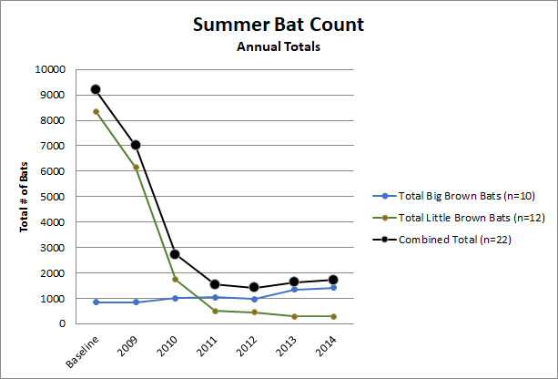
What do you notice? What do you wonder?
Make observations and ask questions. Notice? Wonder?
Notes:
So, starting with a little scientific thinking.
What do you notice from this data? What do you wonder? Take a minute or two…
The NGSS and WSS are about making sense of phenomena… that’s the starting point.

Slide 5
Scientific Thinking…
Goal: building up an explanations of this phenomenon w/ evidence.
*NOT starting with vocabulary (inertia) but layering that vocabulary onto our shared experiences to support scientific explanations.
Notes:
I intentionally started this science experience with a phenomenon, not vocabulary. New research shows vocabulary should help with building explanations of an experience, brought in when needed, not be front-loaded or memorized and used away from the doing of science.

Slide 6
Building from student questions
Driving Questions Board (DQB)
Share questions
Make initial groupings
Fit/create investigations
Revisit and add
Driving Qs
Notes:
When you have students share their noticings and wonderings, you can build from that into creating Driving Question Boards. A teacher would have student write their questions on sticky notes, have small groups categorize their questions, and then put those categories onto a board or piece of chart paper. The teacher and students would refer back to those questions throughout the unit as they are answered or explored.

Slide 7
Eliciting understanding - modeling
Create a scientific model of this phenomenon:
Explain this phenomenon (changing bat populations) through the lens of systems.
Notes:
Modeling is a key practice of science that is highlighted within the new standards.
Think for a minute about our bats and bat data, how could you represent what’s happening to these bats’ ecosystem? How would you create a model that explains changes in bats’ ecosystem over time? Take a minute and jot down a couple ideas.

Slide 8
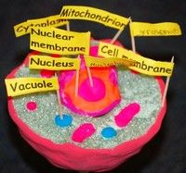
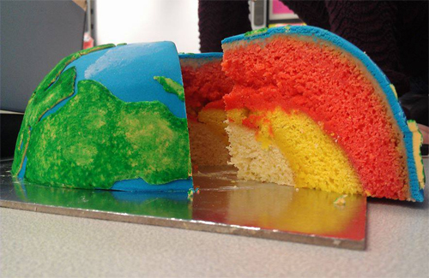
How is scientific modeling done?
This is not modeling…
Notes:
Importantly, if students are really just replicating ideas from somewhere else, they’re not modeling. They’re copying. They might be doing an art project. But, it’s not a scientific practice.

Slide 9
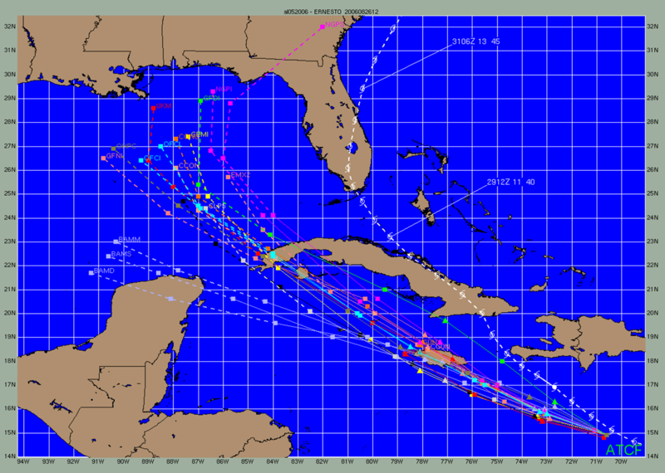
Is there one right answer to modeling?
actual
predictions
Natl Hurricane Center
Notes:
It’s important to note that in modeling there isn’t one “right” answer. The predictions for where Hurricane Ernesto would travel are all to the left. The actual path went up along the Atlantic seaboard.
What do scientists do when their models are not accurate? [They revise them with new data! That’s the core of science!]

Slide 10
Building toward explaining interesting phenomena
Key idea - Is it a “model of” or a “model for”? What is the phenomenon?
Examples - Create a model of the rock cycle, of the phases of the moon, of an animal cell, of mitosis, of a water molecule...
vs. Create a model to explain how organic matter changes into coal, to predict what will happen with a different surface, to compare life cycles of single-cellular and multicellular organisms...
Cynthia Passmore and Jennifer Horton webinar:
bit.ly/2pDVH2e
Notes:
Another way to think about scientific modeling is that we want to move away from “models of” and move toward “models for”. It might be useful to learn a concept to explore a model of the rock cycle. But, that’s learning an idea, not DOING science. If students look at evidence, perhaps different types of rocks at a microscopic level, and then have to develop ideas for how they could have been formed – then we’re getting into scientific modeling.
There is a link to a great webinar on this topic of modeling at the bottom.

Slide 11
Scientists develop models to explain phenomena.
Models – a way to tell a story. In science, you work toward a more an more accurate story.
Pictures, props can help a story.
We often get hints of what can’t be seen.
A story shows relationships, connections. In this case, it also evolves over time.
The story might be words, thoughts – mental, or it might be extremely technical with data and equations (e.g. a child’s conception of where the sun goes or a meteorologist’s prediction tools).
With a detailed story, you can use it to make predictions as to what would happen next.
Notes:
Modeling is, in another sense, telling a scientific story. It has a strong literacy link.
Pictures and props can help tell a story, and help in science models.
A story might have a character’s thoughts, something we can’t see, and a model might have a zoom in portion to note what’s happening at a level we can’t see.
A story shows relationships, so with strong details you can use it to predict what will happen over time.
Like a story, a scientific model doesn’t have to be a drawn picture – it can be verbally sharing thinking, written ideas, built, a mathematical formula, etc.

Slide 12
Further Exploring and Notebooking
Students have opportunities to further explore ecosystems, animal interactions, habitat, survival, change over different scales of time, biodiversity, chemicals in the environment, disease/fungus, and human impacts.
They’re notebooking the whole time (scaffolded).
They work through the lens of their questions!
Notes:
As students go through a series of investigations to build up an understanding of phenomena, they are notebooking the whole time. The teacher might support that notebook w/ scaffolds, or it might be more open.

Slide 13
Effective Explanations: Claims, Evidence, and Reasoning
Example:
https://www.youtube.com/watch?v=REejry8w8yI
Notes:
With a goal of building toward good scientific explanations, the claim, evidence, reasoning framework is helpful. I’d like you to open up a youtube tab and watch a video clip – just type in “Audi alien commercial” and it will be the first hit. [wait] What is the claim, the evidence, the reasoning? If student get stuck on reasoning,
you could ask – “Why does she think this about her dad? What background knowledge does she have? How is she using that to craft her reasoning?”

Slide 14
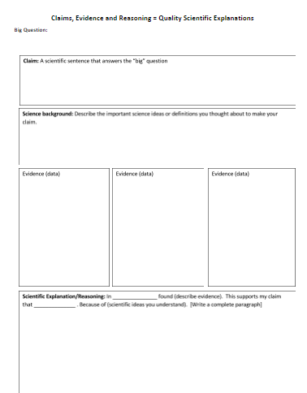
CER Templates/Scaffolds
docs.google.com/document/d/18ekRE2GvuqR5vwisHllRSnqH61UK1VzX-hjZySK-mvg/edit?usp=sharing
Notes:
This is an example of some scaffolding for the claim, evidence and reasoning work. You can open up this template at the link on this page if you’d like.
Going through the template – we start with the big question being investigated.
Students make a claim, which is an answer to that question. Importantly, a claim is not a hypothesis. A claim is made after the investigation is done and there is evidence that has been gathered to support it.
Students then write a few sentences on their background knowledge related to this claim. This reflection helps in formulating their reasoning.
Evidence is placed in the boxes. Younger students might have a template that stops at this evidence piece. The evidence might even be images. It might also be done by the class as a whole.
The final box scaffolds their full explanation paragraph, by suggesting these fill-in-the-blanks - Scientific Explanation/Reasoning: In _____________________ (describe evidence). This supports my claim that ______________ . Because of (scientific ideas you understand). [Write a complete paragraph].

Slide 15
PQM -> conceptual understanding
Notes:
Phenomenon, Questioning, Modeling (PQM) is the framework we’ve used for this science work so far. We start with a phenomenon, have students ask questions and discuss those questions, they develop (or make clear) their initial models in relation to these questions (kind of a pre-assessment), and then they go through various investigations and work to revise their models, and finally they develop a final explanation for the phenomenon.
Reference Cindy Passmore (UW-Madison grad, UC-Davis professor) and Jennifer Horton (teacher, pictured) shared this framework in the webinar noted on the previous slide.
Ask: What are your thoughts and reactions to this “PQM” approach? Feel free to unmute to ask a question or share a comment – or put those in the chat.

Slide 16
Lessons: Use practices, not the “Scientific Method”
Clarification of the practices
Discuss - what’s wrong with the “scientific method”?
Practices do clarify what scientific inquiry means
They’re not meant to represent a sequence
They aren’t the “scientific method”
Students should be using them throughout a school year, not all at once
Recent reports/resources: goo.gl/nz3fw0 (a zero)
a. goo.gl/Ea9tlg (a lower case L)
b. undsci.berkeley.edu/article/scienceflowchart
Notes:
Briefly, I want to take a step back here. In our work, there was no set sequence of science practices, though pieces of many were involved. The scientific method often is viewed and taught as a linear process that doesn’t accurately reflect how science is done. The practices clarify what inquiry means and students should be using them through the year in various ways, without an attempt to cram them all into every investigation. Here are links to a couple articles or reports that talk more about this idea.

Slide 17
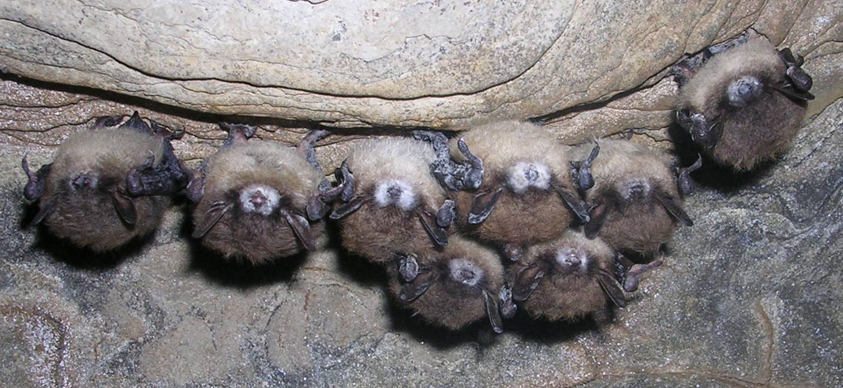
Engineering and WSS
Problem: bats are dying at record numbers, often due to White Nose Syndrome (WNS). WNS spreads among bats while they’re hibernating in their caves, and people spread this fungus from cave to cave. What is a realistic solution to stop the spread of the fungus?
Draw (model) your design.
What materials would you use?
What criteria and constraints should you consider?
How would you test and optimize your design?
Notes:
Lessons can also be done from an engineering perspective, and that’s an important part of our new standards. If at the beginning of a unit, an engineering lesson starts with students defining and working to solve a problem rather than purely making sense of a phenomenon. Engineering could also be done within or at the end of a unit, or even as a means to assess the learning.
In the case of bats, we might ask students to determine how to keep people from spreading the White Nose Syndrome fungus, which has led to the deaths of millions of bats. It’s critical to consider the criteria (what defines success) and the constraints (like money) in the design process.

Slide 18
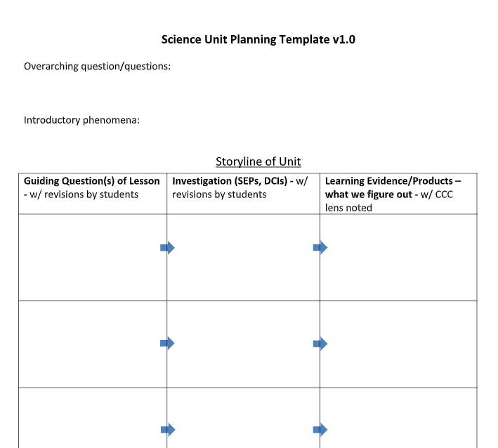
How would we extend learning to create a storyline?
Unit mapping template
Notes:
We have gone through the first piece of a storyline – having students explore some introductory phenomena, creating models and initial explanations based on that evidence. Student questions from earlier could (and should) help in revising this planning document. Our overarching question may have been, “What’s happening to bat populations?” This template can help to see the cycles of questions, investigations, and explanations that students go through.

Slide 19
Goal: Explore and Explain Cycles
Building on their questions – further phenomena are explored and explanations are built.
nextgenstorylines.org
Notes:
The Next Gen Storylines group has several examples of storylines, where students have a driving question and then go through a series of other questions, investigations, and explanation creating to build up explanations in relation to their initial question and phenomenon. Their more current work emphasizes having students’ questions help in determining the next investigation (next row) in the storyline. BUT, their work is not at an introductory level by any means…

Slide 20
Phenomenon, Question, Modeling
Share with a neighbor –
What makes a good phenomenon?
What is a phenomenon related to your current science unit?
www.ngssphenomena.com/ and related article
www.nextgenscience.org/resources/phenomena
www.georgiascienceteacher.org/phenomena
sites.google.com/site/sciencephenomena/
Appendix A of WSS
Best source? Your local community!
Notes:
What makes a good phenomenon? Share an idea in the chat window.
Here is a list of several websites with phenomena ideas, including appendix A of our standards, which lists Wisconsin-based ideas. One of the best sources will be what you find in your community.

Slide 21
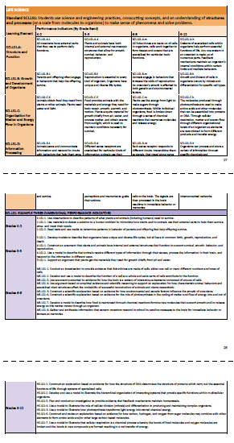
An overview of parts of the Wisconsin Standards for Science
dpi.wi.gov/science/standards
Notes:
I’m going to take us to the science standards website and pull up the science standards.
The introduction to the standards shares our vision and outlines the parts of the standards. There are then three main sections – the crosscutting concepts in green. These spell out how scientists think and reason about the world – for example, using the lens (or crosscutting concept) of cause and effect, energy, systems, or scale.
The blue section is the science and engineering practices – what scientists do. In our work we asked questions, did some scientific modeling, and started thinking about explanations.
The orange section is disciplinary core ideas, or the content – what scientists know. In our work we considered ecosystems and how humans affect the world around us.

Slide 22
An overview of parts of the Wisconsin Standards for Science
dpi.wi.gov/science/standards
Notes:
These three dimensions – crosscutting concepts, science and engineering practices, and disciplinary core ideas – should work together in lessons. We call this being three dimensional or 3D. At the top of every standards page is the foundational phrase for performance indicators for these standards: “Students use disciplinary core ideas, science and engineering practices, and crosscutting concepts to make sense of phenomena and solve problems.” The specific practice or content you put into that phrase will vary depending on your lesson or unit, but it is the main focus of what students do.

Slide 23
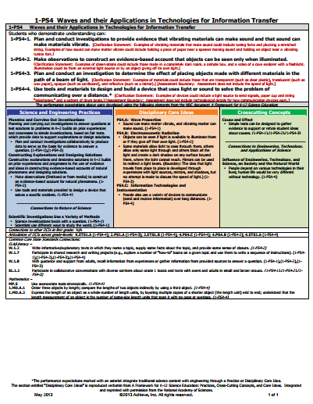
Quick comparison to NGSS
Notes:
If you’ve used or learned about the Next Generation Science Standards (NGSS), you’ll quickly realize that our standards our very similar. A big difference is structure. The NGSS puts all three dimensions on one page, where we put them in separate sections in K-12 grade band progressions. The NGSS also has set ways to put together the three dimensions into performance expectations, which are the bold statement on the top of their pages. While we felt there are lots of ways to combine these dimensions into learning targets, and just listed the NGSS ideas as examples.

Slide 24
Creating Learning Targets
3D – Explain with evidence how changing environmental factors can affect some species of bats more than others.
2D – Draw a model showing all of the relevant elements of the bat ecosystem for your study.
1D – Define an ecosystem.
Notes:
Thinking about learning targets, we are moving away from one dimensional targets like “define an ecosystem” or “analyze this data.” The intent of our standards is to integrate these dimensions to support quality student learning. In the 2D example we have drawing a model (a practice) and understanding what the relevant part of an ecosystem is (a disciplinary core idea). In the 3D example we have explaining with evidence (a practice), cause and affect (a crosscutting concept), and an understanding of varying impacts on different organisms (content).

Slide 25
A Few Lesson and Assessment Resources
ngss.nsta.org – annotated OER lessons
nextgenstorylines.org – detailed NGSS units guided by NGSS writers
California Academy of Science – lesson examples
stemteachingtools.org – research-based implementation, instruction, and assessment ideas
nextgenscienceassessment.org – MS NGSS tasks
snapgse.stanford.edu - set of assessment resources from Stanford group
dpi.wi.gov/science – work in Wisconsin
datanuggets.org – authentic CER builders
BSCS Middle school materials - free
Notes:
I’m not going to describe each of these links, but I wanted to end with a few places you can go for further learning on the standards. These focus on the NGSS, but are just as relevant for our Wisconsin standards.

Slide 26
Reflect on Goal for this Module
Goal:
Work through elements of a WSS/NGSS-based lesson to build an understanding of these standards.
Become familiar with the dimensions of the standards.
Reflect
What is a key takeaway from this webinar?
What do you plan to do in the next few weeks to implement this learning? Plans for the next 1-2 years?
Notes:
Our goals were to work through a WSS lesson components and become familiar with the dimensions of the standards. I’d like you to take a minute to reflect. What are your key takeaways? What might you do in the next few weeks or next year to implement these ideas? Share thoughts in the chat window, or ask final questions.
Thanks for joining me!

