Slide 1
Effective Vocabulary Instruction in Science
by Thersea Burzynski, CESA 10
Notes:
Script of comments introducing these slides:
Hello, I’m Kevin Anderson, the Science Education Consultant at the Wisconsin Department of Public Instruction. As my students sometimes told me, science can be like learning a new language. In order for students to be able to effectively share their ideas and investigate interesting phenomena, they need the language to describe their growing understanding of the world around them. Thersea Burzynski, now at CESA 10, but also a former science teacher and reading specialist, prepared these slides to support teacher professional development in effective vocabulary instruction in science. I’ll be the narrator, but this is her great work. Throughout the presentation I’ll ask questions that could be used for discussion starters if you’re using this resource with a professional learning community, or as guides for reflection if you’re going through it on your own. On this website the transcript of this presentation is provided, as are these discussion questions, along with other links to resources to support your work.
First slide:
Effective Vocabulary Instruction in Science, by Thersea Burzynski, Title I and Science Consultant at CESA 10

Slide 2
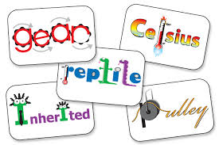
Contents
Overview of research related to vocabulary instruction/learning
Strategies matched to research
Marzano’s Six Step process for Vocabulary Instruction
Activities for staff
Notes:
Briefly, here is an outline of this presentation.
First, I’ll briefly share an Overview of research related to vocabulary instruction and learning.
Second, I’ll discuss some strategies matched to that research
Then, I’ll spend a significant amount of time sharing Marzano’s Six Step process for Vocabulary Instruction. Some of these ideas come from a new book he released on connecting vocabulary instruction to the Next Generation Science Standards.
Finally, I’ll share some an activity for staff on vocabulary instruction and some concluding comments.

Slide 3
The Role of Science Vocabulary
“Scientific investigations,” Neils Bohr pointed out, “are not exclusively formal, mathematical affairs for they also involve informal discussions in which key concepts are explored and understood.”
Foundations of Physics Vol 18, p. 1233
Notes:
In essays and lectures Neils Bohr continually emphasized the role played by language in the field of science and in our basic understanding of nature.
He said, “Scientific investigations are not exclusively formal, mathematical affairs for they also involve informal discussions in which key concepts are explored and understood.”

Slide 4
TIERS of Vocabulary
Tier III -Domain Specific
Discipline Specific Vocabulary (chlorophyll, isotope, magma)
Tier II -High Frequency
Multiple Meaning Words
(analyze, calculate)
Tier I - Basic
General Words (has, take, boat)
3
Science Vocabulary
2
1
Beck, McKeown, and Kucan
Notes:
In a framework by Deck, McKeown, and Kucan, there are three tiers of vocabulary.
Tier I is basic, general words, such as take, eat, basketball
Tier II is high frequency words with multiple meanings, words such as analyze or construction.
Tier III is domain specific, where technical science vocabulary largely resides (though tier II also includes important language for framing student work).

Slide 5
Explicit Vocabulary Instruction
Research indicates that direct instruction in vocabulary can increase vocabulary learning and comprehension.
Effect Size =.97 SD
(John Hattie, 2009)
Notes:
Importantly, research indicates that direct or explicit instruction in vocabulary can increase vocabulary learning and comprehension. John Hattie’s meta-analysis of education studies, Visible Learning, showed this instruction has a significant effect size on assessment outcomes.

Slide 6
Elements of Effective Vocabulary Direct Instruction
• Presenting individual terms and their descriptions in rich contexts (Graves, 2000; National Reading Panel, 2000; Stahl & Fairbanks, 1986) • Asking students to generate information about terms (Anderson & Reder, 1979; Graves, 2000; Nagy, 2005; National Reading Panel, 2000; Scott et al., 2003; Stahl & Clark, 1987; Stahl & Fairbanks, 1986; Vogel, 2003)
• Using multimedia methods (words, pictures, animations, etc.) to introduce and practice terms (Mayer, 2001; Mayer & Moreno, 2002; National Reading Panel, 2000; Neuman et al., 2011; Sadoski & Paivio, 2001)
• Asking students to relate new terms to words they already know (Anderson & Reder, 1979; Booth, 2009; Chi & Koeske, 1983; Entwisle, 1966; Glaser, 1984; Levelt, Marzano, Robert J.; Rogers, Katie (2014-12-10).
Roelofs, & Meyer, 1999; Scott et al., 2003; Stahl & Murray, 1994; Stahl & Nagy, 2006; Tinkham, 1997)
• Providing multiple exposures to new terms and opportunities to use those terms in the classroom (Beck, McKeown, & Kucan, 2002; Beck et al. 1982; Bowman, Donovan, & Burns, 2000; Brophy & Good, 1986; Daniels, 1994, 1996; Dole, Sloan, & Trathen, 1995; Hoffman, 1991; Leung, 1992; McKeown et al., 1985; McKeown, Beck, & Sandora, 2012; National Reading Panel, 2000; Pressley, Allington, Wharton-McDonald, Block, & Morrow, 2001; Rosenshine, 1986; Scott et al., 2003; Sénéchal, 1997; Snow, Burns, & Griffin, 1998; Stahl & Fairbanks, 1986; Wharton-McDonald, Pressley, & Hampston, 1998)Marzano, Robert J.; Rogers, Katie (2014-12-10).
Vocabulary for the New Science Standards. Marzano Research. Kindle Edition.
Notes:
Research reviewed in Marzanos new book on vocabulary in science instruction indicates that direct vocabulary instruction should include these elements:
First – present individual terms and their descriptions in rich contexts.
Second – use multiple media methods to introduce and practice terms
Third – Ask students to relate new terms to words they already know
Fourth – provide multiple exposures to new terms and opportunities to use them
*Take a minute and discuss or reflect on how you use these strategies in your classroom.

Slide 7
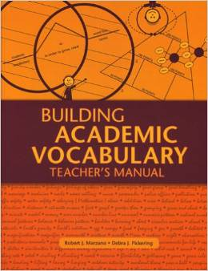
Marzano’s Six Step Process
Based on the research, Marzano developed a process for building academic vocabulary.
Notes:
Marzano used the research on vocabulary instruction to develop a process for building academic vocabulary. It’s a six step process.

Slide 8
Marzano’s 6-Step Process
Provide a description, explanation, or example. Include a visual representation.
(Flaw with relying on dictionary definitions)
Notes:
First, the teacher provides a description, explanation, or example, w/ a visual representation (not a dictionary definition). Note, students can’t just copy a definition out the glossary or dictionary, it must be rooted in visuals and accessible descriptions. That could often include something tangible in science.

Slide 9
Marzano’s 6 Steps Cont’d
2) Ask students to put the term into their own words.
3) Ask students to construct visual.
Notes:
Second, you have students put the term into their own words and construct their own visual.

Slide 10
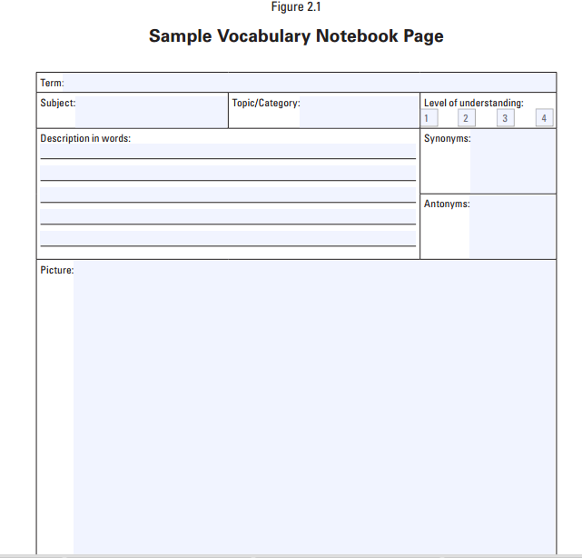
Marzanoresearch.com
Notes:
This is a sample of a page that can guide steps 1-3 using student notebooks or as a stand alone vocabulary glossary which is student developed. Note, access to the reproducible page can be found on the Marzano research link in the resources section of this science vocabulary website.
As I’ll mention again, I think connecting the vocabulary to scientific modeling is even better than just a picture, particularly one just copied from a book. Notably, in scientific modeling, students are not copying a diagram out of a book. They’re making sense of a phenomenon. They’re predicting what will happen. They’re actively building a conceptual understanding. So, diagraming how they think something works and rediagramming their ideas as they learn more would be modeling. Using correct vocabulary to annotate those models is a great strategy.
*Take a minute and share or reflect on strategies you’ve found useful for having students notebook vocabulary. Or, what notebooking strategies might you use in the future?

Slide 11
Marzano’s 6 Step Process
4) Engage students periodically in adding experience with the words.
Examples include:
-Phenomenon Exploration/Explanation
-Modeling
-Inquiry -Videos
-Labs -Field Trips
-Demonstrations -Reading/Research
Vocabulary for the New Science Standards: Marzano’s Resource Site:
Notes:
Fourth, students in science should authentically experience scientific language. Engaging students in science and engineering practices allows for engagement and experiencing the words. It is important to maintain the expectation of understanding and using science terminology once it’s introduced. At times front loading vocabulary prior to the experience may be determined as the most appropriate learning sequence. Or, an introductory experience might provide a scaffold on which to build the language. Students should be using scientific vocabulary as the explain phenomena, though initial explanations as they explore might start with less formal language. Students should be using proper vocabulary as they’re modeling, conducting inquiry-based investigations, discussing videos or demonstrations, conducting research, and reflecting on their learning.

Slide 12
Marzano’s 6 Steps Cont’d
5) Students should USE/SPEAK the words often.
Examples Include:
- Argument/Debate
- Summarizing
- Discourse Structures
- Word Walls, modeling, notebooking
- Writing
Notes:
Fifth, students should use and speak the words often.
It is important to match authentic contexts, i.e. purpose and audience, to the classroom practice.
For students learning English consider the language goals as well as allowing for Total Physical Response (TPR) or scaffolded choral practice. Another option is to consider dialogues such as those created by Bisbee, Westrich, and Berg, which is linked in the reference section of this website.
[http://www.researchgate.net/publication/270274814_Dialogues_for_the_Biology_Classroom_-_Volume_1]

Slide 13
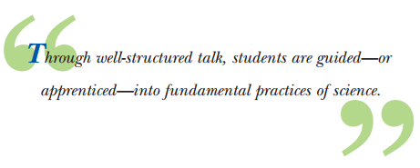
Productive Talk
Terc - Inquiry Project in Science Talk
Notes:
If you haven’t reviewed materials from the TERC Inquiry Project on Science Talk, they’re definitely worth checking out. They’re designed for upper elementary, but they can be adapted below and above that level.
*Take a minute to discuss or reflect on how you structure student talk in your classroom. How do you ensure they’re using science language in those conversations?

Slide 14
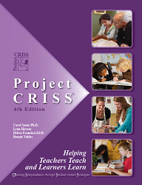
Pause and Chunk
Pause and Chunk Information Regularly:
Keep your ‘lectures’ short
Pause every 5 to 8 min. in ES
& 8 to 12 min. in MS/HS
Have students ‘chunk’ or process the information through strategies such as summarization, think-pair-share, or compare and contrast.
Eric Jensen: Engaging Students with Poverty in Mind
Notes:
Based on observations of many classrooms, teachers talk too much. I’m sure I did too. I encourage you to video your teaching and observe how much you’re talking. If it’s over 30% of classtime, start thinking about ways to stop.
One strategy is to pause and chunk, also referred to as Chunk and Chew…
Pause every 5 minutes in elementary or every 8 minutes in middle school or high school. When you pause have students ‘chunk’ or process the information through strategies such as summarization, think-pair-share, or compare and contrast.
CRISS is a framework that allows for the practices of Pause and Chunk within content literacy. CRISS stands for CReating Independence through Student owned Strategies. There will be a link in the references to this CRISS framework and the work of Eric Jensen.
The benefits of this chunking approach are:
1) increased processing time and retention
2) Vocabulary practice
3) And student engagement (which follows a socio-cognitive theory of learning)
[*http://www.projectcriss.com/ ]

Slide 15
Scientific Writing
Informational Writing & Persuasive Writing Examples:
Research Proposals
Editorials
Article Reviews
Letters to the Editor
Commentary Forums
Research Articles
Letters to community members or govt
Blogs
Lab Reports
Notes:
Students should be communicating often through multiple formats. Some examples of authentic informational and persuasive writing in science could include: research proposals, Editorials, Article reviews, Letters to the Editor, Commentary Forums, Research Articles, Letters to government or community members, lab resports, and blogs.
*Pause and discuss or reflect on what types of authentic writing your students do, and what other projects you might consider.

Slide 16
Marzano’s 6-Steps Cont’d
6) Involve students periodically in games that allow them to play with terms.
Games for the Science Curriculum by Norman Herr PH.D.
Metaphors and Analogies Power Tools for Teaching Any Subject by Rick Wormeli
Vocabulary Games for the Classroom Lindsay Carleton and Robert Marzano
Notes:
Sixth in Marzano’s steps, involve students occasionally in games that allow them to play with vocabulary. Some examples are provided within this list of websites, also listed in the references section.

Slide 17
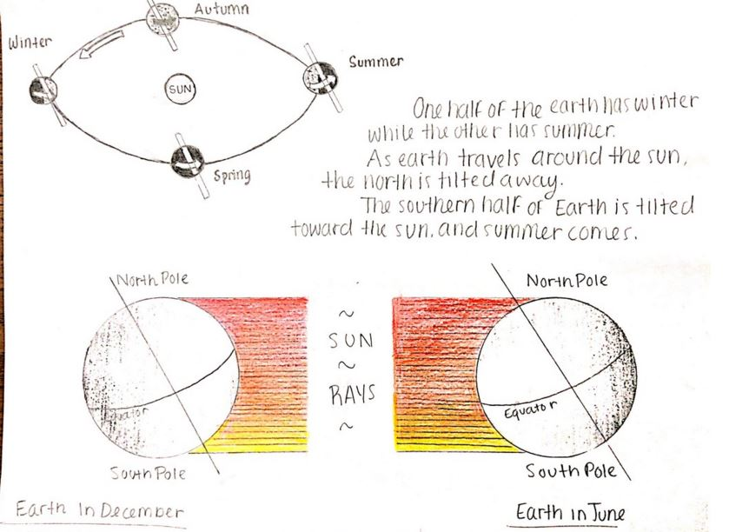
George A. Miller: Psychology Research
When we process information, we do so spatially. The brain likes to put things into categories.
Implications for Student Learning:
- Allow for the categorizing of terms
- Label authentic objects, specimens, or visuals
- Use graphic organizers and concept maps
- Identify missing pieces to a ‘grouping’
- Lists: beneficial primarily for short term memory
Image from: http://hudecscience.weebly.com/
Notes:
Looking at further research into learning, George Miller found that when we process information, we do so spatially. The brain puts things into categories.
So, students learning should include opportunities to:
Categorize terms
Label authentic objects or visuals
Use and develop graphic organizers and concept maps
Classify missing pieces to a group
Create lists
Again, scientific modeling can provide these types of structures.

Slide 18
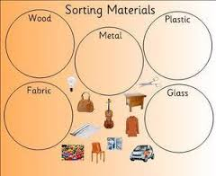
Primary Grades
Place pictures or actual objects into categories based on some identified characteristic or quality while verbally using the words represented.
topicresources.com - Google images
Notes:
Building on this research, in primary grades, students could place pictures or actual objects into categories based on some identified characteristic or quality while verbally using the words represented.

Slide 19
Concept Circles, Janet Allen
Speed Time
Velocity Position
Template for Concept Circles
Notes:
Concept circles are another tool for spatially mapping ideas.
Here we’re moving towards students seeing that
Average Speed = Distance Traveled/time of Travel, and Average Velocity= Change in position/time or displacement/time
This builds on work by Janet Allen.
[https://docs.google.com/a/cesa10.org/file/d/0B3KLg7jZDkhxVnZ1RDBzOVoxWVk/edit]

Slide 20
CLOZE - Activity
System | Key Words | System Features
atmosphere |  | 1) dust storms 2) 3)
 | land | 1) mountains 2) volcanoes 3)
hydrosphere |  | 1) lakes 2) 3)
 | life | 1) plankton 2) coral reefs 3)
NASA Education
Notes:
In CLOZE activities, certain words are removed. This table and CLOZE activity from a NASA (linked on the site). Students would complete the table with the word bank provided – categorizing ideas and terms. It would also make sense to have a class or group discussion afterward where students explain why they put words where they did.
*Considering these past few examples of research-based strategies, discuss or reflect on how you have students organize their learning of concepts. What structures do you provide?
[http://ares.jsc.nasa.gov/education/eeab/guides/SOE/SpheresOfEarth_StudentGuidev3.pdf]

Slide 21
Activity - Connections Across Disciplines
This activity promotes connections across disciplines relating to word parts.
iso-
__________________________
Physical Ed.
Geography
Meteorology
Physics
Mathematics
Visual Arts
Biology
isometric exercise
isoline
isobar
isotope
isosceles triangle
isochromatic
isopod
peri -
iso-
bio-
-cise
-graph-
-pend-
-pod
-path
-ize
-chrome
-port
-meter
Notes:
Here is a secondary staff vocabulary activity that shows connections across disciplines. The references section will describe this middle or high school whole staff activity in more depth. Basically, staff sit together by discipline and brainstorm words related to their disciplines with a chosen stem or affix. They then share the words and consider how well they’re able to understand unfamiliar words because of the common word parts. Finally, they discuss implications for classroom practice.
[resources section includes more details, also noted below but not shared in video]
Facilitator preperation:
Place large T-Charts on poster paper around the meeting room. Put a single word part from the list on top of each T-chart.
Gather markers of a variety of colors. One color should be assigned to each content area. Have enough markers for each individual to have their own marker representing their department’s color.
Activity:
Teachers sit with departments during instruction and initial brainstorming.
Facilitator explain the directions:
Around the room we have t-charts with various word parts on the top of the t-chart.
Your department will be given approx. 12-20 minutes to brainstorm words from your discipline that are built around these words. The words you brainstorm may or may not be ‘typical’ vocabulary you introduce each year as targeted objectives, but they should be from or related to your discipline.
After the brainstorm you will send members of your team out to add to each t-chart using your colored marker to record your content area on the left side of the chart and your term on the right side of the t-chart.
Your group should be ready to define/defend your word when the t-chart is shared to the whole group. Facilitators may use a whole group reading of each chart or send teams of ‘mixed contents’ around on the room on a gallery walk to read and discuss the charts for themselves.
Discuss the following questions as a group:
Did you learn any new words today?
If so, where the words quickly understood by you because you could connect them to your own understanding theword part in your context?
c. Think of the students travels between all of your contents throughout their k-12 years, througout a single year, and even a single day across contents.
d. Now consider the power in connecting the lexicon of our discipline to the broader context of language. (Lexicon: vocabulary of a branch of knowledge or in an individual’s repertoire) How useful is it to teach in a connected way to the lexicon of language across other disciplines? It easier if we focus on word parts vs terminology and it allows students to see the connection.
e. What is the value in developing an awareness or action steps for this instruction in our academic setting?

Slide 22
Greek and Latin Foundations
Science Root & Affix List
Etymology Dictionary
Biology and Medical - Root and Affix Dictionary
Root Words Frequently used in Chemistry
Notes:
These links provide references and resources related to root words and word origins. They relate to the previous activity. The full links are in the resources.
http://www.jdenuno.com/PDFfiles/RootWords.pdf
http://www.etymonline.com/index.php?allowed_in_frame=0&search=mod&searchmode=none
http://www.macroevolution.net/biology-prefixes-a.html
http://www.csun.edu/science/books/sourcebook/chapters/1-vocabulary/resources/chemistry_roots.pdf

Slide 23
Activity for A Science Dept.
Discuss:
How do we have students learn science vocabulary (tier III words)?
How important is it to explicitly teach tier II or process words?
Do we have specific discourse structures or protocols in place?
Notes:
Here are a few further reflections questions for a science department.
How do you have students learn science vocabulary (tier III words)?
How important is it to explicitly teach tier II or process words?
Do you have specific discourse structures or protocols in place?
[pause]

Slide 24
Word Knowledge in Stages…
Edgar Dale’s Degrees of Knowing Word Meanings (1965)
Stage1: I never saw or heard the word before.
Stage 2: I know there is such a word but I don’t know what it means.
Stage 3: I’ve heard it and seen it. I know what it has to do with but I can’t tell you what it means specifically.
Stage 4: I know what it means, I’ll recognize it whenever I see it or hear it, I can use it.
Sample Rating Scales to Use w/Students
Notes:
Edgar Dale was one of the first to look at degrees of knowing word meanings. We have multiple researchers who are using these foundations in their strategies of helping students be aware of their own word knowledge. Too often students feel they KNOW a word if they can quickly access it’s meaning, but in reality they only know it receptively when it can be understood when others use the word in context; it is understood productively when the individual can use it accurately and in the correct context. All english learners understand words receptively before productively, occuring between stages 3&4. That includes native and non-native speakers.
The samples of rating scales linked here can serve as tools for students of many ages to be aware of their stage of word knowledge with the important vocabulary to your content. There are samples to be used a varying grade-levels.
http://education.ky.gov/curriculum/lit/Documents/kclm/vocabulary_rating_comprehension_strategy_teaching%20tools.pdf
Reference, overall idea from:
http://www.iceary.org/Conference/Differentiation.Conrad-Curry.pdf

Slide 25
Engagement in Scientific Practices Provides the Context for Vocabulary Development
Engaging Tasks allow for a deep building of concept development and vocabulary use
-investigation -discourse -modeling & representations -analysis -explanations -argument -application -extended research
Multiple encounters with vocabulary in a variety of contexts allow words to go from the receptive level of understanding to the productive level -categorize -compare/contrast -identify similarities and differences -deconstruct -analogies and metaphors
Notes:
Students should be engaged in science practice in order to effectively develop vocabulary.
Engaging Tasks allow for a deep building of concept development and vocabulary use. Multiple encounters with vocabulary in a variety of contexts – such as investigations, reading, class discussions, small group discussions, individual tasks, etc. - allow words to go from the receptive level of understanding to the productive level.

Slide 26
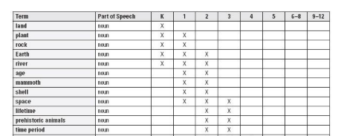
Maps of Next Generation Science Standards Vocabulary by Grade
Notes:
If it’s relevant for your work, Marzano’s book has a listing of vocabulary by grade in the Next Generation Science Standards.

Slide 27
ACT Science Vocabulary List
ACT Science Vocabulary list
Test Prep Coach - ACT Vocabulary
The ACT does not expect you to know the exact definition as much as the general concept and the context of the terms used in the passages.
Notes:
The pressure of word knowledge for success on the ACT and SAT use to place outside pressure on teachers more towards ambiguous terms and the mastery of isolated terms. Please note the emphasis shifts within these assessments to reflect a more moderate approach to vocabulary and the assessment of science knowledge.

Slide 28
SAT Vocabulary Change 2016
As part of the SAT redesign there will be less of an emphasis on vocabulary terms with little context such as the sentence completion questions and there will be a greater emphasis on the meaning of words in extended contexts and on how word choice shapes meaning, tone, and impact. Specifications for the New SAT ( pg. 10)
Notes:
Also, as part of the SAT redesign there will be less of an emphasis on vocabulary terms with little context such as the sentence completion questions and there will be a greater emphasis on the meaning of words in extended contexts and on how word choice shapes meaning, tone, and impact.
[https://www.collegeboard.org/sites/default/files/test_specifications_for_the_redesigned_sat_na3.pdf]

Slide 29
Language of Science
Although some might question whether the time spent on vocabulary instruction is worthwhile, Judith Scott, Dianne Jamieson-Noel, and Marlene Asselin (2003) explained that “when conceptual understanding is central, the time devoted to understanding the vocabulary is well worth the effort….”
Marzano, Robert J.; Rogers, Katie (2014-12-10). Vocabulary for the New Science Standards
Notes:
Finally, although some might question whether the time spent on vocabulary instruction is worthwhile, Judith Scott, Dianne Jamieson-Noel, and Marlene Asselin (2003) explained that “when conceptual understanding is central, the time devoted to understanding the vocabulary is well worth the effort….”

Slide 30
Review and Contact Info
Overview of research related to vocabulary instruction/learning
Strategies matched to research
Marzano’s Six Step Process for Vocabulary Instruction
Activities for staff
Kevin Anderson – kevin.anderson@dpi.wi.gov
Thersea Burzynski – tburzynski@cesa10.k12.wi.us
Notes:
In this presentation, I have:
reviewed some of the research related to vocabulary learning and instruction.
Shared strategies aligned to that research
Discussed Marzano’s six step process for vocabulary instruction
And provided some activities and discussion questions for staff
Please, send an email to me or Thersea if you have any questions or comments on this work!
[end, DPI video ending clip]

