Slide 1
LAWDS
Module 1. Workforce Development Board Roles and Responsibilities
Libraries Activating Workforce Development Skills
Presented By:
Ted Anderson, DWD Job Service
Heather Nilsen, DWD Job Service
Pete Coffaro, Employ Milwaukee, Inc.
Date: February 5, 2020
The LAWDS Project is funded in part by a Laura Bush 21st Century Librarian grant from the Institute of Museum and Library Services.
Notes:
This presentation is designed to share the resources that Wisconsin’s workforce development system, operated locally by WDBs, can offer to the communities served by public libraries.

Slide 2
Purpose: The LAWDS Project brings together public library staff with the staff of local Workforce Development Boards (WDBs) and Wisconsin’s American Job Centers, to facilitate more seamless support of job-seeking patrons, business owners and entrepreneurs.
Module 1 is designed to educate librarians on the roles, responsibilities and resources available through the regional Workforce Development Boards (WDB) to ensure the formation of mentor relationships between the libraries and the WDB located in Milwaukee County.
The Wisconsin Departments of Public Instruction and Workforce Development are Equal Opportunity Employers and Service Providers.
Notes:
LAWDS was collaboratively designed by the WI Dept of Public Instruction (DPI), the WI Dept of Workforce Development (DWD), the Wisconsin Library Association, and the Wisconsin Workforce Development Association.

Slide 3
On Deck…
Training Module 2: Career Planning and Resume Development. Provided by the Department of Workforce Development (DWD) to ensure library staff understand and can navigate the “resume builder” features within the Job Center of Wisconsin web site.
Training Module 3: The Basics of Wisconsin’s Unemployment Insurance System. DWD will serve as the trainer of this curriculum for Library staff to provide more general guidance to unemployment insurance participants.
Training Module 4: Job Center of Wisconsin and Labor Market Research Tools. DWD will serve as trainer of this session, which will focus on mastering the basic features of the Job Center of Wisconsin portal, while also providing a “How-To” reference guide to assist in the locating common data sought by potential library patrons.
The Wisconsin Departments of Public Instruction and Workforce Development are Equal Opportunity Employers and Service Providers.
Notes:
LAWDS was collaboratively designed by the WI Dept of Public Instruction (DPI), the WI Dept of Workforce Development (DWD), the Wisconsin Library Association, and the Wisconsin Workforce Development Association.

Slide 4
Part 1: Employ Milwaukee, Inc. www.employmilwaukee.org 2342 North 27th Street, Milwaukee Phone: (414) 270-1700
Notes:
Last year, Employ Milwaukee served over 17,000 individuals with a range of employment and training services. Over 2,500 individuals got a job, 1,400 youth obtained work experience, and 1,300 completed skill training. On the employer side, almost 1,200 businesses in a variety of high growth, high demand industries received assistance to meet their talent needs.

Slide 5
Who Is Employ Milwaukee?
Key Roles
Authorized under WIOA to be the certified Workforce Development Board for Milwaukee County
(1 of 11 in WI)
Formula funding from the U.S. Department of Labor, passed through the Wisconsin Department of Workforce Development (DWD)
Annual allotment changes each year based on the economy and local conditions
WIOA Local Plan
Federal- and State-approved Local Plan to define strategies and initiatives
Defines governance structures and local policies
Identifies service providers and locations
Conveys the performance and accountability measures for Milwaukee County
https://www.employmilwaukee.org/Employ-Milwaukee/About/WIOA-Local-Plan.htm
Notes:
Last year, Employ Milwaukee served over 17,000 individuals with a range of employment and training services. Over 2,500 individuals got a job, 1,400 youth obtained work experience, and 1,300 completed skill training. On the employer side, almost 1,200 businesses in a variety of high growth, high demand industries received assistance to meet their talent needs.

Slide 6
How Does Employ Milwaukee Serve?
Workforce Innovation and Opportunity Act (WIOA)
-Federal performance metrics
-Individuals served
-Trained
-Credentialed
-Wages
-Placed in jobs
-Retained in jobs
-Annual monitoring by State
-Training providers are approved by the State
-Employ Milwaukee serves as the planning and coordinating entity for workforce partners in Milwaukee County
-Oversees and manages the American Job Centers within Milwaukee County
-WIOA programs provide career services and training for in school youth, opportunity youth, adults, and dislocated workers
Notes:
The Workforce Innovation and Opportunity Act, or WIOA as we know it, is the legislation requiring Employ Milwaukee and other government-funded workforce programs work together as ONE system to serve common customers.
WIOA provides base formula funding for Employ Milwaukee, which comes from the U.S. Department of Labor through the Wisconsin Department of Workforce Development.
Through WIOA, Employ Milwaukee provides employment and training services to youth, young adults, adults, and dislocated workers.
Funding allocations change each year based on economic and other conditions.
In addition to WIOA, Employ Milwaukee has a variety of programs and services funded through other sources.
These programs use sector-specific and innovative training models to prepare and place workers within high demand industries.

Slide 7
Employ Milwaukee’s Service Area
Notes:
Last year, Employ Milwaukee served over 17,000 individuals with a range of employment and training services. Over 2,500 individuals got a job, 1,400 youth obtained work experience, and 1,300 completed skill training. On the employer side, almost 1,200 businesses in a variety of high growth, high demand industries received assistance to meet their talent needs.

Slide 8
Who Does Employ Milwaukee Serve?
Job Seekers + Employers in Milwaukee County
Job Seekers
17,373 participants served in 2018
Youth, adults, dislocated workers, incumbent workers, underemployed, unemployed, returning citizens, older workers, Veterans, and individuals with disabilities
Employers
1,145 employers served in 2018
High demand industries including healthcare, IT, hospitality/retail, construction, manufacturing, transportation-distribution-logistics, and financial services
Notes:
Last year, Employ Milwaukee served over 17,000 individuals with a range of employment and training services. Over 2,500 individuals got a job, 1,400 youth obtained work experience, and 1,300 completed skill training. On the employer side, almost 1,200 businesses in a variety of high growth, high demand industries received assistance to meet their talent needs.

Slide 9
Other Programs at Employ Milwaukee
Youth and Young Adults
Mayor Barrett’s Earn and Learn Program: Paid summer youth employment combined with job readiness and leadership development
MPD Ambassadors: Short-term work experience with the police department enriched with mentorship, community engagement
Career Plus: Workforce services for students within Milwaukee County high schools
YouthBuild: Construction occupational skill training combined with HSED and community service learning

Slide 10
Skill and Credential Attainment Programs
America’s Promise: Free tuition for mid and high skill occupations in healthcare, manufacturing, and financial services
TechHire: Short-term occupational skill training, degrees and technical diplomas, and paid work experience in Information Technology
BankWork$: 8-week occupational skill training in retail banking

Slide 11
Reentry Services
Windows to Work: Employment and training services before and after release from prison
Region 3 Employment and Training: Job placement services for individuals after release from the Department of Corrections
Motivated to Apprenticeship Pathways: Training, work experience, and connection to Registered Apprenticeship for justice-involved youth and young adults
Smart Reentry: Employment and training services for incarcerated individuals and their families

Slide 12
Registered Apprenticeship
Youth Apprenticeship: Paid work experience combined with classroom skill training
American Apprenticeship Initiative: Pre-apprenticeship training and connection to Registered Apprenticeships for underrepresented populations
WAGE$: Give better access to underrepresented populations including women, people of color, people with disabilities, veterans and transitioning service members.
Expansion: Increase awareness and fill the Registered Apprenticeship talent pipeline

Slide 13
Business Solutions
Industry Advisory Boards: Employers communicate talent needs and advise on training programs
Candidate Pre-Screening: Assessment of many individuals to provide a smaller, more qualified pool to interview
Customized Hiring Events: Tailored to individual businesses, industries, and occupations
On-the-Job Training: Off sets employer’s costs during an employee’s training period
Talent Matching: Data-driven, virtual matching of skilled individuals and available job openings

Slide 14
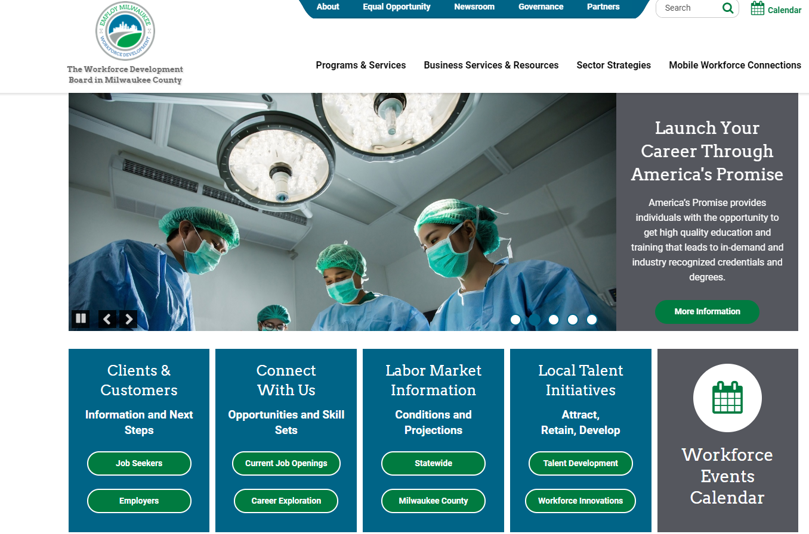
Notes:
Last year, Employ Milwaukee served over 17,000 individuals with a range of employment and training services. Over 2,500 individuals got a job, 1,400 youth obtained work experience, and 1,300 completed skill training. On the employer side, almost 1,200 businesses in a variety of high growth, high demand industries received assistance to meet their talent needs.

Slide 15
Part 2: The American Job Center System
Notes:
Last year, Employ Milwaukee served over 17,000 individuals with a range of employment and training services. Over 2,500 individuals got a job, 1,400 youth obtained work experience, and 1,300 completed skill training. On the employer side, almost 1,200 businesses in a variety of high growth, high demand industries received assistance to meet their talent needs.

Slide 16
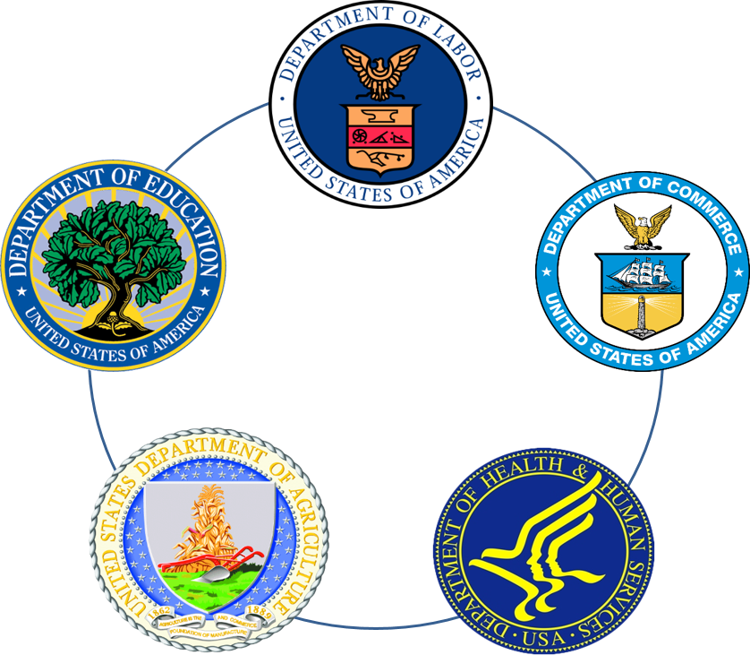
A System-Approach to Public Workforce Development
In 2014, Congress passed a federal law, the Workforce Innovation and Opportunity Act (WIOA), with broad bipartisan support.
This legislation required that all government-funded workforce programs work together as ONE system using a “No Wrong Door” approach to serve common customers.
Notes:
The Workforce Innovation and Opportunity Act – or WIOA as we call it – is the federal law authorizing government-funded workforce programming.
WIOA requires five (5) major departments to work together as one to serve “common customers”, otherwise known as individuals who may use services funded and delivered by each department. (Departments of Labor, Commerce, Health & Human Services, Agriculture, and Education)
“No Wrong Door” means that workforce services should be offered at the “door” of each major department and its local agencies.

Slide 17
WIOA and American Job Center Partners
Our “Friends”
Our “Family”
WIOA Title IB: Adult, Dislocated Worker and Youth Programs – workforce boards find and oversee providers
Career, Training, and Support Services Focused on Job Placement
Activities Supporting Youth Towards Career and Education Goal Attainment
WIOA Title II: Adult Education and Literacy Act (AEFLA) Programs -Technical Colleges and Community-Based Providers
Adult Basic Education
English Language Learning
WIOA Title III: Employment Services - DWD Job Service
JobCenterofWisconsin.com
Job Search and Placement Assistance
Employer Recruitment Services
WIOA Title IV: Vocational Rehabilitation - DWD DVR
Services to assist eligible individuals with disabilities gain, maintain, and advance in competitive integrated employment
Career and Technical Education
Title V Older Americans Act
Job Corps
Native American Programs
Migrant Seasonal Farm Workers
Youth Build
Trade Assistance Act
Community Services Block Grant
Housing and Urban Development
Unemployment Compensation
Second Chance
Notes:
The Workforce Innovation and Opportunity Act – or WIOA as we call it – is the federal law authorizing government-funded workforce programming.
WIOA requires five (5) major departments to work together as one to serve “common customers”, otherwise known as individuals who may use services funded and delivered by each department. (Departments of Labor, Commerce, Health & Human Services, Agriculture, and Education)
“No Wrong Door” means that workforce services should be offered at the “door” of each major department and its local agencies.

Slide 18
How does WIOA serve customers?
The American Job Center Network
A nationwide system of workforce partners serving customers in person and virtually at www.careeronestop.org
Install the CareerOneStop Mobile on your mobile device to have resources at your fingertips!
AJC Network in Wisconsin
The Job Center of Wisconsin serves customers 24 hours a day for free!
The website is accessible on mobile devices and offers a menu of tools for job seeking and business customers alike!
Notes:
WIOA serves individuals through physical, “brick and mortar” American Job Centers, as well as through the Job Center of Wisconsin website.

Slide 19
American Job Center Locations – Milwaukee County
American Job Centers
Job Center Central (MAXIMUS) - Comprehensive 4201 N. 27th Street, Suite 400, Milwaukee, WI 53216; Telephone: (414) 874-0318; TDD/TTY:711 (Wisconsin Relay)
Southeast Wisconsin Job Center (YWCA) 1915 N. Doctor Martin Luther King Drive, Milwaukee, WI 53212; Telephone:414-374-1800; TDD/TTY:711 (Wisconsin Relay)
Milwaukee Walker's Square Job Center (America Works) 816 W. National Ave., Suite 400, Milwaukee, WI 53204; Telephone:414-302-2668; TDD/TTY:711 (Wisconsin Relay)
Milwaukee Southeast Job Center (UMOS) 2701 S. Chase Ave., Milwaukee, WI 53207; Telephone:414-389-6607; TDD/TTY:414-389-6697
Notes:
Every WDA has at least one Comprehensive American Job Center through which Required Partners Provide Access to Programs.
In Milwaukee County, this is Job Center Central (MAXIMUS) at 4201 N. 27th Street.
There are also three Affiliate Job Centers in Milwaukee County.

Slide 22
Resource Room Equipment & Services
Workspace
Telephones
Laser Printers
Copy Machines
FAX
Computers
Internet Access
Resource Room Staff*

Slide 23
Priority of Service
Veterans and Eligible Spouses
Veterans and eligible spouses receive Priority of Service at Wisconsin’s American Job Centers.
They also receive priority for programs and services operated through the American Job Centers, such as early entry to Career Fairs and exclusive access to job postings on JCW for the first 24 hours of posting.

Slide 24
What services are available for employers through the local workforce system?
Training Solutions
Youth and Registered Apprenticeships
Recruitment and Placement Assistance
Workforce and Labor Market Information
WisConomy.com
Information about Other Resources
Hiring Incentives: WOTC, WI Veteran Employment Grant Program, Fidelity Bonding
Build Job Descriptions
Wages, Skill Requirements, Advancement Opportunities and Credentials for Local In-Demand Occupations
Employment Projections
Post Job Openings and Collect Applications
Recruitment and Hiring Events
Guidance on Reasonable Accommodations
Labor Law Clinics, Educational Seminars by DWD
On-the-Job Training (OJT)
Work Experience for Youth and Young Adults
Customized Training
Incumbent Worker Training
Customized Screening and Referrals of Qualified Applicants

Slide 25
Thank you!
www.employmilwaukee.org
www.dwd.wisconsin.gov
1-888-258-9966 and www.JobCenterofWisconsin.com
Notes:
Thank you slide
Questions – what services do you think we could partner with libraries to provide?
How can we do this in a manner that helps us all? Joint venture, limited resources.
What is coming up in next trainings

