Slide 1
Youth Engagement Strategies:
Centering Youth Voice
Youth Engagement Strategies:
Centering Youth Voice
Stacy Broach
Director of Operations, Partnerships and Innovation
March 7, 2024

Slide 2
Our Session Today
Our Session Today
Objective: Reflect on why youth voice is important in decision making and identify clear action steps for better engaging it in your own sphere of influence
Outline:
Why youth voice matters
Defining “youth engagement”
Examples of youth engagement
Action planning

Slide 3
Our Facilitators
Our Facilitators
Stacy Broach: Director of Operations, Partnerships and Innovation
Panel of Participants:
Turn to the person next to you
Introduce yourself (name and role)
Describe the role of youth in decision making in your district or team

Slide 4
Why Youth Voice
in Decision Making
Matters
Why Youth Voice
in Decision Making
Matters

Slide 5
Why Youth Voice Matters
Why Youth Voice Matters
Equity Mindset (DPI Mindset cards)
Builds agency and social-emotional wellness of student (youth panelists share)
Adds to the validity of:
The data interpretation process
The decisions themselves

Slide 6
Defining
“Youth Engagement”
Defining
“Youth Engagement”

Slide 7
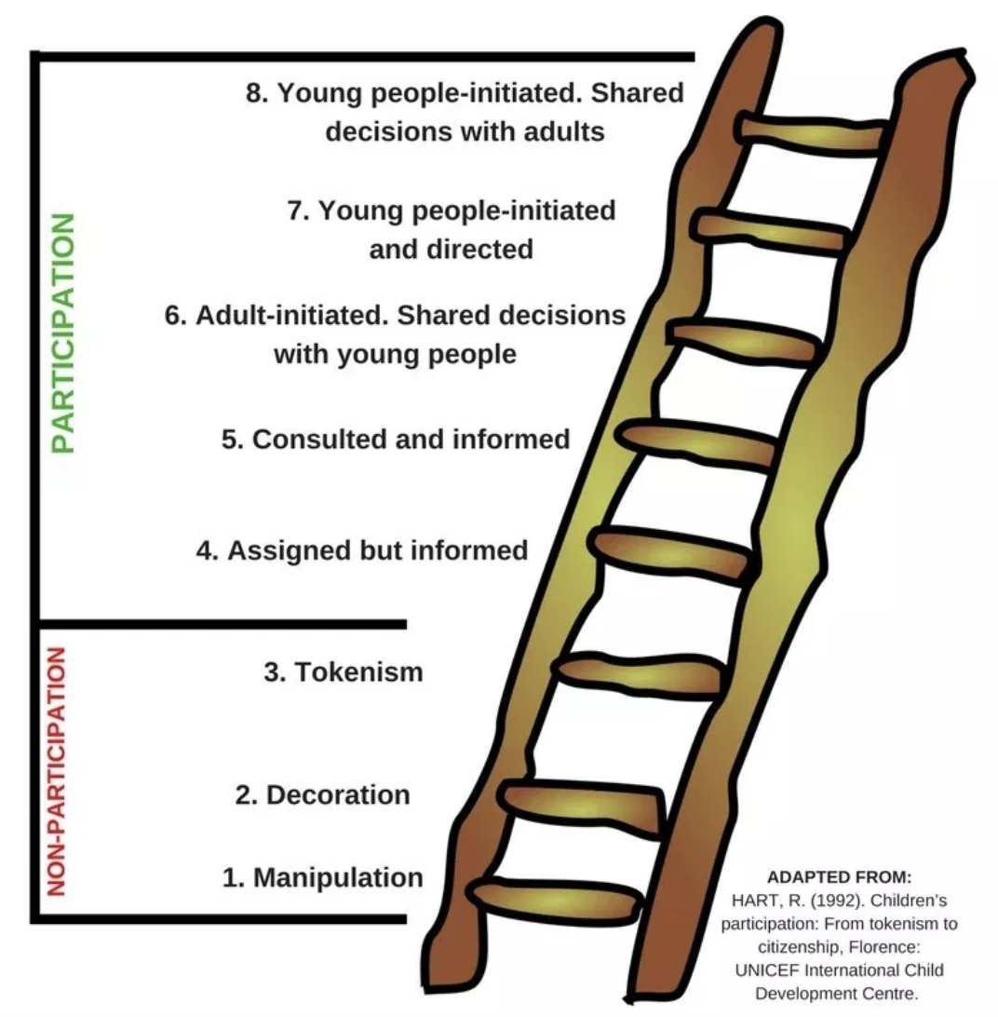
Sample with XL chart or image
Youth Voices Defining Engagement

Slide 8
Youth Voices Defining Engagement
Let’s hear from our youth panelists
How do you know when your engagement is authentic?

Slide 9
Examples of
Youth Engagement
In Data and Decision Making
Examples of
Youth Engagement
In Data and Decision Making

Slide 10
Examples from Youth Panelists
Let’s hear from our youth panelists
Provide us with an example from your own experiences on the ‘higher rungs’.

Slide 11
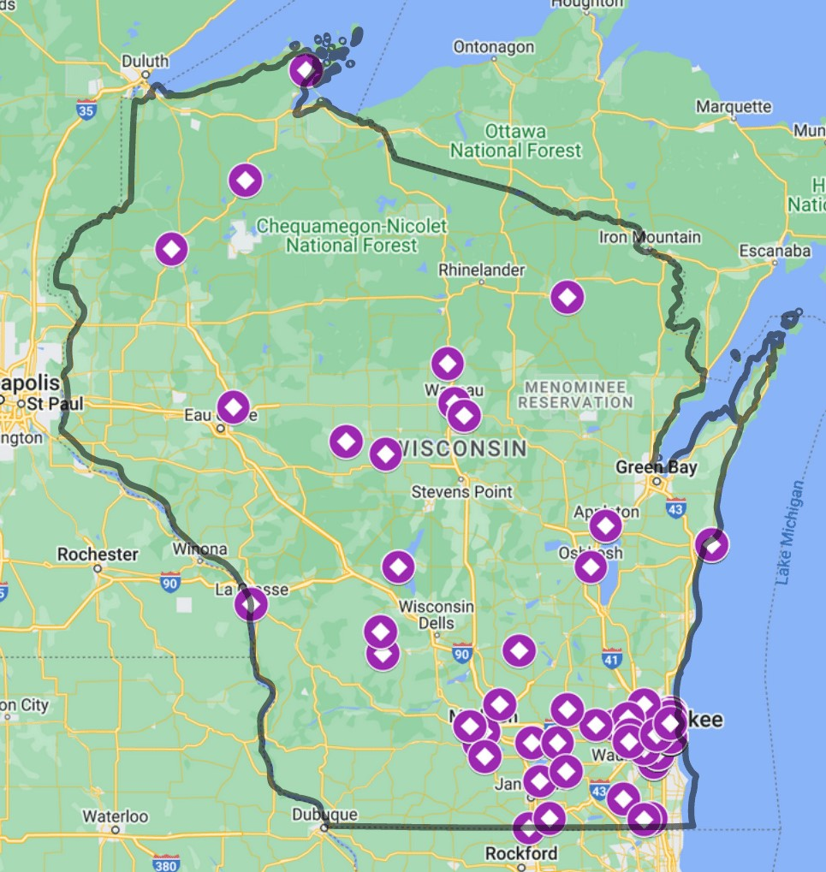
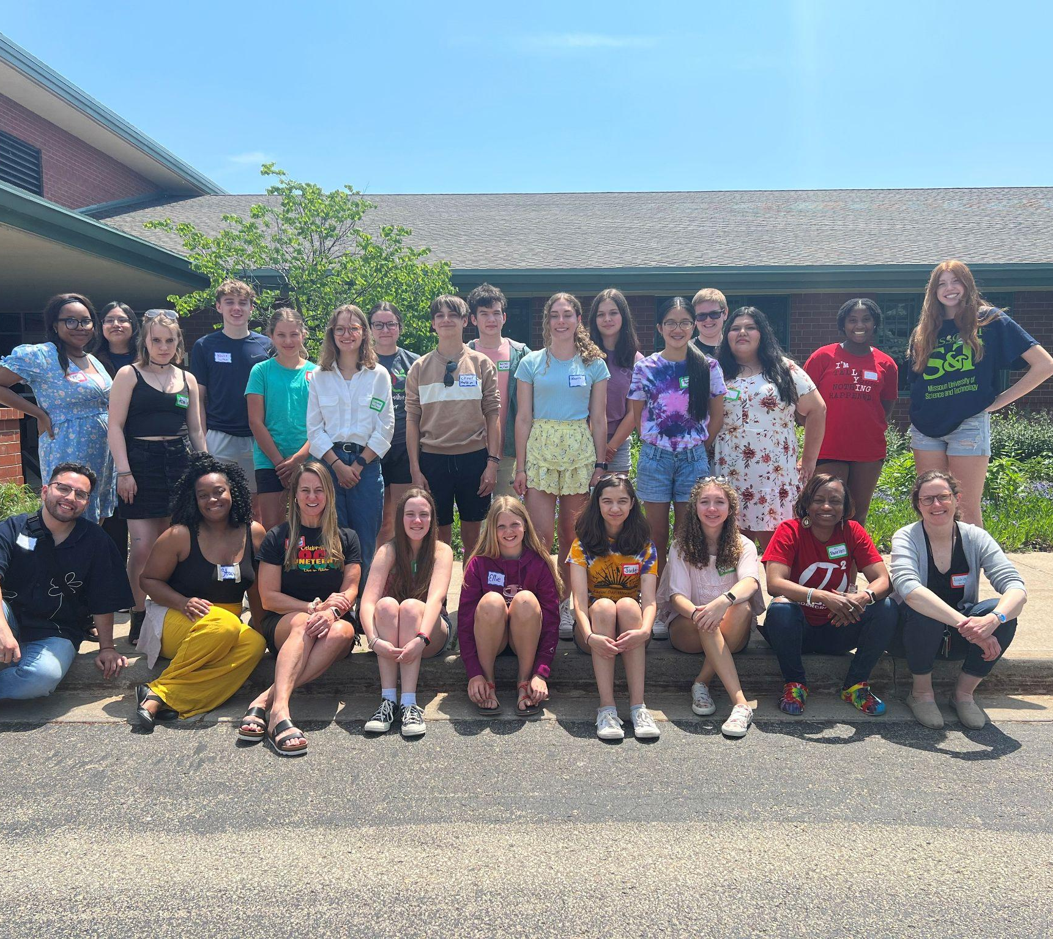

Example: Youth Power (1 of 2)

Slide 12
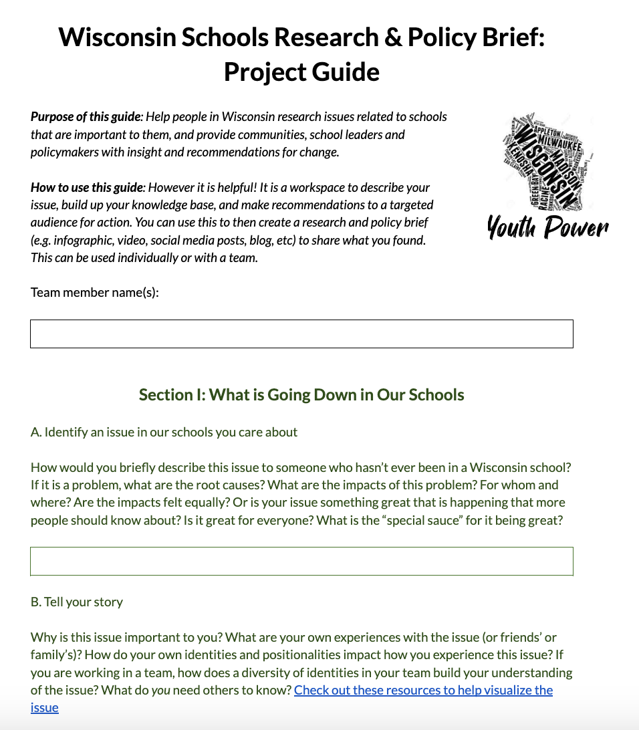
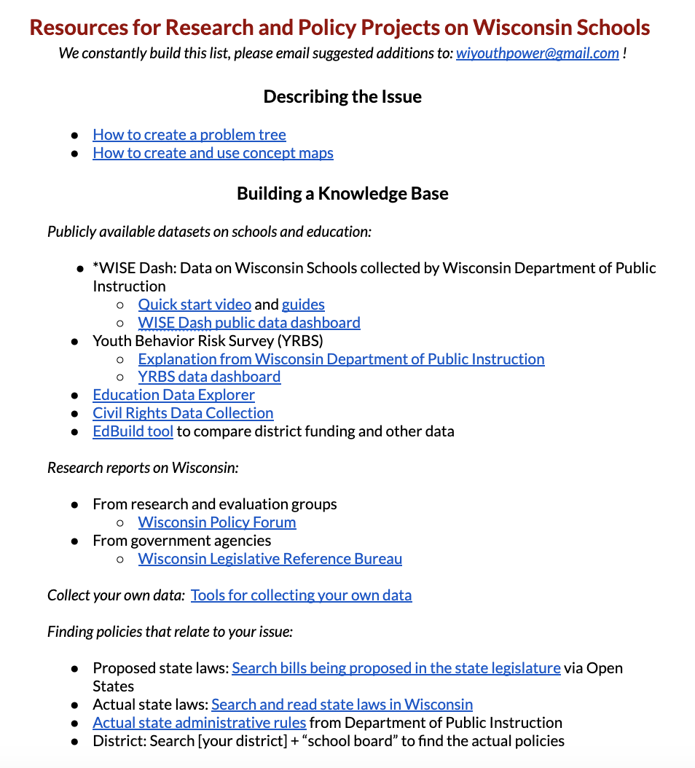
Example: Youth Power (2 of 2)
Example: Youth Power (1 of 2)

Slide 13
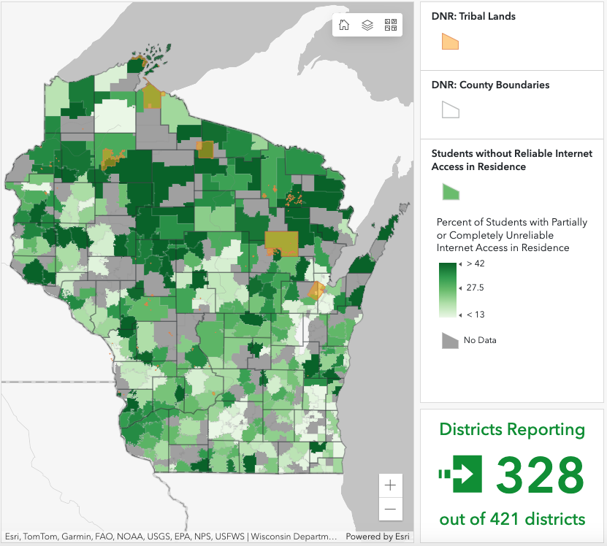
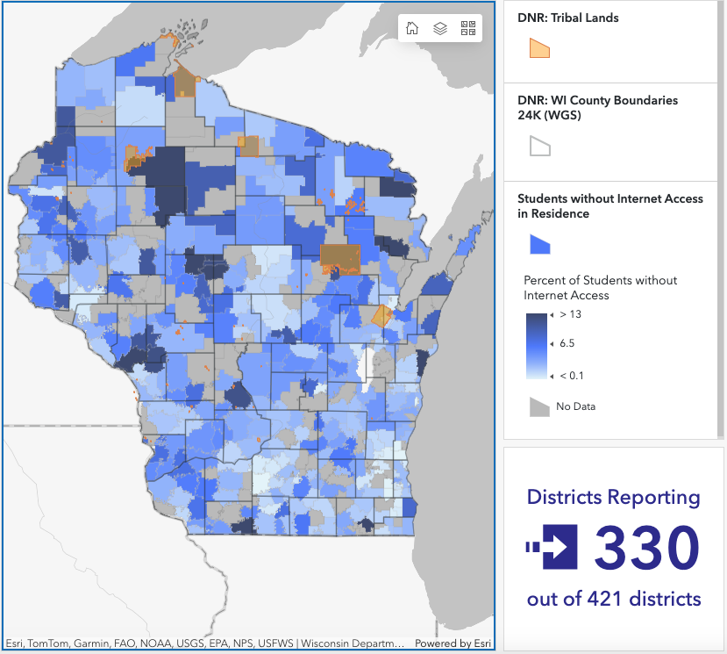
Example: Middle School “Data Dig”
Working with a middle school math teacher to develop students’ data literacy using WISE Dash.
Students interpret data and ask questions, for example about Digital Equity:
Provide us with an example from your own experiences on the ‘higher rungs’.
These are foundational skills to being an active part of data driven decisions.
Digital Equity by Wisconsin School District (2021-22)
Created by the Wisconsin Department of Public Instruction (https://wi-dpi.maps.arcgis.com)

Slide 14
Action Plan
Action Plan

Slide 15
Your Turn
Your Turn
Pick a decision-making space in your school/district or team related to data
Where could you engage youth voice more/better?

Slide 16
Set an intention
What rung describes youth engagement in that space now?
Which rung is feasible in the next year?

Slide 17
Create an Action Plan
Create an Action Plan
What data pieces so students want to weigh in on?
Find out who would need to be contacted.
Think about decisions around the school operations…

Slide 18
Student Panel Discussion
Student Panel Discussion
What is the story behind the data?
Madison Metropolitan School District
Sun Prairie School District

Slide 19
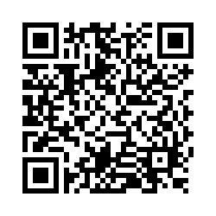
Questions?
Thank you! Thank you!
Please scan the QR code to provide us with your feedback!

