Slide 1
WISE: What's New for 2024-2025?
WISEid & WISEstaff – Josh Roy
WISEdata – Jaidaa Shafaei
WISEdash - Yvette Johanson
School Directory – Mike Fuller

Slide 2

Agenda
Agenda
WISEid and WISEstaff – Josh Roy
WISEdata – Jaidaa Shafaei
WISEdash – Yvette Johanson
School Directory – Mike Fuller
Questions and Answers

Slide 3


WISEid
WISEid
Staff Identity API integration to obtain Staff WISEids inside of vendor systems
Streamline the Change Request process so the requesting district does documentation verification on Change Requests instead of needing dependent agency voting and review
Advanced person search functionality to look for partial name matches

Slide 4

WISEstaff
WISEstaff
Improvements to the Data Quality Dashboard and reports for districts to more easily identify data quality issues
Improved documentation on the data requirements for the staff collection
Improvements to notifications so that resolved issues are removed

Slide 5

WISEdata: Overall Updates
WISEdata: Overall Updates
Dual Reporting in 24/25 SY for Pupil Count Report for Membership
Updates on CTE Reporting
Changes on Parent/Guardian Reporting for Summer EBT
Introduction of New Languages
Overview of Course Changes
Implementation of Staff Identity Integration
Address Verification & Geocoding
Presentation on WISEdata Portal Enhancements

Slide 6
Membership Reporting
Membership Reporting
Membership Reporting: Pupil Count Report (PI-1563 & PI-1563-CA )
    Purpose: Lay the foundation for a seamless transition to the enhanced Pupil Count Module in WiSFiP for the 2025-2026 SY, ensuring heightened functionality and accuracy in pupil count reporting.
    Importance
      The 2024-2025 SY will serve as a parallel reporting year, open to all LEAs.
      By the 2025-2026 SY, the legacy system will be phased out, making the Pupil Count Module in WiSFiP the official reporting platform.
    Optional Data Collection
      Incorporating the supplementary negative daily attendance data proves beneficial
      as it enhances our ability to perform additional data checks.
      This, in turn, allows for the issuance of warnings and or reports in the
      WISEdata Portal when there are uncertainties or discrepancies in meeting
      membership attendance requirements.
Public LEA only

Slide 7
CTE Reporting: CTE Departments (1of 2)
CTE Reporting: CTE Departments (1of 2)
CTE Reporting: CTE Department Reporting & Designation on Courses
    Purpose: Optimize data accuracy to reflect student participation across distinct CTE Departments (a.k.a. Program Area Type).
    Upcoming Modifications:
      Introduce the "CTE Departments" designation directly to courses.
      Collect the "CTE Departments" at the section level using the Course Level Characteristic.
        Agriculture and Natural Resources Education (CTE-A)
        Business and Information Technology Education (CTE-B)
        Family and Consumer Science Education (CTE-F)
        Health Science Education (CTE-H)
        Marketing Education (CTE-M)
        Technology and Engineering Education (CTE-T)
Public LEA only
Notes:
•Challenges
• Current confusion among LEAs regarding "Program Area Type" on CTE Concentrator. >> Renaming the "Program Area Type" to “CTE Department”
• Managing the variability in student participation, especially when some students are affiliated with multiple CTE Departments.
• The CTE Department listed on the course list can serve as a reference for districts in determining CTE courses. Before districts assign the relevant Roster Code to CTE course offerings, they must confirm that the course is instructed by a licensed CTE educator in the specific discipline.
• Given that a course may fall under multiple CTE Departments, the LEA is required to communicate to DPI the chosen CTE Department for the reported course.

Slide 8
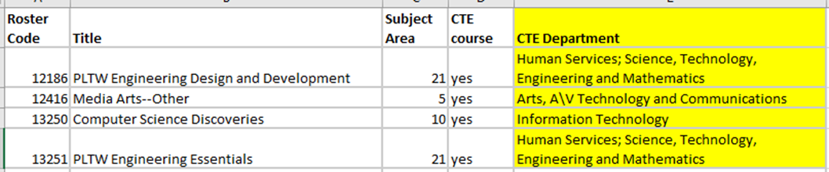
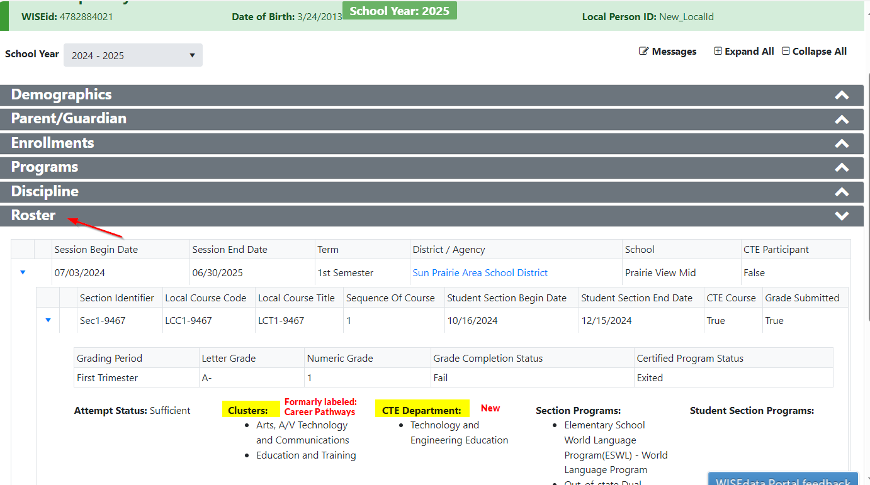

CTE Reporting: CTE Departments (2 of 2)
An example of the new course characteristic to indicate the CTE department(s) associated with the course.
CTE Department(s) will be reported by the LEA at the section level to indicate the selected CTE Department(s).
Notes:
12192 – need screenshot of the courses page.

Slide 9
CTE Reporting: WBL (1 of 2)
CTE Reporting: WBL (1 of 2)
Public LEA only
CTE Reporting: Work-Based Learning (WBL) Changes
Purpose: Streamline the WBL data collection process, reducing confusion
and time burdens for school staff.
Upcoming Modifications:
      Update the Program Types to incorporate IRC (Certified), WBL (Non-Certified),
      and Dual designations.
      Transition the following four Program Names from a "Certified" to a "WBL" Program Type:
        State Co-op Ed. Skill Standards - DPI Employability Skills
        State Co-op Ed. Skill Standards - DPI Occupational
        State Co-op Ed. Skill Standards - DPI Youth Leadership
        Youth Apprenticeship
Notes:
Challenges:
Current usage patterns reveal no specific reports mandating certified WBL through the Certificated Program Status Type.
Widespread feedback indicates school staff do not rely on the Certificated Program Status for monitoring student progress.
This disconnect results in unnecessary complexities and increased workload for school staff

Slide 10
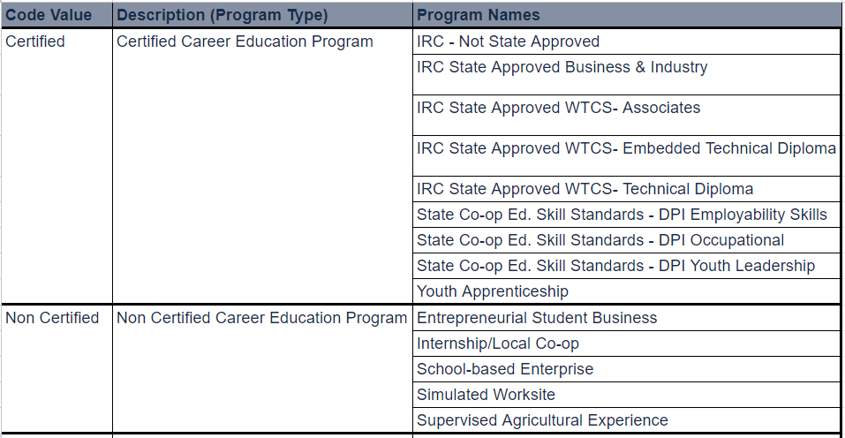
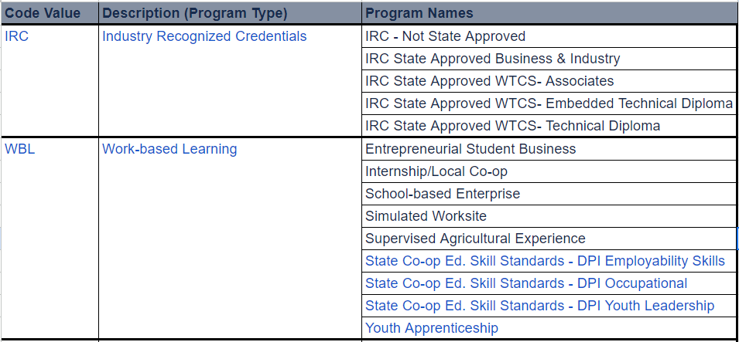
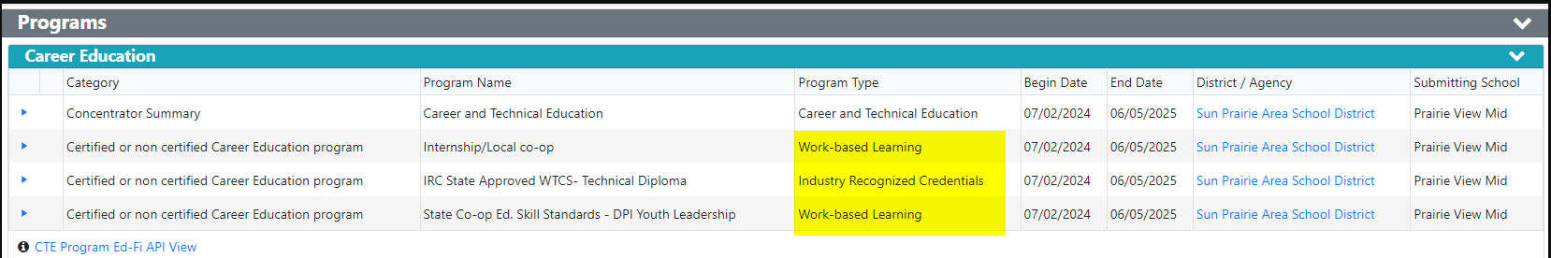
CTE Reporting: WBL (2 of 2)
2023-24 SY and prior
2024-25 SY and after

Slide 11
Parent/Guardian Reporting (1 of 2)
Parent/Guardian Reporting (1 of 2)
Parent/Guardian Reporting: Additional Information for Summer EBT
    Purpose: Share valuable information with the WI DHS, streamlining the distribution of Summer Electronic Benefit Transfer (S-EBT) cards to eligible families.
    Upcoming Modifications:
      Include legal guardian details.
      Capture living arrangements.
      Indicate primary contact status.
All LEAs
Notes:
Legal Guardian Details: Incorporate essential information about legal guardians for accurate beneficiary identification.
Living Arrangements: Capture pertinent details regarding the living situations of beneficiaries to ensure efficient card distribution.
Primary Contact Status: Clearly indicate the primary contact within the family to facilitate effective communication and card delivery.

Slide 12
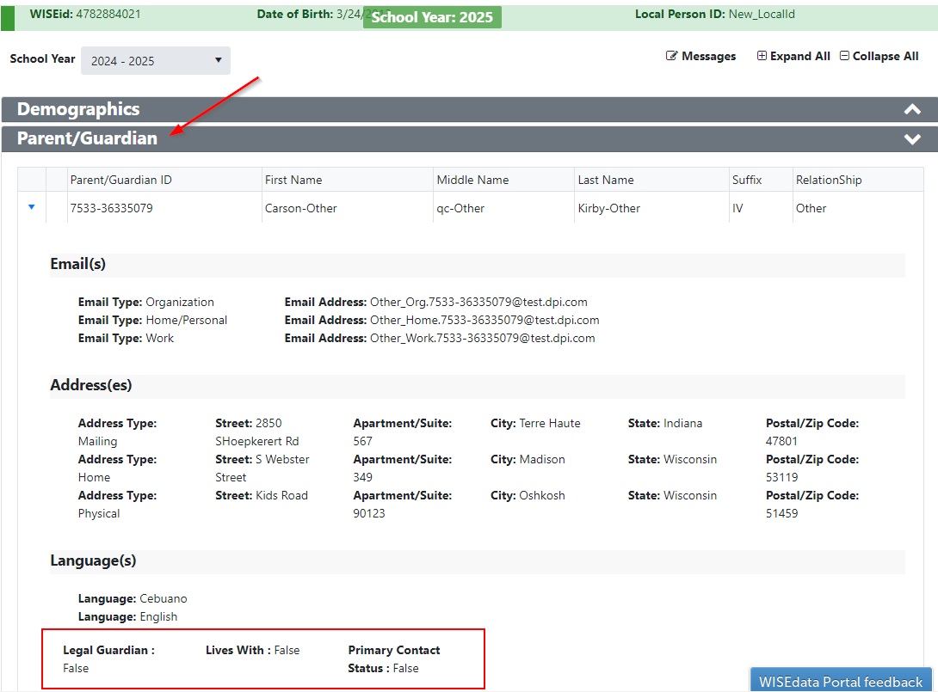
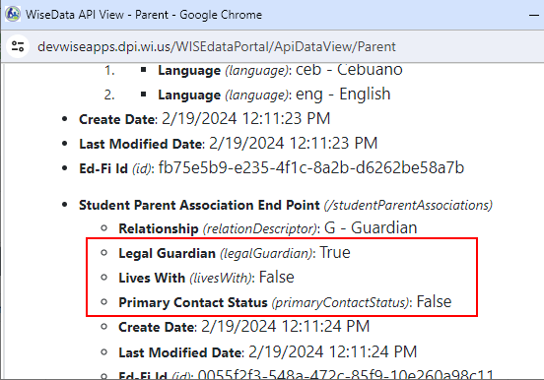
Parent/Guardian Reporting (2 of 2)

Slide 13
Student Demographic Reporting
Student Demographic Reporting
Student Demographic Reporting: Expansion of Language Options
    Purpose: Expand the language repertoire to encompass a more diverse and inclusive range.
    Upcoming Modifications:
      Add the following languages that are currently underrepresented
      on the DPI Language List:
        Afghan Persian, Dari PRS
        K'iche', Quiché QUC
        Kabuverdianu KEA
        Rohingya RHG
        Sign Language SGN
        Uncoded languages MIS
Public LEA only

Slide 14
Roster Reporting
Roster Reporting
Roster Reporting: New Courses and Validations for Rigor Levels
    Purpose: Transition to SCED 11.0 course codes and lay groundwork for the elimination of rigor levels by the 2025-2026 SY.
    Upcoming Modifications:
      New courses, including Hmong Conversation and Culture, Ojibwe for Young Learners (prior-to-secondary), and Computer Science (prior-to-secondary).
      Maintain 'Enriched and Advanced' rigor level designation for AP and IB courses.
      Use 'Regular & General' rigor levels for all other courses.
      Label remaining course codes as deprecated; LEAs using these will receive error code 6798.
Public LEA only

Slide 15
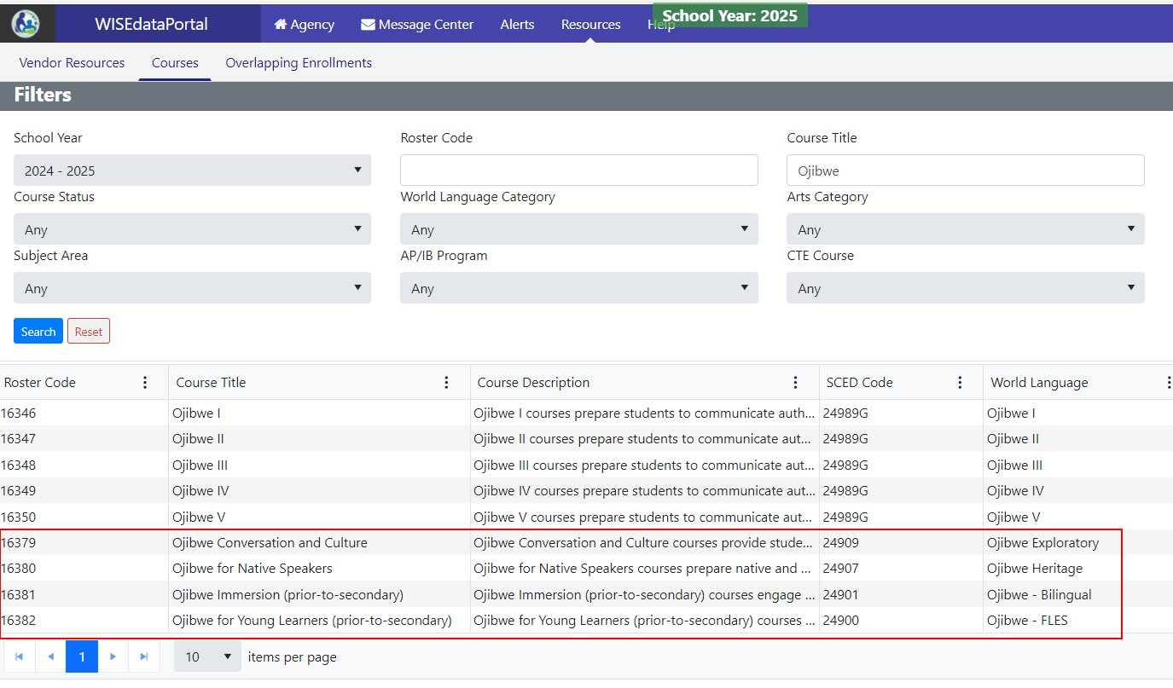
Roster Reporting: New Courses
Notes:
In addition to the five course codes for Hmong and indigenous languages, we have introduced four additional options, mirroring other prevalent World Languages (WL) courses. These four choices encompass Conversation and Culture, Native Speakers, Immersion, and Young Learners.

Slide 16
Staff Identity Integration
Staff Identity Integration
Staff Identity Integration Upcoming
    Purpose: Establish a WISEdata API integration to allow LEAs to seamlessly review and create WISEids for staff members through their designated vendors.
      Please note that the integration is optional for vendors. LEAs should verify whether their chosen vendor intends to implement this integration.
Public LEA only

Slide 17
Address Verification & Geocoding
Address Verification & Geocoding
Address Verification & Geocoding Upcoming
    Purpose: Establish a comprehensive address verification and geocoding service to enhance data precision and reliability.
    Upcoming Modifications:
      Create exports for LEAs, enabling the identification and correction of unverified addresses.
      Facilitate API integration, allowing LEAs to retrieve verified addresses efficiently through their respective vendors.
        Please note that the integration is optional for vendors. LEAs should verify whether their chosen vendor intends to implement this integration.
All LEAs

Slide 18

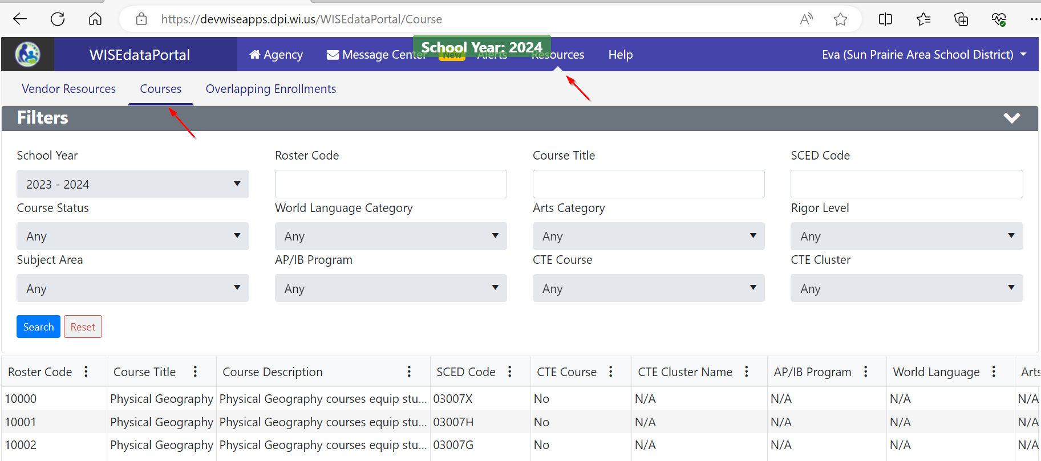
Courses Page
Courses Page
Courses Page Released
    Purpose: Establish a dedicated page in the WISEdata Portal for presenting the course list, providing users with the capability to conveniently filter or search for courses without navigating to the Courses data element page.

Slide 19
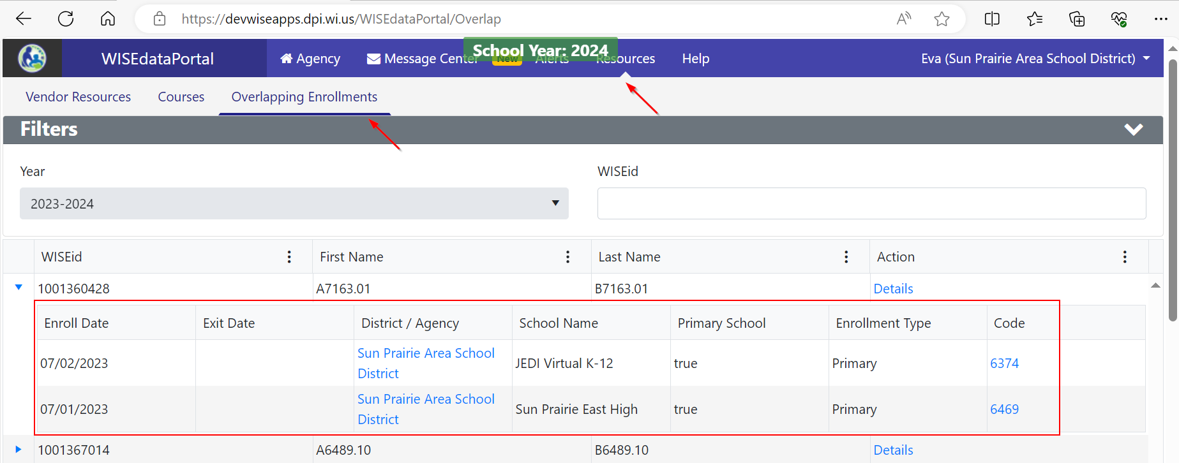
Overlapping Enrollment Page (1 of 2)
Overlapping Enrollment Page (1 of 2)
Overlapping Enrollment Released
Purpose: Created a page for showcasing students with overlapping enrollments, enabling LEAs to delve into specific details and view the validation message code that the other LEA is encountering.

Slide 20
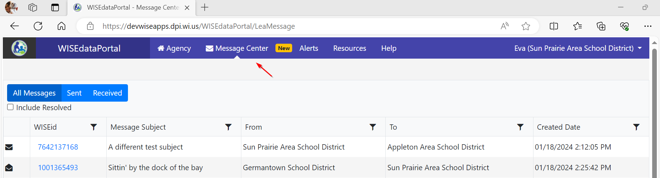
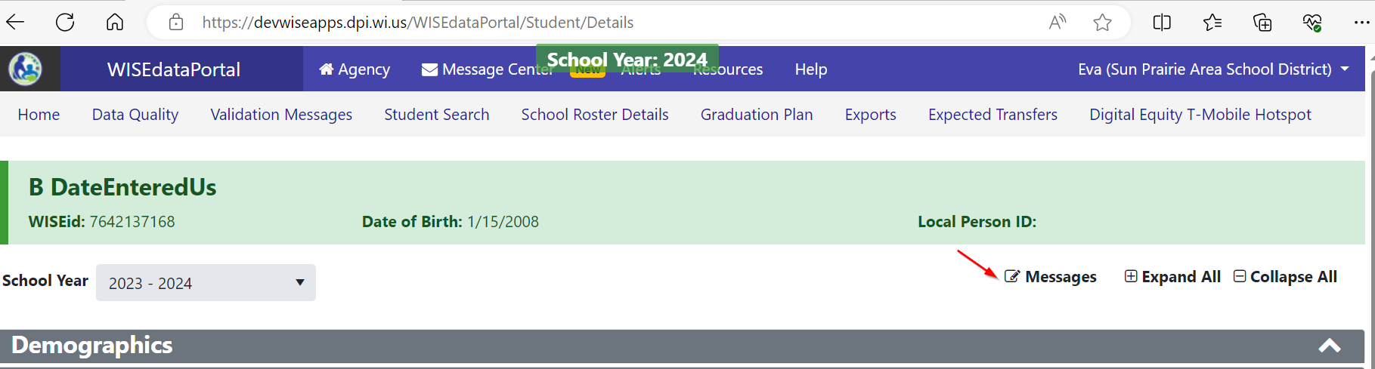
Overlapping Enrollment Page (2 of 2)
Overlapping Enrollment Page (2 of 2)
  Message Center Released
Purpose: Develop a communication hub, known as the Message Center, within the WISEdata Portal to facilitate inter-LEA communication regarding a specific student.

Slide 21
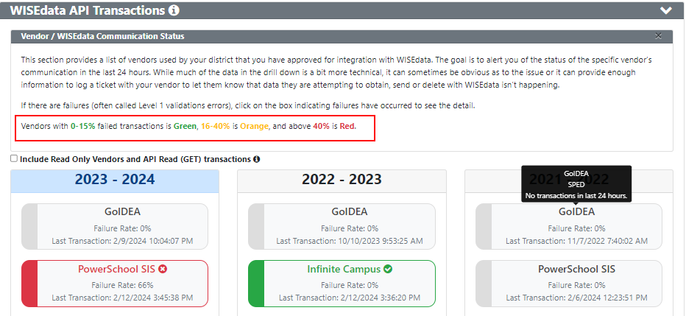
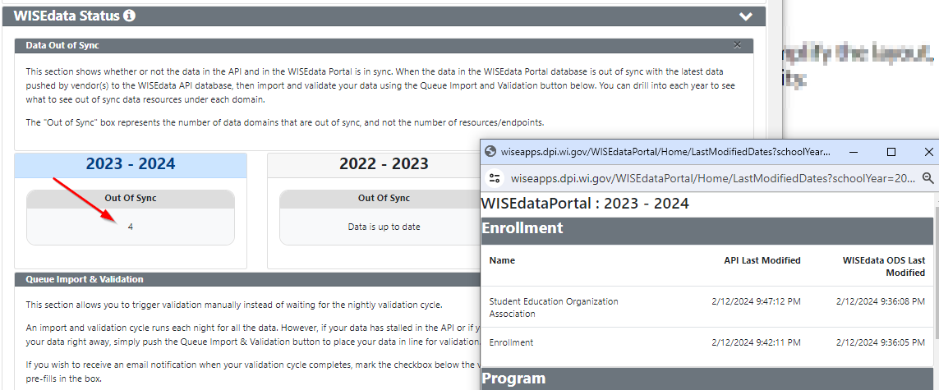
Home Page
  New Look for the Home and Data Quality Pages Released
  Purpose: Revamp the Home and Data Quality pages to streamline and simplify the layout, presenting essential information for LEAs without introducing unnecessary complexity.

Slide 22
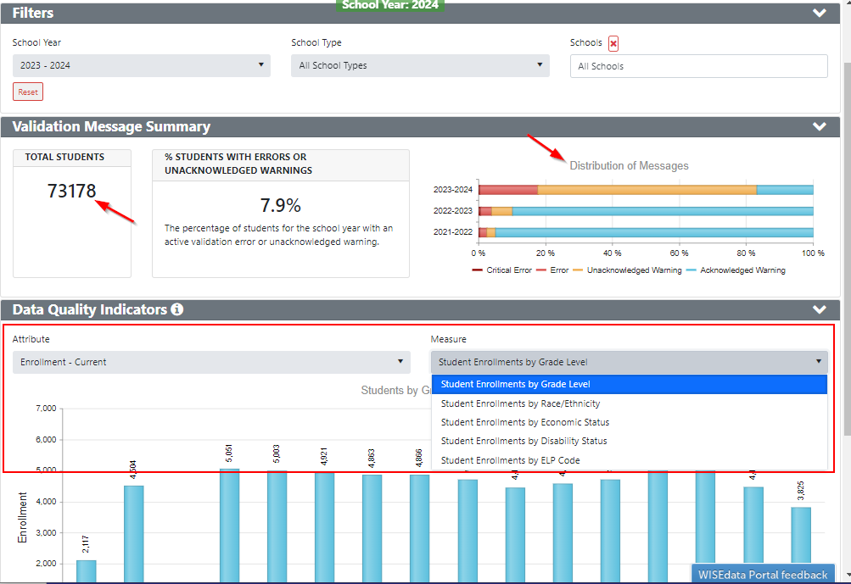
New Look for the Home and Data Quality Pages Released
Data Quality Page

Slide 23
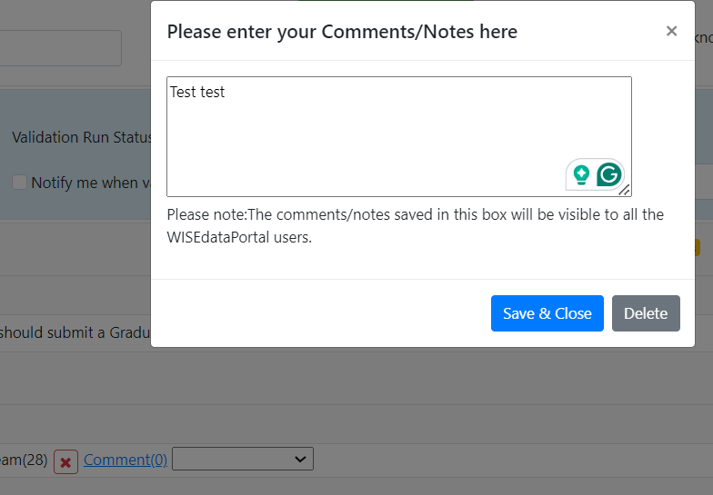
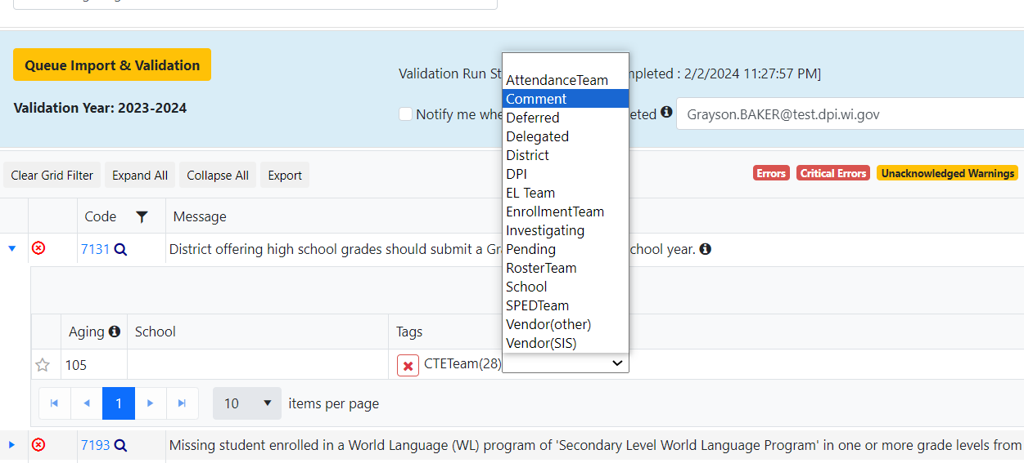
Tag for Validation Messages
  New Tag for Validation Messages Released
  Purpose: Introduce a new validation message tag called "Comment," allowing users to attach notes to records affected by the validation message. This feature streamlines tracking and enhances operational efficiency.
  .

Slide 24
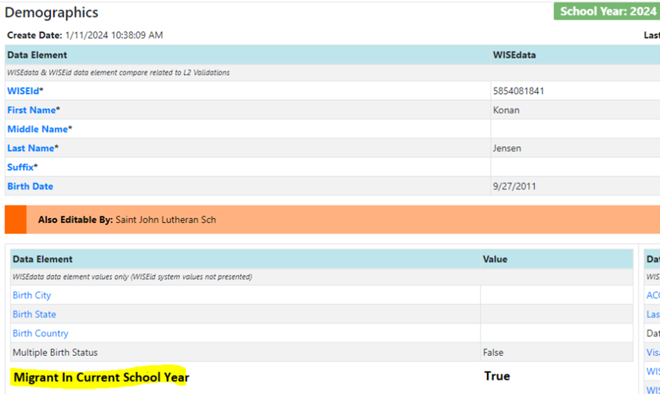
Migrant Status (1 of 2)
Migrant Status (1 of 2)
  Migrant Status Upcoming
  Purpose: Present the migratory status of students to keep LEAs informed about the students' current migrant status. This information is visible on the Student Details page within the Demographics panel and is retrieved from the MIS2000 system.
Notes:
Need screenshot

Slide 25
Migrant Status (2 of 2)
Migrant Status (2 of 2)
Snapshot-centric Filter Upcoming
Purpose: Enhance the Validation Messages page by incorporating a filter mechanism. This filter will allow users to display validation messages associated with a specific snapshot date.
  New Tag for Validation Messages Feedback Needed
  Purpose: Introduce a new tag for validation messages, enabling users to label a rule as "unresolvable." This empowers LEAs to prioritize other rules without the need to address every validation message.
Notes:
The implementation of this feature aims to streamline the data cleanup process for LEAs, providing districts and schools with a more efficient means of addressing pertinent validation messages. By focusing on messages relevant to the selected snapshot, users can avoid unnecessary distractions and optimize their efforts in resolving critical data issues.

Slide 26

WISEdash Public – Past Year
WISEdash Public – Past Year
New menu structure rolled out
New dashboard - October 1 Child Count of students with disabilities (2016-17 onwards)
New PreACT Secure dashboard
Notes:
WISEdash: Wisconsin Information System for Education Data Dashboard​
​
WISEdash is a data portal that uses "dashboards," or visual collections of graphs and tables, to provide multi-year education data about Wisconsin schools. Current and Certified data can be displayed on both platforms for multiple years and it can be grouped and filtered by a variety of demographics including grade level, gender, race/ethnicity, economic status, disability, English proficiency, and migrant status. Data download files are also available.​
​
The WISEdash Public Portal is available to the general public; student data is redacted for protection of personally identifiable information PII. Data on the public portal is available by school, district, or State.​
​

Slide 27
WISEdash Public - Upcoming
WISEdash Public - Upcoming
WISEdash Public releases for the December snapshot data will be in late March
Digital Equity dashboard updates for new 23-24 survey (spring)
WISEdash Public – alternate data reporting platforms (long term)
Notes:
WPP Release – 23-24 data for enrollment and Oct 1 CC, 22-23 data for grad rate, attendance, discipline, postsecondary among others
Including a new Table created in Attendance dashboard to display attendance by Learning Modality, Special Education Indicator data is refreshed in May.
Digital Equity dashboard updates to allow 23-24 data to start flowing.
The WISEdash Public Portal and WISEdash for Districts dashboards have been serving Wisconsin schools and districts and the general public for over 10 years. DPI is now evaluating the potential of alternate data reporting platforms to modernize this service. Ensuring our platform is reliable, forward-looking, accessible, and cost-effective is vital to the future of WISEdash. To that end, DPI is exploring options for refreshing the look and feel of both the WISEdash Public Portal and WISEdash for Districts.

Slide 28
WISEdash for Districts – Past Year
WISEdash for Districts – Past Year
Assessment Analysis dashboard
PreACT Secure dashboards
New menu interface
Snapshot of grades 6-8 courses
New dynamic crosstabs (Immigrant, Mobility, Parent in Military)
Notes:
Assessment Analysis - This dashboard shows how many students are in each Wisconsin Student Assessment System (WSAS) performance level for a given school year. This dashboard displays students’ performance for schools and districts across grades and assessments, instead of for a single assessment as in other dashboards. Uses static data.
New menu interface – allows users to see what dashboards are available at a glance instead of drilling through multiple menus.
Snapshot of grades 6-8 courses – this was in response to both Arts courses and World Language courses.
New dynamic cross tabs – released in February - this was a request both from the prior year WISEdata conference attendees and the WISEdash Advisory Group members.

Slide 29
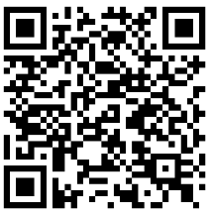
WISEdash for Districts - Upcoming
WISEdash for Districts - Upcoming
Update to Digital Equity dashboards for 23-24 survey / data flow
School District Library Plans
Changes to assessment dashboards to accommodate Forward standard setting.
Addition of Ancestry/Ethnic Origin dashboards
Feedback appreciated! feedback.dpi.wi.gov,
Or scan this QR code
Notes:
School District Library Plans – data started to be collected through the WISEadmin Portal during the fall period. Next step will be to create a metric of metadata about the plans in WISEdash for Districts and then eventually in WISEdash Public.
Ancestry/Ethnic Origins – This data started to be optionally collected a few years ago. This dashboard will allow LEAs to create their own cohorts based on which ethnicities are prevalent in their communities and apply those cohorts to other dashboards in WISEdash (e.g., Attendance, Assessments etc.)

Slide 30
New Legislation
New Legislation
2023 Act 12 - Statistics of crimes and other safety−related incidents
2023 Act 20 - Wisconsin Reads

Slide 31

School Directory
School Directory
New School Directory Management Application is now open!
Platform has updated visual appearance, similar look and feel with SD Public Portal
Familiar features, with a more intuitive design for better user experience
User Guides available
Feedback will be appreciated!

Slide 32
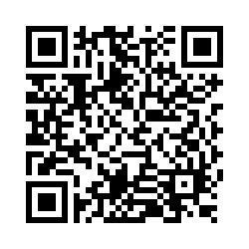
Questions?
Thank you! Thank you!
Please scan the QR code to provide us with your feedback!

