Slide 1
Title Slide
WISEdata: Discipline Reporting
Britt Mueller – WISE Relationship Manager, Customer Service Team
March 6, 2024

Slide 2
Today we will...
Look at discipline-related data elements
Cover common reporting scenarios
Verify data in WISEdata Portal and WISEdash For Districts
Talk about common errors
Answer your questions

Slide 3
What Is “Discipline Reporting”?
Discipline is a section of fields in WISEdata to collect student information regarding:
discipline incidents,
discipline behavior, and
discipline actions.
Reported are expulsions, out-of-school suspensions, and some in-school suspensions.

Slide 4
Who Should Submit Discipline Data?
Discipline data is required to be reported annually by:
All public schools and districts statewide
Non-district independent Charter schools
County Children with Disability Education boards (CCDEB)
State schools (Wisconsin Center for the Blind and Visually Impaired, Wisconsin School for the Deaf)
Discipline reporting requirements are the same regardless of whether the student’s grade level is compulsory or non-compulsory (such as K4).

Slide 5
Who Should NOT Submit Discipline Data?
Discipline data is NOT reported for:
Choice schools
Department of Corrections (DOC)
Department of Health Services (DHS) students
Parentally Placed Private (PPP) special education students with an Individual Service Plan (ISP)

Slide 6
Why Report Discipline Data?
Required by state law and a more limited range of IDEA-required data.
School Boards have statutory powers related to the removal of students from the classroom (§ 118.164) as well as suspension and expulsion of students from public schools ( §120.13 and §119.25, Wis. Stats.).
All students are federally entitled to a free, appropriate, public education (FAPE) as protected by article X, section 3 of the Wisconsin Constitution, and §121.77, so the nuances of suspensions, expulsions, and the time they require students to be away from FAPE are important to get right.

Slide 7
What Discipline Data to Submit
Students without IEPs:
All expulsions, regardless of duration
Out-of-school suspensions, if the student is removed for at least half of their regular school day
Students with IEPs:
All expulsions, regardless of duration
Out-of-school suspensions, if the student is removed for at least half of their regular school day
In-school suspensions, in half day increments
IAES: Student must have an active sSEPA; submitted only if the student is removed for at least half of their regular school day

Slide 8
What Discipline Data Not to Submit
Do NOT Submit Summer School Discipline:
Discipline information for Summer School should NOT be submitted to WISEdata.
This student is removed zero days from the school year for a suspension, so no incident or action is submitted.
Note, if the discipline action was an expulsion, then this incident-action pair would be submitted per the DPI calendar based on the school board decision date, not the incident date.

Slide 9
Interim Alternative Educational Setting (IAES) Placement Disciplines (1 of 2)
IAES Removals (by IAES School Personnel and IAES Hearing Officers) are available after a student with an IEP carries a weapon to, or possesses a weapon at school, knowingly possesses or uses illegal drugs, or sells or solicits the sale of a controlled substance, while at school, or has inflicted serious bodily injury upon another person while at school.

Slide 10
Interim Alternative Educational Setting (IAES) Placement Disciplines (2 of 2)
An appropriate setting is determined by the pupil’s IEP team in which the child is placed for no more than 45 days.
This setting enables the child to continue to progress in the general curriculum; to continue to receive the services and modifications, including those described in the pupil’s current IEP; and to meet the goals set out in the IEP.
Setting includes services and modifications to address the problem behavior and to prevent the behavior from recurring.

Slide 11
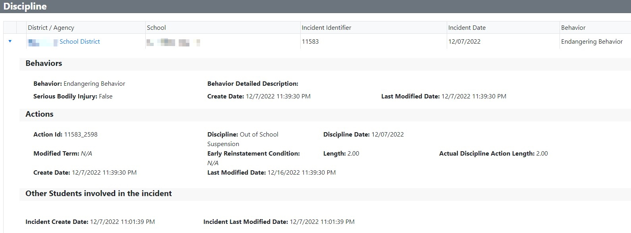
Discipline Record

Slide 12
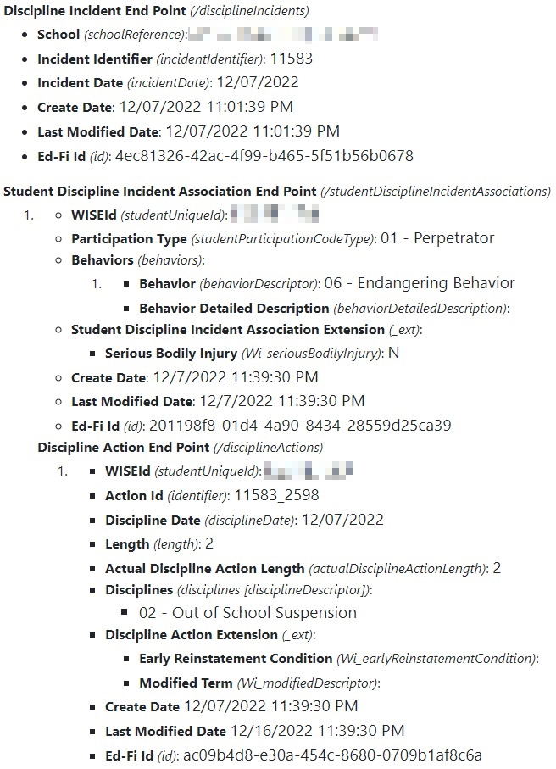
Discipline Record, API
Discipline Record – Ed-Fi API View

Slide 13
Discipline Incident Identifier
A locally-assigned unique identifier used to identify a specific incident or occurrence. This is a required data element.
The same identifier should be used to document the entire incident even if it included multiple offenses and multiple offenders.
Associating, for a single student, multiple disciplinary actions (removals) that resulted from a single incident should be a priority.
The Discipline Incident Identifier is distinct from the auto-generated Ed-Fi Incident ID (i.e, the Discipline Incident ID).

Slide 14
Incident Date
The Incident Date is the date (Day, Month, Year) that the incident resulting in removal occurred.
The incident date must occur within the reporting school year and within an active enrollment period for the associated school.
Summer school enrollment should not be reported to WISEdata. As such, discipline which occurs during summer school is not submitted to DPI.

Slide 15
Behavior Descriptor (1 of 2)
A Behavior must be selected to describe the student’s action resulting in the discipline incident.
Select the option that most closely aligns with the incident that occurred.
Behaviors are ranked in order of severity with handgun being the most severe.
To assist with selecting the correct Behavior, use cases are provided on the Behavior Descriptor data elements page.

Slide 16
Behavior Descriptor (2 of 2)
A detailed description of each Behavior is provided on the Behavior Descriptor data elements page.
Code | Short Description
01 | Handgun
02 | Shotgun or Rifle
03 | Other Firearm
04 | Dangerous Weapon - Not Firearm
05 | Assault
06 | Endangering Behavior
07 | Drug-Related
08 | Alcohol-Related
09 | Other Violation of School Rules

Slide 17
Behavior Detailed Description
Behavior Detailed Description data element is required to explain the reason why there was not an expulsion for a student bringing a firearm to school.
State and federal law require expulsion for a period of not less than one year for any student who brings a firearm to school, but a school board may modify this requirement on a case-by-case basis.
Throws Error 6685
If no expulsion is issued following a firearm-related incident, schools must explain the reason in the Behavior Detailed Description.
This is a required data element for all firearms incidents.

Slide 18
Serious Bodily Injury
Serious Bodily Injury is a True or False value required only when an interim alternative educational setting (IAES) School Personnel discipline is associated with the student and incident.
Serious Bodily Injury (as per 18 USC Section 1365 (3)(h)) describes the result of a discipline incident that involves:
    a substantial risk of death
    extreme physical pain
    protracted and obvious disfigurement
    protracted loss or impairment of the function of a bodily member, organ, or faculty
If no IAES School Personnel discipline is associated, then the value may be left null

Slide 19
Discipline Action Identifier
A locally-assigned unique identifier used to identify a specific discipline action. This is a required data element.
Some incidents result in multiple discipline actions for the same student. A separate discipline action submission is expected for each discipline action.
For example, if an out-of-school suspension and expulsion occurred for one student, then the student should have two discipline actions, each one associated to a single discipline incident.
The Discipline Action Identifier is distinct from the Discipline Descriptor (Action), which is auto-generated and assigned by Ed-Fi.

Slide 20
Discipline Descriptor (Action)
The Discipline Descriptor (Action) data element is a code-based descriptor referring to a type of action resulting from a discipline incident, namely, removal from the classroom. A detailed description of each Discipline Action is provided on the Discipline Descriptor (Action) data elements page.
Discipline Descriptor | Action Code | Minimum Length
In-School Suspension | IS | 0.5
Out-of-School Suspension | OS | 0.5
Expulsion (Without Services) | EX | 0
Expulsion (Receiving Services) | EX | 0
IAES by School Personnel | SP | 0.5
IAES by Hearing Officer | HO | 0.5

Slide 21
Discipline Date
The date (Day, Month, Year) on which the discipline action started
The Discipline Date must occur on or after the incident date.
For suspensions (in or out of school) and IAES discipline actions, the discipline date must be within an active enrollment period in the current reporting year.
For expulsions, the discipline date may occur in the current reporting year or at the beginning of the next school year.

Slide 22
Modified Term for Firearms
Identifies if the duration of the expulsion has been modified from the federally-required one year of expulsion for a firearms incident.
The Modified Term data element refers to a reduction in the minimum one-year (12-month) expulsion period for firearms.
A firearms expulsion period begins on the discipline date and is expected to last one full calendar year. A reduction of that timeframe via Modified Term for Firearms is specified in the student's expulsion order under state law.

Slide 23
Early Reinstatement Conditions
The Early Reinstatement Conditions data element applies following an expulsion, but only if the student had early reinstatement conditions for returning to school prior to the end of the expulsion.
This is a condition that a student is required to meet before being granted early reinstatement to return to school or condition(s) that a student is required to meet after their early reinstatement but before the expiration of the term of expulsion.
Links to applicable state statutes are available on the Early Reinstatement Conditions data elements page.

Slide 24
Discipline Length (1 of 3)
Refers to the number of school days during which a student is removed for a school term, incident, and disciplinary action
Discipline Length is counted based on the student’s scheduled school day.
  For students with non-standard school schedules (i.e., student attends school for a half-day), counting of days removed for discipline purposes will be different from counting days for attendance purposes.
  This is because counting of actual and possible days of attendance is based on the district's standard full school day.

Slide 25
Discipline Length (2 of 3)
Refers to the number of school days during which a student is removed for a school term, incident, and disciplinary action
If the Discipline Action is an Expulsion or Out-of-School Suspension:
  Count days removed from the school's grounds for disciplinary purposes as a result of the expulsion or out-of-school suspension.
  The School Days Removed value should include days during which the student is receiving services in an alternative setting off-school grounds or at an alternative school.

Slide 26
Discipline Length (3 of 3)
Refers to the number of school days during which a student is removed for a school term, incident, and disciplinary action
If the Discipline Action is an In-school Suspension or Placement in IAES:
  Count days the student is removed from his/her educational placement, e.g., the student's regular classroom, for disciplinary purposes.

Slide 27
Discipline Length Calculation
How to Count Discipline Length:
The Discipline Length value, for all discipline actions, should be submitted in half-day increments.
Do not count removals (suspensions or IAES discipline actions) for less than half of a school day.
Do not round up to 0.5 for removals that are less than half a school day.
For any removal of half of a school day in length or longer, round up to the nearest half-day increment.
EXAMPLES:
Removals of 1/3 day would not be counted.
Removals of 2/3 day would round up to 1.0.
Removals of 1.2 days would round up to 1.5 days, etc.

Slide 28
Actual Discipline Action Length
The Actual Discipline Length data element indicates the actual length of a student's disciplinary assignment, as measured in school days.
For suspensions (in or out of school) and IAES discipline actions, actual discipline action length must equal discipline length, due to the restrictions for reporting these disciplinary actions.
For expulsions that span multiple school years - or - for expulsions that do not begin until the next school year:
    Count the total days the student will be removed from the school's grounds for disciplinary purposes over the entire duration of the expulsion order.
    School days removed include days during which the student is receiving services in an alternative setting off-school grounds or at an alternative school.

Slide 29
Review! Important to Know!
Report on
IAES
Removals should be submitted only when the student is removed for at least half of his or her regular school day.
IAES removals only apply to IDEA eligible students. These students must have an active sSEPA record which includes the discipline date.
2. Expulsions
All expulsions should be submitted, regardless of duration, for all students.
3. Suspensions
Do not report in-school suspensions for students without IEPs.
For students with IEPs, in-school suspensions are submitted in half-day increments.
Out-of-school suspensions are reported for all students when they have a length of 0.5 or more.

Slide 30
Discipline FAQ & Use Cases
Find a comprehensive documentation of use cases, as well as answers to frequently asked questions, on the Discipline: Info, Help and FAQ page.

Slide 31
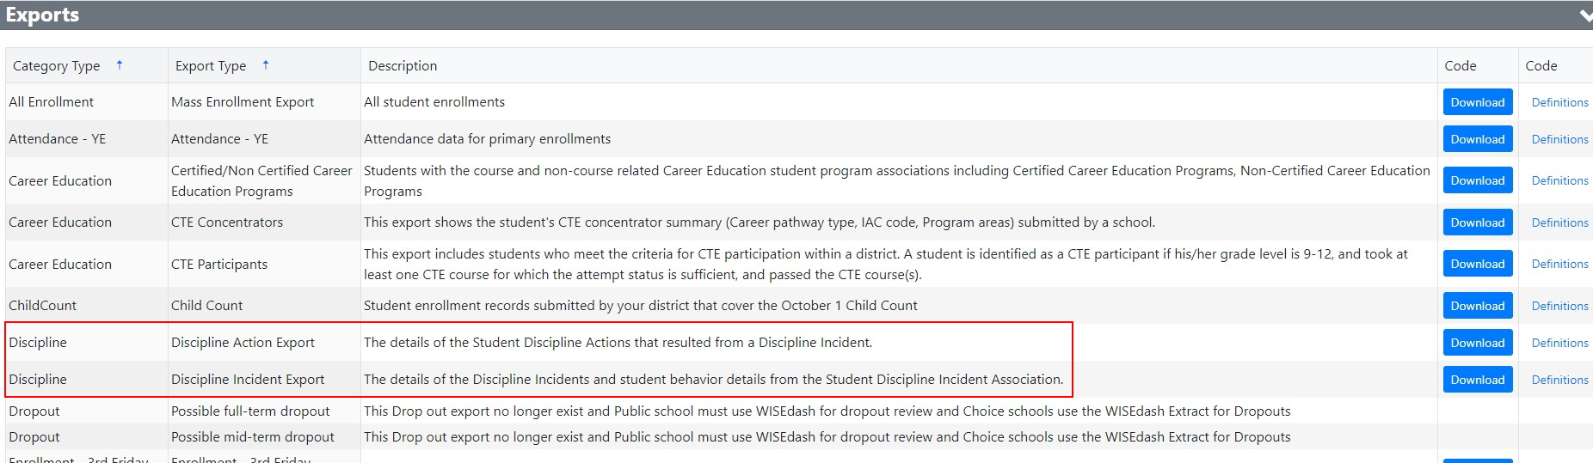
WISEdata Portal Verification
Verify Discipline data in WISEdata Portal using export files.

Slide 32
WISEdash for Districts: Data Verification
Discipline data can be verified in WISEdash for Districts, in both the Topics and Snapshot sections.
WISEdash > Dashboards > Topics > Main > Discipline
WISEdash > Dashboards > Snapshots > Discipline

Slide 33
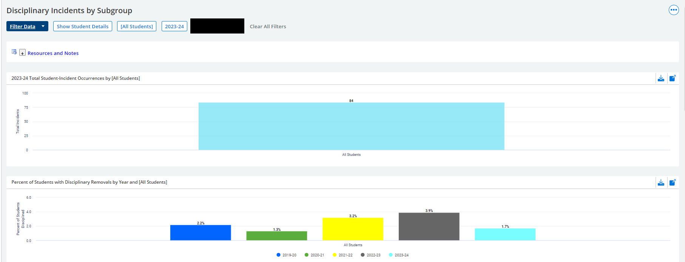
WISEdash for Districts: Topics (1 of 2)

Slide 34
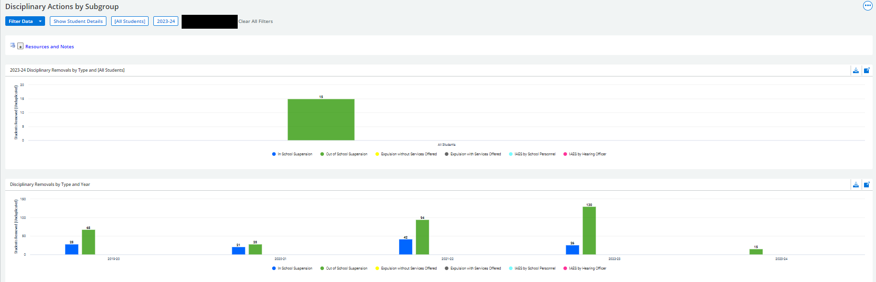
WISEdash for Districts: Topics (2 of 2)

Slide 35
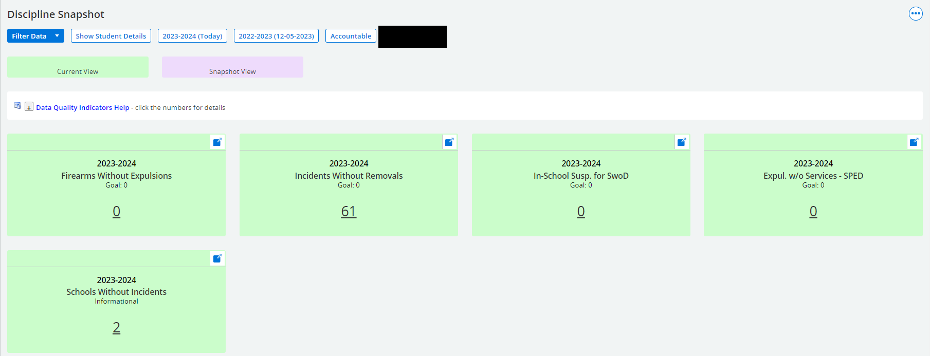
WISEdash for Districts: Snapshot (1 of 2)

Slide 36
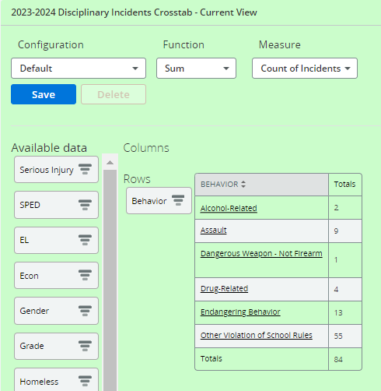
WISEdash for Districts: Snapshot (2 of 2)

Slide 37
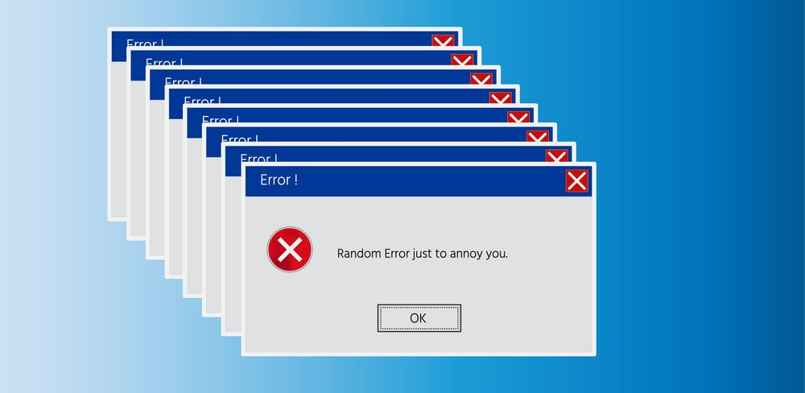
Some Common Validations

Slide 38
Warning 6751
No Discipline records for this school in this school year
Long Text: No Discipline records have been reported for this school for this school year. It is important for discipline to be reported to WISEdata correctly, as it is reported to the US Dept of Ed via EdFacts and is required as part of the Gun-Free Schools Act. If there is discipline data to report for this school submit the information to WISEdata. If the school does not, in fact, have discipline data to report then acknowledge this warning.
NOTE: Failure to acknowledge the warning may result in the school reporting to the US Dept of Ed as not fulfilling the reporting requirements of the Gun-Free Schools Act.

Slide 39
Warning 6690
Discipline Action Length Should Not Be Greater Than Five Days
Long Text: The 'Action Length' exceeds 5 days for Out-of-School Suspension. 'Action Length', days removed this school year, for a single out-of-school suspension should not exceed 5 days unless notice of expulsion hearing has been sent.
If the length exceeds 5 days, you will need to modify the discipline descriptor (action) accordingly unless an expulsion hearing has been set. In that case, if the length is correct, acknowledge the warning.

Slide 40
Warning 6691
Discipline Action Length Within Agency Over 200
Long Text: The 'Action Length', days removed this school year, exceeds 200 days of enrollment within your district. The total days removed this school year for this student exceeds 200 days across one or more schools of enrollment within your district. Do not include days of possible summer session attendance in Action Length.
Verify which discipline action the student was given and what the discipline action lengths were determined to be from the multiple schools involved, reviewing incident reports as needed. If the student has multiple removals, remove the invalid action length for the appropriate school and enter a correct value, ensuring the combined length is less than 200 total days. Also make sure no summer school attendance is included in the action length. If the collective length truly exceeds 200 days, acknowledge the warning.

Slide 41
Error 6681
Discipline Action Out Of School Suspension Invalid Length
Long Text: Invalid 'Length' for Out-of-School Suspension. 'Length', days removed this school year, for out-of-school suspension (OS) may not exceed 15 days.
Remove the invalid length and enter a correct value, ensuring the length is less than 15 days. If the length exceeds 15 days, you will need to modify the discipline descriptor (action) to match.

Slide 42
Error 6665
Invalid Discipline Date Expulsion
Long Text: Invalid 'Discipline Date' for expulsion. 'Discipline Date' must be on or after the Incident Date and must occur within the same school year as the Incident Date or prior to 9/14 of the subsequent school year. When the expulsion begins at the start of the next school year, the Discipline Date is expected to be the first day of school. To ensure that this date is prior to the third Friday of September, the Discipline Date must be on or before 9/14 of the subsequent school year.
Verify the student’s discipline action and discipline date that were determined after the incident. For expulsions, the discipline date should occur in the same school year as the incident date or before September 14 of the next school year. If the expulsion will occur next school year, use a Discipline Date of the first day of school. To clear the error, remove the invalid value in the Discipline Date field and then enter the correct date, ensuring it matches the discipline date’s year or is prior to 9/14 of next school year.

Slide 43
Helpful Resources
Answers to Frequently Asked School Discipline Questions: a resource providing thorough answers to some commonly asked questions.
Discipline: Info, Help and FAQ : a comprehensive documentation of use cases and answers to frequently asked questions.
Discipline and Expulsions: resources from the DPI Student Services / Prevention and Wellness team.

Slide 44
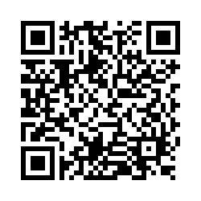
Questions?
Thank you! Thank you!
Please scan the QR code to provide us with your feedback!

