Slide 1
Equity in Data
March 6 & 7, 2024

Slide 2
What to Expect Today:
Outcomes:
See student data as the initial resource.
Use student data to locate needs.
View data through a lens of Equity.
Goals:
Provide WISExplore & other DPI resources
Time for you to reflect, share & plan
Feedback: What would you like more information on?
Notes:
Hello, I’m your host, CARRIE BOE from the Customer Services Team. Thank you for attending our session today.
Improve the practice of using collected data elements to improve student opportunities.
Understand educational rights and Opportunities reflected by the data.
Provide resources and tools on how to use that data to:
Create positive, predictable, safe and supportive environment for all students.

Slide 3
Total Workshop Session Timeline
Multiple facilitators will speak to different data elements over this two-part workshop:
Introduce data element, get juices flowing.
Where to find data element in WISE applications while facilitators assist in self-selected affinity groups
1:00 – 1:10: Opening slides,
1:10 – 2:25: Detailed review of data elements
2:25 – 2:30: Decide on data element for Session 2
End Session 1
2:30 – 2:45 BREAK: Soda, Coffee, Tea, Infused Water, Popcorn and Pretzels
Begin Session 2
2:45 – 3:00 Create affinity groups
3:00 – 3:45 Workshop
3:30/3:45 – 4:00 Wrap Up, Feedback
Notes:
And Hello – I am Carrie’s Co-Host, Kina Stringfellow, also from the Customer Services Team at DPI.
Here is an overview of our schedule for this afternoon. In this 2-part workshop session, we invite you to stay for both parts.
Part 1 is more of a “sit and get” and Part 2 will fully encompass the workshop format. Consider Part 1 as a series of mini-lessons.
Part 2 provides time for you to select any of the data elements discussed in Part 1 and workshop through strategies or action steps that apply to your local data.
In my introduction for this session, I want to cover the 6 W’s: who, what, when where, why and how.

Slide 4
Why We’re Hosting This Session
We know that using data to drive decision making, especially when we are trying to address inequities and close gaps, can be very impactful. As State Superintendent Dr. Underly said in an assessment press release:
“We’ve known Wisconsin’s racial disparities in assessment results are among the widest in the nation for too long, and these troubling results are yet one more indication that we must close the opportunity gap in our state. We need continued investment, intervention, and innovation in our state… to help put targeted resources and supports in our schools and ensure we are helping the students who need it the most at this critical time. They deserve no less, and neither do we.”
Ensuring that we have the most complete picture when it comes to student information is integral to understanding how to meet our students’ needs.
Notes:
KINA
Let’s start with Why – why are we offering this session?
Teachers are the most important school-based factor contributing to student outcomes.
School Leadership is the second most important school-based factor contributing to student outcomes.
And Wisconsin has held one of the worst positions for a very long time regarding racial disparities in education outcomes.
I am certainly not an expert on any of these topics.
But I know how very important this topic of educational equity is, and that it needs and deserves time and space to live and grow and be.

Slide 5
Facilitators
Demetri Beekman – Executive Director for Equity and Inclusion
Carrie Boe – CST, Choice School Liaison
Stacy Broach –OSS, Director of Operations and Partnerships and Innovation
Courtney Jenkins– SpEd, Assistant Director- Special Education Team
ananda mirilli – SpEd, Racial Equity Consultant
Christina Lopez and Sam Minch- Migrant Educator Coordinator
Kristine Nadolski- McKinney-Vento State Coordinator
Rachel Schemelin – ITS, Digital Equity Education Consultant
Kina Stringfellow – CST, Technical Writer
Mai Choua Thao – SpEd, District Improvement Consultant
Lauren Zellmer – OEA, Education Consultant (WISExplore) **attending 3:00-4:00
Notes:
Here’s the WHO – list all of the DPI colleagues attending this workshop.
EACH PERSON here today is a staff member at DPI. We are listed here alphabetically, with titles so that when we get to Session 2, you’ll know who to ask for.

Slide 6
Data Elements Presented Today
In order of appearance:
Race & Ethnicity
Ancestry & Ethnic Origins
Tribal Affiliation
Migrant Data
Immigrant, Refugee Data
EL Status
Economically Disadvantaged Status
Homeless Status
Special Education Status
Discipline
Attendance/Dropouts
Digital Equity
Notes:
These data elements make up the WHAT:
This collection of Data Elements best highlight students that fall within Wisconsin’s opportunity gaps. Students who identify with these data elements also tend to be the most under-reported, and historically marginalized student groups.
Wisconsin schools have Local Control.
We are here today to provide suggestions for what you COULD do with the resources and best practices that DPI supports and provides access to.
We are not here today to tell you what you MUST do. We respect the local control of our LEAs (within the parameters of Federal law and state Statutes).
.

Slide 7
How to Do This Personally: Four Agreements
Stay Engaged: Listen fully (ears, eyes and, heart) – Seek clarification to deepen understanding – Limit distractions – Notice disengagement & aim to re-engage.
Speak Your Truth: Use “I” statements – Share your story – Avoid blame and judgment – Share ‘messy’ but not ‘mean’.
Accept and Expect Non-Closure: More questions than answers – be open to the experience of others – allow others to enter conversations in different ways.
Experience Discomfort: Notice moments of discomfort – pay attention to your reactions to that discomfort, name it and lean in – Growth results from discomfort.
Adapted from Singleton and Linton, Courageous Conversations About Race
Notes:
KINA
Moving into the meatier aspects of today’s session, HOW.
The Four Agreements are the HOW – for each of us to practice on an individual level.

Slide 8
When You Use the Four Agreements:
See student data as the initial resource to solve local needs.
Find celebrations and areas for growth:
Reflect on celebrations, and analyze to find reason for success.
Problem solve areas for growth.
Give feedback to DPI by scanning the QR code on the last slide and giving us your genuine feedback on the evaluation form.
Notes:
KINA
During session 1, we’re going to encourage you to be aware of the Four Agreements on an individual level.
(Stay Engaged
Speak Your Truth
Accept and Expect Non-Closure
Experience Discomfort)
During Session 2, we’re going to have you shift that thinking towards a more systematic or organizational level of thinking.
Today’s session is the WHEN - We want you to use those four personal practices within this space to start creating solutions around your equity data pain points.

Slide 9
How to Do This: Systemically
Educational equity means that every student has access to the resources and educational rigor they need at the right moment in their education, across race, gender, ethnicity, language, ability, sexual orientation, family background, and/or family income.
Notes:
KINA
This is the HOW on a systemic level – educational equity, providing a student what they need when they need it, is the tool that will use to figure out how to close our gaps rework our pain points.

Slide 10
Where Are the Celebrations/Areas for Growth?
Effective Instruction: Each student is taught by teachers using high-quality, standards-aligned, culturally responsive materials and practices.
School and Instructional Leadership: Each student's needs are met in schools led by high quality and effective educators.
Family and Community Engagement: Each student attends a school that authentically engages with families, communities, and libraries.
Safe and Supported Students: Each student learns in an environment that promotes social, emotional, and physical well-being and removes barriers to learning.
Meaningful Relationships with Students: Each student has meaningful connections with at least one adult in their school.
Source: https://dpi.wi.gov/statesupt/every-child-graduate
Notes:
KINA
Finally, for where – the WHERE is your DATA.
Where in your data can you find celebrations and areas for growth?
We’ll get more into these five focus areas in Session 2, because remember that Session 1 is starting with you as an individual. How YOU, personally and professionally react and relate to the data elements we’ll present before you.
WHERE are your successes?
WHERE are your pain points?
In session 2, we’ll use these five focus areas will serve as the essential questions, as you peruse your school's data.

Slide 11
Turn & Talk or Stop & Jot Thoughts, Questions, Noticings
Important points
Jot down something you can add to the evaluation feedback form later…
Circling in your head
‘Squares’ with your thinking
Notes:
We know that 90 minutes is too long to just sit passively, so we’ve peppered this slide throughout the presentation to conclude each data element.
We would love to give you 3 mins but we know how 3 minutes can turn into 5, and since we don’t want to run out of time, we’re going to provide 1 and expect 2-3.
Whenever you see this slide, either chat with a shoulder partner, or spend some time being introspective. You can also compile feedback that you want to give to DPI in this sessions evaluation.
And now I will pass things over to Ananda and Courtney who will kick us off with the race and ethnicity data element.

Slide 12
Data Element: Race & Ethnicity
Race & Ethnicity
Purpose of discussing this data
As defined for reporting to DPI
State data
Areas for growth for these students
Turn and talk
Notes:
ANANDA
COURTNEY

Slide 13
Race: Purpose
Racial and ethnic data are used in federal education reports that districts and states submit to receive federal funds.
Race and ethnicity have always been collected and reported to the U.S. Department of Education.
The reports are required for federal eligibility and accountability reports.
The Office for Civil Rights collects data to assist with its enforcement of laws prohibiting discrimination on the basis of race and national origin.
Notes:
ANANDA
COURTNEY

Slide 14
Race and Ethnicity Defined
Race:
Asian, American Indian or Alaskan Native, Black or African American, Native Hawaiian or Other Pacific Islander, White
Consider home language when identifying a student’s Ethnicity and Race.
Ethnicity:
Hispanic: Government terminology, based in US context
Preferred terminology: Latino/Latina/Latinx/Latine – an ethnic group with multiple racial identities
Notes:
ANANDA
COUTRNEY
Government terminology Hispanic/ need to use Latina/Latinx
Spending time separating and distinguishing the terms Race and Ethnicity
That these terms are based in US context
“Hispanic” - Latino/Latina/Latinx – as an ethnicity with multiple racial identities
These terms are based on our best thinking right now, many LEAs are struggling with understanding and compliance of this
Consider home language

Slide 15
Race/Ethnicity Student Reporting
Question Part I | Answer Part I
Is the person Hispanic or Latino? | Hispanic or Latino
 | Not Hispanic or Latino
Question Part II | Answer Part II
Select one or more of the following categories that apply to this person: | American Indian or Alaska Native
 | Asian
 | Black or African American
 | Native Hawaiian or Other Pacific Islander
 | White
Notes:
ANANDA
COUTRNEY
Notice that DPI does use one of the preferred nomenclatures (Latino)

Slide 16
Statewide Enrollment by Race/Ethnicity
WISEdash Public Compare Enrollment Count by Race/Ethnicity (2022-23)
Notes:
ANANDA
COUTRNEY
White 67.2 = 553,044
Hispanic 13.6 = 111,830
Black 8.8 = 71,767
Two or More 5.1 = 42,343
Asian 4.2 = 34,714
American Indian 1.0 = 8,469
Pacific Islander 0.1 = 636
Unknown = 0%
https://wisedash.dpi.wi.gov/Dashboard/dashboard/18141 - accessed on 12/14/2023

Slide 17
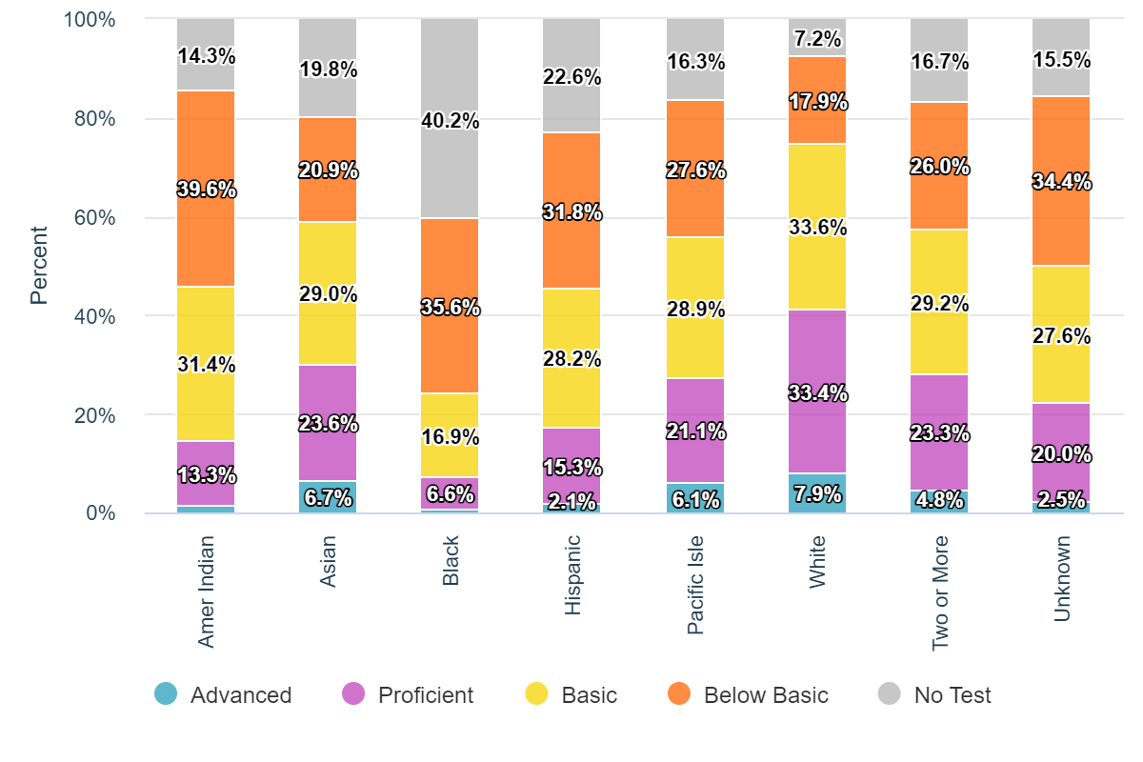
Race / Ethnicity: Data
Wisconsin’s racial disparities in assessment data are egregious.
WISEdash Public Portal 2020-21 statewide English Language Arts data
Notes:
ANANDA
COUTRNEY
Explain WHY this data element is being focused on – support/prove the WHY with data or Federal / State Statute – which is likely founded is evidence based on data indicating a strong need to build awareness and increase opportunities for this population
https://dpi.wi.gov/news/releases/2022/racial-disparities-and-our-collective-will
https://wisedash.dpi.wi.gov/Dashboard/dashboard/19948?filtersetId=c89abea4-003c-4ab9-9ca1-67521c2be139
https://www.nationsreportcard.gov/profiles/stateprofile/overview/WI?cti=PgTab_GapComparisons&chort=1&sub=RED&sj=WI&fs=Grade&st=MN&year=2019R3&sg=Race%2FEthnicity%3A%20White%20vs.%20Black&sgv=Difference&sgvs=desc&ts=Single%20Year&tss=2019R3&sfj=NP
This is the reality of the achievement gap in Wisconsin. It cannot continue this way; we are failing our students of color, and one factor in that failure is in the language we use to describe it. The word achievement places both the possibility of success and blame for failure on the child, and that is not where it belongs.
https://www.wpr.org/education/wisconsin-has-widest-gap-us-math-reading-scores-among-white-and-black-students#:~:text=Race%2C%20Social%20Issues-,Wisconsin%20has%20widest%20gap%20in%20the%20US%20for%20math%2C%20reading,among%20white%20and%20Black%20students&text=Wisconsin%20saw%20the%20widest%20disparity,since%20the%20COVID%2D19%20pandemic.
https://www.jsonline.com/story/news/education/2022/10/24/naep-report-card-wisconsin-has-widest-score-gap-between-black-and-white-students/69581393007/
https://www.cbs58.com/news/nations-report-card-shows-widest-opportunity-gap-between-black-and-white-students-in-wisconsin

Slide 18
Race: Areas of Growth
Tutoring and other evidence-based programs
Implement and ensure students are receiving grade-level, standards-based instruction and curriculum
Use existing support teams to create needed student supports
Survey staff and students about perceptions of safety and belonging
Engage community members to share resources
Engage with families of all races to find ways to celebrate different racial identities
Hold staff book club discussions on topics staff wants to know more about
Notes:
ANANDA
COUTRNEY

Slide 19
Turn & Talk or Stop & Jot on Race Data Thoughts, Questions, Noticings
Important points
Jot down something you can add to the evaluation feedback form later…
Circling in your head
‘Squares’ with your thinking
Notes:
3 mins total
Turn and talk or jot a post note

Slide 20
Data Element: Ancestry, Ethnic Origins
Ancestry, Ethnic Origins
Purpose of discussing this data
Federal reporting categories
Areas for growth for these students
Turn and talk
Notes:
This collection of Data Elements best highlight students that fall within Wisconsin’s opportunity gaps. Students who identify with these data elements also tend to be the most under-reported, and historically marginalized student groups.
Wisconsin schools have Local Control.
We are here today to provide suggestions for what you COULD do with the resources and best practices that DPI supports and provides access to.
We are not here today to tell you what you MUST do. We respect the local control of our LEAs (within the parameters of Federal law and state Statutes).
.

Slide 21
Ancestry/Ethnic Origins: Purpose
Ancestry/Ethnic Origins data element describes racial or ethnic subgroups to which a student belongs and is optional but recommended.
Collecting ancestry/ethnic origin data for Hispanic, Black or African-American, and Asian students
The racial categories for which DPI is most often asked for further breakdown information by community organizations
The ancestry/ethnic origin categories that receive the most attention in educational research and evaluation
Data element captures more specific information than the Race/Ethnicity data element so that schools and districts can better target programs to support students from marginalized groups.
Notes:
Mai Choua/ ananda/ Courtney
•
This information will not impact college entrance.
•
This information will not be publicly reported at the individual student level.
• This information will not impact whether or not your student can attend school.
• While the information is collected for individual students, it will only be publicly reported for groups of students. The reports provided by the department are required to protect every student’s identity, and the group of students must be large enough so that no individual student can be identified.
• This information will not be tied to teacher performance or evaluation.

Slide 22
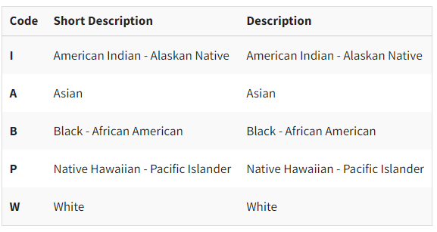
Federal Reporting Categories
Two Part Question
Is this student Hispanic/ Latino? Yes/ No
Select one or more of the following categories that apply to this person:
Notes:
Mai Choua
Federal categories masked the sub categories, not allowing to see all the barriers we need to see as decision makers, and see the needs of our students.

Slide 23
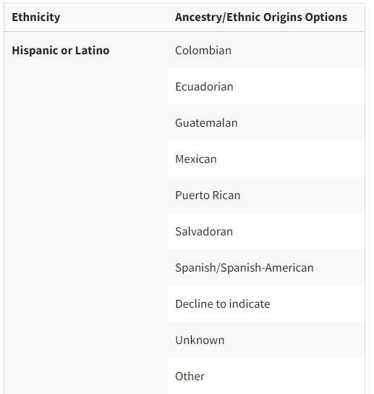
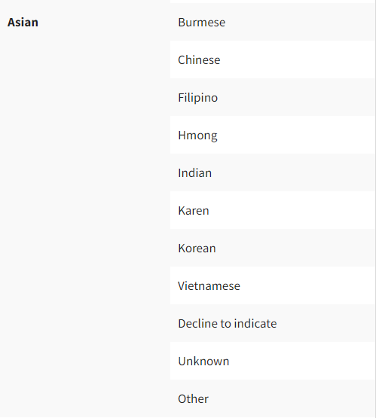
Ethnic Origins: Hispanic/Latinx and Asian
Notes:
Mai Choua
Minnesota as a model
CRT Culturally Responsive Teaching practices
Revisiting curriculum for inclusive content
Drivers of Inequity
While the United States is often described as a nation of immigrants, attitudes toward immigrants have fluctuated over time and have consistently favored White and European-born migrants. During the first half of the 20th century, the United States relied on a national-origins system that favored Northwestern Europeans and barred Asians through explicitly racist policies. In 1965, Congress enacted policy changes meant to unite immigrant families and attract skilled labor, leading to more immigration from Asia and Latin America. These later demographic patterns remain true today. Under President Trump, however, several policy changes including increased militarization of the border and the "travel ban" against seven Muslim-majority countries have contributed to decreased immigration rates since 2008. https://nationalequityatlas.org/indicators/Nativity-and-ancestry#/
Only about one in five Tongan, Samoan, Laotian, and Cambodian working age adults have an AA degree or higher, proportions similar to those of Latinos (20 percent) and Native Americans (23 percent). On the other hand, some South and East Asian groups have the some of the highest levels of educational attainment: roughly three-quarters of Indian (77 percent) and Taiwanese Americans (75 percent) have a BA degree of higher.
https://nationalequityatlas.org/data-in-action/difference-in-educational-attainment
https://americanprogress.org/wp-content/uploads/2019/05/Wisconsin.pdf?_ga=2.84582876.496534482.1677624201-664829474.1677624201

Slide 24
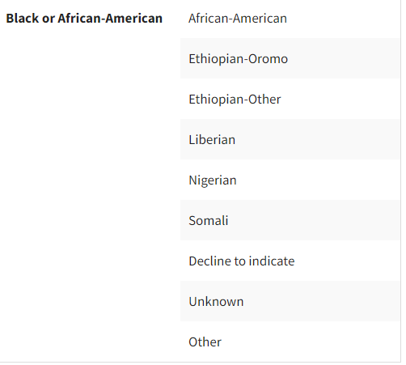
Ethnic Origins: Black / African-American
Notes:
Mai Choua

Slide 25
Ancestry/Ethnic Origin Areas of Growth
Student subgroups are hidden under the federal general categories (e.g., Hmong students in the Asian category).
Develop DPI tools to see students according to ancestry/ethnic origins in groups.
Work within WISEdash crosstabs to build student success.
Annual report release of performance and outcomes of students according to Ancestry/Ethnic Origins.
Notes:
Mai Choua

Slide 26
Turn & Talk or Stop & Jot on Ancestry Data Thoughts, Questions, Noticings
Important points
Jot down something you can add to the evaluation feedback form later…
Circling in your head
‘Squares’ with your thinking

Slide 27
Data Element: Tribal Affiliation
Tribal Affiliation
As defined for reporting to DPI
Statewide data
Purpose of discussing this data
Areas for growth for these students
Turn and talk
Notes:
CARRIE
This collection of Data Elements best highlight students that fall within Wisconsin’s opportunity gaps. Students who identify with these data elements also tend to be the most under-reported, and historically marginalized student groups.
Wisconsin schools have Local Control.
We are here today to provide suggestions for what you COULD do with the resources and best practices that DPI supports and provides access to.
We are not here today to tell you what you MUST do. We respect the local control of our LEAs (within the parameters of Federal law and state Statutes).
.

Slide 28
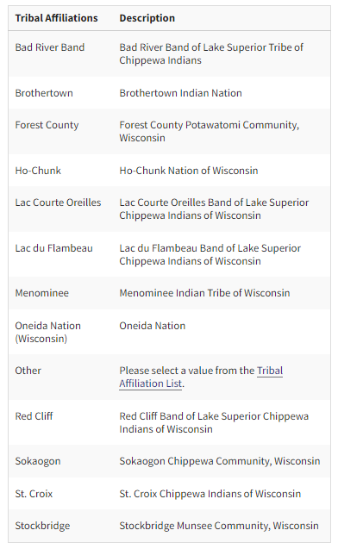
Tribal Affiliations: Defined
The Tribal Affiliation data element allows schools to collect and report tribal affiliations for American Indian students who identify (e.g., enrolled, a descendant of, affiliated with) with a tribe recognized by the federal government*.
This data collection can help to develop, test, and demonstrate the effectiveness of services and programs to improve the educational achievements of American Indian children and youth.
*Brothertown tribe is not federally, or state recognized. However, they are a nation that calls Wisconsin home.
Notes:
CARRIE
Targeting supports and services and knowing where to provide resources
Consultation between tribal nations and school districts – partnerships can become more specific by Nation or Tribe
Title 6 funding/forms - alignment of funding, services and programming based on that identification (does not go through DPI – goes directly from School to Title 6.
LEAs are asked to have consultations with Nation/Tribal groups. This will allow for further conversations with how many nations in that district attend there. It helps align with the Title 6 programs, so they can receive the proper allocations for funding.
63 state recognized nations – Dual Citizenship
Warnings 7151 7152
The Asterisk Nation
While American Indians and Alaska Natives are an integral and unique part of US society, we continue to be invisible to most other Americans due to an absence of data, accurate media images, and historical and contemporary awareness about Native peoples in schools, healthcare facilities, professions, military service, and daily life.
This invisibility is perpetuated by federal and state agencies and policies that leave American Indians and Alaska Natives out of data collection efforts, data reporting and analysis, and/or public media campaigns. American Indians and Alaska Natives may be described as the “Asterisk Nation” because an asterisk, instead of data point, is often used in data displays when reporting racial and ethnic data due to various data collection and reporting issues, such as small sample size, large margins of errors, or other issues related to the validity and statistical significance of data on American Indians and Alaska Natives.
There is a critical need for accurate, meaningful, and timely data collection in American Indian/Alaska Native (AI/AN) communities. Federal agencies are charged with collecting data in AI/AN communities, as well as from the general US population, in order to determine budget requests; support and strengthen budget justifications; allocate resources; provide services; conduct strategic planning; and comply with statutory and regulatory reporting processes. Accurate data collection and community-based planning captures true needs, and thus can drive larger programmatic investments resulting in a cost-effective use of tribal, federal, and private resources. Without quality data, policymakers and community planners cannot set policy goals, monitor implementation, measure impact, or plan for demographic shifts in an effective way. The absence of American Indian and Alaska Native peoples in data and policy domains reflects the lack of a national public discourse on the status of our nation’s First Peoples.
In addition, the research and data on the importance of Native cultures and languages is taking place at a local, and often isolated, level such that national Indian policy research rarely accounts for or highlights the value of Native cultures and languages. A coordinated and comprehensive approach is needed for measuring and reporting how Native cultures and languages matter, especially in light of the rapidly changing demographics in the US and in Indian Country. https://www.ncai.org/policy-research-center/research-data/data

Slide 29
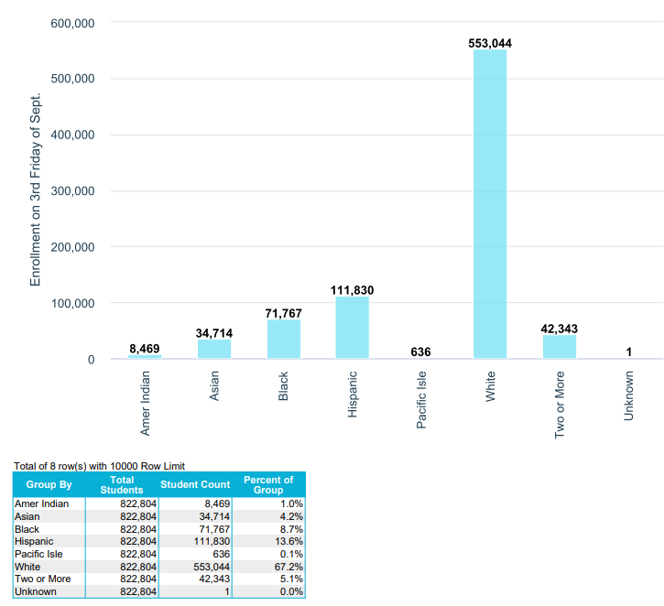
Statewide Enrollment by Tribal Affiliation
WISEdash Public Compare Enrollment Count by Race/Ethnicity (2022-23)
Notes:
Carrie
American Indian 1.0 = 8,469

Slide 30
Tribal Affiliation: Purpose
The Tribal Affiliation data element allows schools to collect and report tribal affiliations for American Indian students who identify (i.e., enrolled, a descendant affiliated with, member) with a tribe recognized by the federal government.
This data collection is currently not required but is currently being considered in legislation, and expected to be required in upcoming years so implementing a process to accommodate this collection is vital.
There is a critical need for accurate, meaningful, and timely data collection in tribal nations and communities.
The importance of collaboration and partnership through formal government to government relationships helps to ensure that Wisconsin’s American Indian students have the resources they need to become college and career ready.
Notes:
CARRIE,
https://www.ncai.org/policy-research-center/research-data/data
While American Indians and Alaska Natives are an integral and unique part of US society, we continue to be invisible to most other Americans due to an absence of data, accurate media images, and historical and contemporary awareness about Native peoples in schools, healthcare facilities, professions, military service, and daily life.

Slide 31
Tribal Affiliation: Areas of Growth
Sense of Belonging – “invisibility” due to:
Absence of data (embedded within category of "Two or More" races)
Inaccurate media images (cultural misappropriation) such as stereotypes and cultural omissions
Historical and contemporary awareness about Indigenous peoples in United States culture
Efforts for tribes/nations to obtain federal or state recognition (e.g., Lumbee tribe is recognized in state of North Carolina, but not federally recognized).
Notes:
CARRIE
When a student identified as two or more races, they do not show up in the 'other' selected race/ethnicity categories. They only appear in the category "two or more' races.
https://www.ncai.org/policy-research-center/research-data/data
While American Indians and Alaska Natives are an integral and unique part of US society, we continue to be invisible to most other Americans due to an absence of data, accurate media images, and historical and contemporary awareness about Native peoples in schools, healthcare facilities, professions, military service, and daily life.
+++++++++++++++++++++++++
From: Piazza, Susan S. DPI <Susan.Piazza@dpi.wi.gov> Sent: Friday, February 10, 2023 9:10 AM To: Kammerud, Jennifer DPI <Jennifer.Kammerud@dpi.wi.gov>; OLS Investigator <OLSInvestigator@dpi.wi.gov>; Sherman, Paul A. DPI <Paul.Sherman@dpi.wi.gov> Cc: DPI SSPW <dpisspw@dpi.wi.gov>; DPI CRM <crm@dpi.wi.gov>; Jones, Michelle A. DPI <Michelle.Jones@dpi.wi.gov> Subject: RE: New Incident Created CRM:00600037972
Thanks, Jennifer. I think a template response may be good, although I often hesitate with template response unless he inquiry is verbatim/duplicate of one that the template response is drafted for.
I think given the circumstances here, I’d prefer to forward on so that the response comes from either OLS or LEAD.
Thanks,
Susan
Susan Piazza | she/her (what’s this?)
Director | Student Services, Prevention and Wellness Team
Wisconsin Department of Public Instruction
(608) 266-5198 | susan.piazza@dpi.wi.gov
DISCLAIMER: The content of this email is for informational purposes only and not for the purpose of providing legal advice. You should contact your attorney to obtain legal advice, including compliance with state and federal laws and regulations.
From: Kammerud, Jennifer DPI <Jennifer.Kammerud@dpi.wi.gov> Sent: Friday, February 10, 2023 8:06 AM To: OLS Investigator <OLSInvestigator@dpi.wi.gov>; Piazza, Susan S. DPI <Susan.Piazza@dpi.wi.gov>; Sherman, Paul A. DPI <Paul.Sherman@dpi.wi.gov> Cc: DPI SSPW <dpisspw@dpi.wi.gov>; DPI CRM <crm@dpi.wi.gov>; Jones, Michelle A. DPI <Michelle.Jones@dpi.wi.gov> Subject: RE: New Incident Created CRM:00600037972
Stephanie, Let’s talk as she’s not showing up in our other system. We may have a tech problem here.
Jennifer Kammerud
Director
Licensing, Educator Advancement and Development (LEAD) Team
Wisconsin Department of Public Instruction
Phone: (608) 228-8160
Email: Jennifer.kammerud@dpi.wi.gov
Schedule a Meeting with Jennifer
From: OLS Investigator <OLSInvestigator@dpi.wi.gov> Sent: Friday, February 10, 2023 8:05 AM To: Kammerud, Jennifer DPI <Jennifer.Kammerud@dpi.wi.gov>; Piazza, Susan S. DPI <Susan.Piazza@dpi.wi.gov>; Sherman, Paul A. DPI <Paul.Sherman@dpi.wi.gov>; OLS Investigator <OLSInvestigator@dpi.wi.gov> Cc: DPI SSPW <dpisspw@dpi.wi.gov>; DPI CRM <crm@dpi.wi.gov>; Jones, Michelle A. DPI <Michelle.Jones@dpi.wi.gov> Subject: RE: New Incident Created CRM:00600037972
The individual does have a SEPA license and it was placed under investigation yesterday. 😊
From: Kammerud, Jennifer DPI <Jennifer.Kammerud@dpi.wi.gov> Sent: Friday, February 10, 2023 7:35 AM To: Piazza, Susan S. DPI <Susan.Piazza@dpi.wi.gov>; Sherman, Paul A. DPI <Paul.Sherman@dpi.wi.gov>; OLS Investigator <OLSInvestigator@dpi.wi.gov> Cc: DPI SSPW <dpisspw@dpi.wi.gov>; DPI CRM <crm@dpi.wi.gov>; Jones, Michelle A. DPI <Michelle.Jones@dpi.wi.gov> Subject: RE: New Incident Created CRM:00600037972
If we continue to receive these, and are certain it is the same incident and individual involved, then there is no need to continue to forward them to the OLS investigator inbox as we are looking into it. I’m not sure how Paul would like this handled. In this instance, and for your awareness, we can look into this and make note for future reference, but there is little we can do on the licensing side as this individual does not need to be licensed to hold the position as a regular education paraprofessional and is not a license holder.
I can provide you with a template response if you would like from the licensing side of things.
Jennifer
Jennifer Kammerud
Director
Licensing, Educator Advancement and Development (LEAD) Team
Wisconsin Department of Public Instruction
Phone: (608) 228-8160
Email: Jennifer.kammerud@dpi.wi.gov
Schedule a Meeting with Jennifer
From: Piazza, Susan S. DPI <Susan.Piazza@dpi.wi.gov> Sent: Thursday, February 9, 2023 3:39 PM To: Sherman, Paul A. DPI <Paul.Sherman@dpi.wi.gov>; OLS Investigator <OLSInvestigator@dpi.wi.gov>; Kammerud, Jennifer DPI <Jennifer.Kammerud@dpi.wi.gov> Cc: DPI SSPW <dpisspw@dpi.wi.gov>; DPI CRM <crm@dpi.wi.gov>; Jones, Michelle A. DPI <Michelle.Jones@dpi.wi.gov> Subject: RE: New Incident Created CRM:00600037972
Looks like we are getting more of these Black River Falls inquiries (they are going to the Customer Services Team and then passed on to SSPW)
Stephanie, I’m passing this one along to you as well. How do you want SSPW and CST to proceed if more come in? Shall they go directly to the OLS Investigator mailbox or Stephanie’s email. Does anyone else need to be copied (Susan, Jennifer, Paul)?
Thanks.
Susan
Susan Piazza | she/her (what’s this?)
Director | Student Services, Prevention and Wellness Team
Wisconsin Department of Public Instruction
(608) 266-5198 | susan.piazza@dpi.wi.gov
DISCLAIMER: The content of this email is for informational purposes only and not for the purpose of providing legal advice. You should contact your attorney to obtain legal advice, including compliance with state and federal laws and regulations.
From: DPI SSPW <dpisspw@dpi.wi.gov> Sent: Thursday, February 9, 2023 3:30 PM To: Piazza, Susan S. DPI <Susan.Piazza@dpi.wi.gov> Subject: FW: New Incident Created CRM:00600037972
Susan,
Here is the message.
Thank you,
Elizabeth
------------------- Original Message ------------------- From: DPI CRM <crm@dpi.wi.gov>; Received: Thu Feb 09 2023 10:14:09 GMT-0600 (Central Standard Time) To: Bethany Redbird <bethany_redbird@yahoo.com>; Subject: New Incident Created CRM:00600037972
Thank you, Bethany, for submitting your request.
Case Details:
Case #: CAS-48819-P3Z0F0
Date Submitted: 2/9/2023 10:13 AM
Description: Good Morning, A recent racist and discriminatory incident occurred at the Black River Falls High School this week and needs to be addressed immediately. There was a video posted to Facebook that details an Aide saying, "You dont' care, I don't care if you get a D minutes, you're Native right? You're just gonna collect a check and don't have to give two shits about your future, so why should I care?" This type of discrimination should not be tolerated in our school system. We know our Native students face racism on a daily basis, and we continue to work with the BRFSD on professional development as the Ho-Chunk Nation Education Department, but things like this derail all the work we have done and proves that there is so much more work to be done. We need to see action on this! We need schools/staff to understand how serious this incident was, and how our Native students face this every day. People act surprised, but this is what our students face all the time. This is nothing new. Serious and swift action must be taken! Lara Sahr must be terminated, and we must demand teachers learn more about microagressions and racism so they can try to understand what our kids go through.
Thank you, Customer Service Team

Slide 32
Six Indigenous Languages of WI
Hocak (Ho-Chunk)
Ojibwe
Oneida
Menominee
Mohican
Potawatomi
American Indian Studies Resources
Waadookodaading Ojibwe Language Immersion School
Notes:
This slide was borrowed from the Data Matters – World Language Education presentation being given by Pam DelFosse
There are 6 indigenous languages spoken by the 11 federally-recognized American Indian Nations in our state.
Prior to this year, course data for these languages was collected under the umbrella term, “American Indian Language”. We will now have language-specific course options and data to support Indigenous Language revitalization in our state. Many elder speakers of these languages were lost during the global health pandemic. Support for American Indian languages matters now more than ever. Thank you for your help collecting and reporting data on where these languages are being supported in our school communities.

Slide 33
Turn & Talk or Stop & Jot on Tribal Affiliation Data Thoughts, Questions, Noticings
Important points
Jot down something you can add to the evaluation feedback form later…
Circling in your head
‘Squares’ with your thinking

Slide 34
Data Element: Migrant Status
Migrant Status
Purpose of discussing this data
Statewide data
Available Services
Areas for growth for these students
Turn and talk
Notes:
SAM
CHRISTINA
This collection of Data Elements best highlight students that fall within Wisconsin’s opportunity gaps. Students who identify with these data elements also tend to be the most under-reported, and historically marginalized student groups.
Wisconsin schools have Local Control.
We are here today to provide suggestions for what you COULD do with the resources and best practices that DPI supports and provides access to.
We are not here today to tell you what you MUST do. We respect the local control of our LEAs (within the parameters of Federal law and state Statutes).
.

Slide 35
Migrant Student Reporting: Purpose
The shared mission of the Title I, Part C Migrant Education Program, and provisions of Title I, Part A of the Every Students Succeeds Act (ESSA), is to provide migratory students the supplemental instructional services and support they need to succeed.
Determination of Eligibility
Referral Tool
Notes:
CHRISTINA LOPEZ and SAM MINCH
A migratory student is someone who moves because they or their family are involved in seasonal agricultural work. Migratory students often move multiple times per year— experiencing interrupted schooling in addition to other educational barriers they may face. The shared mission of the Title I, Part C Migrant Education Program, and provisions of Title I, Part A of the Every Students Succeeds Act (ESSA), is to provide migratory students the supplemental instructional services and support they need to succeed.

Slide 36
Statewide Enrollment by Migrant Data
WISEdash Public Compare Enrollment Count by Migrant Status (2022-23)
Notes:
SAM
CHRISTINA
99.9% = 828,919
0.01% = 224 kids
https://wisedash.dpi.wi.gov/Dashboard/dashboard/18141

Slide 37
Migrant Status: Data
(Cat 1) Total number of children identified
(Cat 2) Students served in supplemental summer programing
Nationally, 90% of migrant children are of Latino origin, and 34% are EL
Notes:
SAM
CHRISTINA
This graph shows data from a different source.
Cat 1 displays the total number of Migrant students identified, and Cat 2 shows the amount of students from Cat 1 who are taking advantage of supplemental recourses. You can see from the amount of space between the blue line and the red line – the gap is students accessing resources is significant.
So again we must investigate the inputs that are creating those disparate results.
We need to question what we are doing as an education system that results in these disparities,
and what can we do to change those educator actions
and, in turn, those student outcomes? …
[Do] we have the collective will to reckon with these disparities and the need for belonging in our classrooms…[?]”

Slide 38
Migrant Student: Eligible Services
Migratory Students are Eligible for the Following Services:
Free school lunch (categorically eligible for the school year and summer)
Access to Title I, Part A services on the same basis as other students
Support services that can be provided through use of Title I, Part A reserved funds
Migrant Education Program (MEP) Summer Programming in literacy and mathematics, credit recovery and accrual, family engagement, UW STEM Day
Notes:
SAM
CHRISTINA
A migratory student is someone who moves because they or their family are involved in seasonal agricultural work. Migratory students often move multiple times per year— experiencing interrupted schooling in addition to other educational barriers they may face. The shared mission of the Title I, Part C Migrant Education Program, and provisions of Title I, Part A of the Every Students Succeeds Act (ESSA), is to provide migratory students the supplemental instructional services and support they need to succeed.

Slide 39
Migrant Status: Areas of Growth
Staff grows their awareness of:
Difference between Migrant, Immigrant
Definition of seasonal and temporary agricultural work
Use of WISE and how to use it
How to correctly identify migratory children with cultural sensitivity and without stereotyping by asking all new enrollments ("Have you worked in agriculture? Was the work temporary or seasonal? Have you moved in the last 36 months?")
Migrant family lived experiences (physical, socioeconomic, emotional, educational)
Notes:
SAM
CHRISTINA
Explain WHY this data element is being focused on – support/prove the WHY with data or Federal / State Statute – which is likely founded is evidence based on data indicating a string need to build awareness and increase opportunities for this population
https://www.colorincolorado.org/article/migrant-students-what-we-need-know-help-them-succeed#h-strategies-for-success
Physical hazards Migrant farmworkers have one of the most labor-intensive, physically-demanding, often hazardous yet grossly undercompensated occupations in the country
Isolation Migrant families tend to live in isolation from the communities where they work
Family separation It is not uncommon for parents and children to be separated if parents want the children to finish the school year in the same school while they move on to the next work site
Socioeconomic disadvantages Migrant children experience more acute poverty, health problems, health hazards, social alienation, educational disadvantages, mobility and lack of educational opportunities than any other major school population segment
Educational background Migrant parents have the lowest levels of educational attainment of any occupational group
Language Large numbers of migrant students lack English language proficiency (even though most are U.S. citizens) and/or require remedial instruction
Graduation rates Migrant children have one of the highest dropout rates in the nation
Program support Federally-funded programs for migrant children are not sufficiently funded to meet the children's needs

Slide 40
Turn & Talk or Stop & Jot on Migrant Data Thoughts, Questions, Noticings
Important points
Jot down something you can add to the evaluation feedback form later…
Circling in your head
‘Squares’ with your thinking

Slide 41
Data Element: Immigrant, Refugee
Immigrant, Refugee
Purpose of discussing this data
Statewide data
Areas for growth for these students
Turn and talk
Notes:
CARRIE
This collection of Data Elements best highlight students that fall within Wisconsin’s opportunity gaps. Students who identify with these data elements also tend to be the most under-reported, and historically marginalized student groups.
Wisconsin schools have Local Control.
We are here today to provide suggestions for what you COULD do with the resources and best practices that DPI supports and provides access to.
We are not here today to tell you what you MUST do. We respect the local control of our LEAs (within the parameters of Federal law and state Statutes).
.

Slide 42
Immigrant (T3) Data: Definition
Three criteria must be met for a student to qualify as an immigrant under the definition specified by ESSA:
Aged 3-21 as of the Third Friday of September,
Not born in any U.S. state, the district of Columbia or the Commonwealth of Puerto Rico
In U.S. schools for less than three full academic years, whether consecutive or not.
Notes:
AMY MACIOLEK
Immigrant (Title III) is an indication of whether or not a student qualifies as an immigrant under Title III, Section 3301 (6) of the ESSA.
Three criteria must be met in order for a student to qualify as an immigrant under the definition specified by ESSA:
Aged 3-21 as of the Third Friday of September,
Not born in U.S.,
In U.S. schools for less than three full academic years, whether consecutive or not.
If the student has a confirmed immigrant status, you should submit this information to WISEdata. If a district submits immigrant information for a student, the student's record will then display a value of Immigrant in the Student Details characteristics of WISEdata. If no immigrant information is submitted on a student, this is assumed to be a No value and nothing displays in the Student Details for this characteristic. Elements are all stored at the student level and shared across districts. Native Language code will also be required for those marked with immigrant status (unless PPP, DOC, DHS).

Slide 43
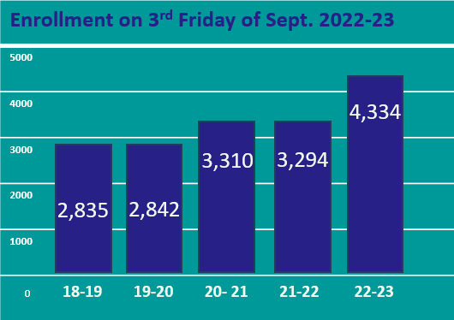
Wisconsin Demographics: Immigrant Students
SY | Total | LIEP | English Proficient | % 
22-23 | 4,334 | 3,169 | 1,165 | 30% 
21-22 | 3,294 | 2,196 | 1,098 | .4% 
20-21 | 3,310 | 2,206 | 1,104 | 16.4% 
19-20 | 2,842 | 1,547 | 1,295 | .2% 
18-19 | 2,835 | 1,489 | 1,346 | --------
Overall Increase in the last 5 years is
52.87 %
EDFacts Data submission
Retrieved: February 19, 2024
Notes:
State Context
Required Data Submission
5 Year Growth 52.87% increase

Slide 44
“Everyone” Means Everyone: Including Undocumented Students
In 1982, the Supreme Court determined in Plyler v. Doe that all students, regardless of their immigration status, are entitled to access to K-12 education.
A school district/personnel should not ask about a child’s or family’s citizenship or immigration status. “Immigration or citizenship status is not relevant and may have a chilling or a discouraging effect on student enrollment.
LEAs should consider the impact of asking for specific documentation, while enrolling students or establishing residency, or other situations where documentation may be required of caregivers (e.g., access to documentation such as a state issued ID, security system screening.)
Source
Notes:
AMY MACIOLEK
Whether they are citizens or not, migrant student are still protected by Constitutional rights in regards to access to education

Slide 45
Immigrant and Refugee Student Reporting
Immigrant/Refugee Families and Youth:
May/may not be fleeing danger or persecution: Youth may/may not understand why they left country of origin
May/may not be legally authorized to live and work in the US: Youth may/may not be financially well supported
May/may not be able to return to their country of origin: Youth may/may not want to be in US
Notes:
AMY MACIOLEK

Slide 46
Turn & Talk or Stop & Jot on Immigrant Data Thoughts, Questions, Noticings
Important points
Jot down something you can add to the evaluation feedback form later…
Circling in your head
‘Squares’ with your thinking

Slide 47
Data Element: EL Status
English Learner (EL) Status
Purpose of discussing this data
Testing and Service Expectations
Statewide data
Areas for growth for these students
Turn and talk
Notes:
This collection of Data Elements best highlight students that fall within Wisconsin’s opportunity gaps. Students who identify with these data elements also tend to be the most under-reported, and historically marginalized student groups.
Wisconsin schools have Local Control.
We are here today to provide suggestions for what you COULD do with the resources and best practices that DPI supports and provides access to.
We are not here today to tell you what you MUST do. We respect the local control of our LEAs (within the parameters of Federal law and state Statutes).
.

Slide 48
EL Status: Purpose
PI 13.08 Wis. Admin Code
English Language Proficiency codes (ELP codes) will be used for disaggregated reporting and accountability purposes, including:
State Report Cards, ESSA Report Cards, and Title III.
They are also used as a measure of the acquisition of English language proficiency and to determine the appropriate participation in WSAS.
Notes:
AMY MACIOLEK
Reporting this data supports students in our Wisconsin schools to continue growing in their proficiency of the English language, proficiency in English being a key resource to success in learning.
Native languages or first languages vary by your student population group. When I worked as a teacher, I know we had the pleasure of working with students who speak Hmong, Spanish, Vietnamese, Tamil, and Hindi. We also assisted refugee families who speak Ukrainian.
Under Title VI of the Civil Rights Act of 1964 and the Elementary and Secondary Education Act (ESEA) of 1965, and as reauthorized by the Every Student Succeeds Act of 2015 (ESSA) and Wisconsin state statutes, school districts throughout the state are required to identify in a uniform manner and provide services to English learners (ELs). This includes immigrant and migrant students, and students with disabilities.
The requirements for identifying, supporting, and reclassifying English learners (ELs) stem from multiple sources, including federal law and associated regulatory guidance, common law, and state law.
For support in understanding the ESSA required,WI state standardized proceedures for Identification Search EL Policy Handbook at the DPI website.

Slide 49
Civil Right Obligations (1 of 3)
Under Title VI of the Civil Rights Act of 1963 and Equal Education Opportunity Act, all states and LEAs must ensure that EL students can participate meaningfully and equally in educational programs and services.
Identify and assess all potential EL students in a timely, valid and reliable manner.
Provide EL students with a language assistance program that is educationally sound, sufficiently staffed, has sufficient resources and proven effective.

Slide 50
Civil Right Obligations (2 of 3)
Ensure that all ELs students have equal opportunities to meaningfully participate in all curricular and extra curricular activities.
Avoid unnecessary segregation of EL students
Ensure that students who have or suspected of having a disability under IDEA (identified, located, and evaluated in a timely manner-language needs are considered in evaluations and delivery of services.
Meet the needs of EL students who have been opted out of language instruction.

Slide 51
Civil Right Obligations (3 of 3)
Monitor and evaluate ELs progressing attaining English proficiency and grade-level content knowledge, monitor exited students for 2 years.
Evaluate the effectiveness of your EL programs students attaining English proficiency and that each program is reasonably calculated to allow students to attain parity of participation in the standard educational program.
Ensure meaningful communication with LEP parents/caregivers.

Slide 52
EL Testing and Service Expectations
Federal and State requirements: Annual testing required for students not participating in an EL program
District including this data element in the effectiveness of their programs
Ensure students are progressing towards full English proficiency
Serves as the single most psychometrically valid and reliable measure of a student’s ELP
WIDA’s English Language Development Standards advance language development and academic achievement for linguistically and culturally diverse students and youth
Notes:
AMY MACIOLEK
Federal and State requirements: Annual testing
Ensure students are progressing towards full English proficiency
Serves as the single most psychometrically (Theory and techniques of measurement – basically it the study of testing and assessing) valid and reliable measure of a student’s ELP
WIDA’s English Language Development Standards advance language development and academic achievement for linguistically and culturally diverse students and youth

Slide 53
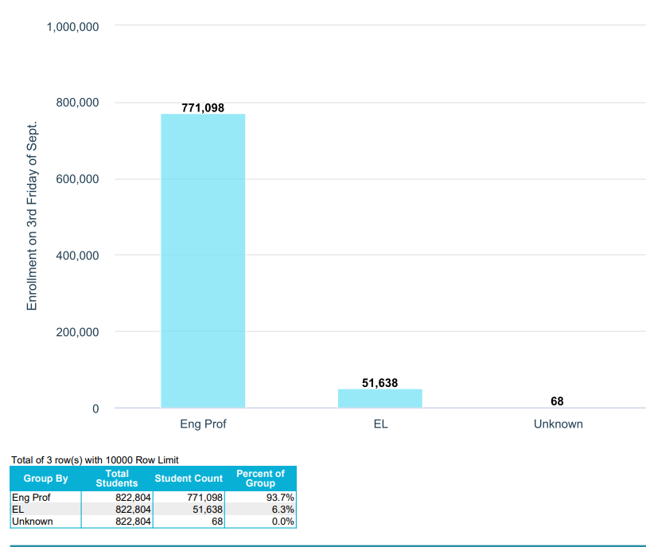
Statewide Enrollment by EL Status
WISEdash Public Compare Enrollment Count by EL Status (2022-23)
Notes:
AMY MACIOLEK
94% = 779, 200 kids
6% = 49, 812 kids

Slide 54
Top Languages
Language​ | Percent​
Spanish​ | 67%​
Hmong​ | 12%​
Arabic​ | 2.1%​
Burmese​ | 1.7%​
Karen​ | 1.2%​
Chinese​ | 1.1%​
Somali​ | 1.0%​
Swahili​ | <1%​
Vietnamese​ | <1%​
Albanian​ | <1%​
Russian​ | <.5%​

Slide 55
Hmong Language Data in Wisconsin
“I feel more confident talking about myself…I feel like I can show my Hmong, instead of holding it in.”
~Ani
(Student within Hmong Language and Culture Enrichment Program)
Wisconsin Life: Hmong Culture
Notes:
This slide was borrowed from the Data Matters – World Language Education presentation being given by Pam DelFosse
We also began collecting data on Hmong language learning this school year. Hmong is the 3rd most spoken language in Wisconsin. Language is an important element of one’s culture and identity. This new data set will help us identify which schools are teaching Hmong so that we can improve our systems of support for Hmong language programs and the diversity of students within them.

Slide 56
EL Status: Areas of Growth
140+ identified languages spoken by Wisconsin students: Spanish, Hmong
Behaviors interpreted as a “will deficit” instead of a “skill deficit”
Resources: classroom instruction, materials, staff
CRT Culturally Responsive Teaching
Grow student confidence and ability to: listen, speak, read, and write in non-native language
Engage families and community, professional development, classroom instruction
Notes:
AMY MACIOLEK
Spanish and Hmong are the most common first language for EL students
Not knowing English can result in students not following school or classroom rules based on misunderstanding. Its important to interpret behaviors as a skill deficit as opposed to a will deficit. And remember that Culturally Responsive Teaching encompasses: Will, Skill and Fill.
We have to have the will to learn about our student’s cultural heritage and practices – and believe that all students can learn
We have to gain skills to LEAD the way in Educational Equity by accepting the responsibly of filling our own knowledge gaps and using practices and curriculum that respect our students cultures
We also need to check our assumptions (read last three bullets)

Slide 57
Turn & Talk or Stop & Jot on EL Data Thoughts, Questions, Noticings
Important points
Jot down something you can add to the evaluation feedback form later…
Circling in your head
‘Squares’ with your thinking

Slide 58
Data Element: Economic Disadvantaged Status
Economic Disadvantaged Status
Purpose of discussing this data
Statewide data
Areas for growth for these students
Turn and talk
Notes:
ANANDA
COURTENY
This collection of Data Elements best highlight students that fall within Wisconsin’s opportunity gaps. Students who identify with these data elements also tend to be the most under-reported, and historically marginalized student groups.
Wisconsin schools have Local Control.
We are here today to provide suggestions for what you COULD do with the resources and best practices that DPI supports and provides access to.
We are not here today to tell you what you MUST do. We respect the local control of our LEAs (within the parameters of Federal law and state Statutes).
.

Slide 59
Economically Disadvantaged Status: Purpose
“Qualifies for Free/Reduced Meals”
Accountability purposes: the Education Data Exchange Network (EDEN),
E-rate, and certain child nutrition program purposes
Data element is used to disaggregate attendance, retention, dropout, and graduation rate data by economic status.
Students, including those enrolled in a school participating in the Community Eligibility Program (CEP), must be individually evaluated every school year to determine ED status. ED status must be reported for students regardless of whether or not the school participates in the National School Lunch Program.
Notes:
ANANDA
COURTENY
Economically Disadvantaged Status codes are used for disaggregated reporting and accountability purposes, the Education Data Exchange Network (EDEN), E-rate, and certain child nutrition program purposes. This data element is used to disaggregate attendance, retention, dropout, and graduation rate data by economic status. Economically disadvantaged status indicators were included in Pre-ID files for statewide testing and used for disaggregated reporting of test results and participation.
When determining economic status, focus on whether a family meets the threshold (eligibility for reduced price meals); no more detail is necessary. The school or district’s participation in the USDA National School Lunch Program must be determined prior to going through the process of determining Economically Disadvantaged status for students.
Every public school student in every grade in every public school, all Choice students and in some cases all private students at a private school participating in the Milwaukee, Racine, or Wisconsin Parental Choice Program must be queried each year to find economically disadvantaged (ED) status.

Slide 60
Statewide Enrollment for Econ Disadv
WISEdash Public Compare Enrollment Count by Economic Status (2022-23)
Notes:
ANANDA
COURTENY
59.9% = 496, 317
40.1% = 332, 810
0% = 16 students Unknown

Slide 61
Economically Disadvantaged Status: Areas of Growth
Disadvantaged children fare worse in almost all well-being areas:
Poor health, including socio-emotional health: lower self-esteem, lower life satisfaction, multiple health complaints
Interconnectedness of living in poorer environments across home, school, and community require support across multiple domains.
Multiple domains require government administrations, community shareholders, and community members to create and work towards common goals.
Notes:
ANANDA
COURTENY
https://www.oecd.org/wise/Starting-unequal-How-is-life-for-disadv
Disadvantaged children fare worse in almost all well-being areas The indicators presented in Starting Unequal show that, across well-being areas, children from socially and economically disadvantaged backgrounds frequently experience worse outcomes than their more advantaged peers.
For example, children from disadvantaged backgrounds: • still too often lack access to basic material necessities, including basic food and nutrition, good quality housing, and modern necessities like the internet. For example, on average across European OECD countries, more than 10% of low income children are living in very poor quality housing. • are more likely to experience poor health outcomes, with those with low socio-economic status over-represented among children reporting poorer self-rated health, as well as among overweight and obese children. On average across OECD countries, more than one in six disadvantaged 11-, 13-, and 15-year olds rate their own health as only “fair” or “poor”, compared to one in ten among the most advantaged. And, around 25% of disadvantaged children in this age group are considered overweight or obese based on the World Health Organization’s definition, compared to 16% from the most advantaged households. • do worse in education. They are far less likely to perform well on international student assessments, such as OECD PISA. For instance: on average across OECD countries, only 6% of disadvantaged 15-year-olds reached “top performer” status on the OECD PISA tests, compared to 29% among the most advantaged. They are also far more likely to report limited ambitions for future education. • more often report poorer social and emotional outcomes, including weaker perceived support from family, lower self-belief, and lower life satisfaction. On average across the OECD, as many as 19% of disadvantaged 15-year-olds report low satisfaction with their life as a whole, compared to 14% among the most advantaged, with gaps as large as 10 percentage points in some countries. antaged-children-Policy-Insights-July-2022.pdf

Slide 62
Turn & Talk or Stop & Jot on Econ Data Thoughts, Questions, Noticings
Important points
Jot down something you can add to the evaluation feedback form later…
Circling in your head
‘Squares’ with your thinking

Slide 63
Data Element: Homelessness Status
Homelessness Status
Purpose of discussing this data
Statewide data
Areas for growth for these students
Turn and talk
Notes:
KRISTINE
This collection of Data Elements best highlight students that fall within Wisconsin’s opportunity gaps. Students who identify with these data elements also tend to be the most under-reported, and historically marginalized student groups.
Wisconsin schools have Local Control.
We are here today to provide suggestions for what you COULD do with the resources and best practices that DPI supports and provides access to.
We are not here today to tell you what you MUST do. We respect the local control of our LEAs (within the parameters of Federal law and state Statutes).
.

Slide 64
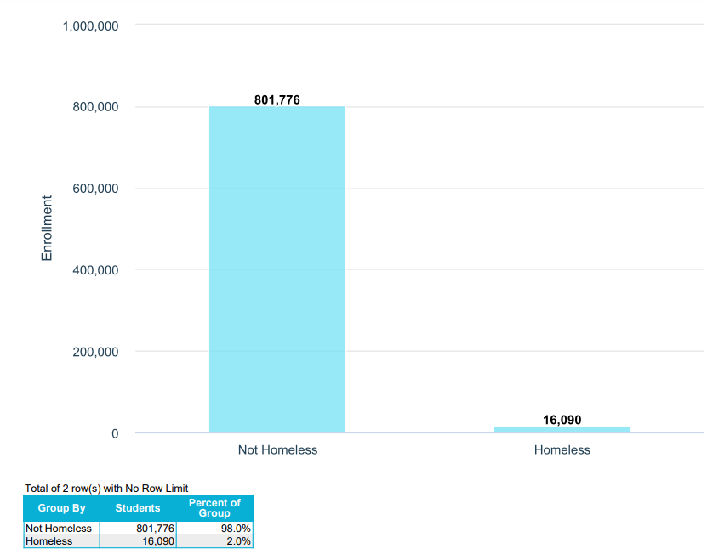
Homelessness Status: Purpose
Determine the status of the education of homeless students in general.
Evaluate the effectiveness of programs supported by the McKinney-Vento Homeless Assistance Act (under ESSA Title IX, Part A).
Required for all students in all WISEdata records, regardless of whether or not the district receives McKinney-Vento grant funds
WISEdash Current Enrollment by Homeless Status 2023-24
Notes:
KRISTINE
All LEAs are required to identify students experiencing homelessness to meet Mckinney-Vento Homeless Assistance Act requirements. Once a student is identified, LEAs must remove barriers for the student to participate fully in their education and extracurriculars. All LEAs have a designated homeless liaison who is required to ensure this work is being done.

Slide 65
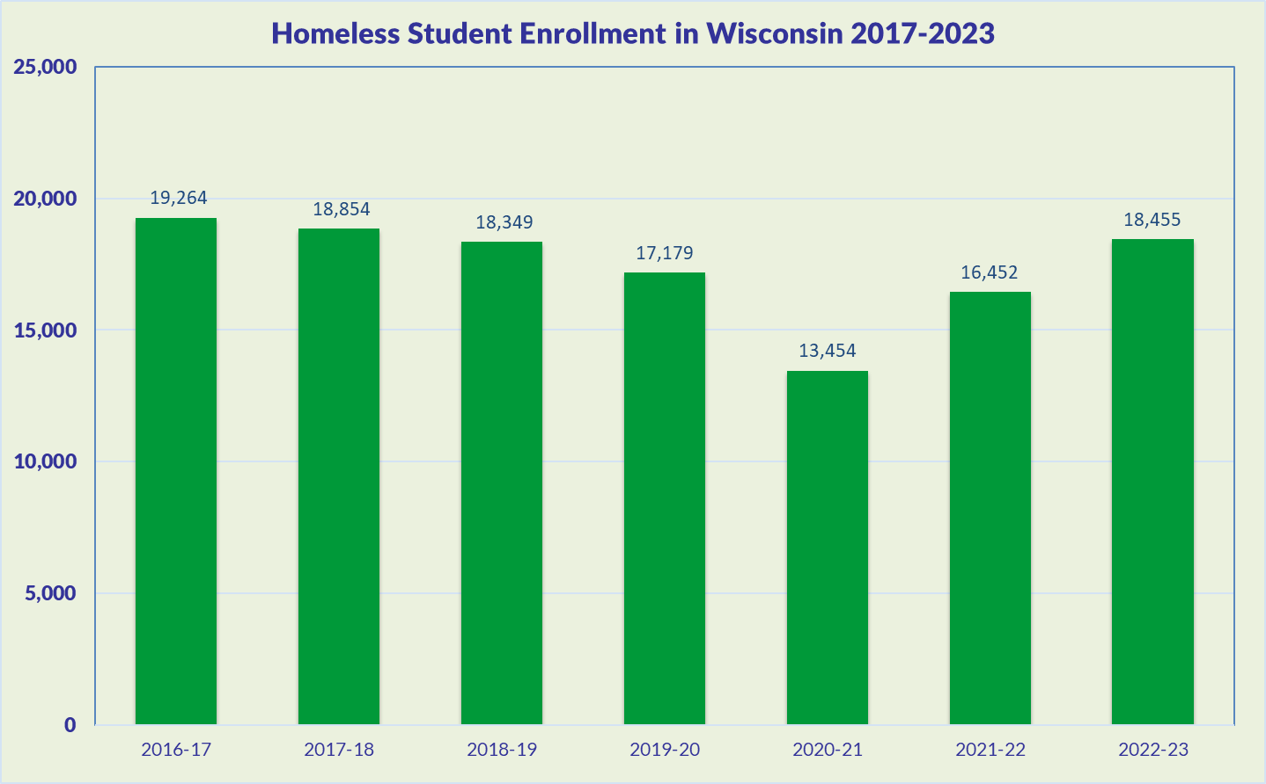
Homelessness Status: Enrollment
The McKinney-Vento Homeless Assistance Act defines homeless children and youths as those who lack a fixed, regular, and adequate nighttime residence.
Notes:
KRISTINE
Homeless status is an indication of whether a student is homeless. Homeless students lack a fixed, regular, and adequate nighttime residence and include students who:
are sharing the housing of other persons due to loss of housing, economic hardship, or a similar reason; are living in motels, hotels, trailer parks, or camping grounds due to the lack of alternative adequate accommodations; are living in emergency or transitional shelters; or are abandoned in hospitals;
have a primary nighttime residence that is a public or private place not designed for or ordinarily used as a regular sleeping accommodation for human beings (within the meaning of section 103(a)(2)(C));
are living in cars, parks, public spaces, abandoned buildings, substandard housing, bus or train stations, or similar settings; and
migratory children who qualify as homeless because the children are living in circumstances described in (1) through (3) above.

Slide 66
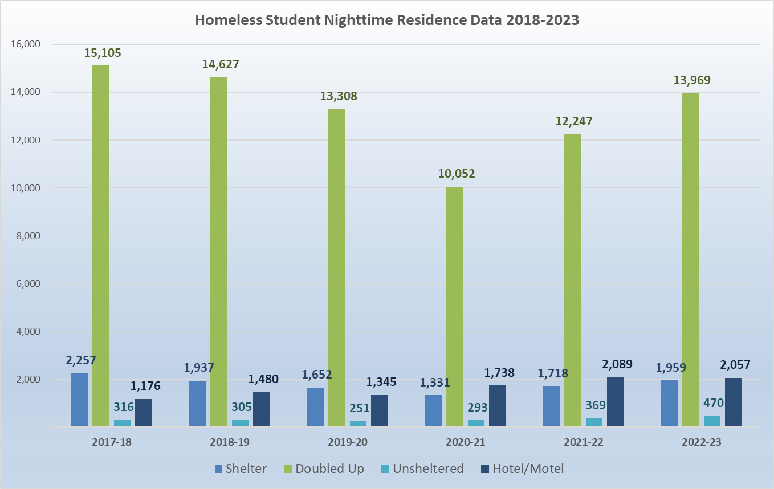
Homelessness Status: Nighttime Res
Doubled Up, or sharing the housing of others due to economic hardship, loss of housing, or similar reasons, is the most common nighttime residency.
Notes:
KRISTINE
Doubled up is 76% of our students in WI

Slide 67
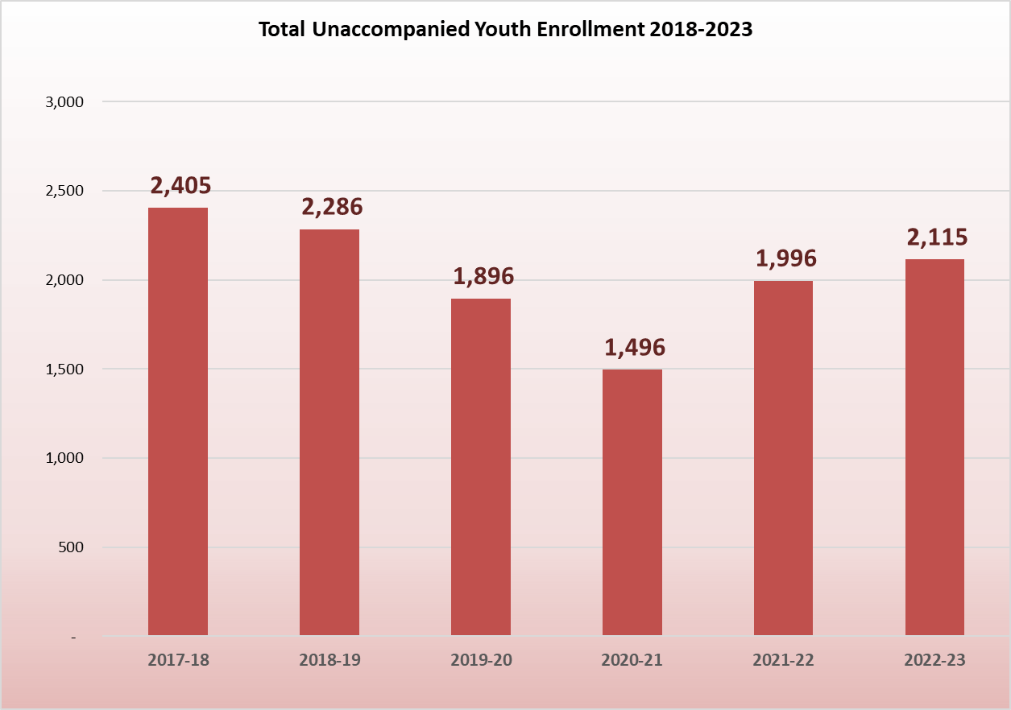
Homelessness Status: Unaccompanied Youth
Unaccompanied Youth indicates whether or not homeless children or youth are in the physical custody of a parent or legal guardian.
Notes:
KRISTINE

Slide 68
Homeless Children and Youth: Areas of Growth
Using the data available to make informed decisions regarding youth experiencing homelessness
Achievement gaps between housed and unhoused students persists and tends to worsen over time
Higher incidents of students dropping out of school, lower attendance rates, lower academic performance than economically disadvantaged students
How to correctly identify youth experiencing homelessness- doubled up is homeless under McKinney-Vento
Notes:
KRISTINE

Slide 69
Turn & Talk or Stop & Jot on Homeless Data Thoughts, Questions, Noticings
Important points
Jot down something you can add to the evaluation feedback form later…
Circling in your head
‘Squares’ with your thinking

Slide 70
Data Element: Special Education Status
Special Education, or
Student with a disability (SwD)
Purpose of discussing this data
Statewide data
Oct 1 and MoE reporting requirements
Areas for growth for these students
Turn and talk
Notes:
COURTNEY
ANANDA
MAI CHOUA
This collection of Data Elements best highlight students that fall within Wisconsin’s opportunity gaps. Students who identify with these data elements also tend to be the most under-reported, and historically marginalized student groups.
Wisconsin schools have Local Control.
We are here today to provide suggestions for what you COULD do with the resources and best practices that DPI supports and provides access to.
We are not here today to tell you what you MUST do. We respect the local control of our LEAs (within the parameters of Federal law and state Statutes).
.

Slide 71
Special Education: Purposes
The special education team collects and processes data on special education programming required in Wisconsin Statutes, Chapter 115, and for reporting requirements under the federal Individuals with Disabilities Education Act (IDEA) of 2004 and as required under the Every Student Succeeds Act of 2015.
Notes:
COURTNEY
ANANDA
MAI CHOUA

Slide 72
Statewide Special Education Data
WISEdash Enrollment Count by Disability Status (2022-23)
Notes:
COURTNEY
ANANDA
MAI CHOUA
White 67.2 = 553,044
Hispanic 13.6 = 111,830
Black 8.8 = 71,767
Two or More 5.1 = 42,343
Asian 4.2 = 34,714
American Indian 1.0 = 8,469
Pacific Islander 0.1 = 636
Unknown = 0%
https://wisedash.dpi.wi.gov/Dashboard/dashboard/18141 - accessed on 12/14/2023

Slide 73
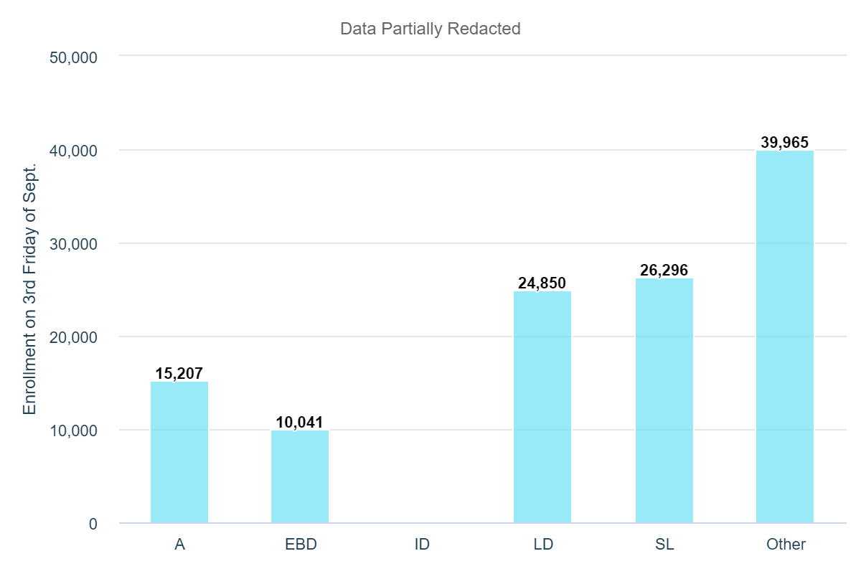
Special Education: Enrollment
Statewide Special Education Enrollment Counts
Notes:
COURTNEY
ANANDA
MAI CHOUA

Slide 74
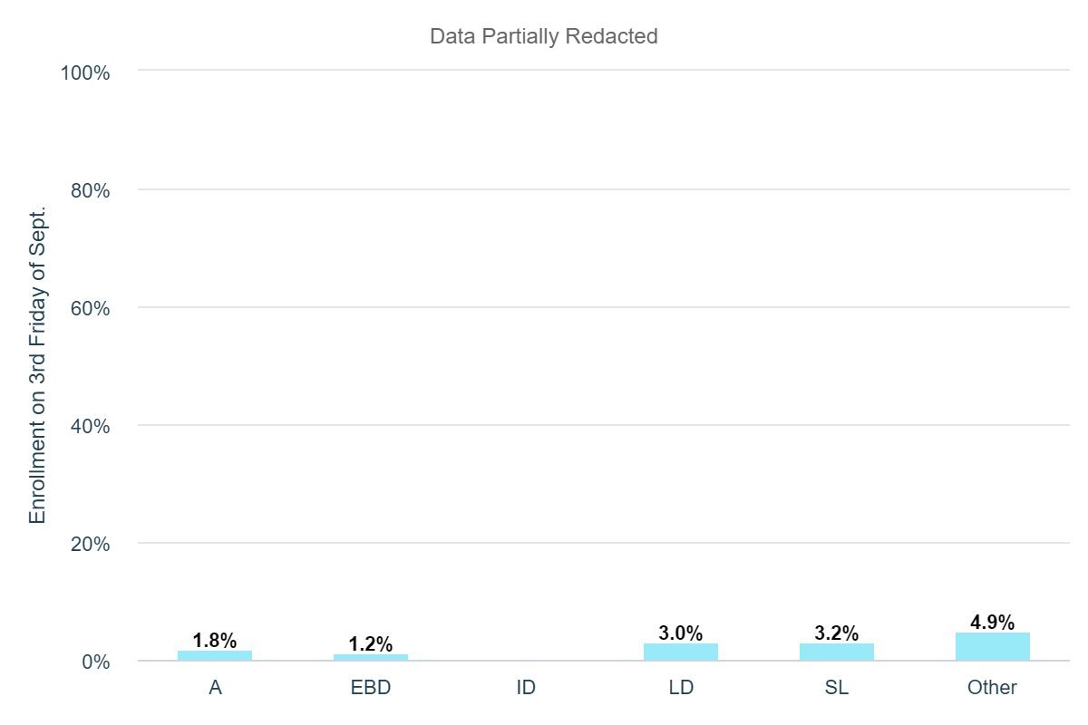
Special Education: Enrollment on TFS
Enrollment Percent by Disability (2022-23)
Notes:
COURTNEY
ANANDA
MAI CHOUA

Slide 75
Special Education: October 1 Child Count
The October 1 Child Count data is used by the Special Education team for the purposes of Maintenance of Effort (MOE) reporting.
LEAs’ compliance with IDEA MOE establishes that state and local funding of special education remains relatively constant from year to year.
As part of the MOE testing, LEAs can demonstrate compliance using an annual comparison of per pupil expenditures.
This test uses the Oct. 1 Child Count as the source.
Failure to meet MOE compliance will result in the LEA having to repay local funds (not IDEA funds) back to the U.S. Department of Education (through DPI).
Notes:
COURTNEY
ANANDA
MAI CHOUA

Slide 76
Turn & Talk or Stop & Jot on SpEd Data Thoughts, Questions, Noticings
Important points
Jot down something you can add to the evaluation feedback form later…
Circling in your head
‘Squares’ with your thinking

Slide 77
Data Element: Discipline
Discipline Data
Purpose of discussing this data
Statewide data
Areas for growth for these students
Turn and talk
Notes:
ANANDA & COURTNEY
This collection of Data Elements best highlight students that fall within Wisconsin’s opportunity gaps. Students who identify with these data elements also tend to be the most under-reported, and historically marginalized student groups.
Wisconsin schools have Local Control.
We are here today to provide suggestions for what you COULD do with the resources and best practices that DPI supports and provides access to.
We are not here today to tell you what you MUST do. We respect the local control of our LEAs (within the parameters of Federal law and state Statutes).
.

Slide 78
Discipline: Purpose
Districts submit discipline data, specifically data about suspensions and expulsions, because discipline data are required by state law and a more limited range of IDEA-required data.
All students are federally entitled to a free, appropriate, public education (FAPE) as protected by article X, section 3 of the Wisconsin Constitution, and §121.77, so the nuances of suspensions, expulsions, the time they require students to be away from FAPE are important to get right. This PDF provides details on which LEA is responsible for providing FAPE under different scenarios. The FAPE-Responsible School/District data element page may also be a good resource.
The Department of Public Instruction created this guide, Answers to Frequently Asked School Discipline Questions, to serve as a resource providing you with thorough answers to some commonly asked questions.
Notes:
ANANDA & COURTNEY

Slide 79
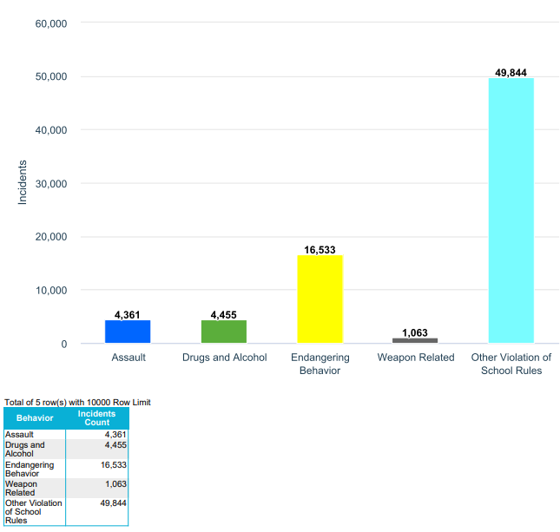
Statewide Discipline Data
WISEdash Incident Count by Behavior 2021-22
Notes:
ANANDA & COURTNEY

Slide 80
Discipline: Areas of Growth
Overreporting-- According race/ethnicity, disability status
Classroom and school environment, and limited resources for support result in higher discipline reporting.
Locally controlled
Students are removed from traditional educational environments.
Lack of opportunity for students who have been expelled
Lack of resources and strategies to create a safe learning environment
Notes:
ANANDA & COURTNEY
Over reporting. According race/ethnicity, disability status-
Classroom and school environment, and limited resources for support result in higher discipline reporting – schools with less administrative, educator and paraprofessional support for students with behavioral issues often have higher disciplinary reporting because teachers’ capacity, training, and ability to navigate behavioral issues is not always available
Locally controlled, - no consistency across the state on how students are disciplined
Students are removed from traditional educational environments- reintroducing students to the traditional setting is not common and very challenging, new non-traditional settings unfortunately may increase or continue student behavior rather than reducing
Lack of opportunity for students that have been expelled – Wisconsin struggles to find useful activities like remote learning, non-traditional educational settings that are successful for students who have been expelled, and often are left to wait to attain their GED on their own which is extremely challenging without the background knowledge, and study support
Lack of resources and strategies to create a safe learning environment- high turnover with teaching staff leads to fewer prolonged personal connections needed to foster trust in the classroom, less experience to navigate behavioral issues, and training and resources to create safe learning environments and navigate behaviors is not provided and available for staff

Slide 81
Turn & Talk or Stop & Jot on Discipline Data Thoughts, Questions, Noticings
Important points
Jot down something you can add to the evaluation feedback form later…
Circling in your head
‘Squares’ with your thinking

Slide 82
Data Element: Attendance and Dropouts
Attendance and Dropouts
Purpose of discussing this data
Statewide data
Areas for growth for these students
Turn and talk
Notes:
KINA
This collection of Data Elements best highlight students that fall within Wisconsin’s opportunity gaps. Students who identify with these data elements also tend to be the most under-reported, and historically marginalized student groups.
Wisconsin schools have Local Control.
We are here today to provide suggestions for what you COULD do with the resources and best practices that DPI supports and provides access to.
We are not here today to tell you what you MUST do. We respect the local control of our LEAs (within the parameters of Federal law and state Statutes).
.

Slide 83
Attendance Data: Purpose
Very strong relationship between attendance and achievement
Attendance is contact between a student and a teacher during which district-supervised PK-12 educational services are provided.
Actual Days of Attendance and Possible Days of Attendance must both be recorded (§ 118.15 compulsory school attendance and §118.16 attendance reinforcement). Reported by half-day increments (0.5)
Compulsory age school attendance (age 6 – 18):
WISEdash (and WINSS and SDPR) data tools/reports include data for all public schools (including charter schools) in school districts and all non-district charter schools under s. 118.40(2r), Wis. Stats..
Notes:
KINA
Attendance holds a very direct connection to school success. Its hard to learn in school when you’re not there.
Absenteeism patterns from 1st grade, but more strongly starting in middle school, strongly correlate with dropouts.
“Longitudinal Results”: Poor attendance has serious implications for later outcomes as well.
Students who eventually dropped out of high school missed significantly more days of school in first grade than their peers who graduated from high school.
By ninth grade, attendance was shown to be a key indicator significantly correlated with high school graduation
https://nces.ed.gov/pubs2009/attendancedata/chhttps://dpi.wi.gov/wise/data-elements/attendanceapter1a.asp#:~:text=Students%20who%20attend%20school%20regularly,in%20a%20child's%20school%20career.
https://dpi.wi.gov/wise/data-elements/attendance

Slide 84
Dropout Data: Purpose
Reported annually for grades 7 through 12.
"Dropout" means a student who either:
(1) exited during the school term or who exited prior to start of that school term but completed the previous school term and
(2) who did not re-enroll by the 3rd Friday of September of the following school term.
Dropout rate = the number of students who dropped out during the school term divided by the total expected to complete that school term in that school or district.
"Total expected to complete the school term" is the sum of students who completed the school term plus dropouts.
Notes:
KINA
When students don’t attend school/are absent at a high enough rate, this leads to chronic absenteeism (old term for this was truant/truancy), and chronic absenteeism has a strong data correlation with students that dropout.
Dropouts are calculated starting in 7th grade.
Students are considered to be chronically absent if they miss more than 10% of school days out of the total number of school days during which they were enrolled. a student is considered chronically absent if he or she misses more than 10% of possible attendance days, but is only included in the calculation if he or she was enrolled for at least 90 non-consecutive days in the school year.
But Natasha Bedingfield nailed it when she said, “The rest is yet unwritten…”
https://dpi.wi.gov/wise/data-elements/attendance

Slide 85
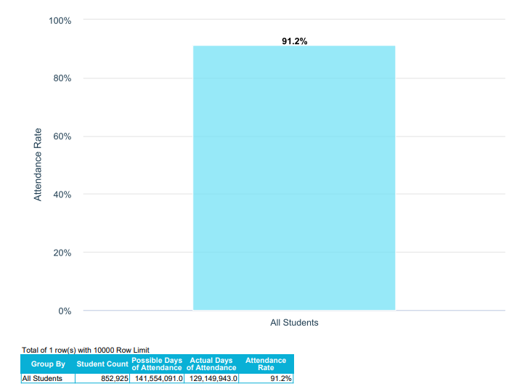
Statewide Attendance Rates
WISEdash 2021-22 Attendance Rates
Notes:
The “gobbeldy gook” on the previous two slides define the terms that you see here on this WISEdash Data.
At a glance, 91% is a good strong number. In a high school grading system (without a curve) this is an A minus.
The question that we’ve been asking throughout this session – What’s going on with the other 8.8%?
Because that 8.8% is just over 75,000 kids.
852,925 (student count) x 0.088 = 75,057.4

Slide 86
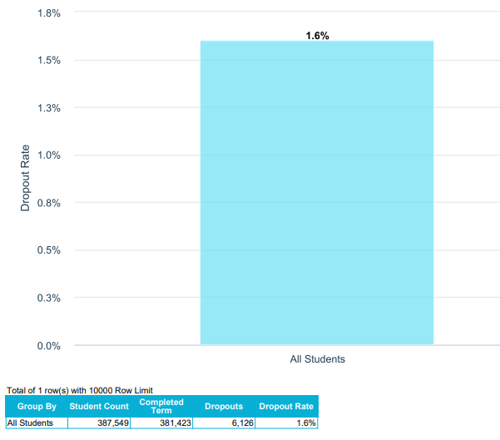
Statewide Dropout Rates
WISEdash 2021-22 Dropout Rates
Notes:
The student count on the previous bar graph was 852, 925 for all students.
This graph also says, “All Students” but it only shows 387, some odd thousand kids because dropouts are only calculated for students in grades 7-12.
Breaks this up into student count, completed term and dropouts.
Completed Term (381,549) + Dropouts (6,126) = Student Count (387,549)
"Total expected to complete the school term" is the sum of students who completed the school term plus dropouts.
852,925 total students across the state
6,126 stop attending school.
If there are 72 counties across WI, that’s 85 kids per county who don’t graduate.
Using 2019-2020 data for the number of schools, there were 984 schools that could have potentially served grades 7-12, that averages out to about 6 kids per school.
Could you name the 6 kids in your school who you’d be most worried about being a potential dropout?
An “At Risk” adolescent youth, perhaps with:
Family issues?
Trauma?
Negative interactions with teachers and school staff?
Student s who don’t feel connected to their school?
Do we know what they need to re-connect and stay in school?
https://dpi.wi.gov/sites/default/files/imce/eis/pdf/schools_at_a_glance.pdf
https://dpi.wi.gov/sites/default/files/imce/accountability/pdf/Data_At-A-Glance_2021-22_Report_Cards_Final_09_26_2022.pdf
https://dpi.wi.gov/strategic-plan/wisconsin-glance/schools

Slide 87
Attendance and Dropout: Areas of Growth
The disciplinary response to absenteeism too often includes loss of course credits, detention, and suspension.
Alternative educational programming needed and supported in the school system.
Connect with DPI for learning opportunities, like the Spring 2024 Truancy Prevention Learning Communities series, sponsored by the Student Services Prevention and Wellness (SSWP) Team. (SSPW School Attendance page)
Notes:
KINA
Many of the sessions in these spring series have passed (one was just yesterday morning!), but as per the SSPW School Attendance webpage:
Register for an upcoming session, or for a past session, to receive a recording of the webinar.
Please allow 3-5 days to receive the recording once registered.

Slide 88
Turn & Talk or Stop & Jot on Attendance Data Thoughts, Questions, Noticings
Important points
Jot down something you can add to the evaluation feedback form later…
Circling in your head
‘Squares’ with your thinking

Slide 89
Data Element: Digital Equity
Digital Equity
Purpose of discussing this data
Statewide data: Maps and dashboards
Areas for growth for these students
Turn and talk
Notes:
RACHEL
ANANDA & CORTNEY
This collection of Data Elements best highlight students that fall within Wisconsin’s opportunity gaps. Students who identify with these data elements also tend to be the most under-reported, and historically marginalized student groups.
Wisconsin schools have Local Control.
We are here today to provide suggestions for what you COULD do with the resources and best practices that DPI supports and provides access to.
We are not here today to tell you what you MUST do. We respect the local control of our LEAs (within the parameters of Federal law and state Statutes).
.

Slide 90
Digital Equity Data: Purpose
Closing the digital equity gap is a priority to ensure high-quality learning for all children in Wisconsin. This requires:
Dedicated learning device
Sufficient internet access
Availability (widespread rural issue)
Affordability (affects residents in all areas of the state)
Notes:
ANANDA & CORTNEY
Universal Access > Universal Design for Learning (UDL) ensuring all students have access to instruction and assessment.

Slide 91
Digital Equity Data Collection
What device does the student most often use to complete schoolwork at home?
Who provided the learning device to the student?
Is the primary learning device shared with anyone else in the household?
Can the student access the internet on their primary learning device at home?
If the student is unable to access internet in their primary place of residence, why not?
What is the primary type of internet service used at the residence?
Can the student stream video on their primary learning device without interruption?
Notes:
ANANDA & CORTNEY

Slide 92
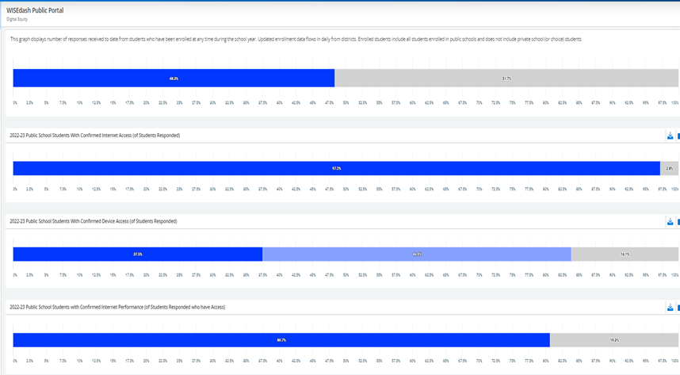
WISEdash Public Digital Equity Dashboard
Participation is optional but most districts participate.
In the most recent survey, about half of all students were represented.
3% did not have internet access.
16% did not have a dedicated device.
19% did not have acceptable internet.
https://wisedash.dpi.wi.gov
Select "Digital Equity" in the top menu.
2022-23 Data
Notes:
ANANDA & CORTNEY
Note: This slide displays 2022-23 data, the DPI Data Warehouse Team is still working on updating the 2023-24 dashboards and maps. We expect them to be released in late April.

Slide 93
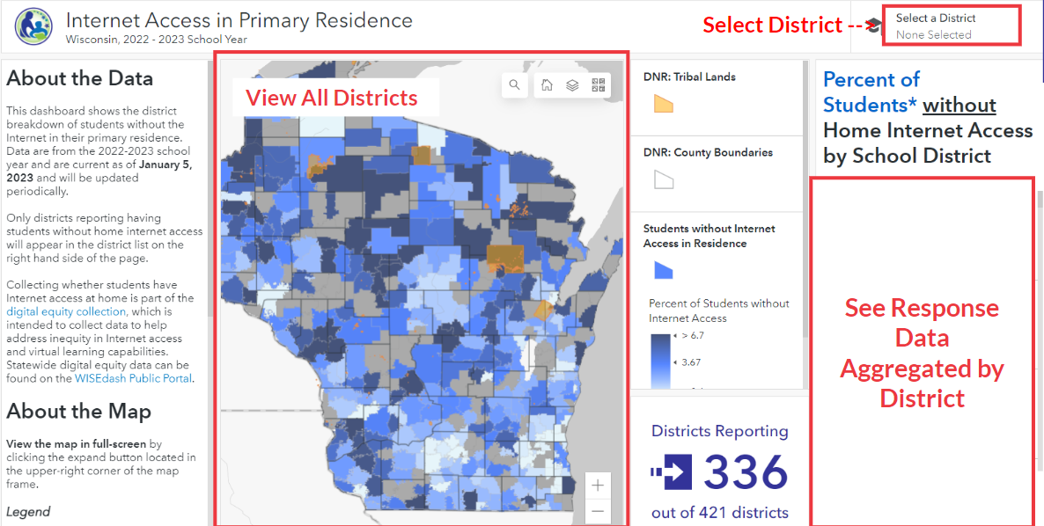
Public Digital Equity Maps by School District
Select a school district from the drop-down menu.
The map will zoom in and display aggregated data by district.
https://student-internet-access-wi-dpi.hub.arcgis.com/
Notes:
ANANDA & CORTNEY
For each school district, view: response rate to the questions, percentage of students without access, percentage of students who don't have access because of either internet access or affordability, and if they have access % of students that cannot stream video for learning.

Slide 94
Digital Equity Data: Areas of Growth
Increase response rates to the digital equity data collection.
Just like any data rolled over from year to year, there should be a mechanism to re-confirm/update the data if it is rolled over.
Collecting data may require phone calls, paper, and other methods in addition to annual online registration/information verification.
Translations of the questions are currently available in: Albanian, Arabic, Dari, Farsi, Hmong, Spanish, Tamil, Telugu, and Ukrainian.
Notes:
ANANDA & CORTNEY
Please reach out to Rachel Schemelin if additional translations are needed. Korean is in the works.

Slide 95
Turn & Talk or Stop & Jot on Digital Equity Data Thoughts, Questions, Noticings
Important points
Jot down something you can add to the evaluation feedback form later…
Circling in your head
‘Squares’ with your thinking

Slide 96
Stay With Us for Session 2!
Multiple facilitators will speak to different data elements over this two-part workshop:
Introduce data element, get juices flowing.
Where to find data element in WISE applications while facilitators assist in self-selected affinity groups
1:00 – 1:20: Opening slides, facilitator panel
1:20 – 1:25: Overview of data elements
1:25 – 2:25: Detailed review of data elements
2:25 – 2:30: Decide on data element for Session 2
End Session 1
2:30 – 2:45 BREAK: Soda, Coffee, Tea, Infused Water, Popcorn and Pretzels
Begin Session 2
2:45 – 3:00 Create affinity groups
3:00 - 3:45 Workshop
3:30/3:45 – 4:00 Wrap Up, Feedback
Notes:
Kina closing; snack break;
STUDENT DATA INQUIRY
1. Question: Teams ask questions about overall performance, equitable performance, and content detail. They may examine proficiency attainment and academic growth. The Data Inquiry Planning Guide may be used to assist in planning for student data inquiry.
2. Investigate: Teams locate the data that best answers their inquiry questions. Three types of student data may be investigated from local and state sources including: achievement data from strategic assessments, perceptions data, and engagement data.
3. Clarify: After data has been investigated and captured, teams discuss data findings, clarify the data and determine priority outcomes for further action. This is where a long-term goal for student success is developed. 4. Hypothesize: Based on the priority outcome for students, teams pose hypotheses of educator practices to determine likely root causes for results.
EDUCATOR PRACTICES INQUIRY
1. Question: Teams pose inquiry questions about the likely root cause to shape investigation into evidence-based strategies research and actual practice in their school. Questions are posed for both instructional practices and leadership practices related to the highest likely root cause.
2. Investigate: Teams design a plan to investigate qualitative data about practices. Teams may develop and locate evidence sources for instructional and leadership practices that have not been examined before including classroom walk-throughs, educator surveys, interviews and artifacts all relevant to the root cause in practices. Data are collected and organized for analysis and clarification.
3. Clarify: After practice data has been investigated and captured, teams discuss data findings, clarify the data and determine priority outcomes for further action. It is critical that this process be deemed as non-evaluative, but informing in terms of the evidence-based strategies for improvement. 4. Propose: Based on the priority outcomes for practices, teams propose objectives to implement the evidence-based improvement strategy that will achieve the long-term goal for student success.
IMPROVEMENT PLANNING
1. Theorize: The Improvement Plan Strategy ties the previous work together in a theory of action while adding a means for monitoring student progress. IF … we successfully implement this evidence-based improvement strategy THEN … teachers and leaders would demonstrate these practices SO THAT … growth is accelerated for students who most need it, while learning is increased for all students THEREBY … meeting the long-term student goal 2. Plan: Teams design a detailed set of action steps. Each action is described including the resources needed, staff assigned and evidence for task completion. The action plan is dynamic and continuously revisited during implementation to determine progress.
3. Monitor: Teams revisit their action steps, study collected quantitative and qualitative student and practices data and summarize what is happening during implementation. Each cycle culminates with proposed modifications and adjustments to the action plan. 4. Sustain: Teams determine policies, procedures and responsible staff needed to sustain improvement efforts. Funding and other resources are allocated for capacity building and ongoing implementation. Finally, teams determine how they will measure fidelity to the plan for continued success.

Slide 97
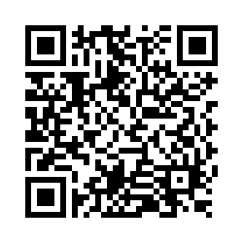
Questions?
Thank you for the great conversations!
We hope to see you in Session 2!
Please scan the QR code to provide us with your feedback!

