Slide 1
Attendance: Deep Dive
Adam Mueller
DPI Customer Services Team
March 6, 2024

Slide 2
Today we will...
Look at attendance-related data elements
Cover common reporting scenarios
Verify data in WISEdata Portal and WISEdash for Districts
Talk about common errors
Answer your questions

Slide 3
What is “Attendance”?
Contact between a student and a teacher during which district-supervised educational services are provided
Attendance policies are set by the school district, and the schools in the district must adhere to these attendance policies.
Each district may have a slightly different policy, which may differ further based on whether the class takes place in the school building or a remote/virtual classroom.
Regardless of local policy, Actual Days of Attendance and Possible Days of Attendance must both be recorded.

Slide 4
Attendance: Uses
An important measure of student engagement
A heavy predictor of student success
Attendance data (attendance and absenteeism rates) is used for multiple reporting and accountability purposes, including, but not limited to:
Public reporting via the WISEdash Public Portal
School Report Cards
District Report Cards
Federal reporting of Chronic Absenteeism to
EDFacts
Civil Rights Data Collection

Slide 5
Attendance Tools
WISEdash & WISEdata Exports

Slide 6
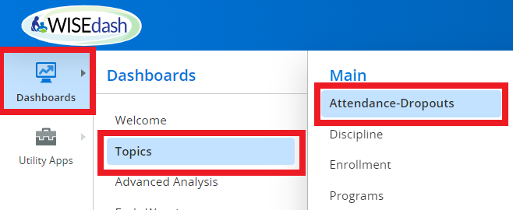
WISEdash: Topics Dashboards
WISEdash → Dashboards → Topics → Attendance-Dropouts

Slide 7
WISEdash: Attendance-Dropouts
Good for reviewing and comparing current to prior year data
Trends, is it getting better or worse?
Compare your data to the statewide data
Helps you determine strategies at a local level
Data is for your use internally

Slide 8
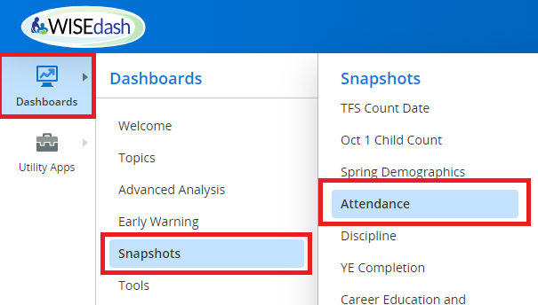
WISEdash: Snapshot Dashboards
WISEdash → Dashboards → Snapshots → Attendance

Slide 9
WISEdash: Snapshot Attendance
Publicly reported
Also available in WISEdash Public
Used for report cards
Data is used for external reporting

Slide 10
WISEdash: Data Quality Indicators
The Data Quality Indicators were created to assist you in preparing for an upcoming snapshot. The indicators give you a quick glance at your overall data for the selected district or school and point out possible issues with your data that you should investigate further.
Drill into the indicators to see the students or details that make up the count or rate in the indicator.

Slide 11
Data Quality Indicators
There are three types of Data Quality Indicators.
Informational indicators give you an easy way to see important counts or percentages for the topic at hand.
Caution indicators show you data that may be in error or may be questionable but may also be valid. Review the data more closely to see if it is correct.
Goal: 0 indicators show you data that is likely to be in error or that may be questionable. You should review the data more closely to see if it is correct.
The Attendance Snapshot Dashboard includes the following Data Quality Indicator(s) based on the current view of the data. All of the filters above are applied to the count(s).

Slide 12
Researching Data Quality Indicators
Zero Scheduled Value - Students with no attendance reported in WISEdata.
Students with WISEdata enrollments must have attendance. Why is it missing?
Schools with Zero Attendance - Schools with no attendance reported in WISEdata. Why is no attendance being reported; is the school not in use this year?
Schools with 100% Attendance - Schools with 100% attendance reported in WISEdata. Why is there 100% attendance?
*NOTE: It is valid for virtual schools and detention centers to have 100% attendance.

Slide 13
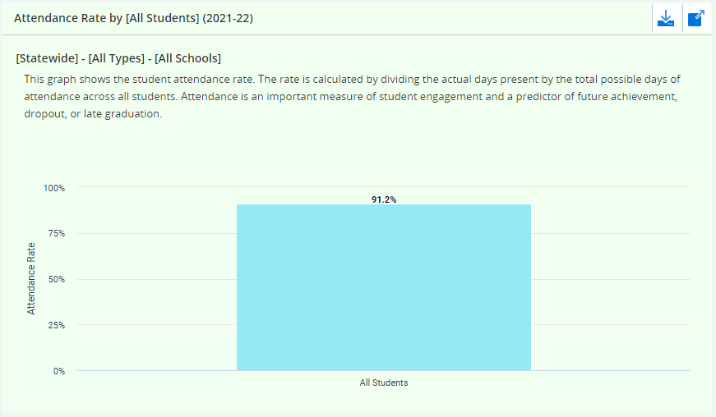
WISEdash Public: Attendance Example

Slide 14
Review Attendance in WISEdata Exports
WISEdata → Exports → Year End Attendance

Slide 15
Data Elements: Possible Days of Attendance
The total number of days that could occur for a specific student in the school term
Reported to the one-half day
If a student is enrolled for less than the entire school term, then Actual days cannot equal Possible days; Actual days < Possible days.
If a student can be present for one-half day or less, then the Possible days of attendance should reflect that.
For example, certain K4 or KG programs may have half-day programs.

Slide 16
Data Elements: Actual Days of Attendance
The actual number of days a student attended school during a school term
Reported to the one-half day
If a student is enrolled for less than the entire school term, then Actual days cannot equal Possible days; Actual days < Possible days.
Full Day ( 1.0) | Half Day (0.5) | Absent (0.0)
$≥$66% = 1.0 | $≥$33% $≤$ 66% = 0.5 | $≤$33% = 0.0
Students who receive at least 66% of district-supervised educational services for the day have accrued a full day (1.0) of actual attendance for that day. | Students who receive at least 33% and less than 66% of district-supervised educational services for the day have accrued a half day (0.5) of actual attendance for that day. | Students who receive less than 33% of district-supervised educational services for the day have accrued no (0) actual attendance for that day.

Slide 17
Important Attendance Factors
Numerous factors create uncommon situations in attendance reporting.
We’ll cover:
Attendance recording interval
Partial day or week schedule
Excused absences
Quarantine/Illness
Transportation issues
Virtual online/blended
Homework
Field trips
Services off school grounds
Study hall and recess
Summer
Runaways
Discipline
In-school suspension
Out-of-school suspension
Temporary expulsion
Permanent expulsion
PK and K4
Enrollment types

Slide 18
Attendance Recording Interval
School district policy determines the interval that is best for recording attendance, such as hours or periods.
For reporting to WISEdata, the district should report for each school day:
absent = 0 (under 33%)
present for half day = 0.5 (33% - 66%)
present for whole day = 1.0 (66% or greater)

Slide 19
Partial Day or Week Schedule
Very young students may receive limited educational services (such as speech and language) with Possible attendance less than one hour per day. In these situations, Possible days should be counted as 0.5, and, if students are present for that time period, then actual days should be counted as 0.5.

Slide 20
Excused Absences
WISEdata Attendance reporting does not differentiate between “excused” and “unexcused” absences.
Any absence during a school day in which a student is expected to attend should result in a decrease in the percent of the district-supervised educational services used to calculate ‘Actual Days of Attendance’.
This includes medical and dental appointments.
However…

Slide 21
Students in Quarantine or Unable to Attend In Person Due to Illness (1 of 2)
Districts may code student attendance as “present" if the student is quarantined due to possible exposure and is completing work while in quarantine, even if enrolled in an in-person learning environment.
Districts may code student attendance as “present” if the student is ill and unable to attend in-person instruction and is completing work.

Slide 22
Students in Quarantine or Unable to Attend In Person Due to Illness (2 of 2)
Local policy determines what and how much counts as completing work.
If local policy dictates that students in quarantine are submitted as absent, this absence will not contribute to truancy. It will, however, negatively affect the overall attendance and absenteeism rate of the district.
Guidelines are detailed on the Attendance data elements page.

Slide 23
Students Who Cannot Attend Due to Transportation Issues
If a district does not have enough bus drivers and is unable to transport a student, and if that student learns from home and is completing work, they should be considered present if they meet the criteria listed for students in quarantine.

Slide 24
Virtual Online and Blended Learning Students
Students taking classes online through a virtual school should follow district attendance policy.
In most cases, for students attending virtual programs, such as RVA, attendance is still reported by the resident district

Slide 25
Homework
Under typical circumstances, homework sent home to a temporarily absent student, such as during a family vacation, is not counted as actual attendance time.
However, in light of COVID-19, if a school provides homework and learning materials to a student in quarantine or unable to attend in person due to illness, the district could count this as actual attendance time if they meet the criteria listed for students in quarantine.

Slide 26
Field Trips
Time spent on a district-supervised field trip is counted as actual attendance.

Slide 27
Services Off School Grounds
Time spent receiving district-supervised educational services off school grounds is counted as actual attendance.
For example, services received at a:
library,
hospital,
county correctional facility,
college,
home, etc.

Slide 28
Study Hall/Recess vs. Afterschool Activities
Time during the regular school day for study hall or recess when the student is expected to be present is counted as actual attendance.
Athletic or academic clubs outside the regular school day are NOT counted as attendance.

Slide 29
Summer Classes
There is no summer enrollment or attendance data sent to WISEdata.
Normally attendance during summer classes is not counted in Actual Days of Attendance or Possible Days of Attendance because these classes are operated after the end of the school term.
DPI only wants enrollment and attendance for the regular school year.
EXCEPTION for YEAR-ROUND SCHOOLS: Summer classes may be operated during the school term of a year-round school, and attendance for these classes should be included in the counts of Actual and Possible Days.

Slide 30
Runaways
A student who has run away from home, is not attending school, and has an unknown location, should have their enrollment managed according to school board policy.
If the local policy does NOT withdraw the student from school, the days that the student was missing must be reported to WISEdata as included in the Possible Days of Attendance count and excluded from the Actual Days of Attendance count.

Slide 31
Discipline-related Scenarios
Sometimes it is confusing to determine how to report attendance for students who are serving discipline actions.
In-school Suspension
Out-of-School Suspension
Temporary Expulsion
Permanent Expulsion

Slide 32
In-School Suspension
Time when students are present for instruction after placement in an in-school suspension room is counted as Actual attendance time.
Mark the student as present in your attendance records.

Slide 33
Out-of-School Suspension
If a student subject to out-of-school suspension receives district-supervised educational services, submit Possible attendance days as time when services are offered or scheduled, whether the student is present to receive these services or not.
However, suspended days do not count towards the student's Actual attendance and should be marked as absences.
Example: a student had perfect attendance other than a two-day suspension in a school with 180 instructional days. Report for the student 180 Possible Days of Attendance and 178 Actual Days of Attendance.

Slide 34
Temporary Expulsion
If a student is expelled temporarily but still receiving district-supervised services off school grounds, then you must maintain attendance records for this student.
All expelled with services days would still count as Possible Days of Attendance, but for Days of Actual Attendance, you would submit a zero (0) for all days the student is absent.
For a temporary expulsion without services, the student should be exited with an Exit Date and Exit Type, at which point attendance data is no longer collected.

Slide 35
Permanent Expulsion
For expelled students who continue in enrollment status but who are not receiving educational services, submit zero (0) for the Actual and Possible Days of Attendance.
Permanently expelled students without services have exit dates, so no attendance data is collected.

Slide 36
PK & K4
PK and K4 students must have attendance reported in WISEdata.
If the student is in WISEdata, you must report their attendance.
K4: Students in K4 must be four years old on or before September 1 in the year that he or she proposes to enter school. (See Section 118.14, Wis. Stats.)
PK: PK is not considered a grade level. Students in PK have not reached the age for first grade and are not enrolled in K4 or KG but have an IEP and receive primary educational services from the district.

Slide 37
Enrollment Types
Primary Enrollment
Report attendance
Coursework Enrollment
Do NOT report attendance

Slide 38
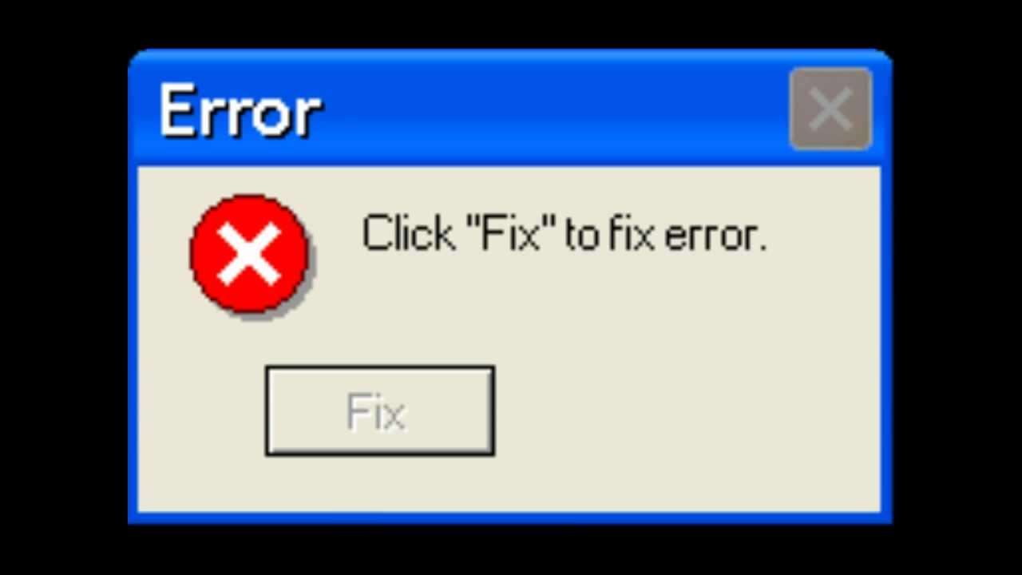
Some Common Validations

Slide 39
Validation Message Work Through
WISEdata live demo review of attendance validation messages

Slide 40
Warning 6471
Actual or Possible Days of Attendance exceeds 200 days across multiple schools of enrollment.
This is total attendance summed across multiple districts or agencies, if applicable.
This warning often displays for PPP students. Public schools should send a value of zero (0) for attendance for choice PPP students.
Summer school attendance should not be reported.
Check for accidental overlapping of enrollments that may be driving up the total days of attendance.

Slide 41
Warning 6473
Actual or Possible Days of Attendance exceeds 366 days across multiple schools of enrollment.
This is total attendance summed across multiple districts or agencies, if applicable.
Summer school attendance should not be reported.
Check for accidental overlapping of enrollments that may be driving up the total days of attendance.

Slide 42
Error 6464
Actual Attendance and Possible Attendance are missing.
If the student has no Actual or Possible days of attendance, then submit 0. If attendance exists in your local SIS but isn’t displaying in WISEdata, then contact your vendor to determine how to submit attendance via the Wisconsin extension of the Student API resource.
This error throws when either Possible or Actual Days are null.
This error is not thrown when attendance resources are submitted as 0, only when NULL (blank).
This error is not thrown for PPP students.

Slide 43
Error 6476
Invalid Actual Days of Attendance
Actual Days of Attendance must be equal to or less than the Possible Days of Attendance. This error throws when either Possible or Actual Days are null.
Sometimes the two totals are accidentally reversed.

Slide 44
Warning 6474
Actual or Possible days of attendance for this school are zero
For schools that are open, it is expected there will be enrollments and Actual or Possible days of attendance. Verify that enrollment and attendance are submitted to DPI.
This is a school-level warning and throws when no attendance data has been reported for an entire school.

Slide 45
Warning 7107
100 percent attendance is submitted for every student in a school
Acknowledge the warning if attendance is reported correctly. If the reported data is incorrect, then revise the student attendance (Actual Days of Attendance and/or Possible Days of Attendance) and submit to WISEdata.
This is a school-level warning and throws when 100 percent attendance is submitted for every student in a school.
It's unlikely that every student will have 100% attendance for a school year, so this warning is a prompt to review the attendance reporting and ensure that it's accurate.
If attendance is reported accurately, acknowledge the warning. Otherwise, correct the attendance and resubmit.

Slide 46
Helpful Resources (1 of 2)
Answers to Frequently Asked Compulsory School Attendance Questions
Attendance Data Elements Page
Reporting Uncommon WISEdata Situations

Slide 47
Helpful Resources (2 of 2)
WISEdata Help: links to WISE help pages and useful resources
Data Elements: list of links to all data elements and their descriptions, uses, and codes
Knowledge Base articles: useful articles on validations and other related topics
Info for Schools: basics of getting started with WISEid
Google Currents/Workspaces is switching over to Teams!
Stay tuned for communications from the Customer Services Team.
Platform change will occur next week.
WISEdata Events Calendar: View deadlines, trainings, webinars, etc.

Slide 48
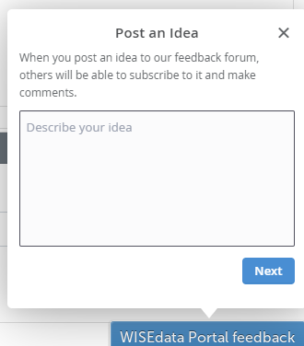
Giving Feedback
Within most DPI applications you can provide feedback directly, enter a new suggestion, and vote on suggestions made by other people.
https://feedback.dpi.wi.gov/

Slide 49
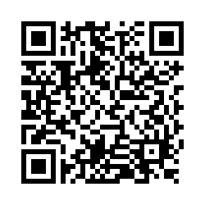
Questions?
Thank you! Thank you!
Please scan the QR code to provide us with your feedback!

