Slide 1
Career Education and Coursework Snapshot Review
Jessie Sloan
CTE Data Consultant
jessica.sloan@dpi.wi.gov
March 2024
Notes:
Greetings, This is Jessie Sloan the DPI, CTE Data Consultant. Today we are going over CTE, Career Education and Coursework Snapshot Reviews.
My name is Jessie Sloan and I am the DPI CTE Data Consultant. jessica.sloan@dpi.wi.gov
Also with me today are:
Mark Schwingle, Gifted and Talented Teaching and Learning Consultant, mark.schwingle@dpi.wi.gov
Chris Gleason, Arts and Creativity Teaching and Learning Consultant, chris.gleason@dpi.wi.gov
Emily Colo, Office of Educational Accountability Consultant, emily.colo@dpi.wi.gov

Slide 2
Agenda
Snapshot
Data Team
WISEdata Portal
WISEdash for Districts
Data to be Reviewed
Resources
Notes:
The agenda is Snapshot due date, CTE & coursework Data Team, Data to be reviewed, WISEdata Portal, WISEdash for District, and Resources

Slide 3
Snapshot: December 10, 2024 (1 of 2)
The Snapshot begins at the start of the business day on December 10, 2024.
All Career Education and Coursework data should be accurate in WISEdash for District before December 10, 2024. If you see it in WISEdash the day before the Snapshot, you know that the data has been sent.
Notes:
December is the Snapshot for Career Education Data. The next Snapshot for Career Education will be December __10_, 2024, it will capture 23.24 school year Career Education data.
-The Snapshot begins at the start of the business day on the date of the Snapshot.
-All CTE and Career Education data should be accurate in WISEdash for District before December 4, 2024. If you see it in WISEdash the day before the Snapshot, you know that the data has been sent.
-Start this work early and not the weekend before the Snapshot.
-It takes time for the data to flow from your Student Information System (SIS) to WISEdata Portal and into WISEdash for District.
-When the entire state is submitting data at the same time, the server gets slow.
-Changing data in your SIS does not automatically flow to WISE. Only new data automatically flows. Changed data calls for a resync from your SIS.

Slide 4
Snapshot: December 10, 2024 (2 of 2)
It takes time for the data to flow from your student information system (SIS) to WISEdata Portal and into WISEdash for Districts--at least 24 hours for the entire process.
When the entire state is submitting data at the same time, the server gets slow.
Changing data in your SIS does not automatically flow to WISE. Only new data automatically flows. Changed data calls for a resync from your SIS.
Notes:
December is the Snapshot for Career Education Data. The next Snapshot for Career Education will be December ___, 2024, it will capture 23.24 school year Career Education data.
-The Snapshot begins at the start of the business day on the date of the Snapshot.
-All CTE and Career Education data should be accurate in WISEdash for District before December 4, 2024. If you see it in WISEdash the day before the Snapshot, you know that the data has been sent.
-Start this work early and not the weekend before the Snapshot.
-It takes time for the data to flow from your Student Information System (SIS) to WISEdata Portal and into WISEdash for District.
-When the entire state is submitting data at the same time, the server gets slow.
-Changing data in your SIS does not automatically flow to WISE. Only new data automatically flows. Changed data calls for a resync from your SIS.

Slide 5
Data Teams
Submitting accurate data to WISE takes a team!
Divide and conquer:
Identify who checks WISEdata Portal?
Certified/Non-Certified Export
Participants Export
Concentrators Export
Roster: Course Offerings Export
Identify who checks WISEdash for Districts
Snapshot > Career Education and Coursework
Snapshot > Perkins
Notes:
Submitting accurate data to WISE takes a team!
Many individuals play a part in accurate data collection, data entry, checking, and using the data for Perkins Accountability and school report cards.
Divide and conquer:
Identify who checks WISEdata Portal?
Certified/Non-Certified Export
Participants Export
Concentrators Export
Roster: Course Offerings Export
Identify who checks WISEdash for District
Snapshot>Career Education and Courses
Snapshot>Perkins

Slide 6
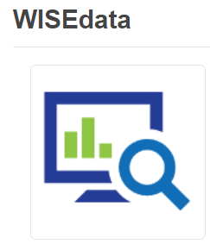
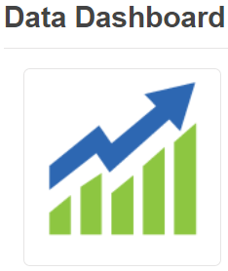
Data Flow
SIS
Data entered into
student information system
Data flows to WISEdata Portal through business rules
Check in WISEdash for Districts before SNAPSHOT
Notes:
Here is a quick pictorial of how data is reported to DPI.
Everything begins in the Student Information System
-Teams will need to record data elements on paper and provide to data entry personnel.
-Usually, data entry personnel watch the data flow to the first stop called WISEdata Portal.
-This is where raw data goes through the business rules at DPI.
-The final stop and where the Snapshot is taken, is in WISEdash for District.
No one can do this work alone. It takes a team to follow the data and see it correctly in WISEdash for District, before the December Snapshot.
Data is considered live and in real time. WISEdash for District updates about every 24 hours. It does take a bit longer the closer we get to a Snapshot because
everyone in the state is trying to push last minute data….So, do not wait to submit and check the weekend before a Snapshot.
Data received after a Snapshot will not be included in that reporting years data.

Slide 7
Data to Be Reviewed (1 of 2)
Career Ed and Coursework Data Quality Check (DEMO) -
Career Ed and Coursework Data Quality Check (blank)
Use your Data Team to assist with these data checks:
Someone can check WISEdata Portal.
Someone can check WISEdash for Districts>Snapshot>Career Education and Coursework dashboard.
Someone can reference the Roster Work Plan and ensure that all the: AP/IB/Arts/CTE and DE courses are being counted.
Someone to take notes
Notes:
Data to be reviewed.
Here is a demo and blank copy of a quick data check to begin this work and take notes on what you see.
Keep in mind that data quality has to do with the size, scope, and depth of your curriculum and teaching practices. Data quality also has to do with communicating with data entry personnel.
Today, we are simply checking numbers. Only your academic teams can dig into the quality of their curriculum.
Use your Data Team to assist with these data checks:
Someone can check WISEdata Portal
Someone can check WISEdash for District>Snapshot>Career Education and Coursework dashboard
Someone can reference the Roster Work Plan and ensure that all the: AP/IB/Arts/CTE and DE courses are being counted.
Someone to take notes

Slide 8
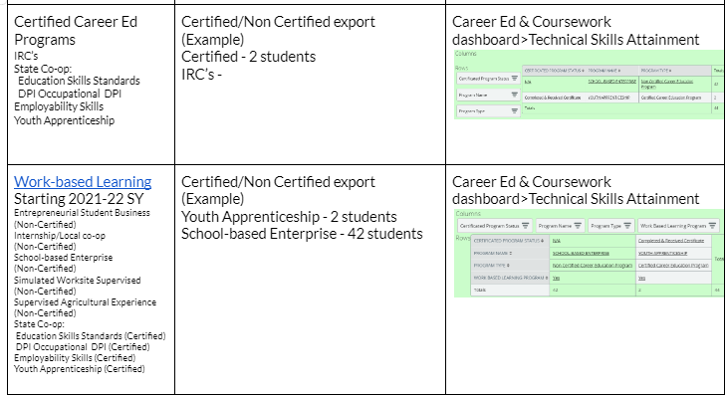
Data to Be Reviewed (2 of 2)
Notes:
This is a simple worksheet demo to remind you of the data elements and definitions of what to look for in WISEdash for Districts.
On the previous slide, there was a blank copy for your findings.
The first column is “topics,” provides you with what data to check.
The second column is what WISEdata Portal export to check. WISEdata Portal is the first place data comes into DPI and runs through validation rules.
The third column is WISEdash for District and shows you how to view your data that is at DPI.
Remember, your data team members have different levels of access into your student information system, WISEdata Portal and WISEdash…that is why a Team approach is so important.
Based on your role on the Data Team, you will enter the numbers you see on the Career Ed and Coursework Data Quality Check (blank) document ….to reconcile what is being reported in WISEdash.
Perkins Accountability Reports and School Report Cards should never be a surprise, if you are reviewing your data in live time and before a Snapshot.

Slide 9
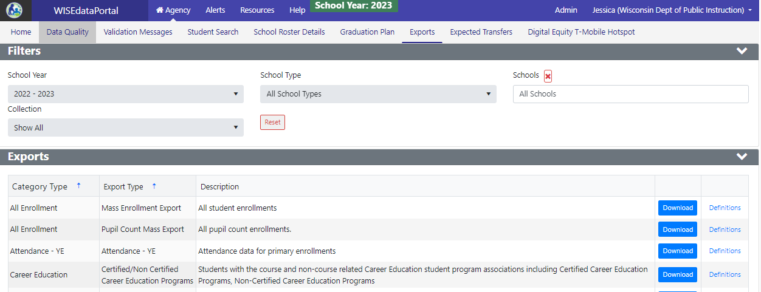
WISEdata Portal
Notes:
This is a snippet of WISEdata Portal to show you where to get these exports.
I also circles “Resources,” so you can find your SIS vendor specific training for CTE data.

Slide 10
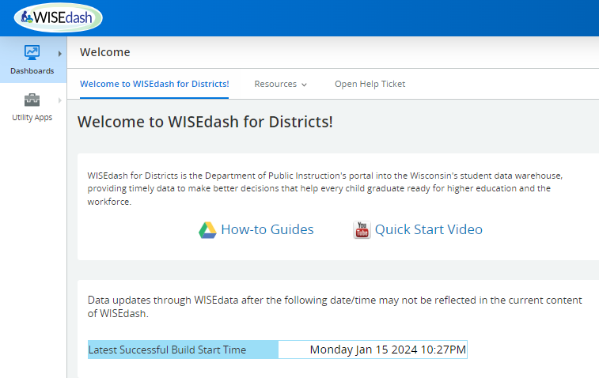
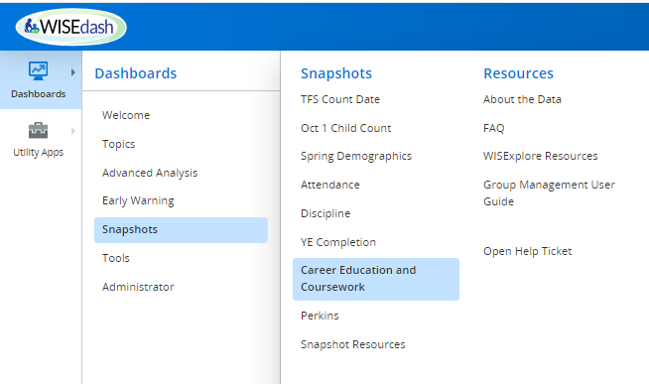
WISEdash for Districts: Dashboards
Notes:
Quick navigation into WISEdash
The Career Education & Coursework menu has 2 dashboards:
Student Participation Count - (students counted one time only). This slide shows Student Participation Count.
Outcome Count - (students may be counted more than once)

Slide 11
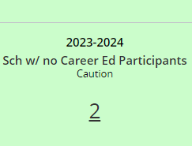
WISEdash for Districts
Career Ed and Coursework Data Quality Check (DEMO) -
Career Ed and Coursework Data Quality Check (blank)
WISEdash for Districts>Snapshot> Career Education and Coursework dashboard
Technical Skills Attainment
Advanced Credit Opportunities
Arts Student Participation
Notes:
Here is a blank copy of the Career Ed and Coursework Data Quality Check.
Sch w/ no Career Ed Participants, caution, 2 - THIS IS CONFUSING TO PEOPLE….THE GOAL IS 0. 2 IS TELLING ME THAT 2 SCHOOLS HAVE MISSING DATA.
Pay attention to:
Green - Current view
Purple - Snapshot view
I will do a quick intro to finding each dashboard in WISEdash for District. However, there are many How-to-Guides available on the Welcome page of WISEdash for District.
This is the Technical Skills and Attainment table. It is informing me of what WBL and IRC data was reported in the last snapshot.

Slide 12
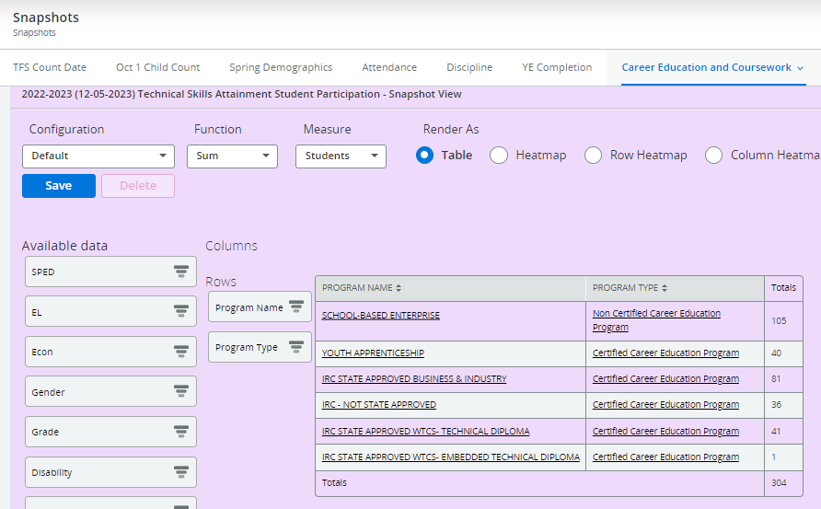
WISEdash, CE & Coursework: Technical Skills
Technical Skills Attainment
Program Name
IRC’s
WBL
Program Type
Certified
Non-Certified
Only students who participated in WBL or IRC will be in this table.
Use other crosstabs to review counts by student characteristics.
Notes:
Technical Skills Attainment
Program Name
IRC’s
WBL
Program Type
Certified
Non-Certified
Use other crosstabs to review student demographics and characteristics
Only students that participated in in WBL or IRC will be in this table.

Slide 13
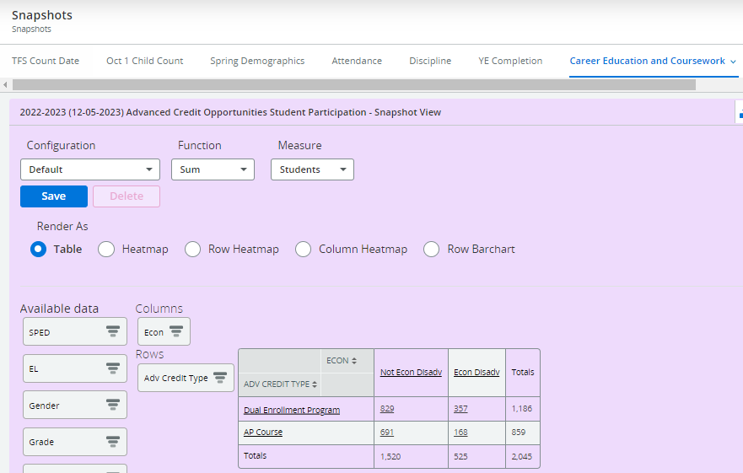
WISEdash, CE & Coursework: Advanced Credit
Advanced Credit Opportunities
Adv Credit Type
Dual Enrollment
Advanced Placement
International Baccalaureate
Only students who participated in DE, AP, IB will be in this table.
Use other crosstabs to review counts by student characteristics.
Notes:
Advanced Credit Opportunities
Adv Credit Type
DE
AP
IB
Only students that participated in DE, AP, IB will be in this table.
Use other crosstabs to review student demographics and characteristics

Slide 14
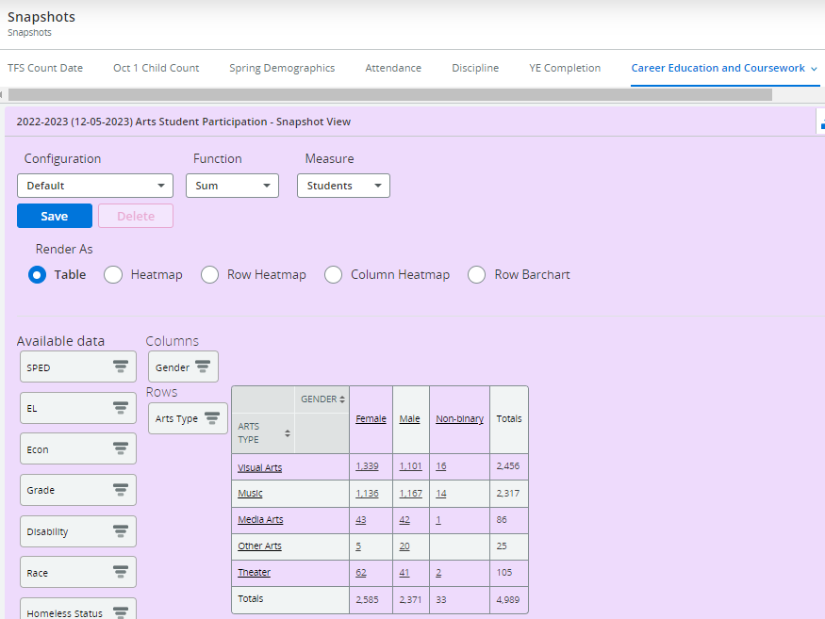
WISEdash, CE & Coursework: Arts
Arts Student Participation
Arts Type
Visual Arts
Music
Media Arts
Other Arts
Theater
Dance
Only students who participated in an Arts designated course will be in this table.
Use other crosstabs to review counts by student characteristics.

Slide 15
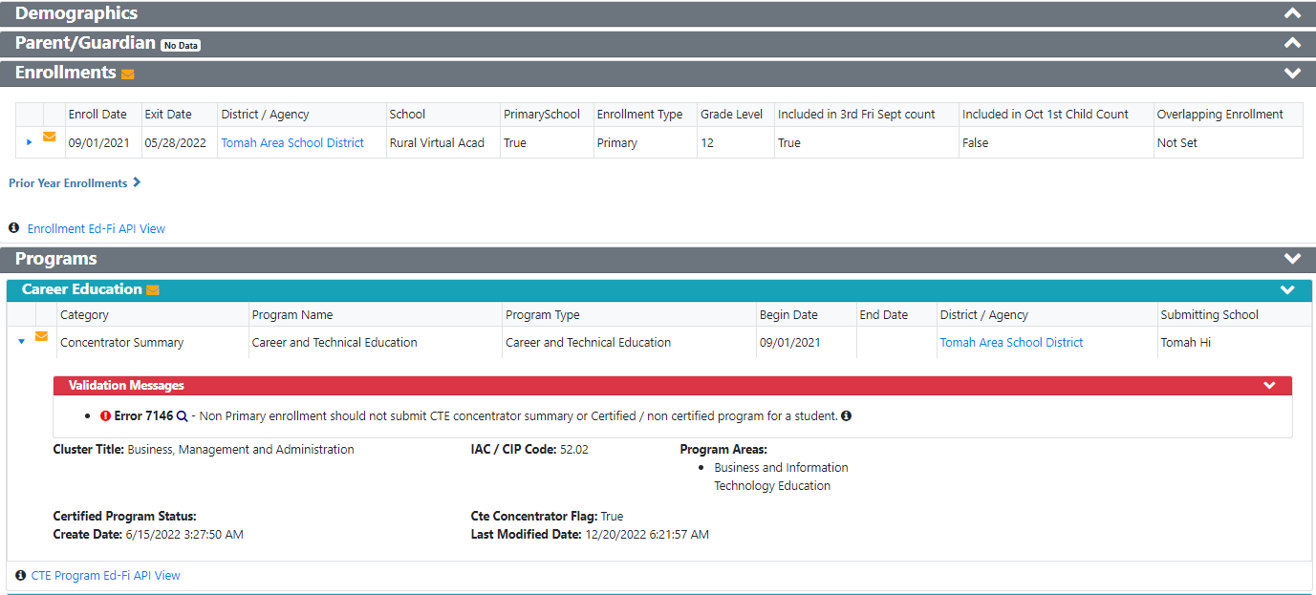
WISEdata Portal Error 7146 (1of4)
Notes:
Error 7146 is informing you that the Career Education - Concentrator Summary submitted by Tomah Hi does not match the students School of Primary Enrollment, which is RVA. Tomah SD has a separate entity or school called RVA and that school needs to submit the Concentrator Summary.
Many district contract with RVA to have their “own” virtual school. The entity/school that enrolls the student as Primary needs to report the students’ data.
*Pay attention to Residency Status for Coursework Enrollment. Home

Slide 16
WISEdata Portal Error 7461 (2 of 4)
Notes:
The Certificated Program Status is missing. The course YA-Healthcare Admin Y1 has been identified as certified WBL course. This is to remind you that you need to add the Certificated Program Status to each students’ record in the course…just because you have a course setup as certified does not mean that it will record the Certificated Program Status automatically.
Setting up the course as certified for IRC and WBL is to help you stay organized!

Slide 17
WISEdata Portal (3 of 4)
Notes:
*Pay attention to Residency Status for Coursework Enrollment. This is an example of a homeschool student.
Residency Status ('R-HOME' and 'NR-HOME')
Homeschool students would use the Coursework Enrollment type, they do not count for courses or CTEstudent program association. You may get error 7146 or 7461 if you forget to add the Residency Status (R-Home or NR-Home) for Membership count.
Homeschool students will not be a CTE concentrator/participant or any other CTE program association because they are not Primarily Enrolled in your school. Perkins counts Primary Enrollment. Homeschool students are primarily enrolled at home.

Slide 18
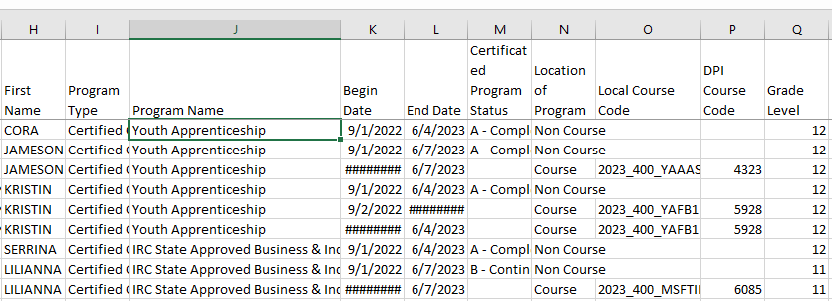
WISEdata Portal Exports (4 of 4)
Certified/Non-Certified Career Education Programs Export
Notes:
Cora - completed a Youth Apprenticeship, however, she was not put into a YA course. A CTEstudent program association was added to her student record. I would not see a WBL course on Cora’s schedule or transcript. I want to see a WBL course on Cora’s transcript to show that she completed 450 hours of YA.
Jameson - was scheduled into a YA course locally called 2023_400_YAAAS. The course was setup as Certified to remind me to add the Certificated Program Status to his record at the end of the year. I can see Youth Apprenticeship on Jameson’s transcript and he got credit for 1 semester. I can see that I added the Certificated Program Status to his student record because it says “Non Course” and A in columns M and N.
Kristin - she took a YA course locally called 2023_400_YAFB1 for 2 semesters (or all year). She also has the Certificated Program Status added to her student record and YA shows up on her transcript.
Serrina - completed an IRC-State Approved Business & Industry. I do not know what course offered the IRC because there is no Local Course Code. Thus, the IRC was entered as a CTEstudent program association on her student record. I wonder what course has an IRC at this school?
Lilianna - she is continuing to work on IRC-State Approved Business & Industry in a local course called 2023_400_MSFTII. I can check the course handbook to find out what exact IRC she is workin on. Also, I need to remember to find out if she completed it or not in the 23-24 school year.

Slide 19
Resources
CTE Data Resources
CTE and Career Education Snapshot Preparation Guide
CTE and Career Education Data WISE Guide
Career Ed and Coursework Data Quality Check (DEMO)
Career Ed and Coursework Data Quality Check (blank)
Report Card Resources
Course and Program Data Guide
Wisconsin Guide to Implement Career-Based Learning Experiences
WISEdash Course User Guide
Notes:
Here are some key resources, that I used to put this presentation together.
The CTE Data Resources webpage is an up to date web page with short trainings on all CTE, Career Ed and Perkins data.

Slide 20
Reach Out
Please reach out if you have questions!
Jessica Sloan, CTE Data Consultant, jessica.sloan@dpi.wi.gov
Mark Schwingle, Gifted and Talented Teaching and Learning Consultant, mark.schwingle@dpi.wi.gov
Chris Gleason, Arts and Creativity Teaching and Learning Consultant, chris.gleason@dpi.wi.gov
reportcardhelp@dpi.wi.gov for questions specific to School and District Report Cards
DPI Help Ticket for questions about WISE data submission and troubleshooting
Notes:
Thank you! Please feel free to reach out if you have questions. I am available or submit a DPI Help Ticket to customer service.

Slide 21
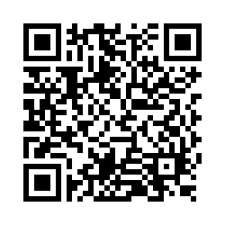
Questions?
Thank you! Thank you!
Please scan the QR code to provide us with your feedback!

