Slide 1
Roster Work Plan
Jessie Sloan
CTE Data Consultant
jessica.sloan@dpi.wi.gov
March 2024
Notes:
Greetings! This is Jessie Sloan, DPI, CTE Data Consultant
Emily Colo, Education Consultant for Office of Educational Accountability

Slide 2
Agenda
What is Roster?
Roster Codes
Roster CTE
Roster Work Plan
Notes:
The agenda will cover What is Roster? Roster Codes and Roster CTE

Slide 3
What is Roster
Roster is a collection within WISEdata and WISEdash of course information, data about students and teachers associated with the courses, and the location of where courses are taught, such as the primary school where the student is enrolled.
Roster data is required for all grade levels 3K, 4K, and KG through grade 12.
Data will be entered in your student information system (SIS) and pushed to WISEdata, and then to WISEdash.
Notes:
Roster is a collection within WISEdata Portal and WISEdash for District of course information,
it collects data about students and teachers associated with the courses,
Roster data is required for all grade levels in school districts. (K3, K4, and KG through grade 12)
Data will be entered in your student information system (SIS) and pushed to WISEdata, and then to WISEdash.
This data collection is done through your SIS vendor course master.
Here is the direct link to DPI’s webpage for Roster collection. There is everything Roster on this webpage and I will summarize a few key areas for CTE.

Slide 4
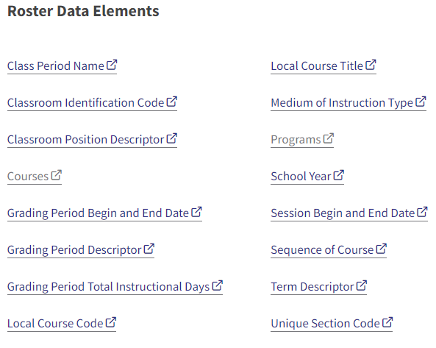
Roster
Roster: Info, Help and FAQ
Notes:
DPI collects many data elements for Roster. These are some of the individual data elements that are collected from your courses.
Utilizing the Roster webpage link on the previous slide, will bring you to these hyperlinks to read more.

Slide 5
Roster Work Plan Row 1 (front half)
Link to Roster Work Plan - save to your Google Drive or print (8.5”x11”)
Google Sheets Example
Notes:
Here is the roster Work Plan.
It is a PDF and Google doc and can be saved to your Google Drive.
Please make a copy, as this link is view only.
This is your historical record of course setup.
When I dig into errors, I ask these data element questions.
We cannot communicate, if we do not know the data elements that go into Career Education Reporting.
Data element definitions need to be shared with Data Entry personnel.
We do not want Data Entry personnel to guess and create a different structure for Career Pathways and identification of Concentrators.
This happens.
We will start with what is outlined in the red box and identify:
Course Title
Roster/State/SCED code
Grade Level
Programs
Teacher License
Performance Base Conversion Type

Slide 6
What is a CTE course?
A secondary course offered through the recognized Wisconsin program areas listed below and must be taught by an appropriately licensed CTE instructor for that specific discipline.
Agriculture and Natural Resources
Business and Information Technology
Family and Consumer Science
Health Science
Marketing Management and Entrepreneurship
Technology and Engineering
Notes:
So what is a CTE course? Let’s quickly review the definition of CTE course for data reporting. A CTE course is a secondary or high school course that is offered through one of the six recognized Wisconsin CTE program areas listed here. In addition, the course must also be taught by an appropriately licensed CTE instructor within that specific discipline or area. Remember, there are multiple pathways to obtain licensure to teach a CTE course, including experience-based licensure in CTE. This is especially important for educators seeking to obtain appropriate licensing in the Health Science program area, which can now be acquired through experience-based licensure in CTE.
<Potential questions may be raised related to this topic>
School secretaries often express confusion and hardships in understanding and identify licensing, specifically CTE experience based licensure; there have been examples of secretaries associating this with an error in the WISEstaff report; Mai Choua to connect with Joshua Kundert about this error in the WISEstaff auditing report.

Slide 7
Licensing for a CTE Course
There are multiple pathways to licensure to teach a CTE course, including experience-based licensure in technical education.
Additional information on license requirements and qualifications can be found on the Pathways to Licensure DPI webpage.
Notes:
So what is a CTE course? Let’s quickly review the definition of CTE course for data reporting. A CTE course is a secondary or high school course that is offered through one of the six recognized Wisconsin CTE program areas listed here. In addition, the course must also be taught by an appropriately licensed CTE instructor within that specific discipline or area. Remember, there are multiple pathways to obtain licensure to teach a CTE course, including experience-based licensure in CTE. This is especially important for educators seeking to obtain appropriate licensing in the Health Science program area, which can now be acquired through experience-based licensure in CTE.
<Potential questions may be raised related to this topic>
School secretaries often express confusion and hardships in understanding and identify licensing, specifically CTE experience based licensure; there have been examples of secretaries associating this with an error in the WISEstaff report; Mai Choua to connect with Joshua Kundert about this error in the WISEstaff auditing report.

Slide 8
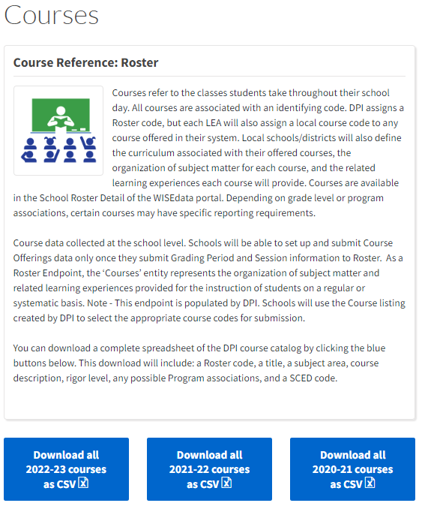
Roster/SCED/State Code
All courses have Roster/SCED/State Codes to be able to send to WISE.
Courses data element page
Select the reporting year and download.
Each year there are a few updates (a code no longer used usually causes an error).
Notes:
Show download and how to sort
Roster/SCED/State Codes convert our written course name and description into a number. Computer programs read numbers.
Each course in a district gets a Roster/SCED/State Code. If the course does not have a Roster code, it does not report to WISE.
Each year, there is an update to SCED….little updates.

Slide 9
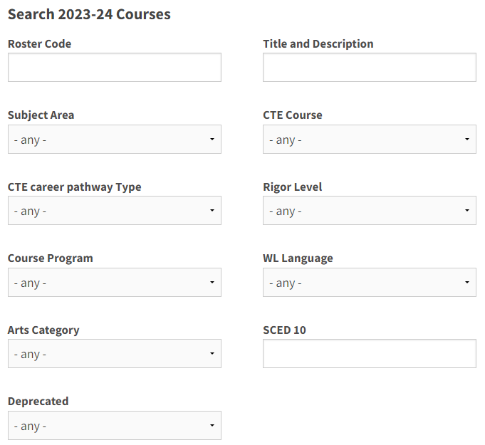
Roster Codes
Each course must have a Roster/State/SCED code. If it does not, it will not send to WISE.
Each student information system (SIS) uses slightly different language to describe Roster codes (Roster/State/SCED).
Each year an updated spreadsheet is available at Courses - https://dpi.wi.gov/wise/data-elements/coursereference . Some SIS vendors integrate these spreadsheets into their software. However, only the person that creates courses would see that. Teachers would need to reference the Courses download.
The Courses webpage provides a description of the columns within the spreadsheet.
Search 2023-24 Courses provides a “quick search.” Note Subject Area and CTE Career Pathway Type.
Notes:
Each course must have a Roster/State/SCED code. If it does not, it will not send to WISE.
Each student information system (SIS) uses slightly different language to describe Roster codes (Roster/State/SCED).
Each year an updated spreadsheet is available at Courses website- https://dpi.wi.gov/wise/data-elements/coursereference . Some SIS vendors integrate these spreadsheets into their software. However, only the person that creates courses would see that. Teachers would need to reference the Courses download found on the webpage.
Also, on the Courses webpage is a description of the columns within the spreadsheet.
Another feature on the Courses webpage is the “Search 2022-23 Courses.” It provides a “quick search” feature. You can use the Subject Area or CTE Career Pathway Type to narrow your Roster search down.

Slide 10
Roster CTE (1 of 2)
Download Courses document
Freeze 1st row
Column A & K- Roster Code is the State code. Read column K, “SCED” to find the corresponding SCED code, if your SIS uses SCED.
Column B - Title used by National Center for Education Statistics (NCES)
Column C - Subject Area
Column D - Description, very generic description of the course
Column E - Rigor Level, discuss with your team the level of course rigor
Sort columns
Column F - courses taught by a licensed CTE Teacher should only use CTE Course codes
Column G - CTE Career Pathway Type
Column H - Course Program for Advanced Placement and International Baccalaureate
Column I & J - World Language & Arts
Column L - Deprecated means retired
Column M - New
Notes:
This is a snippet of the Courses download. This is what I use to communicate with schools. I am not able to see into your student information system, so we can have a conversation about this downloaded document.
When I work with schools, I download the Courses document and freeze the 1st row. There are 10,000+ codes on this spreadsheet, so I use sort and filter to search.
I like to start by sorting Z-A in column F, to have all the CTE courses pop up with a Yes. Then I can begin to look for a Roster/SCED code by reading the column D-Description.
Sometimes, I know the CTE Career Pathway Type that I am searching for and filter by the career pathway in column G. This lets me only select Roster codes that are associated with a specific career pathway that I have developed at school.

Slide 11
Roster CTE (2 of 2)
Non-CTE versions of CTE course offerings have been available since the 2021-22 school year. Schools offering these courses without a licensed CTE instructor should submit the non-CTE versions of the course offerings.
Pay attention to CTE Career Pathway Type. These Roster codes and corresponding Career Pathways should align with the IAC code you use to describe the Career Pathway.
Roster raw/aggregate data can be reviewed in WISEdata Portal export>Course Offerings
Course Enrollment data can be analyzed in WISEdash for Districts>Topics>Coursework>filter by Course Subject. Quick enrollment numbers can also be viewed in WISEdata Portal>Exports>Course Offerings>Column U, Student Count.
Notes:
Non-CTE versions of CTE course offerings have been available since the 2021-22 school year. Schools offering these courses without a licensed CTE teacher should submit the non-CTE roster versions of the course. This means that many districts in the 21.22 school year had to update their Roster codes to the CTE versions because their student information system defaulted on the non-CTE roster code.
Pay attention to CTE Career Pathway Type. These Roster codes and corresponding Career Pathways should align with the IAC code you use to describe the Career Pathway.
Roster raw/aggregate data can be reviewed in WISEdata Portal export>called Course Offerings. Work with your data team to understand Roster codes already being used and if any need to be updated or if new courses are being developed. Also, if your school is creating a new career pathway, reviewing the Roster codes for the sequence of courses will be important to make sure the Roster code career pathway type matches the IAC code career pathway.
Course Enrollment data can be analyzed in WISEdash for District>Topics>Coursework>filter by Course Subject

Slide 12
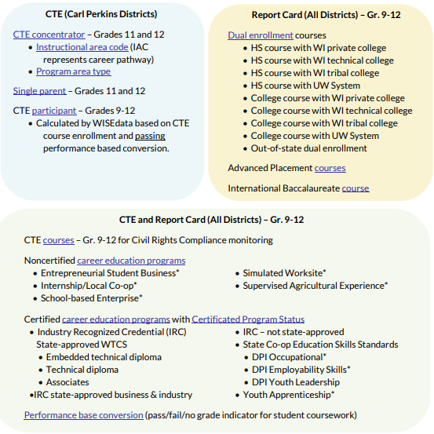
Programs
Programs
Certified Career Education
Non-Certified Career Education
Dual Enrollment
Career Education Programs
Industry Recognized Credentials
Work-based Learning
Career Education Data Reporting - graphic
Notes:
We need to identify if a course offers programming that pertains to Certified Career Education, Non-Certified Career Education or Dual Enrollment.
That means, what courses have WBL, IRC’s and are dual enrollment.
This is part of our course organization and Data Entry needs to know if any course has these components when they setup a course in the coursemaster.
Some SIS vendors all schools to add these data points to individual student records, that is when Data Entry adds a “program” associated to WBL or IRC to an individual student record. You would have to remember all this somehow.
CTE does not include World Language.
AP courses are not dual enrollment. AP and dual enrollment are different types of courses, with different course setup, and different curricular organization.

Slide 13
Performance Conversion Base Type
Performance Conversion Type
Pass
Fail
Not completed
Not graded
Report for students in grades 9-12
Performance Conversion Base Type is automatically calculated when a course is set up to grade.
Notes:
SIS vendors often automatically do this for the school, it may not be extra work
The SIS takes your grades and automatically converts. If you offer CTE courses for no credit or grade, think through it. For example a Youth Apprenticeship release time that is incorporated into a Career Pathway. Do we give credit and grade or not grade?

Slide 14
Roster Work Plan Row 1 (back half)
Identify Postsecondary Preparation participation:
Dual enrollment
Advanced Placement (AP), International Baccalaureate (IB), and Arts and Creativity
Industry Recognized Certificates
Work-Based Learning - 6 criteria
How are you informing Data Entry personnel of this information? Course handbook?
Notes:
All the blue boxes are used for report card data reporting. WBL is used for both report cards and Perkins accountability. The specific report card pages are Postsecondary Preparation and Arts Course Information.
Dual Enrollment - BE VERY AWARE OF HOW YOU SCHEDULE DE COURSES. IF YOU HAVE DE COURSES THAT 1 YEAR LONG (Annual) BUT ARE SCHEDULED AS 2 SEMESTERS. MAKE SURE THAT ALL SECTIONS ARE SETUP CORRECTLY TO REPORT DE. THIS IS A BOX CHECKED IN THE COURSE SETUP. You can review courses in the WISEdata Portal export called Roster: Course Offerings.
AP and dual enrollment are not the same. AP and IB use specific roster codes vs dual enrollment is box checked within the course setup. AP and dual enrollment organization and curriculum is not the same.
Advanced and Arts Courses (AP, IB, Arts)
Industry Recognized Credentials
Work Based Learning
The data elements are collected for students in grades 9-12.
This information is used in Carl Perkins accountability and data analysis and Postsecondary Preparation on Report cards.
Again, the Roster Work Plan helps you organize the data elements that Data Entry personnel need to setup the course master or add to each student record.
Also, it is best practice to provide this information to students and families in your course handbook.

Slide 15
Course Handbook Example: Course
SMALL ENGINE REPAIR (3928)
Grade Level: 10-12
High School Credit: 1
Dual Enrollment: WI Technical College
Advanced Placement: No
Industry Recognized Credential: Small Engine Repair Certificate, (Certification Organization)
Work-Based Learning: No
Career Pathway (IAC): Transportation, Distribution, and Logistics (14.01)
Description: Topics covered include: 4 cycle theory and engine operation, engine construction and repair, fuel systems, lubrication systems, cooling systems and more.
Notes:
This is an example from a Course Handbook.
Students need to know this information to make informed decisions about their schedules. Providing the extra Roster code and IAC code will help having one common place to record all this information.

Slide 16
Course Handbook Example: Table
Roster Code | Course | 9 | 10 | 11 | 12 | DE | IRC | WBL | IAC | CTE Career Pathway Type/Cluster Title
3928 | Small Engine | x | x | x | x | x | x |  | 14.01 | Transportation, Distribution, and Logistics
3882 | Power & Energy | x | x | x | x |  |  |  | 14.01 | Transportation, Distribution, and Logistics
4887 | Woodworking I | x | x | x | x |  |  |  | 46.02 | Architecture and Construction
4892 | Woodworking II |  | x | x | x |  |  | x | 46.02 | Architecture and Construction
Will need to identify specific DE, IRC, WBL types
Notes:
This is another example of a Course Handbook.

Slide 17
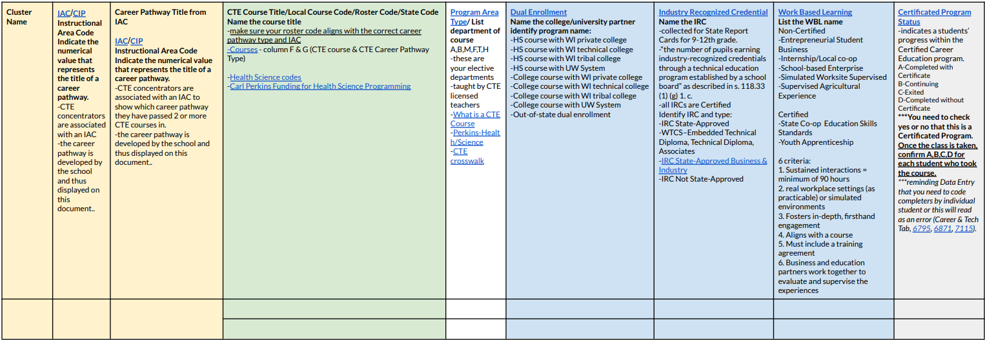
Career Pathway Design
Career Pathway Type - Title of Career Pathway
IAC/Cluster - Numerical value representing the title of the Career Pathway/IAC Title. Groups courses together
CTE Course Title/Roster Code - Use from Row 1
Notes:
Row 2 of the Roster Work Plan is to help you setup and record Career Pathways. We use Career Pathways to count Concentrators for Perkins. Your CTE team is developing sequences of courses and curriculum that go into Career Pathways. Students that take the specific courses identified in the Career Pathway are identified as Concentrators in 11th & 12th grade for Perkins.
You will work with your CTE team to identify the Career Pathways that have been developed in your school. We create Career Pathways by grouping 2 or more courses together. You will need to know from your Career Ed/CTE team which courses are in which Career Pathway. The IAC code ties/groups courses together.
Some SIS vendors are able to add the IAC to each course. So, you would have 2+ courses using the same IAC code to create the Career Pathway. Then, you schedule the students into any of those courses and your SIS helps you track the student through the Career Pathway.
EACH SIS vendor has instructions on how their software works. Some SIS vendors need a utility to run, some need you to do this work manually for each student.
Each vendor has a recorded training from August in WISEdata Portal, under Vendor Resources, show you how to do this for your SIS.
The key is to organize and record your Career Pathways on paper, so you can understand what is going to be entered into the SIS. You can’t print the SIS!
You will need to know what courses are in each Career Pathway when you analyze the data in WISEdash for District. WISE does not draw a map of courses for you. It just shows the students that have been identified as Concentrators in a Career Pathway.
We will start by filling out the 3 boxes outlined in red:
Career Pathway Type - title of Career Pathway
IAC/Cluster - Numerical value representing the title of the Career Pathway/IAC Title. Groups courses together.
CTE Course Title - name of the course
You will notice that there is one box for Career Pathway Type and 2 lines for CTE Course Title. This is because you are grouping courses together, under a single IAC code and Career Pathway. You can add more than 2 courses. I just have 2 lines for presentation purposes.

Slide 18
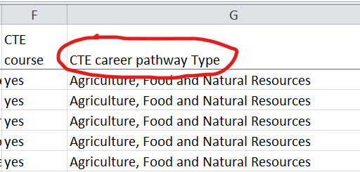
IAC
IAC download Column E (Cluster Title) should match Column G (CTE Career Pathway Type) on the Courses download.
IAC Title is a specific strand within a Cluster. Your district may not be teaching that granularly. It is acceptable to select a more generic IAC code to cover more courses in a career pathway.
IAC also indicates if it is NTO for a specific gender.
Sometimes, there are two CTE career pathway Types on the Courses download. You must open the field.
Notes:
To find the IAC code, work with your Career Ed/CTE Team. They are working with the Perkins grant and Regional Career Pathways to create the curriculum for Career Pathways. Once the team selects an IAC code it should not change, unless the curriculum changes. The IAC code is used to name the career pathway in WISEdash. IAC is also used to identify if the career pathway is non-traditional (NTO) for a specific gender. CTE teams examine Labor Market Information to know if a career pathway is NTO.
The Career Ed/CTE team will use the IAC download to select an IAC code. In the IAC download look at Column E (Cluster Title), this should match Column G from the Courses download.
IAC download Column E (Cluster Title) should match Column G (CTE Career Pathway Type) on the Courses download
IAC Title is a specific strand within a Cluster. Your district may not be teaching that granular. It is acceptable to select a more generic IAC code to cover more courses in a career pathway.
IAC also indicates if it is NTO for a specific gender.
Sometimes, there are two CTE career pathway Types on the Courses download. You must open the field.

Slide 19
Program Area Type
Program Area Type - CTE Departments
Agriculture
Business
Marketing
Family and Consumer Science
Technology Education
Health Science
Taught by CTE licensed teachers
What is a CTE Course
Perkins-Health/Science
CTE crosswalk
Utilize CTE standards
Notes:
The next part of the Roster Work Plan is “Program Area Type.”
This is where you identify which CTE Department the course is part of. The 6 areas are listed here:
Agriculture, Business, Marketing, Family and Consumer Science, Technology Education, and Health Science. Health Science has a different bullet point because you can only have Health Science when you have a properly licensed Health teacher that also has a CTE license. If you do not have a Health teacher dual licensed in CTE, you do not have Health Science.
Also, general health for graduation is not a CTE course and not part of a Career Pathway. Work with Data Entry and Administration to understand Health Science and utilizing CTE standards.

Slide 20
Roster Work Plan Row 2
Indicate Postsecondary Preparation Programs:
Dual enrollment - List CTE dual enrollment/transcripted credit and institution
Industry Recognized Certificates - List IRC
Work-Based Learning - Does the CTE course meet the 6 criteria? List the type of WBL
Notes:
This next section, outlined in red will cover dual enrollment, IRC, and WBL each year. We need to identify which courses offer these data elements.
Each of these boxes has quick links and brief notes to remind you of what each mean.
We also need to keep a historical record of these courses and opportunities because they are often based on teaching staff abilities and certifications.

Slide 21
Non-certified Career Education Programs
Career Education Programs Career Education Data Reporting (graphic)
Non-certified WBL - only need to submit a final grade
Internship/Local Co-Op
Supervised Agricultural Experience
Simulated Worksite
School-Based Enterprise
Entrepreneurship Student Business
Notes:
Non-certified and Certified are two buckets of Certifications or Certificates. “Non” does not mean “no certificate.” It means it is not on the approved industry recognized list from DWD. Non-certified WBL courses are counted based on students grades.
Certified IRC and WBL mean that a final Certificated Program Status Type that needs to be entered at the end of grading for the data to be counted.
Report cards is a participation count.
Schools can use the Certificated Program Status to dig into their WBL and IRC data to see who actually completes these opportunities.
This slide listed the Non-certified Work Based Learning opportunities.
These only need a final grade entered to count.

Slide 22
Certified Career Education Programs
Career Education Programs Career Education Data Reporting (graphic)
Report for students in grades 9-12:
Industry Recognized Credentials (IRC) state-approved WTCS
Embedded Technical Diploma
Technical Diploma
Associates
IRC state-approved Business and Industry
IRC - Not state-approved
State Co-op Educational Skill Standards
DPI-Occupational
DPI-Youth Leadership
DPI-Employability Skills
Youth Apprenticeship
Submit a final grade AND Certificated Program Status Type for each student.
Notes:
This is another view of all the specific Program Types for Certificated Program Status Type.
All IRCs are Certified.
State Coop Educational Skills - DPI-Occupational, DPI-Youth Leadership, and DPI-Employability Skills, and Youth Apprenticeship are Certified Career Education Programs.
These WBL opportunities are all governed by a specific organization, outside of your school.
Recording this information will help you analyze the data over time (years). Certified WBL has changed a few times, and people forget year to year. A common error I see in data is that we forget to add the Certificated Program Status Type to IRC and Certified WBL. Then reports come out and no students counted, because the data was not entered completely.

Slide 23
Certificated Program Status Type
Report Certificated Program Status for each student program participation.
A - Student met the requirements of the certificated program and was or is to be awarded a certificate
B - Student is continuing in the certificated program
C - Student has left the certificated program before completion
D - Student completed program but did not meet the requirements for the certificate
Report for students in grades 9-12
Before summer break, CTE teachers should provide student list to Data Entry personnel with students’ Career Education Program (Non-certified and Certified) and Certificated Program Status.
Notes:
The final box on the Roster Work Plan, outlined in red here, is a reminder to collect Certificated Program Status.
For the Certified Career Education programs on the last slide:
Report Certificated Program Status for each student program participation
A - Student met the requirements of the certificated program and was or is to be awarded a certificate
B - Student is continuing in the certificated program
C - Student has left the certificated program before completion
D - Student completed program but did not meet the requirements for the certificate
DPI counts students in grades 9-12
Before Summer break, CTE teachers should provide student list to Data Entry personnel with students Career Education Program (Non-certified and Certified) and Certificated Program Status.

Slide 24
WISEdata Portal Export
Roster: Course Offerings
Sort by Local Course Title or Dual Enrollment
Do the sections make sense?
Example - *CAPP Pre-CALCULUS has 2 sections reporting without Dual Enrollment, but course title and rest of the sections are indicating this Dual Enrollment. Should it be Dual Enrollment?
Equity and Access
Notes:
Check courses being reported to DPI.
Use WISEdata Portal exports - Roster: Course Offerings or Student Section Associations or any other roster export that make sense to you.
This is example is from Course Offerings. It is sorted by column K - Local Course Title and then I reviewed for courses reporting as dual enrollment or not.
*CAPP PRE-CALCULus does not make sense to me?
The rest of the sections are reporting as dual enrollment. However, these two sections are not dual enrollment, even though the course title says CAPP. I know that CAPP courses are approved dual enrollment with UW-Oshkosh.
I need to investigate why these two sections are reporting this way. Then make changes.

Slide 25
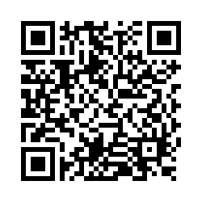
Questions?
Thank you!
Please reach out if you have questions.
jessica.sloan@dpi.wi.gov
DPI Help Ticket
Please scan the QR code to provide us with your feedback!

