Slide 1
Fall at a Glance WASBO New Admin/Support Staff
Mark Elworthy, Director
School Financial Services Team
September 6, 2023
Notes:
Introductions
Survey group experience

Slide 2
Reasons for Fall at a Glance
Connections
Resources
Priorities
Developing your plan

Slide 3
Connections
Introduction SFS Team members
Relationships matter

Slide 4
RESOURCES
Get to know your team
Review prior budgets, audits and school board meetings
Learn how is the board updated monthly on the budget

Slide 5
Table Exercise
First three community members you met
First projects completed
Next three projects

Slide 6
Priorities
Know what is expected of you in the first 100 days
Complete budget reports so October 15 General Aid can be calculated
Develop/finalize budget for the current year

Slide 7
Developing your plan
Elevator speech about the district and budget
Quick wins
Long-term goals and developing a plan to support the educational goals
Challenge – Using someone’s budget format

Slide 8
Juggling Three Years
Prior Year 2022-23 | Most of your DPI reporting involves submitting prior year data in the fall Affects most current year state aids
Current Year 2023-24 | Active budget you are working under Pupil counts are very important! October is about Revenue Limit and Tax Levy
Next Year 2024-25 | Budget-building process starts over the winter and goes into the spring and summer
Notes:
Depending upon the time of year you are working on up to three “budgets”
Annual Report and audited financial statements
Budget Report
Planning for the future, enrollment projections

Slide 9
How will I keep track of all this?
Fiscal Year at a Glance – Due dates for reports by name & purpose
Fiscal Year "Multi-tasker" Planning Calendar - What to do related to prior year, current year and next year
dpi.wi.gov/sfs/communications/calendars/ overview
Notes:
Fiscal Year at a Glance - One two-sided document listing most of the finance teams reports
Multi-tasker provides information for the three fiscal years on a bi-monthly basis

Slide 10
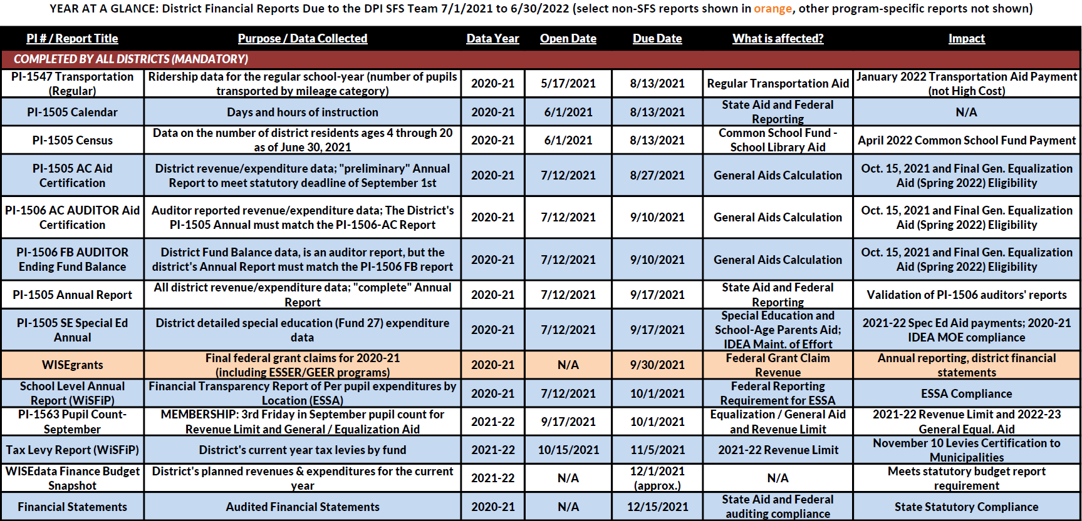
Fiscal Year at a Glance
REQUIRED FOR ALL
AS APPLICABLE
Notes:
DPI reports and due dates both required and optional
PI Number for most reports
Purpose
Data Year – reporting on prior year
What is affected
Impact

Slide 11
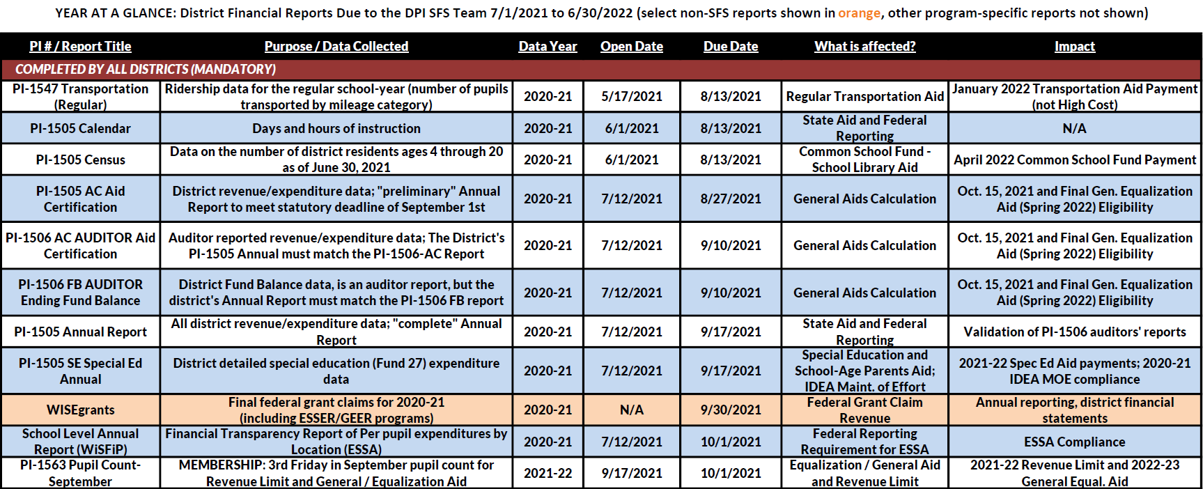
Fiscal Year at a Glance

Slide 12
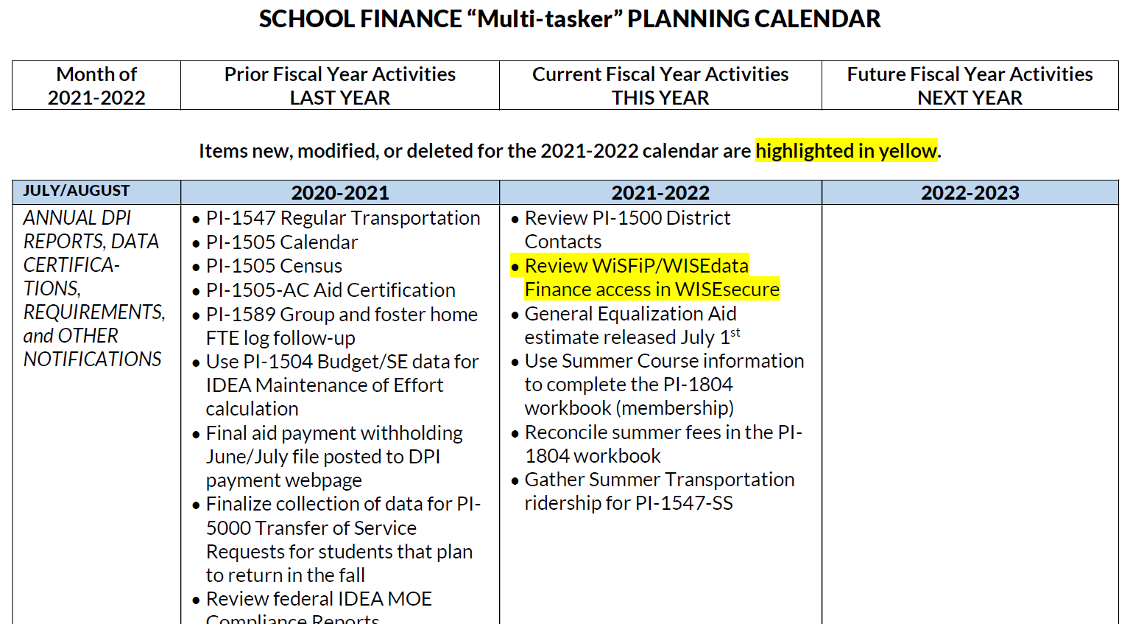
Multi-Tasker Calendar
Notes:
Three years of activities in two month increments grouped by
DPI related reports and notifications
District Activities
District Policies and Procedures – questions the Team gets are often addressed in BOE policy

Slide 13
Table Exercise
How do you organize your days, weeks, months, years

Slide 14
Reports due in September
Annual Report
Transfer of Service
Third Friday Pupil Count
Final 2022-23 Grant Claims

Slide 15
Where are you at with these reports?

Slide 16
Third Friday of September Count
Notes:
Fall Pupil Count PI-1563 – Third Friday in September- Do not confuse with WISE SIS data – this is membership FTE
Challenge Academy PI-1563CA
Critical data for revenue limit calculation-changes in membership will change calculation
Complicated as students may attend other districts, challenge academy and part-time
Data from the report is converted to FTE and used in the calculation of a district’s current year Revenue Limit and following year’s Equalization/General Aid

Slide 17
Membership vs. Enrollment
ENROLLMENT
MEMBERSHIP
Where students live
Drives district revenues
Where students learn
Drives district expenses
Notes:
Very important distinction!
Membership: Resident students whose education your district is financially responsible for – includes residents attending other schools under Open Enrollment, Independent Charter, or Choice (“Voucher”) programs
Enrollment: Students actually being educated in your district’s schools – includes nonresidents attending under Open Enrollment, may also include cooperative programs (usually in special ed)

Slide 18
This Year Affects the Future
School Year | Funding Impacts
2021-22 | Revenue Limit (1/3 of 3-year average membership) …and Tax Levy Per Pupil Aid (also uses 3-year average)
2022-23 | General State Aids (last year’s membership) and Revenue Limit (3-year average)…and Tax Levy Per Pupil and Other Categorical State Aids
2023-24 | Revenue Limit and Per Pupil Aid
2024-25 | Revenue Limit (starts with comparison to the previous year’s 3-year average)
Notes:
This year’s count affects four years of school funding for your district.
Most significant impact will actually be next year.

Slide 19
Revenue Limits
A revenue limit restricts (controls) the amount of money a district can receive from:
General State Aids (mostly Equalization Aid)
High Poverty Aid (no longer July 2023)
Local Property Taxes
Department of Revenue Exempt Computer and Personal Property Aids

Slide 20
General State Aids
General State Aids are state funds within the revenue limit that partly offset your local tax levy.
Aid formula is a comparison of your district to the 420 others in Wisconsin.

Slide 21
How do you explain funding to:
Staff
Parents
Community member

Slide 22
Remember!
Revenue Limit membership: 3-year rolling average
Aid membership: Last year’s membership for this year’s general school aids

Slide 23
The Bottom Line - District Planning
LOCAL PROPERTY TAXES
GENERAL STATE AIDS
REVENUE LIMIT
–
+
=

Slide 24
The Bottom Line – Community Impact
REVENUE LIMIT
GENERAL STATE AIDS
LOCAL PROPERTY TAXES
–
=
General State Aids function as tax relief under the Revenue Limit.

Slide 25
More about Aid & Revenue Limits…
How is your district aided?
DPI Resource – Longitudinal Aid
Multi-Year Aid: 2010-11 to current.

Slide 26
Required Reports to generate October 15 General Aids
October 15 General Aid
Step #5
Step #4
Due October 27 – School-Level Annual Report
Step #3
Due September 22 - Annual Report
Step #2
Due September 15: Auditor Aid Certification and Fund Balance
Step #1
Due September 1: District Aid Certification
Notes:
Steps in process – labeling
Common School District
Unified districts do not have an annual meeting, only a hearing

Slide 27
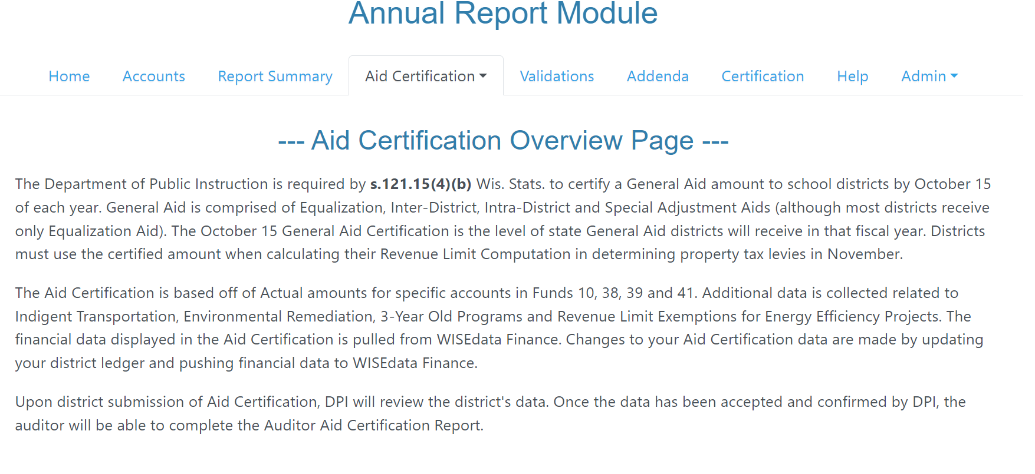
District Aid Certification (Formerly the PI-1505-AC Aid Certification)
Was due September 1
“Baby Annual Report” with data for Oct. 15 aid certification
Auditor submits & compares the same for Auditor Aid Certification (formerly their PI-1506 reports)

Slide 28
Auditor Aid Certification and Fund Balance (PI-1506-AC/FB Auditors’ Reports)
You won’t see these
Due Sept. 15
Confirm/update your District Aid Certification
Report ending fund balances & variance from audit statements

Slide 29
Tying It Together
Your District Aid Certification must be reviewed and approved…
…before the auditor can start their Aid and Fund Balance Certification

Slide 30
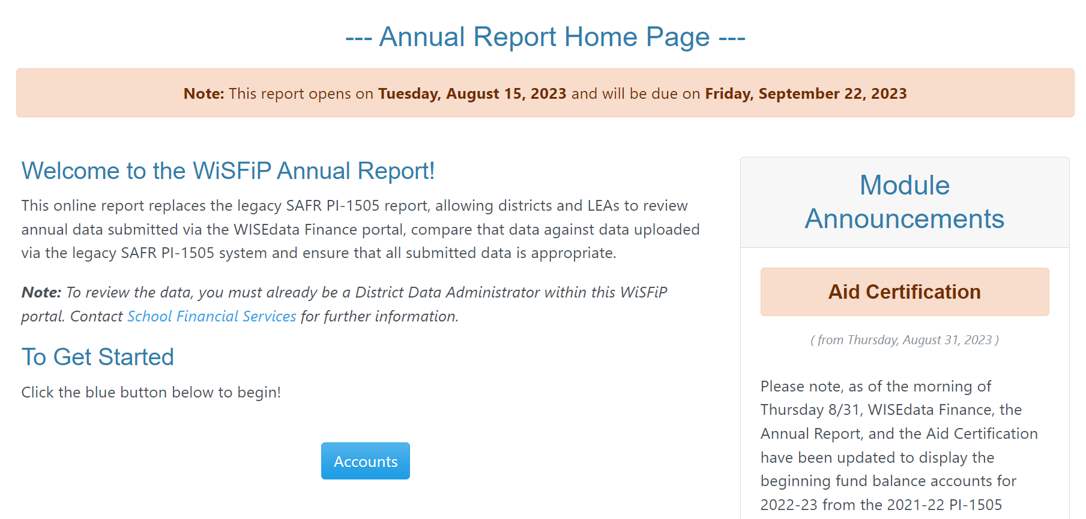
Annual Report (PI-1505 Annual Report)
Due on Sept. 15
“Full Annual” with complete data for all funds
Majority of your fall reporting work

Slide 31
Tying It Together
The auditor’s Aid Certification and Fund Balance reports must be approved…
…before you can submit your Annual Report.

Slide 32
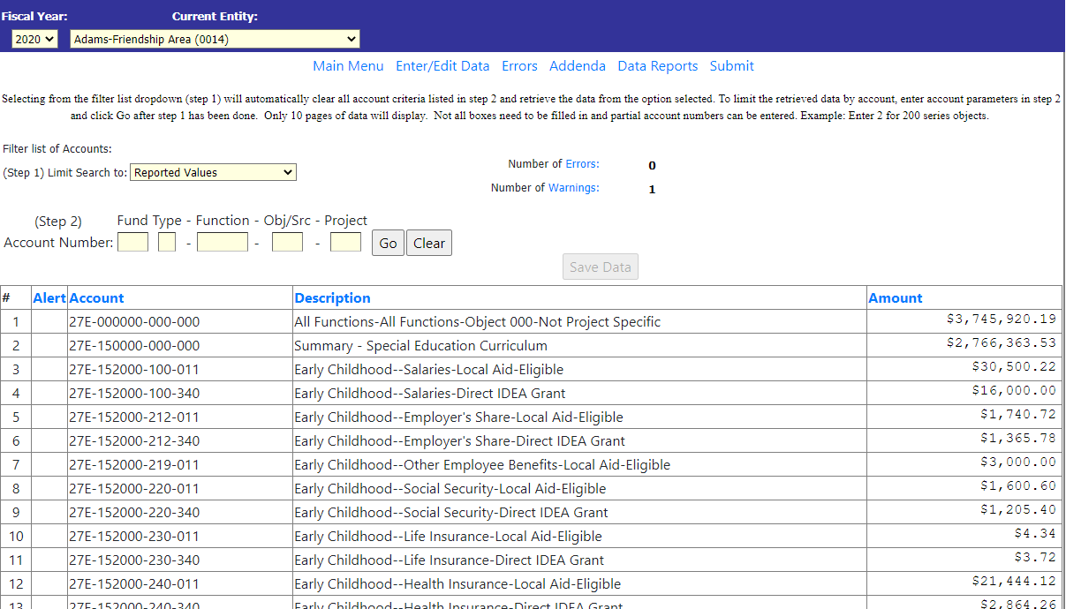
PI-1505-SE Special Ed Annual Report
Also due Oct. 17
Detail report for special education (Fund 27) expenses
Used for state special education aid

Slide 33
Tying It Together
IDEA grant costs must match
PI-1505-SE detail must match the full PI-1505 Annual

Slide 34
More about Annual Reports coming up…
Q: Why did we cover these slides?
A: All of these reports build to the calculation
of the October 15 General Aids

Slide 35
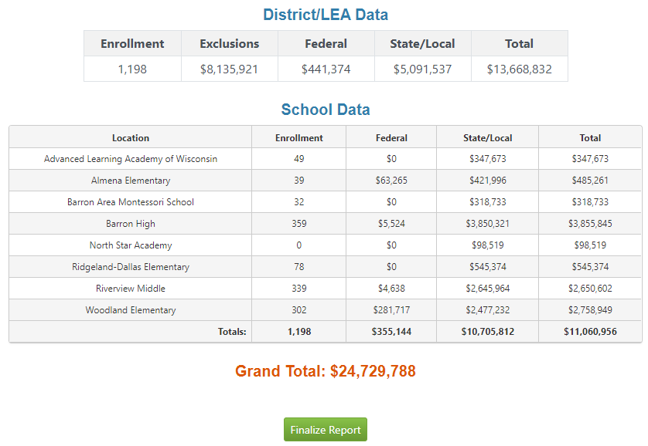
School Level Annual Report
Due on Oct. 1
Expenditures only broken down by
School or District
Federal or State/Local Funded
“Exclusions”
Used for federal ESSA per pupil reporting

Slide 36
Tying It Together
School Level Report total, exclusions & federal costs…
…are reconciled to the full Annual Report.

Slide 37
Annual Report Reviews
DPI review including reconciling data
DPI may identify errors in your SE data
DPI may request additional information
Changes in one district may impact another
All changes must be made by February
Timely responses are important for all to meet the deadline

Slide 38
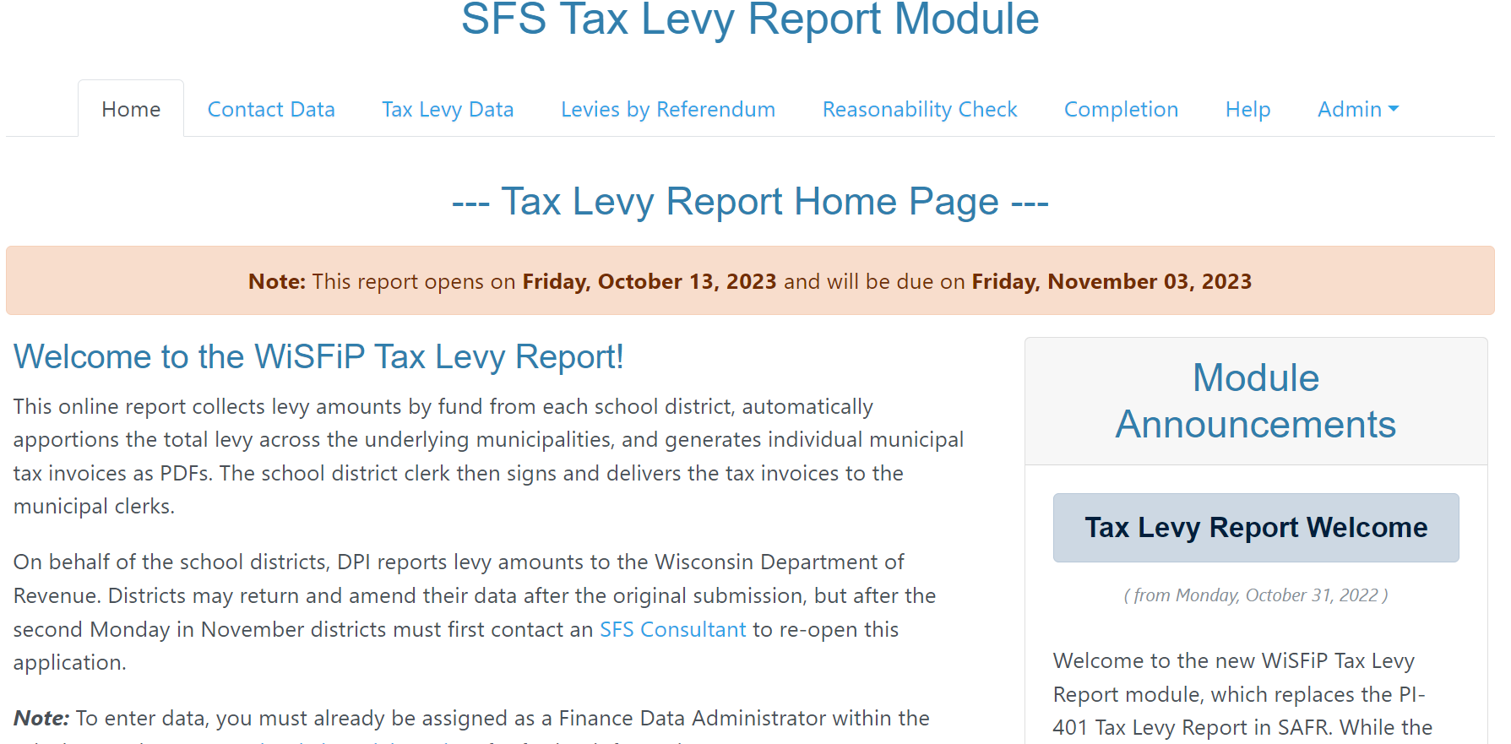
Financial Reports
September Pupil Count (PI- 1563 in SAFR)
Tax Levy (WiSFiP)

Slide 39
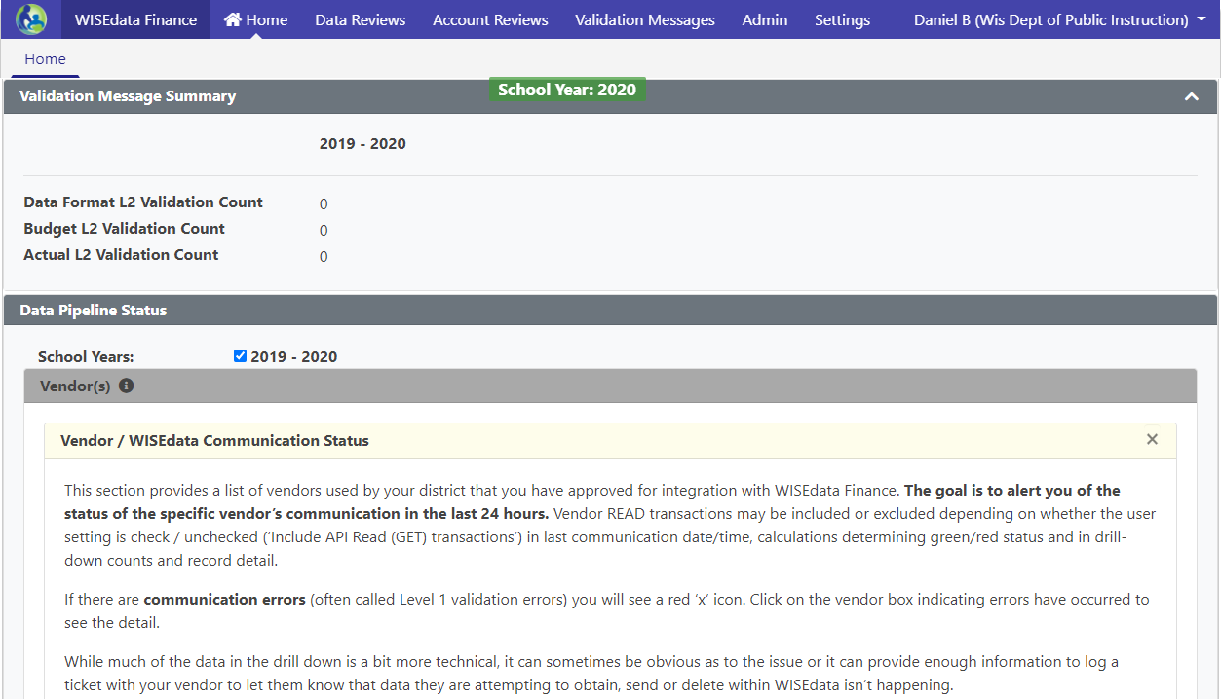
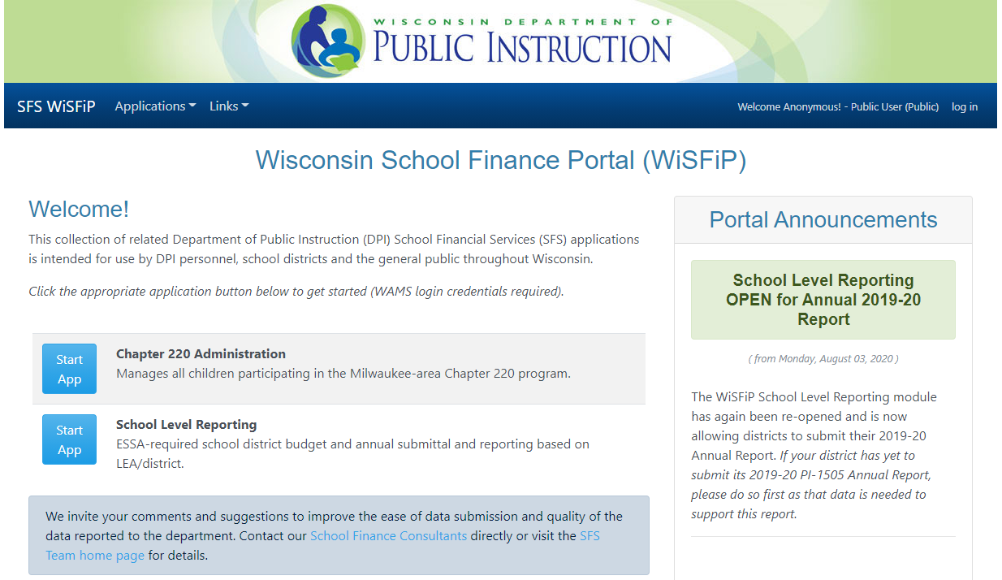
The Future is Here
WISEdata Finance
WiSFiP
Finance data reported just like student data, directly from your data system
Reports compiled from WISE-data Finance and additional information you provide
Notes:
WiSFiP = Wisconsin School Finance Portal

Slide 40
What’s Next? Membership!
Federal SLDS Grant is funding development of membership reporting & parental choice tools with WISEdata (Student)
Pupil Count Pilot in 2023-2024 (30 districts)

Slide 41
Budget to Tax Levy…
Notes:
Annual Meeting
Budget Hearing
Budget Adoption
Tax Levy
Summer and interim session pupil count
September Pupil Count

Slide 42
Overview: Budget Adoption and Tax Levy
Adopt a budget at a school board meeting and set the tax levy
Step #5
The electors at the annual meeting vote a tax (Common School Districts only)
Step #4
Step #3
The public hearing is held, at which time residents of the district have an opportunity to comment on the proposed budget
Step #2
Publish a class 1 notice in the newspaper
Step #1
Create a proposed budget that identifies expected revenues, expenditures and fund balances for the upcoming/current year
Notes:
Steps in process – labeling
Common School District
Unified districts do not have an annual meeting, only a hearing

Slide 43
Budget Adoption
The school board shall adopt a budget at a school board meeting after the public hearing and no later than the meeting in which the tax levy is set. This is sometimes referred to as the “original” budget.
Deadline November 1st
Step #5
Adopt a budget at a school board meeting and set the tax levy
Notes:
District can accept & spend money before the budget is finalized.

Slide 44
Contacting the SFS Team
Email: dpifin@dpi.wi.gov
Phone: (608) 267-9114
Web: dpi.wi.gov/sfs
Team Directory: dpi.wi.gov/sfs/communications/staff-directory

Slide 45
My Contact Information
Mark Elworthy Director DPI School Financial Services Team mark.elworthy@dpi.wi.gov (608) 266-9534

Slide 46
Recommended DPI Bookmarks
SFS Team Page and Assignments
Sign-up for the Newsletter
Year at a Glance and Planning Doc
SAFR Portal
Comparative Costs per member
PI 1500 Contacts

