Slide 1
Meal or No Meal
An Offer Versus Serve Lesson & Game
DPI School Nutrition Team
2022

Slide 2
What is Offer versus Serve (OVS)?
The service model allows students to decline food items or components offered during mealtimes.
Notes:
Before we get started, let’s review the definition of Offer versus Serve (OVS). OVS refers to the option children may be given to refuse items offered as part of a federally-subsidized school meal without the meal service operation losing the federal reimbursement for the meal.

Slide 3
OVS
Pros | Cons
Students select what they enjoy Potentially higher meal counts Less food waste Lower food costs | Training for students and Point of Service (POS) staff to identify a reimbursable meal A potential for increased food waste
Notes:
What are some of the pros and cons of OVS?
Pros:
Students get to select what they enjoy.
There is a potential for higher breakfast and lunch counts - students love selection!
There is a potential for less food waste - after the Point of Service (POS) since students select what THEY like to eat.
There is a potential for lower food costs – staff will prepare less food because they only need to make the forecasted amount. For example, instead of opening 5 - #10 cans of diced pears; maybe you only open 2 based on historical data from past production records.
Cons:
More training is needed for students and POS staff to identify a reimbursable meal – Training is required to ensure everyone knows how to identify a reimbursable breakfast and/or lunch.
There is a potential for more food waste if the forecasting is not done properly – preparing more choices COULD leave you with more food waste. For example, prepping various types of breakfast sandwiches in advance, but only one popular sandwich is chosen by the students. The other choices were not salvageable by the end of service (e.g. too dried out) and are tossed for the day.

Slide 4
When is OVS required?
Required | Optional and Encouraged | All students meeting the definitions below
Lunch, grades 9-12 | Breakfast, grades K-12 Lunch, grades K-8 | Special Needs Students Students on Field Trips Students Serving Detention
Notes:
Offer vs. Serve is required for senior high school students at lunch. It is optional, but encouraged, for elementary and middle school students at lunch and for all grade levels at breakfast.
OVS applies to all students in all situations. This includes students with special needs or students on field trips and those in detention.

Slide 5
Lunch Food Component
Five food components must be offered at lunch.
Milk Grain Fruit Vegetable Meat/Meat Alternate
Notes:
Let’s go over some terms used in OVS. What exactly is a food “component”?
At lunch, OVS is implemented using the five food components required under the meal pattern. These are meat/meat alternate, grain, fruit, vegetable, and fluid milk.
Point to make: a milk variety is required at breakfast and at lunch.

Slide 6


Menu Item
A menu item is a food offered that may contain multiple food components within.
Notes:
Another term used in OVS is a menu item. A menu item is a food offered of one of the five food components and may contain multiple components within. For example, a salad, which might have multiple food components within it (e.g. vegetable, meat/meat alternate, and fruit), is one menu item offered.

Slide 7



Breakfast Food Item
½ cup fruit
(or vegetable if substituting)
1 ounce
equivalent grain
(or Meat/Meat Alternate if counting toward grain)
1 cup milk
Notes:
At breakfast we talk about food items. A breakfast food item is defined as ½ cup of fruit (or vegetable, if substituting for fruit), 1 ounce equivalent (oz eq) grain (or meat/meat alternate if counting toward a grain), and 1 cup of milk.
We will talk about a meat/meat alternate counting toward a grain on the next slide.

Slide 8
Meat/Meat Alternate as a Grain
Schools may offer a meat/meat alternate at breakfast and count it toward the grain component.
Must also offer 1 oz eq of grains daily
The meat/meat alternative counts toward weekly grain minimum
Notes:
A meat/meat alternate is not required at breakfast, however it can be offered and counted towards the grain component. This is specific to breakfast only. To count a meat/meat alternate at breakfast as a grain, at least 1 oz eq of a true grain must also be offered.
When the meat/meat alternate is offered in place of a grain as part of the reimbursable meal, the menu planner counts it toward both the weekly grain requirement and the dietary specifications. It then counts as a “food item” under OVS.
Keep in mind that although the menu planner has to offer a grain in order to count the meat/meat alternate towards the grain component, the student does not have to select it.
If a meat/meat alternate is offered but no grain is offered, the meat/meat alternate cannot count toward the grain component, and the grain component is considered missing. If the meat/meat alternate is not counted as a grain, it would be considered an extra and will not count as an item under OVS.

Slide 9
Required Food Items and Components
Breakfast | Lunch
Offer 4 food items | Offer 5 food components
Must select 3 food items | Must select 3 different food components
One food item must be ½ cup fruit or vegetable | One component must be ½ cup fruit or vegetable
Notes:
For breakfast, the menu planner must offer four food items. Students must select at least three food items, one of which is ½ cup fruit and/or vegetable for a reimbursable meal.
For lunch, the menu planner must offer five food components. Students must select at least three full, different food components, one of which is ½ cup fruit and/or vegetable for a reimbursable meal.

Slide 10
Sample Breakfast, OVS
The menu planner must offer (at least) these four food items
½ cup fruit (1 food item)
½ cup fruit (1 food item)
1 cup milk (1 food item)
1 oz equivalent grain (1 food item)
The student must select (at least) three food items
Food item 1 ( ½ cup fruit)
Food item 2
Food item 3
Notes:
Here is visual of breakfast – what must be offered and what must be selected.
On the left is what the menu planner must offer, daily. This includes the components: fruit, grain, and milk and at least four food items from these three food components must be offered.
On the right is what a student must at least select to make a reimbursable meal. They must select at least three food items, one of which is ½ cup fruit and/or vegetable to make a reimbursable meal.

Slide 11
Sample Lunch, OVS
The menu planner must offer (at least) these five food components. Component amounts depend on grade group.
Fruit
Vegetable
Milk
Meat/Meat Alternative
Grain
The students must select (at least) three full components. One being a fruit and/or vegetable.
Full component #1
Full component #2
Full component #3 (½ cup fruit and/or vegetable)
Notes:
Here is a visual of lunch – what must be offered and what must be selected. On the left is what the menu planner must offer. This includes all five food components: fruit, grain, vegetable, meat/meat alternate and milk. Amounts to offer of each will depend on the grade group served. On the right is what a student must at least select to make a reimbursable meal. They must select at least three full, different, food components, one of which is ½ cup fruit and/or vegetable to make a reimbursable meal.

Slide 12
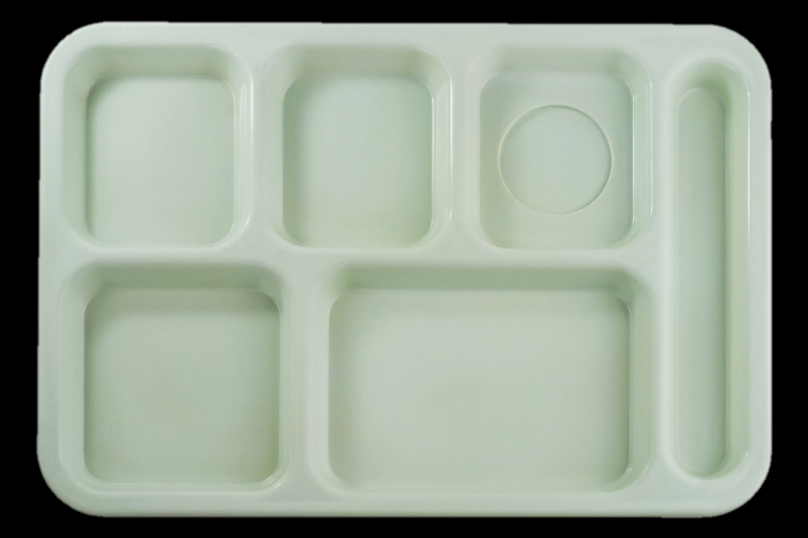
Let’s play Meal or No Meal!
We will show the planned menu, and then, show what the student has selected.
Based on the student’s selection, respond ‘yes’ or ‘no’ if the meal is reimbursable under Offer Versus Serve.

Slide 13



Breakfast Menu 1
K-12 student
Breakfast sandwich
(1 oz eq whole grain rich bagel; 1 oz. equivalent egg and ham patty)
½ cup orange slices
½ cup strawberries
1 cup milk
Notes:
We are going to start with breakfast examples.
Here is the planned breakfast menu for the day for a K-12 menu. Remember, four food items from the three required food components must be offered daily at breakfast.
Ask group: What are the three required food components?
Answer – grain, fruit, and milk.
Ask group: If serving a K-12 menu at breakfast, what is the daily minimum that must be offered of each of the three food components?
Answer – 1 cup milk, 1 cup fruit, and 1 oz eq grain.
This menu for the day includes a breakfast sandwich of 1 oz eq grain bagel and 1 oz eq egg n’ ham patty, ½ cup strawberries, ½ cup orange slices, and 1 cup milk.
Ask group: Did the menu planner meet the meal pattern for the day?
Answer – yes!

Slide 14


Breakfast menu 1 example 1
Breakfast
Meal or No Meal?
1 food item
Notes:
*click once*
This student selected a milk and a breakfast sandwich, which the menu planner planned as 1 food item.
Point to make: the menu planner determines how many food items to count something as prior to service. It is not up to the POS to determine how much a food item counts as at the time of determining a reimbursable meal. This must be communicated beforehand.
Is this a reimbursable meal?
Answer – No! Only two food items are on the tray.
*click again* The student added ½ cup strawberries. Is this a reimbursable meal?
Answer – Yes! Now there are three food items on the student’s tray, one of which is ½ cup fruit and/or vegetable.

Slide 15
Breakfast menu 1 example 2
Breakfast
Meal or No Meal?
2 food items
Notes:
*click once*
Now let’s say the menu planner plans to count the sandwich as two food items. Remember that they can do this because the sandwich contains 1 oz eq grain and 1 oz eq meat/meat alternate. The student selected the sandwich and the strawberries.
Is this a reimbursable meal?
Answer – Yes. There are three food items on the tray, one of which is ½ cup fruit and/or vegetable.

Slide 16

Breakfast menu 1 example 3
Breakfast
Meal or No Meal?
2 food items
Notes:
*click once*
Again, the menu planner plans to count the sandwich as two food items. The student selected the sandwich and a milk.
Is this a reimbursable meal?
Answer – No! There are three food items on the student’s tray, but none of which are ½ cup fruit and/or vegetable.
*click again* The student added the orange slices. Is this a reimbursable meal?
Answer – Yes. There are now actually four food items on the tray, which is allowable. The student chose four food items, one of which is ½ cup fruit and/or vegetable.

Slide 17




Breakfast Menu 2
½ cup blueberries
½ hard-boiled egg
(1 oz. equivalent M/MA (grain))
Whole wheat toast
(1 oz equivalent grain)
½ cup hash browns
1 cup milk
Notes:
Here is the planned breakfast menu for the day. It includes ½ a hard boiled egg (which credits 1 oz eq meat/meat alternate, which is being counted as a grain), a slice of whole wheat toast (which credits 1 oz eq grain), ½ cup blueberries, ½ cup hash browns, and 1 cup milk.
Ask group: Why can the menu planner count the egg as a grain?
Answer – Because they also offered a 1 oz eq true grain!
Ask group: Does anyone know the new rule with crediting hashbrowns, or starchy vegetables at breakfast?
Answer – you no longer need to also offer at least 2 cups of non-starchy vegetables from dark-green, red/orange, beans/peas or the other vegetable subgroup during the week before the starchy vegetable can be counted towards the meal pattern. You can freely offer starchy vegetables at breakfast!
Ask group: Did the menu planner meet the meal pattern for the day?
Answer – yes! They offered at least four food items from at least 1 oz eq grain, 1 cup fruit, and 1 cup of milk.

Slide 18



Breakfast menu 2 example 1
Breakfast
Meal or No Meal?
Notes:
*click once*
The student selected a ½ hard boiled egg and ½ cup of hash browns.
Is this a reimbursable meal?
Answer – No! The student only selected two food items.
*click again* The student added ½ cup of blueberries. Is this a reimbursable meal?
Answer – Yes! The student now selected three food items and at least one of them is ½ cup fruit or vegetable. In this case they have a fruit and a vegetable!
Point to make: Although the menu planner has to offer a grain in order to count the meat/meat alternate towards the grain component, the student does not have to select it.

Slide 19

Breakfast menu 2 example 2
Breakfast
Meal or No Meal?
Notes:
*click once*
The student selected toast and milk. Is this a reimbursable meal?
Answer – No! The student only selected two food items.
*click again* The student added the hard-boiled egg. Is this a reimbursable meal?
Answer – No! The student has not selected ½ cup fruit or vegetable.
*click again* The student added the blueberries. Is this a reimbursable meal?
Answer – Yes! The student now has at least three food items, one of which is ½ cup fruit.

Slide 20
Breakfast menu 2 example 3
Breakfast
Meal or No Meal?
Notes:
*click once*
The student selected hashbrowns, blueberries, and a milk. Is this a reimbursable meal?
Answer – Yes! Even though this student only chose fruit, vegetable, and a milk and no “entrée,” it is still a reimbursable meal because they selected three food items, one of which is ½ cup fruit.

Slide 21



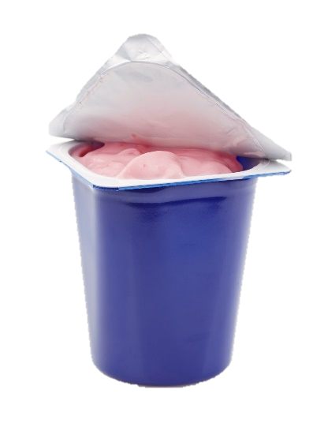
Breakfast Menu 3
½ cup peaches
1 cup milk
Whole grain-rich muffin
(2 oz. equivalent grain)
½ cup 100% juice
4 oz. yogurt
(1 oz. equivalent M/MA (grain))
Notes:
Here is the planned breakfast menu for the day. It includes ½ cup 100% juice, 1 cup milk, ½ cup peaches, and a 4 oz. yogurt (which credits 1 oz eq meat/meat alternate, which is being counted as a grain).
Ask group: Did the menu planner meet the meal pattern for the day?
Answer – No!
Ask group: What do they need to add and why?
Answer – a grain. In order for the yogurt to count as a grain, a true grain must also be offered. *click* a muffin appears, which credits 2 oz eq grain.

Slide 22

Breakfast menu 3 example 1
Breakfast
Meal or No Meal?
1 food item
Notes:
*click once*
The student selected the muffin, which counts as 1 food item, and a juice. Is this a reimbursable meal?
Answer – No! The student satisfied the ½ cup fruit requirement, but there are only two food items on the tray.
*click again* The student added a yogurt. Is this a reimbursable meal?
Answer – Yes! The student now has at least three food items, one of which is ½ cup fruit.

Slide 23
Breakfast menu 3 example 2
Breakfast
Meal or No Meal?
2 food items
Notes:
*click once*
The student selected the muffin, which the menu planner planned as 2 food items, a yogurt, and a milk. Is this a reimbursable meal?
Answer – No! The student has four food items, none of which are ½ cup fruit.
*click again* The student added peaches. Is this a reimbursable meal?
Answer – Yes! The student now has five food items, one of which is ½ cup fruit.

Slide 24
Breakfast menu 3 example 3
Breakfast
Meal or No Meal?
2 food items
Notes:
*click once*
The student selected the muffin, which the menu planner planned as 2 food items, a yogurt, a milk, a juice, and peaches. Is this a reimbursable meal?
Answer – Yes! The student selected one of everything offered, which is allowable. They have at least three food items, and at least one of those food items is ½ cup fruit.
Ask group: Are you allowed to charge students more for selecting one of everything offered with a reimbursable meal?
Answer – No! Reimbursable meals must be priced as a unit. This means that prices cannot vary depending on how much a student accepts or declines under OVS, as long as they select enough to make a reimbursable meal.

Slide 25



Lunch Menu 1
1st Grade Student
Lasagna
(1 oz eq grain, 1 oz eq M/MA)
¾ cup broccoli
½ cup nectarines
1 cup milk
Notes:
Now we are going to move on to lunch examples.
Here is the planned lunch menu for the day for a 1st grade student. Remember, all five food components must be offered daily at lunch. The amounts of each depend on the grade level served.
Ask group: What are the five required components to be offered at lunch?
Answer – grain, meat/meat alternate, fruit, vegetable, and fluid milk.
Ask group: If serving a K-8 menu at lunch, what is the daily minimum that must be offered of each of the five components?
Answer – 1 cup milk, ½ cup fruit, ¾ cup vegetable, 1 oz eq grain, and 1 oz eq meat/meat alternate.
This menu for the day for a 1st grade student includes a piece of lasagna which credits 1 oz eq grain and 1 oz eq meat/meat alternate, ¾ cup broccoli, ½ cup nectarines, and 1 cup milk. Note that for this example, the menu planner is not crediting the tomato sauce in the lasagna.
Ask group: Did the menu planner meet the meal pattern for the day?
Answer – Yes! All five food components are offered in their minimums for the K-8 meal pattern.

Slide 26
Lunch menu 1 example 1
Lunch
Meal or No Meal?
1st Grade Student
Notes:
*click once*
The student selected the lasagna and a milk. Is this a reimbursable meal?
Answer – No! The student selected three full, different components, but none of which are fruit and/or vegetable.
*click again* The student added ¾ cup broccoli. Is this a reimbursable meal?
Answer – Yes! The student now satisfies the ½ cup fruit and/or vegetable requirement.

Slide 27
Lunch menu 1 example 2
Lunch
Meal or No Meal?
1st Grade Student
Notes:
*click once*
The student selected a milk, broccoli, and nectarines. Is this a reimbursable meal?
Answer – Yes! The student selected three full, different components, one of which is ½ cup fruit and/or vegetable.
Point to make: The student does not have to select the entrée to make a reimbursable meal.

Slide 28
Lunch menu 1 example 3
Lunch
Meal or No Meal?
1st Grade Student
Notes:
*click once*
The student selected the lasagna. Is this a reimbursable meal?
Answer – No! The student must select at least three full, different components, one of which is ½ cup fruit and/or vegetable.
*click again* The student added nectarines. Is this a reimbursable meal?
Answer – Yes! The student now satisfies the ½ cup fruit and/or vegetable requirement.

Slide 29
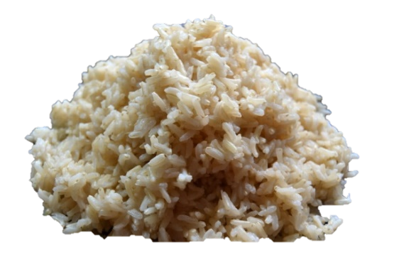

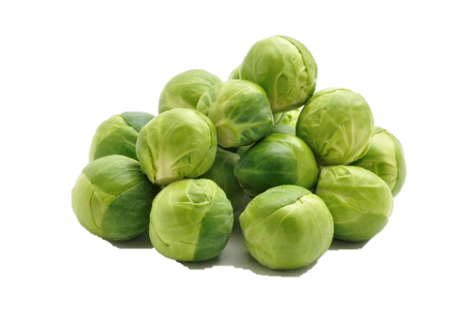


Lunch Menu 2
10th Grade Student
1 cup brown rice (2 oz eq grain)
1 cup plums
½ cup asparagus
½ cup Brussels sprouts
1 cup milk
2 oz tilapia (2 oz eq M/MA)
Notes:
Here is the planned lunch menu for the day for a 10th grade student. Remember, all five food components must be offered daily at lunch. The amounts of each depend on the grade level served.
Ask group: What meal pattern will we follow for a 10th grade student?
Answer – 9-12 meal pattern.
Ask group: If serving grades 6-12 in one building, can we follow the 9-12 menu for all at lunch?
Answer – No! The 6-8 must follow the K-8 or 6-8 meal pattern and 9-12 must follow the 9-12 meal pattern. The menu planner cannot apply the 9-12 meal pattern to all grades 6-12.
This menu for the day for a 10th grade student includes ½ cup Brussels sprouts, ½ cup asparagus, 1 cup plums, 1 cup brown rice (which credits 2 oz eq grain), and 2 oz tilapia (which credits 2 oz eq meat/meat alternate).
Ask group: Did the menu planner meet the meal pattern for the day?
Answer – No!
Ask group: What did the menu planner forget?
Answer - The menu planner did not include milk. *click* milk appears.

Slide 30
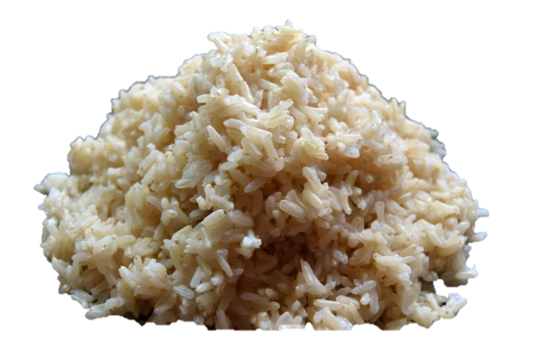
Lunch menu 2 example 1
Lunch
Meal or No Meal?
10th Grade Student
Notes:
*click once*
The student selected the plums, brown rice, and a milk. Is this a reimbursable meal?
Answer – Yes! The student selected three full, different components, one of which is ½ cup fruit and/or vegetable.

Slide 31
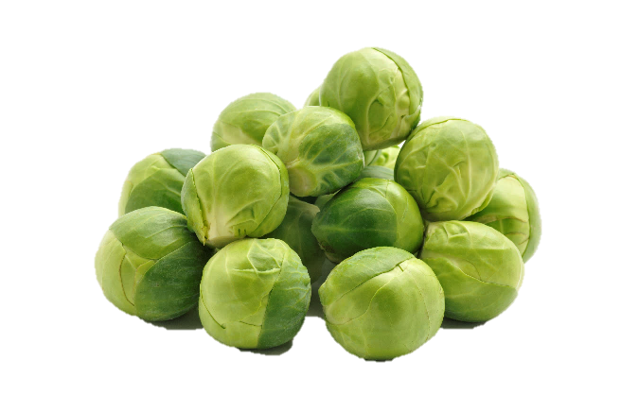
Lunch menu 2 example 2
Lunch
Meal or No Meal?
10th Grade Student
Notes:
*click once*
The student selected the Brussels sprouts, asparagus, and a milk. Is this a reimbursable meal?
Answer – No! The student must select at least three full and different components, one of which is ½ cup fruit and/or vegetable. Here, even though the student has three different menu items, they only have two full components (the vegetable and milk).
*click again* The student added plums. Is this a reimbursable meal?
Answer – Yes! The student has at least three full and different components, one of which is ½ cup fruit and/or vegetable.

Slide 32

Lunch menu 2 example 3
Lunch
Meal or No Meal?
10th Grade Student
Notes:
*click once*
The student selected the brown rice and tilapia. Is this a reimbursable meal?
Answer – No! The student must select at least three full, different components, one of which is ½ cup fruit and/or vegetable. They only have two full components (grain and meat/meat alternate).
*click again* The student added milk. Is this a reimbursable meal?
Answer – No! The student has at least three full, different components, but none of which are ½ cup fruit and/or vegetable.
*click again* The student added asparagus. Is this a reimbursable meal?
Answer – Yes! The student has at least three full, different components, one of which is ½ cup fruit and/or vegetable.

Slide 33
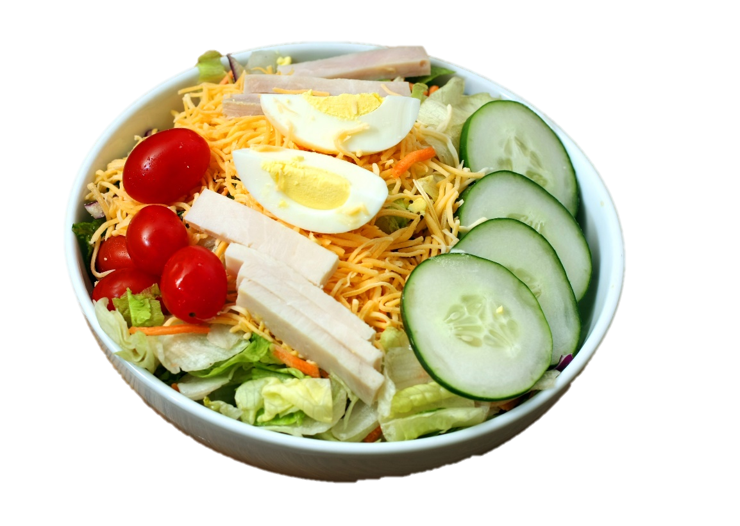


Lunch Menu 3
10th Grade Student
1 cup pear
Cobb Salad
(2 oz eq M/MA, 2 oz. equivalent grain,
1 cup vegetable)
1 cup milk
Notes:
Here is the planned lunch menu for the day for a 10th grade student. This menu includes a Cobb salad, which contains 2 oz eq meat/meat alternate, a 2 oz eq whole grain-rich dinner roll and 1 cup vegetable, as well as 1 cup fruit, and 1 cup milk.
Ask group: Did the menu planner meet the meal pattern for the day?
Answer – Yes! The menu planner met the daily minimums for the 10th grade student using the 9-12 meal pattern.

Slide 34


Lunch menu 3 example 1
Lunch
Meal or No Meal?
10th Grade Student
Notes:
*click once*
The student selected the cobb salad. Is this a reimbursable meal?
Answer – Yes! Although one menu item, the student selected at least three full and different components, one of which is ½ cup fruit and/or vegetable (salad contains: grain, meat/meat alternate, and vegetable).

Slide 35


Lunch menu 3 example 2
Lunch
Meal or No Meal?
10th Grade Student
Notes:
*click once*
The student selected the pear and a milk. Is this a reimbursable meal?
Answer – No! The student must select at least three full components, one of which is ½ cup fruit and/or vegetable. Although there is a fruit, they only have two full components (fruit and milk).
*click again* The student added the Cobb salad. Is this a reimbursable meal?
Answer – Yes! The only other menu item to choose from is the Cobb salad, which comes grouped together. Therefore, in this case the student must select the Cobb salad to make a reimbursable meal.

Slide 36
USDA non-discrimination statement
In accordance with federal civil rights law and U.S. Department of Agriculture (USDA) civil rights regulations and policies, this institution is prohibited from discriminating on the basis of race, color, national origin, sex (including gender identity and sexual orientation), disability, age, or reprisal or retaliation for prior civil rights activity.
Program information may be made available in languages other than English. Persons with disabilities who require alternative means of communication to obtain program information (e.g., Braille, large print, audiotape, American Sign Language), should contact the responsible state or local agency that administers the program or USDA’s TARGET Center at (202) 720-2600 (voice and TTY) or contact USDA through the Federal Relay Service at (800) 877-8339.
To file a program discrimination complaint, a Complainant should complete a Form AD-3027, USDA Program Discrimination Complaint Form which can be obtained online at: https://www.usda.gov/sites/default/files/documents/USDA-OASCR%20P-Complaint-Form-0508-0002-508-11-28-17Fax2Mail.pdf, from any USDA office, by calling (866) 632-9992, or by writing a letter addressed to USDA. The letter must contain the complainant’s name, address, telephone number, and a written description of the alleged discriminatory action in sufficient detail to inform the Assistant Secretary for Civil Rights (ASCR) about the nature and date of an alleged civil rights violation. The completed AD-3027 form or letter must be submitted to USDA by:
mail:
U.S. Department of Agriculture
Office of the Assistant Secretary for Civil Rights
1400 Independence Avenue, SW
Washington, D.C. 20250-9410; or
fax:
(833) 256-1665 or (202) 690-7442; or
email:
program.intake@usda.gov
This institution is an equal opportunity provider.
Notes:
USDA non-discrimination statement

