Slide 1
LEA 101
Establishing an Independent Charter School as Local Education Agency in Wisconsin
Facilitated by
The PEO Charter Schools Team
with Department-wide support
and hosted by WRCCS July 2022

Slide 2
Agenda
9:00 – 9:15 Introduction to ICS – Alexander Burke Roberson
9:15 – 9:45 Title Funding Overview – Brielle Glatzel
9:45 – 10:00 Accountability Overview – Michael Blauw
10:00 – 10:30 WISEData Reporting – Britt Mueller
10:30 – 11:00 McKinney-Vento – Clara Pfeifer & Kristine Nadolski
11:00 – 11:30 English Learner Policies – Amy Maciolek & Tanya Morin
11:30 – Noon Special Education Overview – Ryan McNamara

Slide 3
Life as an LEA
An Independent Charter School (ICS) becomes its own LEA (Wis. Stat. 115.775)
All state and federal requirements and obligations of a school district belong to the governing board of the ICS charter school
e.g., Civil Rights; ADA; IDEA; § 504; ESEA; FERPA; McKinney-Vento

Slide 4
Accountability
a charter school LEADER/OPERATOR is accountable to their GOVERNING BOARD
the GOVERNING BOARD is held accountable by the AUTHORIZER through non-renewal and revocation or required corrective action plans
There may be state and federal consequences for malfeasance, misfeasance, or nonfeasance (e.g., failure to provide a Free and Appropriate Public Education)
There are private rights of actions (e.g., ADA) that permit you to be sued

Slide 5
Disclaimers
This presentation is not all-encompassing or final.
This is a 30,000-foot view. You are still responsible for knowing the “Google Street” view.
The content of this presentation is for informational purposes only and not for the purpose of providing legal advice. You should contact your attorney to obtain legal advice, including compliance with state and federal laws and regulations.

Slide 6
ICS Basics
Alexander B. Roberson Parental Education Options
School Administration Consultant
July 2022

Slide 7
What does it mean to be an ICS?
Independent Charter Schools are not authorized by a district
For the most part, statewide enrollment
No “open-enrollment”
Cannot be virtual

Slide 8
How do we get paid?
Schools submit a preliminary membership count report; a Third Friday in September count report; a Second Friday in January count report; and a membership audit
Payments in September, December, February, and June
See Program Calendar for specific dates

Slide 9
How do we get paid?
Submit the Pupil Count Report
Located on the ICS webpage
Instructions on the ICS webpage as well
Be sure to identify the correct resident district
Submit via Kiteworks on time

Slide 10
Who are our points of contact?
Everyone at DPI is student-driven and committed to helping you navigate and meet bureaucratic burdens so you can educate kids;
Unless you have a designated point of contact on another team (e.g., Program Calendar) contact Alexander B. Roberson first.
You should contact your board attorney, too.
You have friends at WRCCS.
You should always keep your authorizer informed.

Slide 11
Overview of
Title I, Part A

Slide 12
ESEA and Title I, Part A
The purpose of this title is to provide all children significant opportunity to receive a fair, equitable, and high-quality education, and to close educational achievement gaps.
Title I, Part A funds are targeted to high-poverty LEAs and provide supplementary education to students who are educationally disadvantaged or at risk of failing to meet the state standards.
20 USC 6301
Notes:
The Elementary and Secondary Education Act (ESEA) was first enacted in 1965 with the goal to reduce achievement gaps by providing all children fair and equitable education. ESEA includes numerous programs across a total of ten titles, including Title I. While Title I contains many components, we’re just going to focus on Title I, Part A.
Under the Title I, Part A grant funds are targeted to high-poverty school districts and are used to provide supplementary education to students who are educationally disadvantaged or at risk of failing to meet the state standards.

Slide 13
Allocation of Funds to LEAs
The formula is based on:
the state’s average per pupil expenditure, and
the count of children from low-income families.
US Census Bureau
Small Area Income and Poverty Estimates (SAIPE) are used to determine poverty.
20 USC 6333
Notes:
The formula to allocate funds to LEAs relies on two primary elements: the state's average per pupil expenditure and the LEA's count of children from low-income families.
For Independent Charter Schools, the allocation is calculated off of poverty counts of students by district, using the resident district’s poverty %.

Slide 14
Allocation of Funds to LEAs
LEA Poverty Percentage
Basic
Targeted
Financial Incentive
Concentration
15%
X
X
X
X
5%
X
X
X
2%
X
20 USC 6333
Notes:
An LEA's Title I allocation is based on the LEA's US Census Bureau's poverty percentage and consists of as many as four separate funding streams: basic, targeted, financial incentive and concentration grants. (CLICK)
If an LEA has at least 10 children in poverty and the number of children in poverty exceeds 2% of the LEA's total student population, the LEA is eligible for a basic grant. (CLICK)
Targeted and Financial Incentive Grants are distributed to LEAs with at least 10 children in poverty and the number of children in poverty is at least 5% of the LEA's school aged population.
If an LEA is at 4.99% poverty one year and then their poverty rate increases to over 5% in the next year, the funding allocation will jump because the LEA will then receive their allocation from the three funding streams. Consequently, if an LEA is at 5% poverty one year and 4.99% poverty the next year, an LEAs allocation will be less because it will only receive their allocation from the basic funding stream. (CLICK)
Finally, an LEA with a poverty rate of 15% or more, will receive the first three grants plus a concentration grant.
An LEA's allocation could change dramatically from year to year, if they teeter between 14.99% and 15% poverty because they would go between three funding streams and four.
It is important to keep in mind that an LEA receives one total allocation for all the funding streams applicable to their LEA.

Slide 15
Equitable Participation
ESEA contains provisions that require an LEA to provide equitable services to private school children attending a private school located within the LEA’s boundaries. These provisions, often referred to as equitable participation, are required under each of the Title formula grants.
Since Independent Charter School LEAs do not have geographic boundaries there are no equitable participation requirements for charter-school LEAs.
However, you may notice functionality in WISEgrants that references Private Schools, as this requirement applies to some district LEAs.

Slide 16
Reservations
The LEA may take funds “off the top” of their allocation for various reasons before making per pupil amount allocations at the school level.
There are some reservations that may be required. Other reservations are optional and at the discretion of the LEA.
20 USC 6313(a)(3)

Slide 17
Required Reservations
Homeless Reservation:
Required for all LEAs.
Used to provide equitable services to students experiencing homelessness at any time during the year.
Family Engagement Reservation:
Required only if the LEA’s allocation is greater than $500,000.
Must reserve at least 1% of allocation for family engagement activities.
20 USC 6313(c)(3) and 6318(a)(3)

Slide 18
Reservations
Optional reservations include:
Family Engagement (if LEA’s allocation is less than $500,00),
Administrative Costs,
Centralized Services (if multiple charter school LEA)
Professional Development,
Services to specific student groups (i.e. students in out-of-home care, students in neglected/delinquent institutions, or with migratory status), and
Additional financial resources for LEA’s with Title I Targeted Support Identification (TSI) and/or Comprehensive Support and Improvement Identification (CSI).
20 USC 6313

Slide 19
Title I School Eligibility
For district LEAs, school building eligibility is determined through ranking based on poverty.
For most Independent Charter School LEAs, which consist of a single school, the ranking is pro forma, and the PPA can be determined by dividing the available funds by the low-income enrollment.
20 USC 6313

Slide 20
Types of Title I Programs
Targeted Assistance
Schoolwide (SWP)
Title I supplemental services are provided to a select group of children.
All staff, students, & resources are part of the Title I schoolwide program.
Eligible children – children identified with the greatest academic need (failing, or most at risk of failing) the state’s academic achievement standards.
The SWP is a comprehensive reform strategy designed to upgrade the entire educational program in order to improve the achievement of the lowest achieving students.
Notes:
There are two kinds of Title I-A programs. Schools may elect to operate as a targeted assistance program or a schoolwide program. This is just a brief overview of the two programs.
Title I Targeted Assistance programs provide services to a select group of children identified as those with the greatest academic need. The purpose of the targeted assistance program is to use Title I funds to improve the academic achievement of those identified Title I students. The goal of the Targeted Assistance program is to improve teaching and learning, to enable those identified students to meet the challenging state performance standards. A Targeted Assistance Program must include effective methods and strategies that rely on scientifically based research; instruction from highly qualified teachers; and parental involvement activities. Targeted Assistance programs may also include resources necessary to provide a well-rounded education.
A Schoolwide program uses Title I funds to implement comprehensive strategies to upgrade the educational program in the whole school in schools to increase the academic proficiency all students. Title I schools start as Targeted Assistance programs and must apply to operate their school as a schoolwide program. Once a school is an approved schoolwide program it remains as a schoolwide program.
The emphasis of a Schoolwide Program is to serve all students by improving structures that support student learning and combining resources to achieve a common goal. Schoolwide programs allow for staff and stakeholders in schools the ability to redesign their programs to meet the needs of all children, so that every student is able to succeed.

Slide 21
Who are “Title I Eligible” Students?
Targeted Assistance
Schoolwide (SWP)
Title I students are identified through a multi-step process.
All students are Title I students.
Schools must first use multiple academic measures to identify eligible students.
Then schools rank students according to academic need.
Schools are not required to rank students for services. The SWP upgrades the educational program for all students while addressing the needs of the lowest achieving students.
Notes:
In a Targeted Assistance Program, Title I students are identified through a multi-step process. Schools must first use multiple academic measures to identify eligible students, then rank and serve students according to academic need.
Students do not have to be from low-income families to receive services. Low-income poverty data is used to determine a Title I School’s eligibility for funding. Poverty data is not used to determine which students to serve. Once the funding reaches the school, children are selected for services solely on the basis of academic need.
In a Schoolwide Program all students are Title I students and are a part of the Title I program.
All staff at the school are also Title I staff. Finally as you might have guessed it, all families are Title I families.
In other words, that comprehensive program should aim to meet the needs of all students, staff, and families!
.

Slide 22
Allowable Costs & Needs
Targeted Assistance
Schoolwide
Services for the needs of Title I students, parents, and educators.
Strategies identified through the Schoolwide Plan.
Allowable costs must meet the needs identified for the Targeted Assistance program.
Allowable costs must support the comprehensive improvement efforts identified through the Schoolwide Plan.
Notes:
For Title I schools implementing a Title I Targeted Assistance program, the budget item should address the needs of the eligible Title I students, their parents, and their educators.
And, for Title I schools implementing a schoolwide program, the budget item should support the comprehensive improvement efforts identified in the schoolwide plan, because all students in a schoolwide program are eligible to receive services.

Slide 23
Title I Allowable Costs
Is the proposed budget item addressing the needs of Title I students?
Does the cost adhere to the Uniform Grant Guidance, EDGAR, and the LEA policies?
Allowability checklist
Notes:
So how should an LEA determine if a cost is allowable under Title I?
Each LEA is required to have written procedures to determine allowability of costs and those procedures should include a step for the LEA to ensure that the school received its full share of state and local funds. When that is confirmed, the LEA needs to make sure the proposed budget item is addressing the needs of Title I students.
Additionally, like all budget items charged to any federal grant, the costs must be reasonable and necessary to meet the purpose of Title I.

Slide 24
Grant Period & Carryover Policy
Fiscal Year: July 1 to June 30
LEA’s Allocation* Less than $50,000 | LEA’s Allocation* Greater than $50,000
No limit on carryover. | LEAs may carryover 15% of the total allocation. LEAs must apply for a waiver to carryover more than 15% of the total allocation. This is only allowed once every three years.
*Allocation plus any funds transferred to Title I, Part A.
20 USC 6339
Notes:
Title I allocations are aligned to our state's fiscal year. This means that a grant's obligation period begins on July 1 and ends on June 30.
Grant funds not spent within the fiscal year the funds are awarded may be carried over into the next fiscal year. The amount that can be carried over depends on the size of the LEA's allocation.
Districts receiving a Title I allocation that is less than $50,000 per year may carry over unobligated funds without limitation.
A district with an allocation greater than $50,000 can only carry over 15% of the total allocation.
It is important to note that carryover is based off the LEA’s Title I-A allocation amount plus an funds transferred from Title II-A and/or TIV-A.

Slide 25
Technical Assistance
Title I Shorts
http://dpi.wi.gov/title-i/title-i-shorts
DPI’s Title I Website
https://dpi.wi.gov/title-i
Notes:
For technical assistance on various topics covered in this presentation, please visit the DPI Title I website. There are Title I Shorts which are short videos, under 5 minutes, explaining different Title I topics.

Slide 26
LEA 101
State Report Cards & Assessments
Office of Educational Accountability
July 20, 2022

Slide 27
State Report Cards
All Wisconsin public schools and districts and choice schools receive a report card annually per state statute. This includes charter schools.
Report card score requires two years of at least 20 tested students, who were enrolled for the full academic year.
Schools that do not have enough tested students (including new schools) participate in alternate accountability.

Slide 28
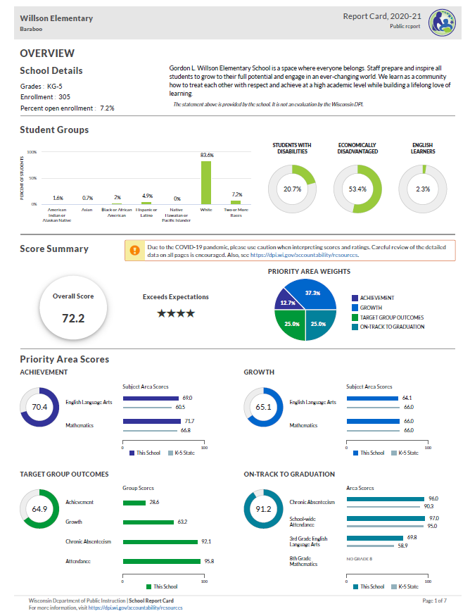
Report Card Overview
Report cards contain the following information:
Overall score and rating
School information
Statement from School (optional)
Four priority areas:
Achievement, Growth, Target Group Outcomes, On-Track
For schools with grades 9-12
Course and program data (not on front page)

Slide 29
Report card timelines
Two report card releases: Secure and Public
Secure release in Oct
Via a secure login site (SAFE)
Non-redacted data--should never be shared.
Internal review, opportunity to open an inquiry for data corrections
Public release: Oct/Nov
Final release – no more data inquiries
New schools in 2022-23 will receive their first report card(s) in the fall of 2023. Those report cards will be rated using alternate accountability because we will only have one year of data for the school. Their first scored report cards will come in the fall of 2024.

Slide 30
Report Card Resources
Please visit our Accountability Resources webpage for resources specific to last year’s report cards and stay tuned to this page for updated resources in the fall.
Here are some other helpful links related to report card requirements and reporting:
Snapshot Preparation
Course and Program Data
Report Card Inquiry Process
Notification Requirements
For questions about report cards, please contact OEA at ReportCardHelp@dpi.wi.gov

Slide 31
Statewide Assessment Updates

Slide 32
2021-22 Statewide Assessment Data Release
Assessment Data is now available in vendor portals.
DPI will publicly release the statewide assessment results in the fall.
Districts will be notified when results may be shared publicly. The public release of the assessment results is not permissible (this includes school boards).
Districts may use the data for professional development and curriculum/instructional planning.
Notes:
Lauren

Slide 33
20202022-23 Statewide Assessment Calendars
Wisconsin State Assessment Calendar - Provides a calendar timeline of when the state assessments are administered.
2022-23 State Assessments by Grade - Provides state assessments in a table by grade and time of year administered.

Slide 34
New Assessment: PreACT Secure (Grades 9 & 10)
Secure assessment
Single battery, 155 minutes (Aspire 285 minutes)
Online testing, paper available for certain accommodations only
Predictive of the ACT
Subjects: English, Mathematics, Reading and Science (no separate writing test)
Three test windows are offered similar to ACT with writing
Scoring aligned to ACT (1-36, max 35)
PreACT Secure Website

Slide 35
Assessment Resources
Statewide Assessment Related Resources
Assessment Correspondence – access to important assessment related emails and weekly DAC Digest newsletters
Assessment web page – includes calendar dates, information and resources
Strategic Assessment Resources
Wisconsin's Strategic Assessment Systems (SAS) Website
Assessment and Data Literacy E-Learning series
Ms. G’s Year of Assessment
Contact Information: osamail@dpi.wi.gov
reportcardhelp@dpi.wi.gov

Slide 36
Questions?

Slide 37
Thank you!
Viji Somasundaram
Director of Office of Educational Accountability
Sam Bohrod
Assistant Director of Accountability
Michael Blauw
OEA ​Education Consultant
Policy Analyst
Lauren Zellmer
OEA ​Education Consultant
Standards Based Assessment & Communications

Slide 38
WISEData Reporting

Slide 39
McKinney - Vento

Slide 40
Requirements under the McKinney-Vento Homeless Assistance Act:
Supporting Students Experiencing Homelessness
Kristine Nadolski
Clara Pfeiffer
Department of Public Instruction
Notes:
Kristine/Clara - Introduce selves

Slide 41
McKinney-Vento Homeless Assistance Act
Federal Education Law, Reauthorized under ESSA
All LEAs are required to be in compliance
Works hand-in-hand with IDEA, Title I-A and other federal education programs.
Notes:
Kristine
Every Student Succeeds Act (ESSA) amendments to the McKinney-Vento Homeless Assistance Act took effect October 1, 2016
The intent of the McKinney-Vento Act is to remove barriers to students’ educational access and success.

Slide 42
Basic Requirements of McKinney-Vento
All LEAs are required by the McKinney-Vento law to:
Designate a homeless liaison.
Identify and immediately enroll any homeless child or youth (preschool to grade 12).
Continue children or youth in their school of origin.
Inform parents/guardians of the educational rights of their children.
Provide transportation to and from the school of origin.
Ensure no barriers exist (for example, residency requirements, lack of transportation or school fees) for full educational participation.
Develop partnerships with community agencies to identify and assist with basic services for homeless families, children, and youth.
Notes:
Kristine
We want to mention the basic requirements under McKinney-Vento because all districts in the state must be in compliance with the McKinney-Vento Homeless Assistance Act regardless of whether they receive grant funds from DPI.
All districts are required to:

Slide 43
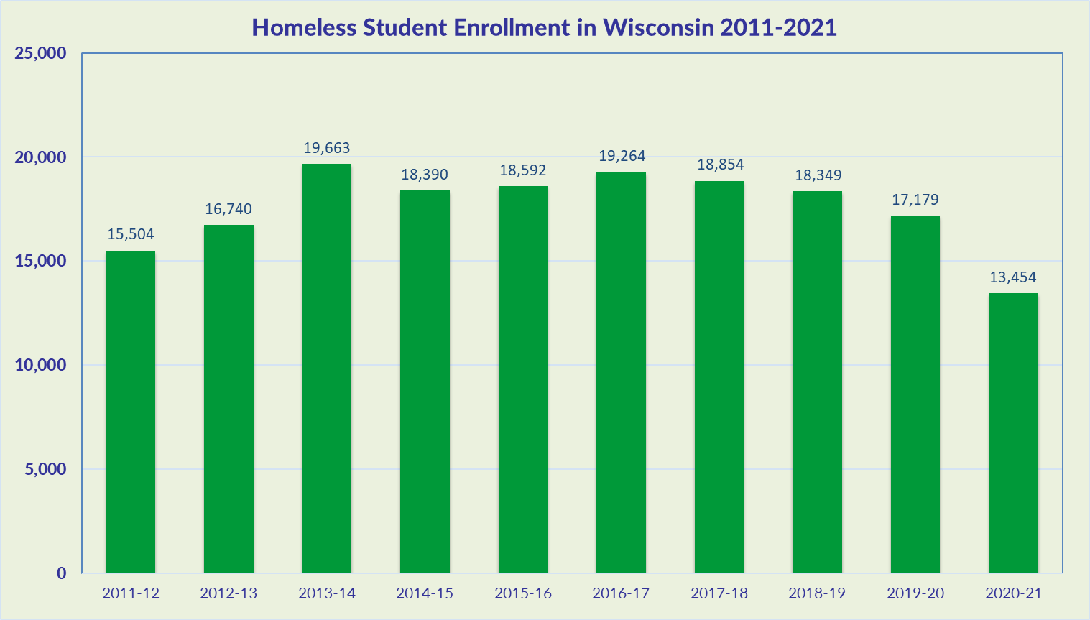
Notes:
Kristine
WI identified 17,179 students in 2019-20 school year - this decrease from previous years can likely be attributed to the difficulty LEAs had with identification of students during virtual learning in COVID.
Otherwise, the state has seen a steady increase over the last 14 years, with around a total of 2-2.5% of the total number of students in WI schools being identified as homeless.

Slide 44
Causes of Homelessness
Lack of affordable housing
Poverty
Increase in low vs middle wage employment
Health problems
Lack of health insurance
Alcohol and other drug abuse (AODA), mental health
Domestic violence
Natural and other disasters (fires, floods, etc.)
Abuse, neglect, family dysfunction
COVID-19
Notes:
Clara

Slide 45
Homelessness Defined
Under the McKinney-Vento Act, homeless children and youth means:
“Children who lack a fixed, regular, and adequate nighttime residence—”
What exactly is a fixed, regular, and adequate nighttime residence?
Notes:
Clara
Children who lack a fixed, regular, and adequate nighttime residence.

Slide 46
Fixed, Regular, and Adequate
Fixed:
-Stationary, permanent, not subject to change
Regular:
-Used on a predictable, routine, consistent basis
-Consider the relative permanence
Adequate:
-Lawfully and reasonably sufficient
-Sufficient for meeting the physical and psychological needs typically met in a home environment
Can the student go to the SAME PLACE (fixed) EVERY NIGHT (regular) to sleep in a SAFE AND SUFFICIENT SPACE (adequate)?
Notes:
Clara

Slide 47
Role of the Homeless Liaison
Every LEA must designate a McKinney-Vento homeless liaison able to carry out the legal duties under the McKinney-Vento Homeless Assistance Act.
Liaisons must ensure that:
Children and youth in homeless situations are identified; enrolled in, and have full opportunity to succeed in school; receive educational services, including preschool; and are referred to healthcare, dental, and mental health services;
Parents and guardians are informed of their rights under McKinney-Vento and can participate in their children’s education;
Public notice of educational rights is posted;
Parents, guardians, and unaccompanied homeless youth are informed of transportation services and assisted with transportation arrangements to the school of origin;
Data are collected and submitted (ex. In the Student Information System);
All LEA staff receive professional development and other support on McKinney-Vento and the unique needs of students experiencing homelessness.
Notes:
Clara
ESSA created new requirements for the capacity, training and duties of LEA McKinney-Vento liaisons.
-There’s recognition that every liaison may not be able to carry out duties.. Now whomever the district designates, there needs to be the ability to carry out duties.
The liaison is ENSURING that these things happen. Not that the liaison is having to do all these duties. Working collaboratively with the district and the community

Slide 48
Role of the Homeless Liaison (continued)
Ensure that:
Disputes regarding eligibility, school selection or enrollment are mediated/resolved;
Unaccompanied youth are enrolled in school and that procedures are implemented to identify and remove barriers that prevent them from receiving credit for full or partial coursework satisfactorily completed at a prior school, in accordance with state, local, and school policies;
Liaisons must participate in professional development and technical assistance as determined appropriate by the state coordinator;
LEAs must develop, review, and revise policies to remove barriers to the identification, enrollment and retention of children and youth in homeless situations, including barriers due to outstanding fees or fines, or absences.
Notes:
Clara
This new requirement ensures that states and school districts remove barriers that prevent young people from getting the credit they need for staying in school and graduating from school.
Liaisons must participate in professional development and technical assistance as determined appropriate by the State Coordinator.
While some states had already provided professional development, such as we have in the form of webinars, not all liaisons were required to participate. Now, as determined by the state coordinator, liaisons will be required to participate.

Slide 49
Role of the Homeless Liaison - Resources
DPI EHCY Role of the Homeless Liaison Webinar
DPI Training Resources: https://dpi.wi.gov/homeless/resources
Liaison Toolkit: https://nche.ed.gov/homeless-liaison-toolkit/
Assessing the Capacity of Liaisons: https://www.schoolhouseconnection.org/wp-content/uploads/2017/10/liaisoncapacityassessmentFINAL.pdf
Notes:
Clara
Resources available for local liaisons

Slide 50
Eligibility
Sharing the housing of others due to loss of housing, economic hardship, or similar reason (sometimes referred to as doubled-up)
Living in motels, hotels, trailer parks, camping grounds due to lack of adequate alternative accommodations
Living in emergency or transitional shelters
Living in a public or private place not designed for ordinary use as a regular sleeping accommodation for humans (cars, parks, bus or train stations, abandoned buildings, substandard housing, etc.).
Children from migratory families who qualify as homeless because they are living in circumstances described above.
Unaccompanied youth living in the above circumstances
Notes:
Kristine

Slide 51
Unaccompanied Homeless Youth
Definition:
Youth who meet the definition of homeless AND are not in the physical custody of a parent or guardian (i.e., youth living with relatives on an emergency basis, youth living with a friend or runaway).
Notes:
Kristine
Build trust! Be patient, and ensure discretion and confidentiality when working with youth.
Many youth become separated from parents due to lack of space in living situations or shelter policies:
Many flee abuse: 20-50 percent sexual; 40-60 percent physical
Many flee family dysfunction: Over 2/3 Hotline callers report at least one parent abuses drugs or alcohol
Roughly 1/3 homeless youth identify as LGBTQ (compared to 3-5 percent of the overall population)
10 percent of currently homeless female teens are pregnant

Slide 52
School of Origin
Each LEA shall, according to each child’s or youth’s best interest:
Continue the student’s education in the school of origin for the duration of homelessness, and until the end of the academic year in which the student becomes permanently housed; OR
Enroll in the resident public school.
School of origin: school that child or youth attended when permanently housed or last enrolled.
School of residence: school in the local attendance area where the child or youth is staying.
Notes:
Kristine

Slide 53
School Stability
In determining best interest, the LEA shall:
Presume that keeping the student in the school of origin is in the student’s best interest
Unless contrary to the request of the parent, guardian, or unaccompanied youth
Consider student-centered factors, including the impact of mobility on achievement, education, health, and safety
Give priority to the parent’s/guardian’s request.
Give priority to the youth’s request (in the case of an unaccompanied youth)
Notes:
Kristine

Slide 54
Transportation
LEAs must provide transportation to and from the school of origin, including until the end of the year when the student obtains permanent housing, at a parent’s or guardian’s request (or at the liaison’s request for unaccompanied youth).
The charter school must provide transportation for a student to remain in the charter school as their school of origin.
Transportation must be provided (if it is a barrier) even if the charter school does not provide transportation for any other students.
Both LEAs (charter school of origin and the resident LEA) must determine how to divide the responsibility and share the cost, or they must share the cost equally.
Notes:
Kristine
Previously districts had the choice to provide transportation until the end of the school year, now all districts must- If it is in the student’s best interest
In the absence of an agreement, two districts must share cost and responsibility equally.
Developing a transportation agreement among districts in the CESA may be a good strategy to prevent disputes about cost
Look at policies to try to eliminate transportation barriers to full participation. This might include extracurricular activities as well.

Slide 55
Immediate Enrollment for Charter Schools
For families and students experiencing homelessness seeking enrollment:
Immediate enrollment is required even if students do not have required documents, such as school records, records of immunization and other required health records, proof of residency, guardianship, or other documents
McKinney-Vento requires immediate enrollment even if students have missed application or enrollment deadlines during any period of homelessness.
Charter schools do not have to enroll if enrollment is full, but give priority to the student.
Be flexible on enrolling new students even if it’s past an existing deadline
Revise enrollment policies if this presents a barrier to families
Notes:
Kristine

Slide 56
Support for Academic Success: Coordination with Other Laws/Programs
Students eligible under McKinney-Vento are automatically eligible for free school meals.
LEAs must coordinate McKinney-Vento and special education services within the LEA, and with other involved LEAs.
LEAs must coordinate with Title I-A.
Title I-A Homeless Reservation is required.
Information about a McKinney-Vento student’s living situation is a student education record subject to Family Educational Rights and Privacy Act (FERPA).
Notes:
Clara
FERPA- living situation cannot be disclosed so unless the youth tells you you won’t know housing status

Slide 57
Resources
Wisconsin Department of Public Instruction Education for Homeless Children and Youth: https://dpi.wi.gov/homeless
McKinney-Vento 101 Module: https://media.dpi.wi.gov/title-i/mckinney-vento/story_html5.html
SchoolHouse Connection
https://www.schoolhouseconnection.org/
National Center for Homeless Education
https://nche.ed.gov/
Notes:
Clara
Website:
Modules
Video
Sample questions document

Slide 58
Questions?
Contacts:
Kristine Nadolski
State Coordinator
kristine.nadolski@dpi.wi.gov
Clara Pfeiffer
Grants Specialist-Advanced
clara.pfeiffer@dpi.wi.gov
Notes:
Clara

Slide 59
Uniqueness of Independent Charter Schools
July 2022

Slide 60
WHAT IS A CHARTER SCHOOL?
Tuition-free public school
Created on the basis of a contract or “charter”
Contract with a local school board or authorizer
Autonomy over its operations in exchange for greater accountability
Notes:
Charter schools have greater autonomy and flexibility than traditional public schools because they are governed by a nonprofit board of directors and not a local school board. They have flexibility from certain state and local regulations in exchange for a higher level of accountability.

Slide 61
WHAT IS A CHARTER SCHOOL?
Independent charter schools, sometimes referred to as 2r or 2x charter schools, are charter schools that are not authorized by a public school district. Each of the following have authority to authorize a charter school in Wisconsin:
The common council of the city of Milwaukee
The chancellor of any institution in the University of Wisconsin System
Each technical college district board
Waukesha County Executive
College of Menominee Nation
Lac Courte Oreilles Ojibwe College
UW-System Office of Educational Opportunity
Notes:
Some charter schools are college oriented, some project based, etc.

Slide 62
WISCONSIN STATE STATUTE S.118.40
The terms "2r" or "2x" refer to the section of the charter school law within s. 118.40 that grants these entities authority to authorize charter schools. Independent charter schools may also be referred to as legacy or new independent charter schools. Legacy schools are schools chartered by authorizers who had the authority prior to 2015 Act 55 (UW-Milwaukee, the City of Milwaukee, UW-Parkside, and the Milwaukee Area Technical College), and new independent charter schools are those chartered by an authorizer who received authority to authorize in or after 2015 Act 55 (Waukesha County Executive, College of Menominee Nation, Lac Courte Oreilles Ojibwe College, Office of Educational Opportunity, any UW Chancellor (other than UW-Milwaukee and UW-Parkside), and any technical college district board (except MATC).
Under Wis. Stat. § 118.40(4)(ag), no more than a minority of the governing board's members may be employees of the charter school or employees or officers of the school district in which the charter school is located”. Therefore, no more than a minority of the governing board could be filled by employees or officers of the school district they are physically located in.
For more in-depth information on independent charter schools see: Wisconsin Legislature Chapter 118.40 quick reference or Wis. Stats. Chapter 118.40(2r) and (2x).
Notes:
2r part of the state statute
MATC has not authorized any schools

Slide 63
INDEPENDENT PUBLIC CHARTERS
Staffed by non-union teachers that are not employees of the school district
Enroll pupils that are not counted by school districts for state aid purposes
Receive funding from the state through an equal percentage school aid reduction in all Wisconsin districts
Notes:
Not connected to MPS although MPS has its own charter schools.

Slide 64
EXEMPTIONS AND REQUIREMENTS
Charter schools are exempt from most state education laws but must:
Participate in the FORWARD and other state exams
Complete the annual School Performance Report
Count their students for membership
Employ DPI-licensed teachers
Have policies and procedures (e.g., Child Find)
Participate in compliance monitoring (e.g., self-assessment)
Be open to all students in the district - cannot discriminate
May not require any student to enroll
May not charge tuition
Follow all health and safety requirements of public schools
Follow seclusion and restraint reporting and IEP meeting rules

Slide 65
AUTONOMY AND ACCOUNTABILITY
Charter schools have increased autonomy and flexibility under the law in return for accountability
Charter schools are accountable to their authorizer to meet the goals in their charters and to produce positive student achievement results
Notes:
Often there is tension between special education regulations and the principle of autonomy that is central to the charter school concept. Charter schools vary considerably in the degree of freedom they are provided by law and policy but as part of the public education system, they are not free from regulations and oversight in the area of special education.

Slide 66
5 - YEAR CHARTER LIMIT
Under Wisconsin law, contracts/charters may be for any term not exceeding 5 school years
At the end of the term, the authorizer may renew the charter school with the governance board if goals are met or close the school if goals are not met
Notes:
Charter schools are often approved for a set period of time, usually three to five years.
They are accountable for performance goals defined in their charter. If they fail to meet those goals and do not operate in compliance with relevant laws and regulations, they may be closed.

Slide 67
INDEPENDENT CHARTER & SPECIAL EDUCATION
Charter schools have autonomy under State Law but must comply with Federal Laws like the Individuals with Disabilities Education Act (IDEA)
Charter schools are public schools therefore they bear the same responsibility to ensure Free Appropriate Public Education (FAPE)
Independent Charter Schools must follow Federal Laws to ensure FAPE (e.g., Transition at age 16)
Notes:
Charter schools need to follow federal regulations regarding special education but are exempt from some state regulations because state regulations may go beyond what the federal regulation requires.

Slide 68
Special Education Enrollment
May not categorically deny admission to students based on disability
Charter schools should not enroll students with disabilities at significantly lower rates than local public schools
Students are underrepresented because they require more intense resources (ie. ID, EBD, Autism)
May not deny admission to a student with a disability solely because of a need for special education or related services
Staff cannot discourage parents from enrolling students with disabilities and suggest a traditional public school can better meet their needs
Notes:
Counseling out

Slide 69
Special Education Enrollment
Must provide students with disabilities the opportunity to meet any appropriate minimum eligibility criteria for admission
Schools cannot require admissions tests and interviews that result in students with certain disabilities being excluded
Open enrollment “lottery” system includes students with disabilities

Slide 70
IEP TEAM
Individualized Education Program = IEP
IEP team:
Parent or person acting as the parent
Student if able to participate and present
LEA representative
Special education teacher
Regular education teacher
Other staff or people with expertise

Slide 71
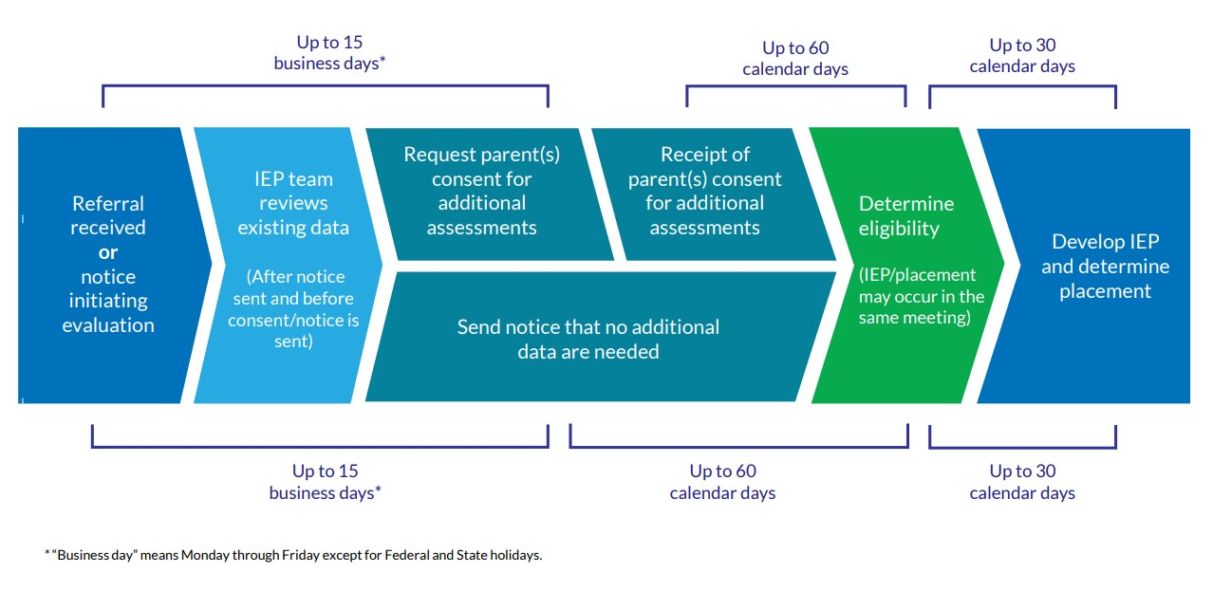
EVALUATION TIMELINE

Slide 72
CONTINUUM OF PLACEMENTS
Instruction in regular classroom
Instruction in special education classroom
Homebound instruction
Instruction in alternative settings
Notes:
Charter schools often do not have a continuum of placement options. They may have one self-contained classroom or all special education students are included in general education. Many do not have resources for alternative placements. However, charter schools must ensure that appropriate instructional options are available for students whose needs can not be met in an inclusive setting. How can CESA’s representatives in charter schools help them develop these options? Regardless of the mix of approaches, charter schools are required to respond to student needs and not for students to fit into what the school can provide.

Slide 73
FOLLOW PROCEDURES
Develop the IEP, determine the placement, and decide how the IEP will be implemented
Ensure the IEP team makes placement decisions
With all transfer students, convene a meeting to adopt and review/revise the IEP
Services just can’t disappear from an IEP; when a service is not something that you have provided, determine what will you offer to meet the student’s disability related need
Notes:
As members of IEP teams in charter schools keep in mind these procedures. Be especially cautious with transfer students. Sometimes if there is a service on the student’s IEP that is not provided in the charter school, it disappears. Be proactive and suggest best practices.

Slide 74
EDUCATIONAL ENVIRONMENT
Educational environment is...
Educational environment is not...
Reflection of participation with nondisabled peers
IEP team decision based on student’s disability related needs
Continuum of placements
Reflection of the amount of special education services
“One-size-fits-all” approach
One educational environment code preferred over another
Notes:
One environment is not necessarily better than another. Educational environment needs to be determined on an individual basis by the IEP team.

Slide 75
DECISIONS BASED ON AVAILABLE RESOURCES
When charter schools are focused on available resources, they may be tempted to work backward to develop a plan based on those resources.
Amending an IEP to match the services a charter school provides is illegal
Charter schools may have more flexibility under state law but they must abide by Federal laws concerning students with disabilities

Slide 76
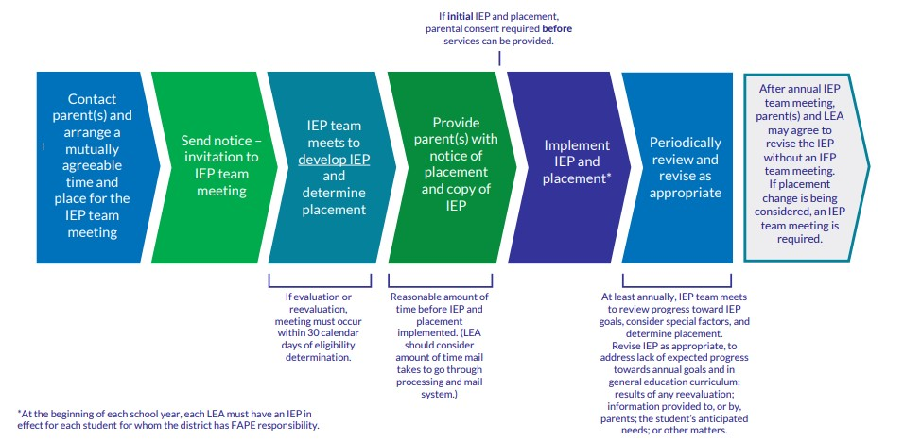
IEP & PLACEMENT TIMELINES

Slide 77
ESSA/IDEA Determinations (JFN)
Joint Federal Notifications (JFN) include:
ESSA report
IDEA report
Disproportionality report
Reports are found in the Secure Access File Exchange (SAFE) portal
Released each March
Notes:
As a new charter school you need to be aware of the JFN Packets containing these 3 reports. Preliminary Packets are sent in December. In your first year you will not receive this report. However there are things you need to be aware of during this first year and make sure you are in compliance. Upcoming slides show some of the indicators schools are responsible for with compliance. Keep in mind whatever you do this year will be in your report next year if the school does not meet requirements of IDEA Part B. The following slides will explain each report.

Slide 78
ESSA REPORT
Requires SEAs to report on the performance of all students and specific student groups
Notify schools that qualify for Comprehensive, Targeted or Additional Targeted support
Contains 5 areas:
Academic achievement
Student growth
Graduation rate
ELP progress
Absenteeism
Notes:
ESSA requires SEAs to report on the performance of all students and specific groups of students. They need to notify schools if they qualify for comprehensive, targeted or additional targeted support.
LEAs with a Federal identification can schedule a meeting with DPI staff to review reports and plans. CESAs are also available to assist.

Slide 79
IDEA DETERMINATIONS REPORT
Graduation
Dropouts (grades 7-12)
Math Assessment Participation
ELA Assessment Participation
Math Proficiency
ELA Proficiency
Disproportionate Discipline
Education Environment (6-21)
Education Environment (3-5)
Disproportionate Special Education
Disproportionate Specific Categories
Timely Initial Evaluations
Preschool Transition (Doesn’t apply to charter schools)
Post-secondary Transition Plan (Required age 16+)
Timely and Accurate Reporting
Notes:
The purpose of this determination is to inform LEAs of their IDEA compliance based on the data submitted to DPI. Information and resources are provided to help in their improvement planning.

Slide 80
Special Education Indicators
Indicator 1 (Graduation Rates)
Indicator 2 (Drop-Out Rates)
Indicator 3 (Assessments)
Indicator 4 (Suspension/Expulsion)
Indicator 5 (Educational Placements Age 6-21)
Indicator 6 (Educational Placements Age 3-5)
Indicator 7 (Preschool Outcomes)
Indicator 8 (Parent Involvement)
Indicator 9 (Inappropriate Sped Identification)
Indicator 10 (Inappropriate Identification Specific Disability Categories)
Indicator 11 (Timely Evaluation)
Indicator 12 (Preschool Transition Part C to Part B)
Indicator 13 (Transition Goals Age 16+)
Indicator 14 (Post High School Outcomes)
Compliance (SPP):
Indicator 1 (Graduation Rates)
Indicator 2 (Drop-Out Rates)
Indicator 3 (Assessments)
Indicator 4 (Suspension/Expulsion)
Indicator 5 (Educational Placements Age 6-21)
Indicator 6 (Educational Placements Age 3-5)
Indicator 7 (Preschool Outcomes)
Indicator 8 (Parent Involvement)
Indicator 9 (Inappropriate Sped Identification)
Indicator 10 (Inappropriate Identification Specific Disability Categories)
Indicator 11 (Timely Evaluation)
Indicator 12 (Preschool Transition Part C to Part B)
Indicator 13 (Transition Goals Age 16+)
Indicator 14 (Post High School Outcomes)
Notes:
This is part of the checklist we use with new charter schools.

Slide 81
DISPROPORTIONALITY REPORT
Data is collected to determine if significant disproportionality based on race and ethnicity is occuring in local educational agencies
Review and revision of policies, practices, and procedures
May need to participate in disproportionality procedural compliance self-assessment
Notes:
Data is examined with respect to the identification of children with disabilities, the placement in particular educational settings and the incidence, duration, and type of disciplinary action.

Slide 82
Assurances and Budget
WISEGrants portal
Assurances need to be signed by July 1
Budget needs to be created
Assurances include:
Allowable costs
Budget modifications
Charter schools and their students
MOE
CEIS, CCEIS and more
Review the assurance form:
https://dpi.wi.gov/sites/default/files/imce/sped/pdf/f3201-assurances.pdf

Slide 83
Resources
CESA 1 Independent Public Charter Schools Resources
CESA 9 WI Resource Center for Charter Schools
DPI Independent (2r or 2x) Charter Schools Page
DPI Special Education Main Page
DPI Special Education Bulletin Index Page
DPI Timeline Visuals and Summaries
DPI Example JFN communication from 2021
Federal FAQ IDEA and Charter Schools

Slide 84
LEA 101: English Learners
Amy Maciolek
Tanya Morin
Notes:
Put questions in chat
Will also be time for questions at e

Slide 85
Introductions
Amy Maciolek - ML/Title III
608.266.1570
amy.maciolek@dpi.wi.gov
Tanya Morin- Multilingual and Multicultural
608.267-9393
Tanya.Morin@dpi.wi.gov
Jesse Roberts - EL Assessment
608.267.5153
jesse.roberts@dpi.wi.gov
Notes:
Tanya/Amy
Who we are
What we do
Mention Jesse as ACCESS testing person)

Slide 86
Who is an English Learner?
An English learner (EL) is a student:
aged 3-21;
enrolled or preparing to enroll in an elementary or secondary school
who was not born in the United State or whose native language is a language other than English; and
where difficulties in speaking, reading, writing, or understanding of English may be sufficient to deny them
the ability to meet the State’s proficient level of achievement on State assessments
the ability to successfully achieve in classrooms where the language of instruction is English; or
the opportunity to participate fully in society
Notes:
Tanya
Lot of terms you might hear
Official legal term per Title III/ESEA - EL
Official definition
Student scoring 1-5 on ACCESS for ELLs (or ??? on screener)
Federal definition

Slide 87
WI Demographic
Who are English Learners?
Students who must learn English at the same time as learning content.
State Demographic:
Number of ELs 21-22
49, 812
Top Languages:
Spanish
Hmong
Arabic
Chinese
Somali
Notes:
Tanya

Slide 88
EL Acronyms
EL (ELL) English Learner
ML Multilingual learner
BLBC Bilingual- Bicultural
ELP English Language Proficiency
LIEP Language Instruction Education Program
ACCESS ACCESS for ELLs, annual English Language Proficiency test
HLS Home Language Survey
Screener Initial Language Proficiency Screener used for Identification
Exited The time when an EL reaches native proficiency and is
no longer served in an Language program.
LIEP Crosswalk Document used by DPI outlining Language Instruction Program types
Notes:
Tanya
ELL - outdated (LEP - state law)
Multilingual learners - asset-based perspectives/highlights the strengths/assets kids bring to the classroom
ELP - official term for language level (levels 1-5, 6, 7)
Will go into more detail on LIEP, ACCESS, HLS, etc. on later slides

Slide 89
Legal Requirements: Federal
Lau vs. Nichols
ESEA Title I
ESEA Title III
Equal Education Opportunities Act
Castañeda vs. Pickard
Plyler vs. Doe
See Chapter 14 of EL Policy Handbook
Notes:
Amy
High-level overview of Federal Laws and CR laws

Slide 90
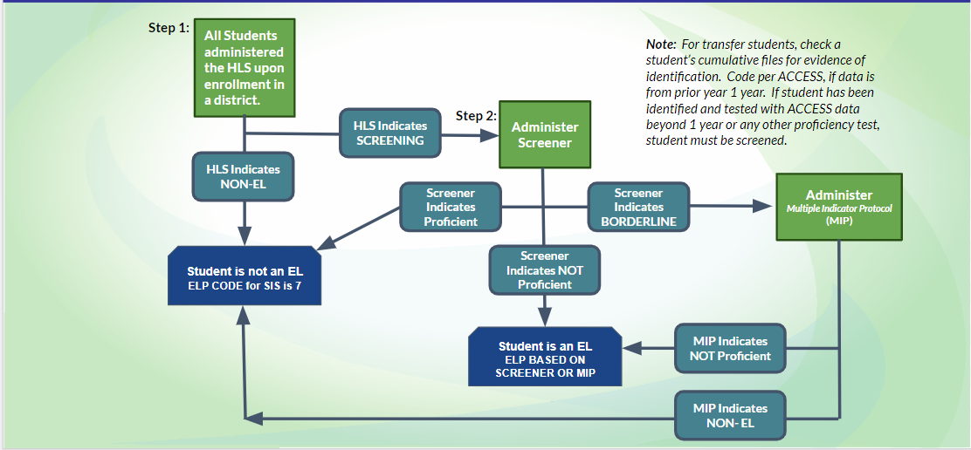
Entrance Procedures
Notes:
Amy
Highlight - translations available on website
Two-step process, Lau plan

Slide 91
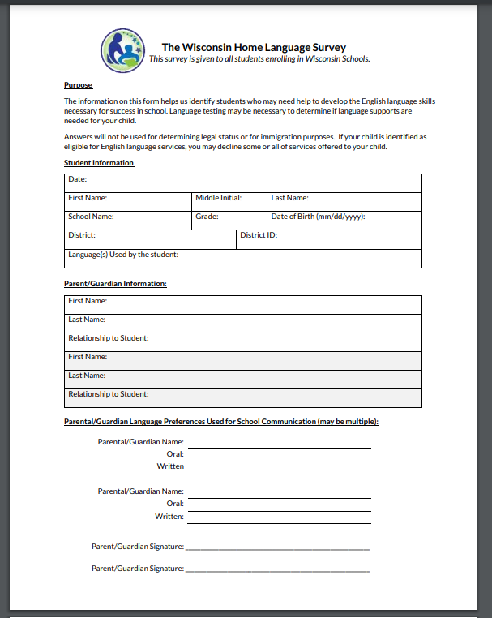
Home Language Survey (HLS)
Purpose:
Use of Language in the home
Identify students (language support)
Language Needs of Caregivers
See EL Policy Handbook page for form
Notes:
Amy

Slide 92
Effective Programs
DPI required to ensure districts provide effective programming for ELs
Language assistance programming for EL students must:
Be educationally sound in theory and effective in practice
Be regularly assessed and continually improved,
Include adequate staff, time, and materials.
Additionally, districts must be able to demonstrate program effectiveness in supporting both:
Academic content needs of ELs
EL students’ English language proficiency proficiency growth
See DPI’s EL Policy Handbook Chapter 8 for more information
Notes:
Amy
Program evaluation

Slide 93
Program Models: LIEP Crosswalk
Language Instruction Educational Program (LIEP)
Plan for serving EL students
Variety of models
New LIEP Crosswalk
LIEP flowchart
See Chapter 8 of EL Policy Handbook for more details
Notes:
Amy
Chapter 8 of handbook: https://docs.google.com/document/d/1lUN0b-Iam2FLbOd1b2MALAqIagu0qB-oMvbNU-kvS60/edit
Tanya/Take slides from CESA presentation
Revised crosswalk
Codes for students
Bil/ESL
Flowchart

Slide 94
ACCESS for ELLs
Required to assess English language proficiency (ELP) for all ELs annually, including for students whose caregivers have refused services
Must use state-defined ELP assessment
ELP assessment for WI: ACCESS for ELLs
Annual ELP assessment window: December - February.
Check annually with DPI’s Office of Student Assessment for exact dates
See Chapter 5 of EL Policy Handbook for more details
Notes:
Amy
Frequency/timeline
Reporting scores
Exiting based on scores

Slide 95
Exit Procedures
ACCESS Testing
Composite 5- MUST exit
Composite 4.5-4.9 (may exit w/MIP)
2 year Monitoring upon exit
See Chapter 6 and Chapter 15 of EL Policy Handbook for more details
Notes:
Amy

Slide 96
Data Reporting
Data Elements:
Immigrant children
Languages spoken
English Language Proficiency Levels
Primary Service: LIEP
* This list is not exhaustive
Notes:
Amy
Immigrant children - beginning of year
LIEP - beginning of year
ACCESS - initial id - beginning of year

Slide 97
English Language Development Standards
State required to adopt English Language Development Standards (ELDS)
WI Standards: WIDA English Language Proficiency Standards
Aligned to ACCESS for ELLs
Focus for 22-23: Curriculum Guide and PD/TA opportunities
See DPI’s ELDS webpage for more information
Notes:
Tanya
Requirement - Title I
Where to find
Info about rollout

Slide 98
State Bilingual Education Requirement
Wisconsin Statute 115.95 – State bilingual education requirement
Trigger numbers:
10 students in grades K-3
20 students in grades 4-8
20 students in grades 9-12
Create and communicate plan for bilingual-bicultural (BLBC) program
Approved programs eligible for reimbursement of a percentage of costs
See DPI’s Bilingual-Bicultural page for criteria and application information
Notes:
Tanya
High-level overview
Trigger numbers
Bilingual ed requirement
Staffing requirement
Submitting initial plan
Submitting PoS and EoY report - WISEhome

Slide 99
Professional Learning
WIDA training
Self-paced workshops
Facilitated workshops
Title III/Special Education Collaborative Conference:
March 8-9 (WI Dells)
CESA EL Networks/Consortia
Notes:
Tanya
WIDA trainings - shared via network meetings, Title III listserv, Google currents

Slide 100
Resources
DPI’s Bilingual and English Learners webpage
DPI’s EL Policy Handbook
USED/OELA EL Toolkit
USED/OELA Newcomer Toolkit
Center for Applied Linguistics
WIDA self-paced workshops
Title III listserv and Google Currents Community
BLBC listserv
Notes:
Tanya

Slide 101
Questions?

