Slide 1
Job Center of Wisconsin Registration
Login
Create a Logon
Complete Registration
Resume Builder
Notes:
The purpose if the PPT is to walk participants through the web pages they will encounter when either logging in or creating a JCW account.

Slide 2
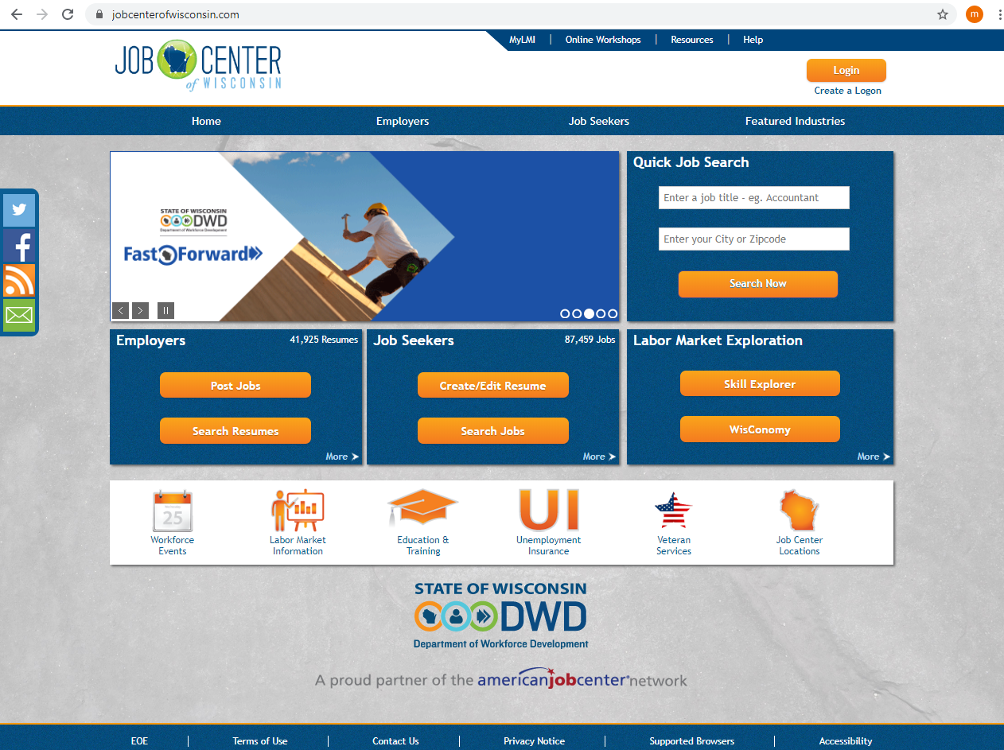
Notes:
JCW Home Page. The login and Create a Login options are at the top of the page.

Slide 3
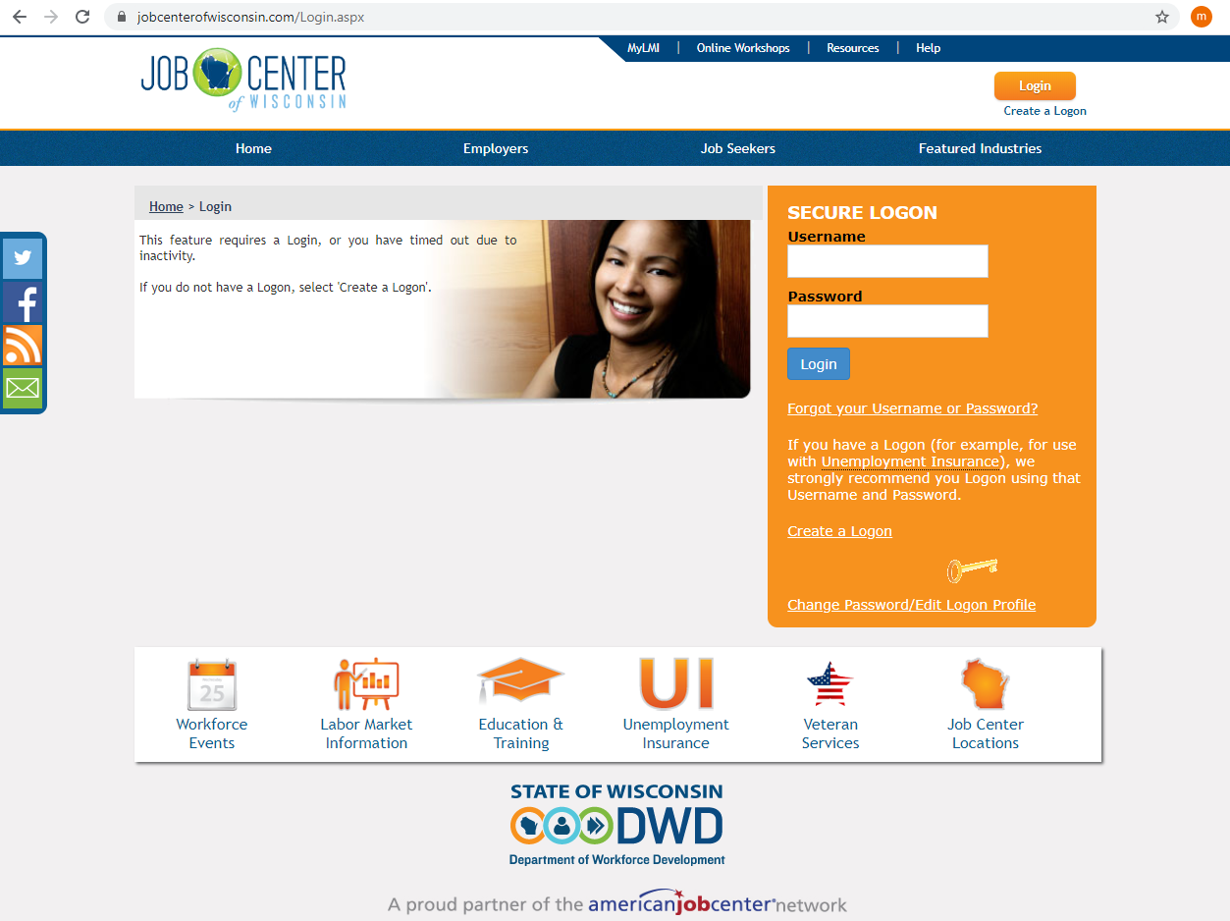
Notes:
When the Login icon is selected, this page will ask for the Username and Password.

Slide 4
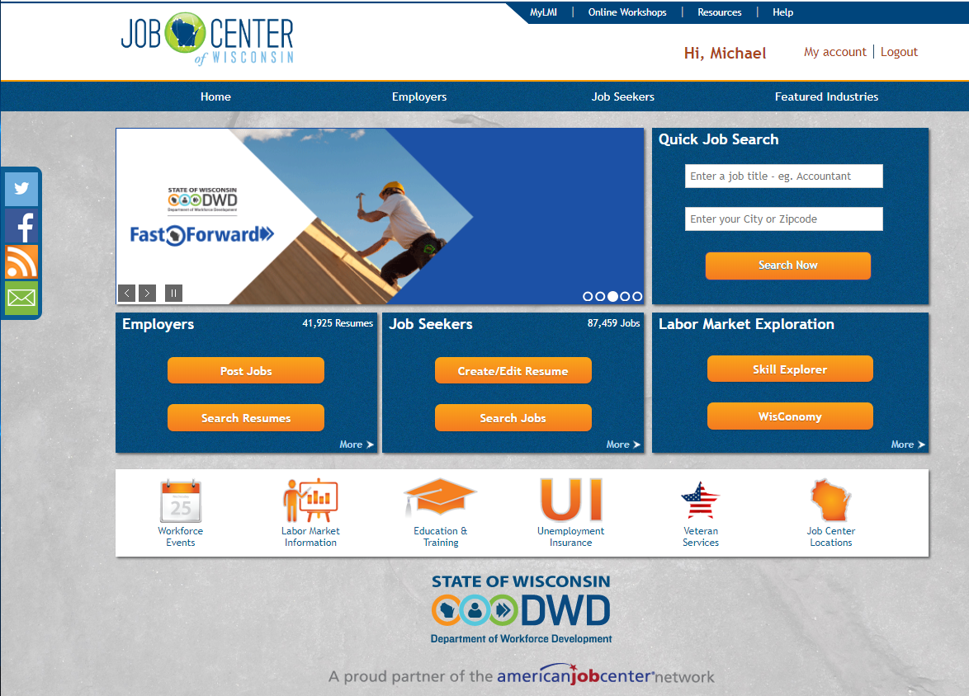
Successful Log-in
Notes:
If the participant has a valid Username and Password, the page will indicate they have successfully logged in and their name will appear at the top of the page.

Slide 5
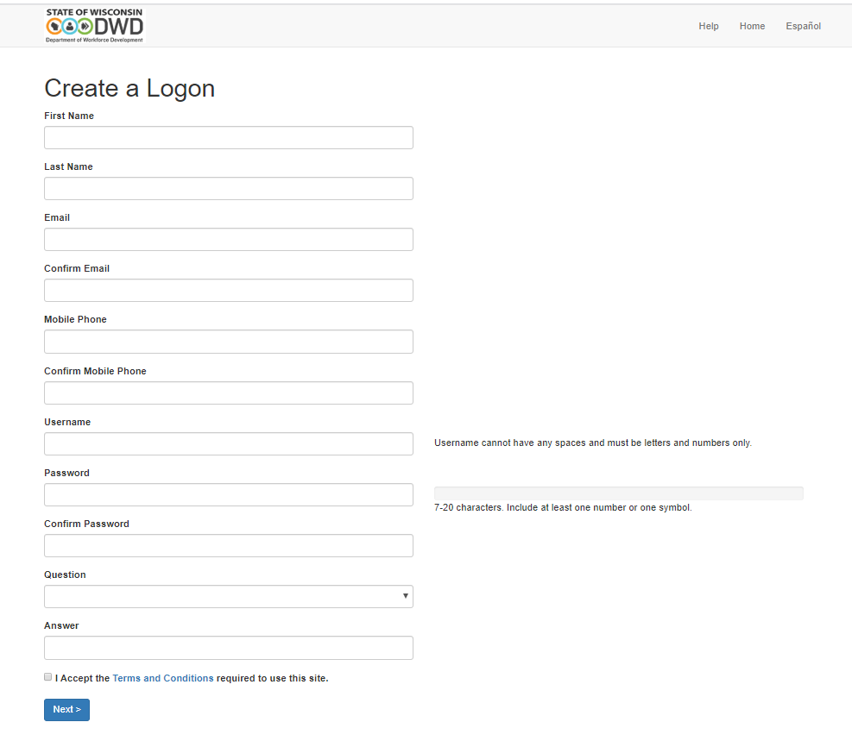
Notes:
If the participant needs to create an account, this is the first page they will see. They will need to enter information into each section in order to proceed to the next step. I highlighted the option for Spanish in the top right hand corner.

Slide 6
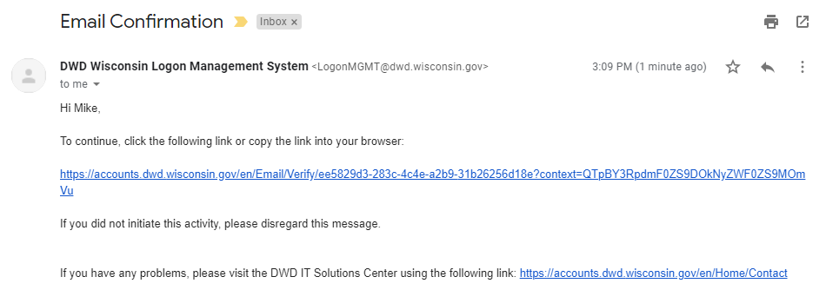
Notes:
An email confirmation will be sent to the email the participant entered on the previous page.
When they access their email, the message will include a link which the participant needs to “click” on in order to confirm the registration.

Slide 7
Notes:
Once the link is “clicked” the participant will receive an alert that the being activated and may take approximately 15 seconds.
Once activated, the participant is notified that the logon has been created.

Slide 8
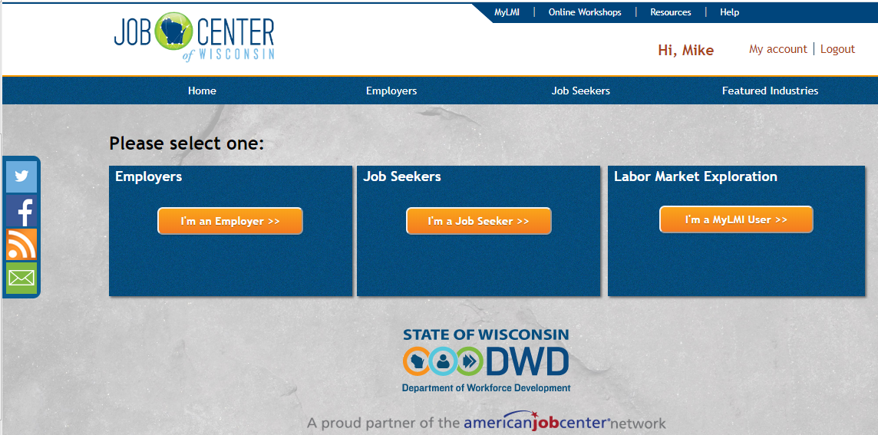
Successful Log-in
Notes:
The participant can now return to jobcenterofwisconsin.com and log in.
The page will indicate they have successfully logged in and their name will appear at the top of the page.

Slide 9
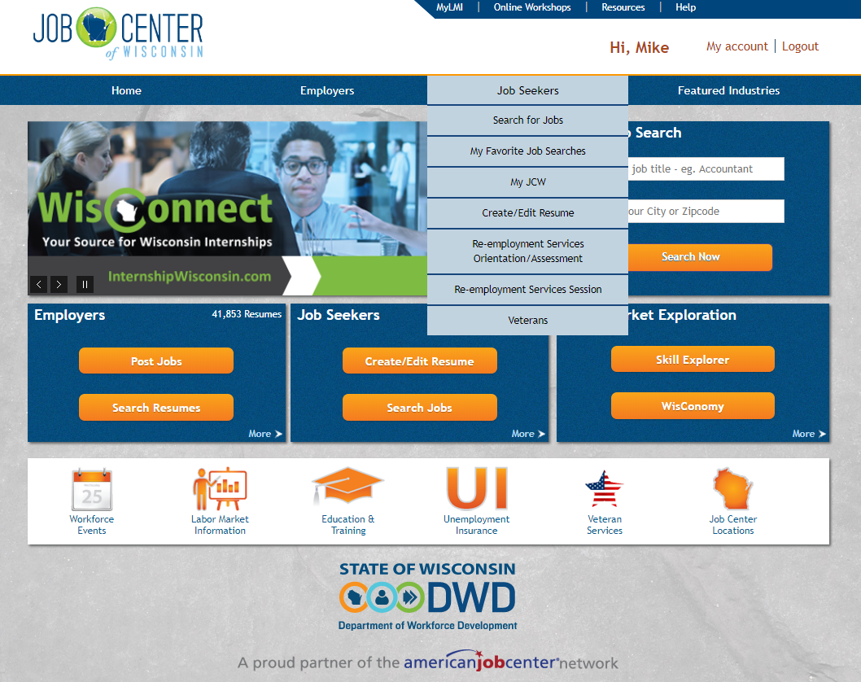
Notes:
If a participant wants to see the progress of their registration, they can hover the curser over the Job Seekers tab and select My JCW.

Slide 10
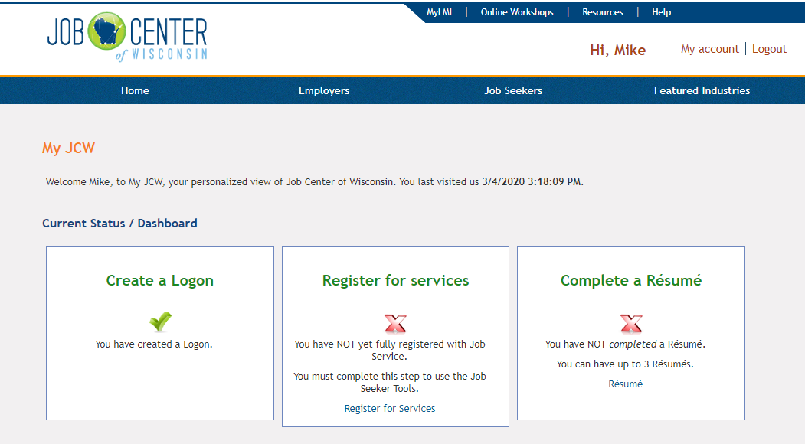
Notes:
This page allows the participant to see what steps are needed to be completed the JCW registration. A red “X” indicates the action needs to be completed. A green “Check Mark” indicated the action has been completed.

Slide 11
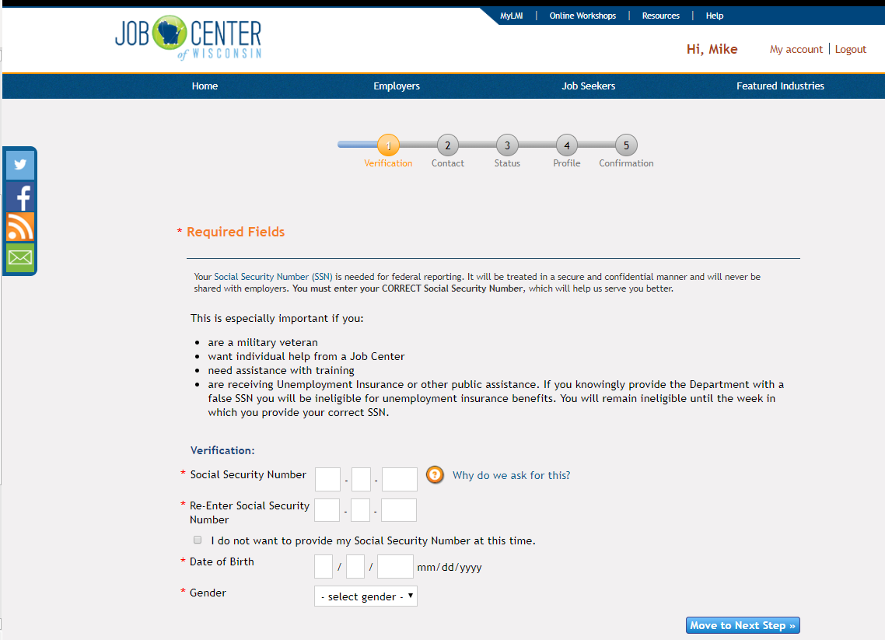
Notes:
There are 5 steps to complete the registration for services
Verification
Sections with an asterisk need to be completed.

Slide 12
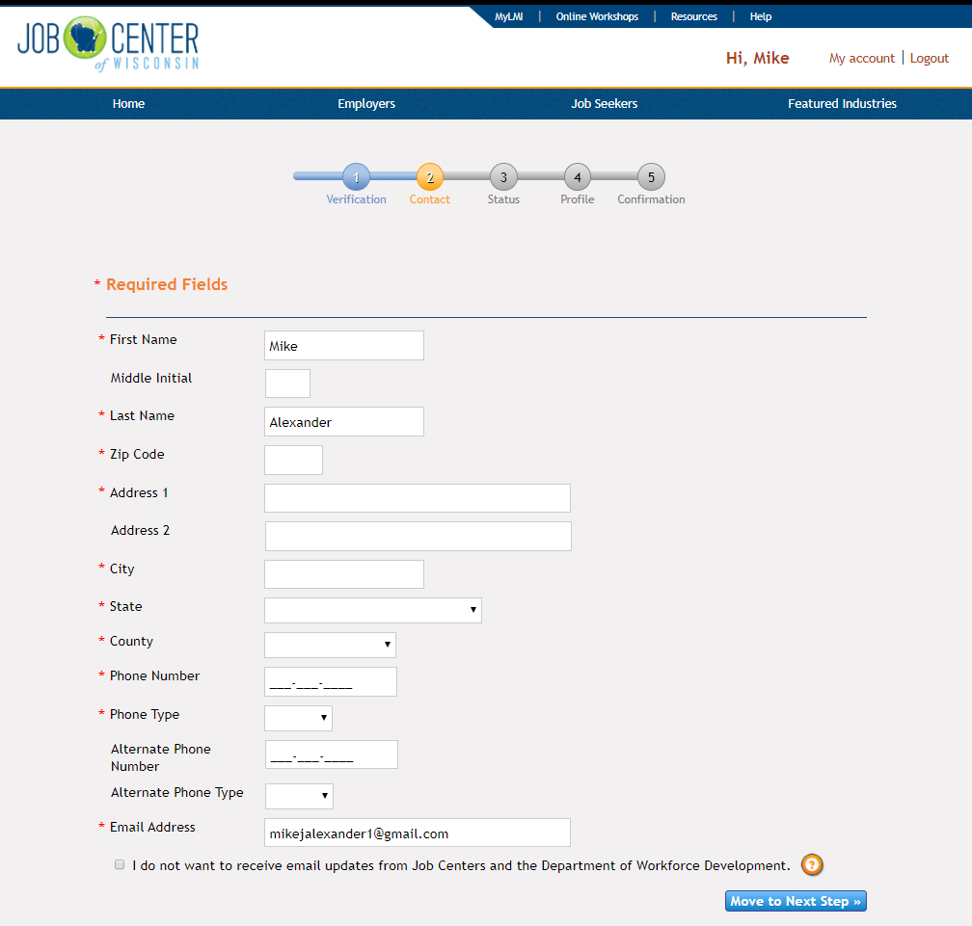
Notes:
Contact Information
Sections with an asterisk need to be completed.

Slide 13
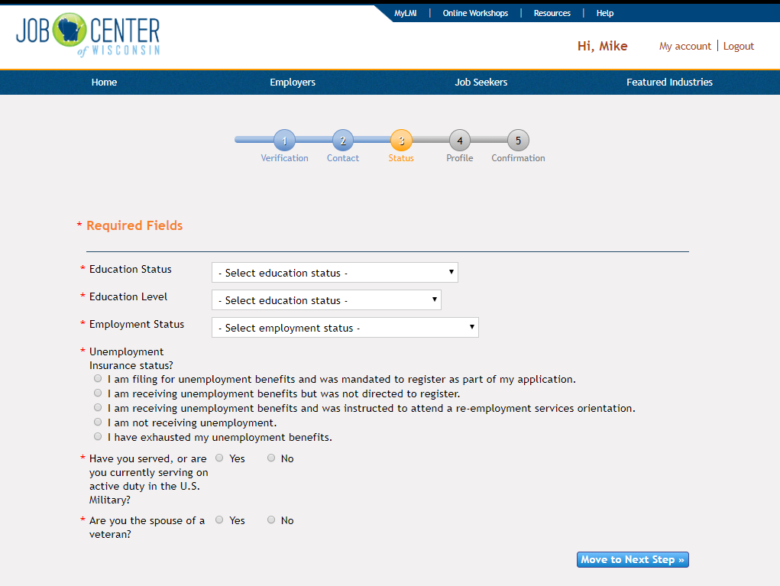
Notes:
Status
Sections with an asterisk need to be completed.

Slide 14
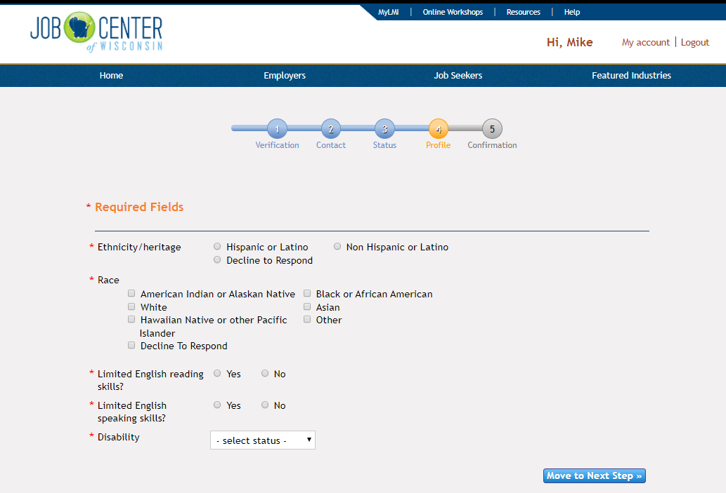
Notes:
Profile
Sections with an asterisk need to be completed.

Slide 15
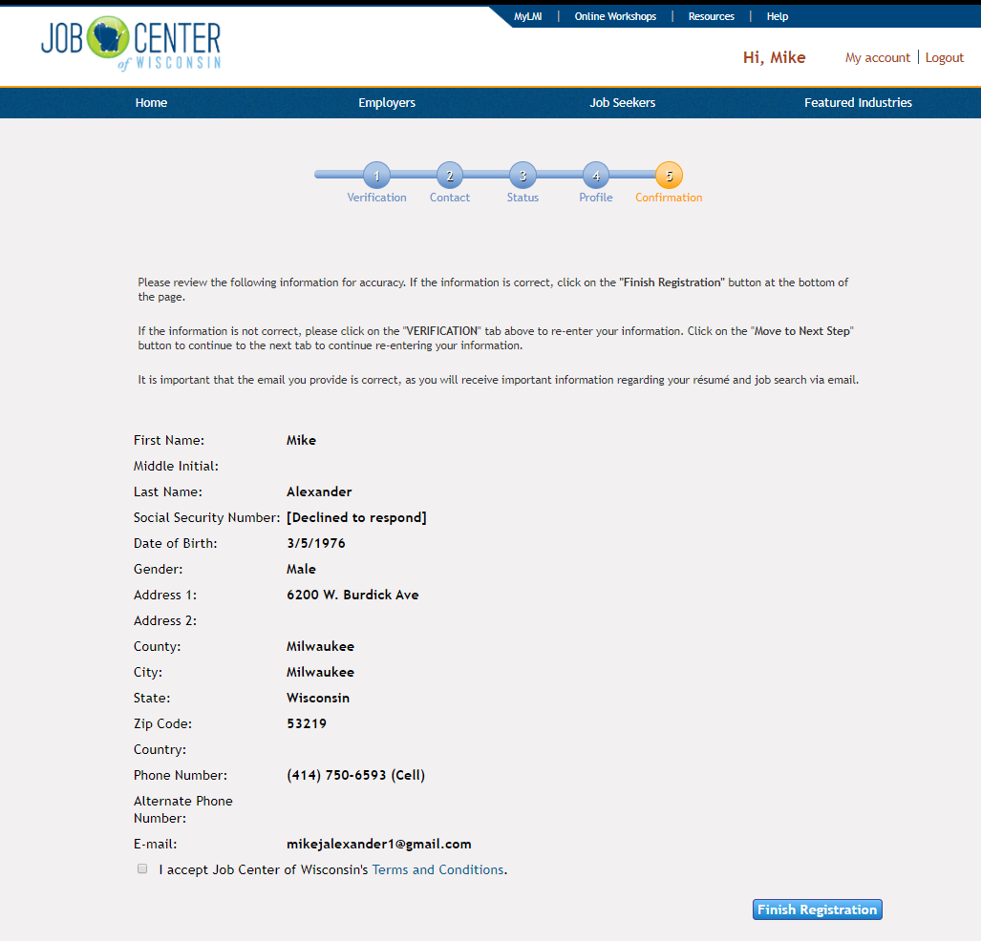
Notes:
Confirmation
Sections with an asterisk need to be completed.

Slide 16
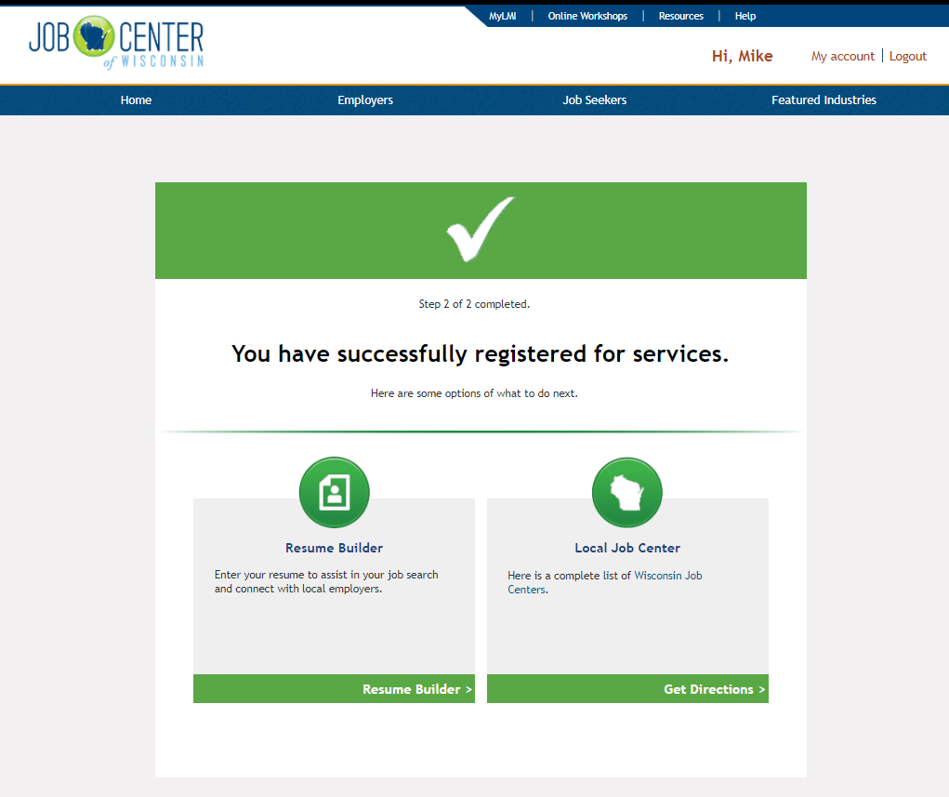
Notes:
Once the registration is complete, the participant is given the option to create a resume.

Slide 17
Notes:
The participant can hover the curser over the Job Seekers tab and select Create/Edit Resume.

Slide 18
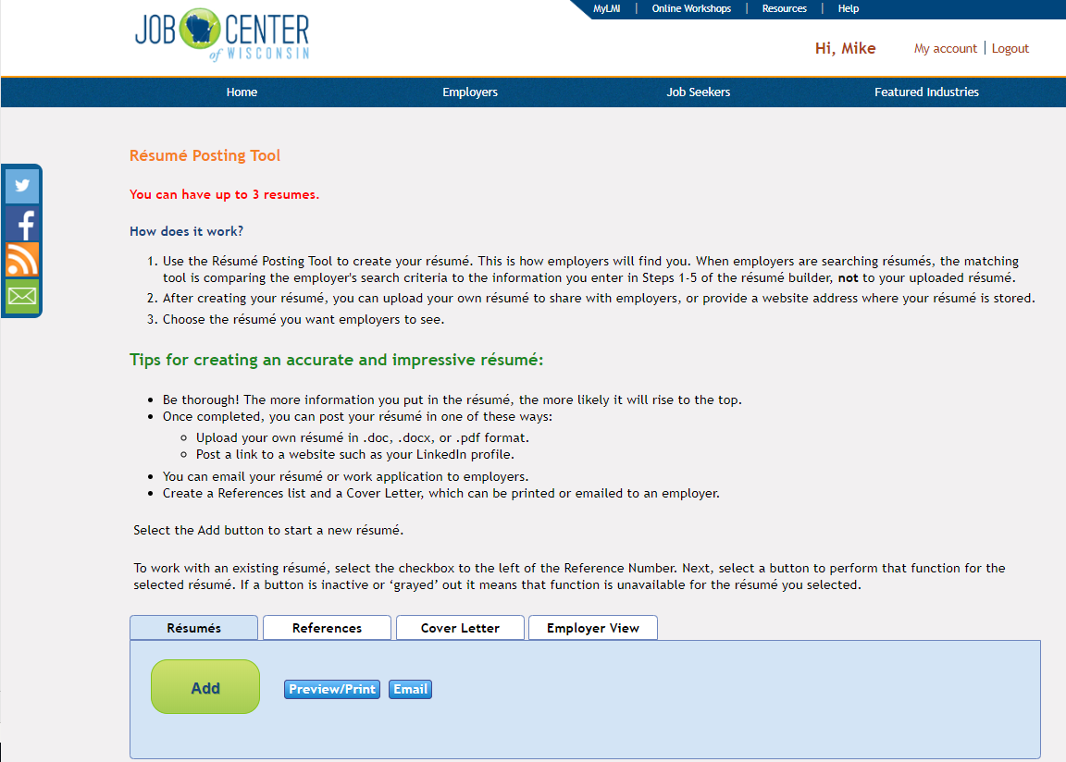
Notes:
This page provides the participant with information about creating and/or uploading a resume and tips for creating a new resume.

Slide 19
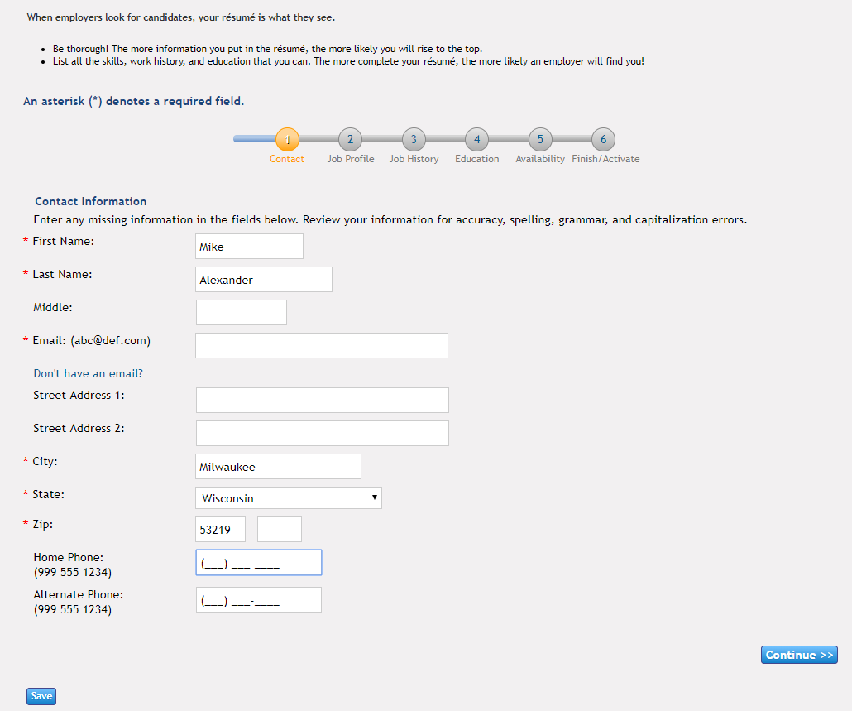
Notes:
There are 5 steps to complete the resume
Contact
Sections with an asterisk need to be completed.

Slide 20
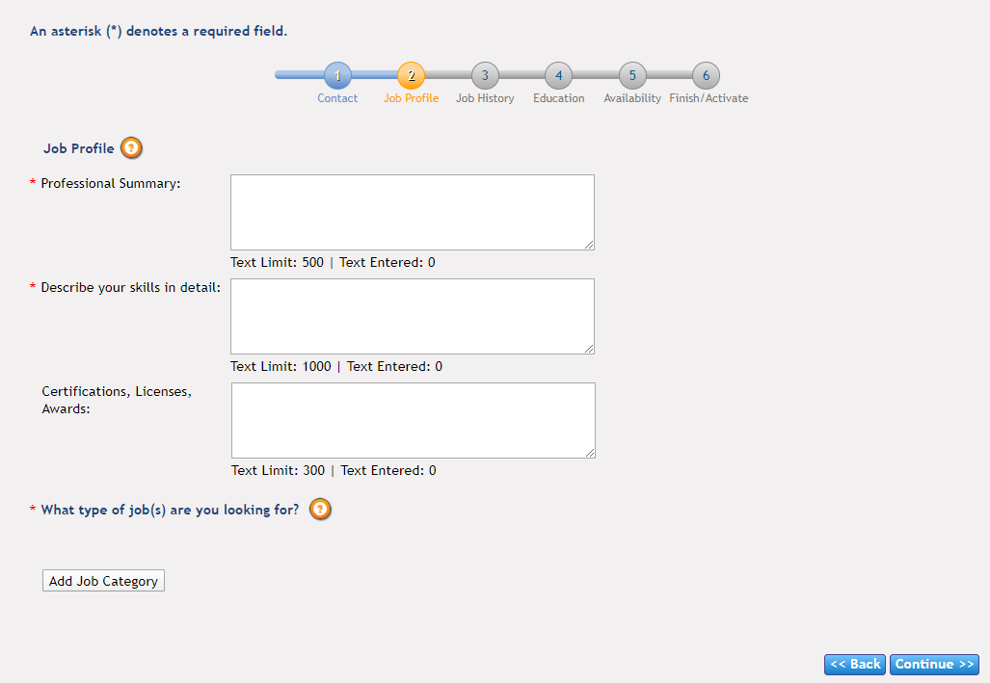
A resume summary statement is a short paragraph at the beginning of a resume that highlights a job seeker's professional skills and experience. It gives hiring managers a glimpse into the job seeker's expertise before diving into their resume.
Hard skills are abilities specific to the job and/or industry. Generally, these are more technical skills you learn in school, certification programs, training materials or experience on the job.
Soft Skills are abilities that can be applied in any job. Often, soft skills may be referred to as “people skills” or “social skills”
https://www.indeed.com/career-advice/resumes-cover-letters/best-resume-skills
Notes:
Job Profile
Sections with an asterisk need to be completed.

Slide 21
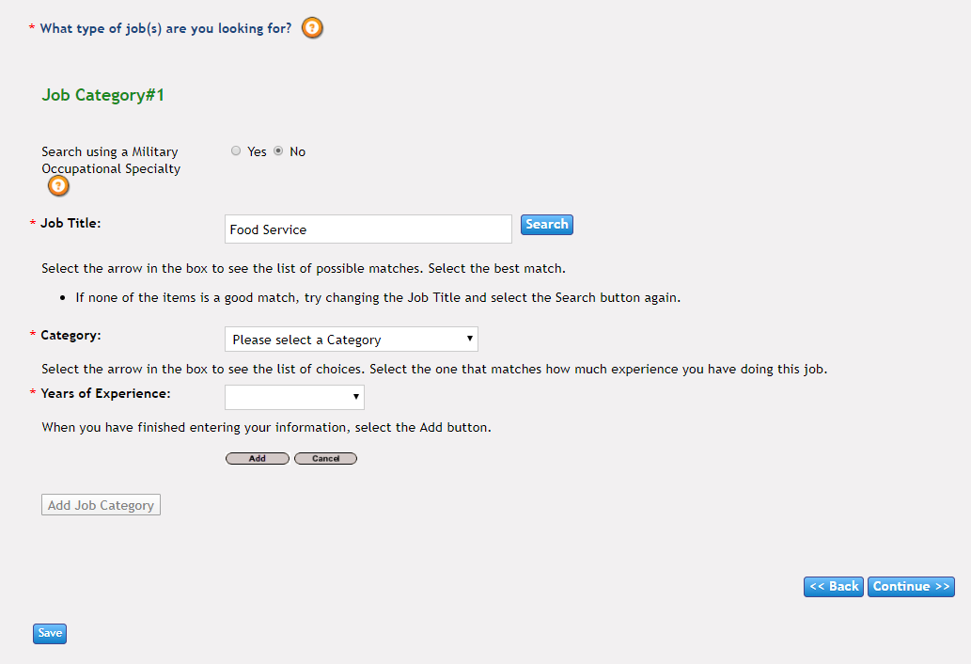
Notes:
Job Profile (cont.)
Sections with an asterisk need to be completed.
Enter a job title
“Click” Search
“Click” Please select a Category, for occupation options.

Slide 22
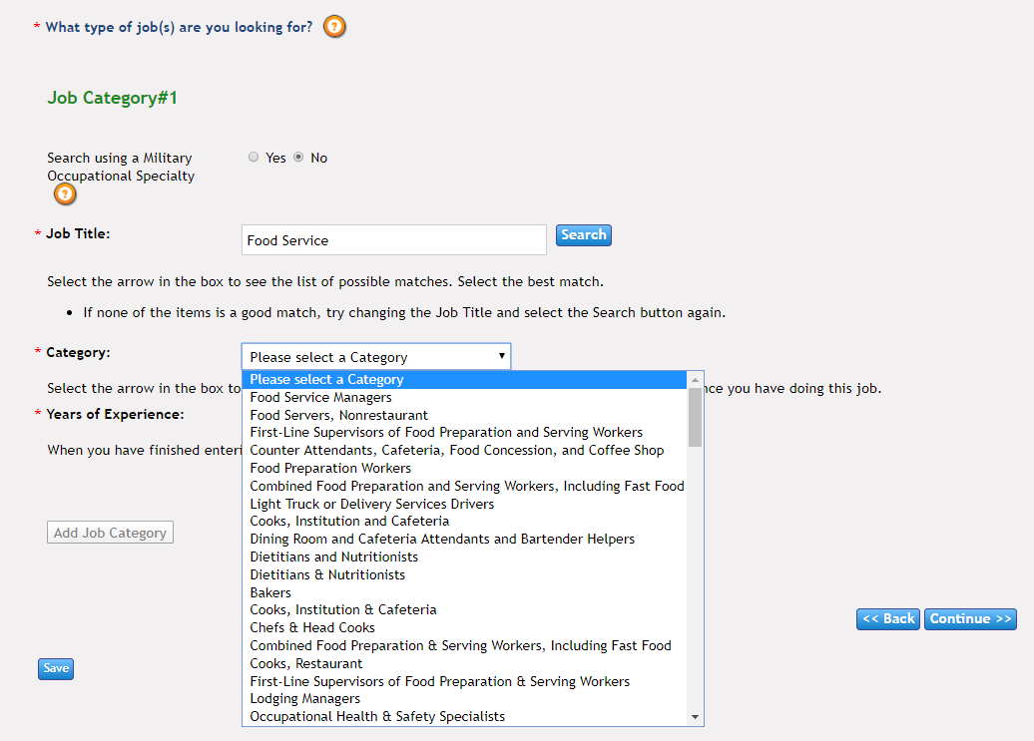
Notes:
Job Profile (cont.)
Sections with an asterisk need to be completed.
Select an occupation that best matches the work history

Slide 23
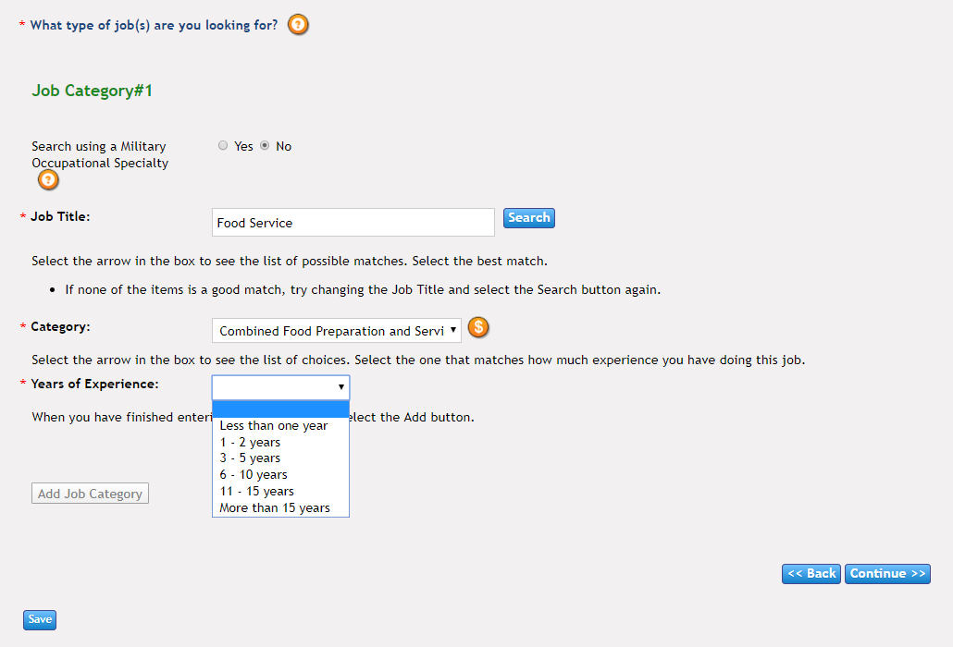
Notes:
Job Profile (cont.)
Sections with an asterisk need to be completed.
Select years of experience

Slide 24
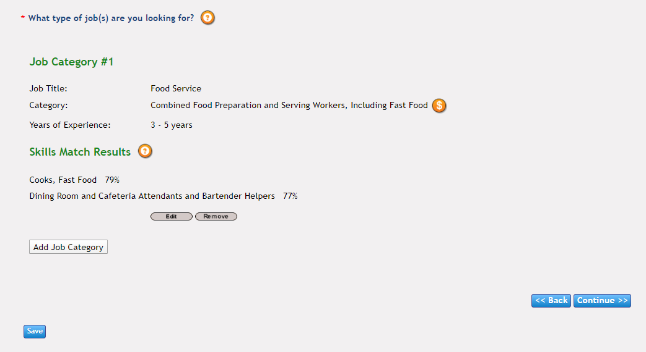
Notes:
After the information is entered, the skills matching software shows the Skills Match Results. Occupations that align with the Knowledge, Transferable Skills and Abilities from the participant's previous work experience.

Slide 25
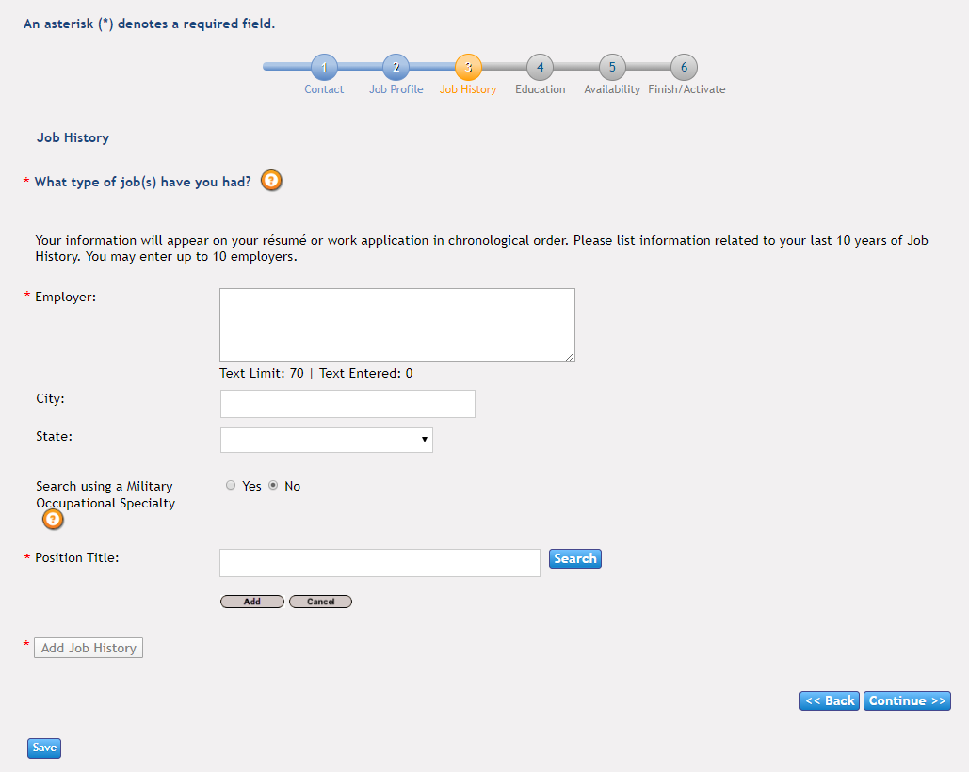
Notes:
Job History
Select, “Add Job”
Sections with an asterisk need to be completed.

Slide 26
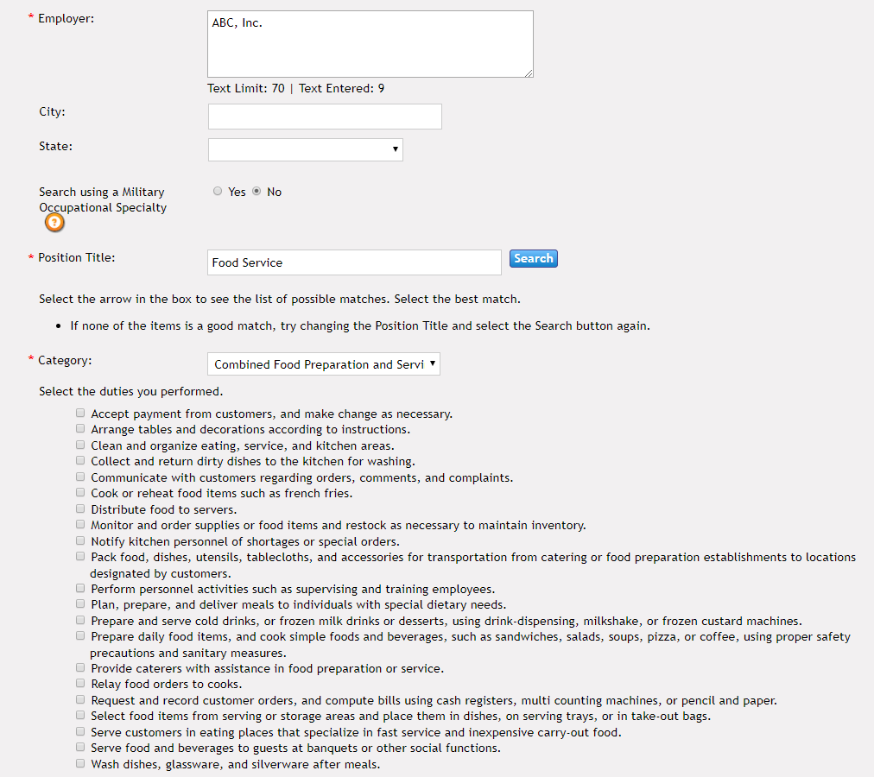
Notes:
Job History
Enter the name of the employer
Enter the Position Title and “click” Search
“Click” Category
Select an occupation that best matches the work history
Job descriptions with appear that reflect job duties of that occupation. Participants can “click” on the boxes of the job duties that describe their work experience.

Slide 27
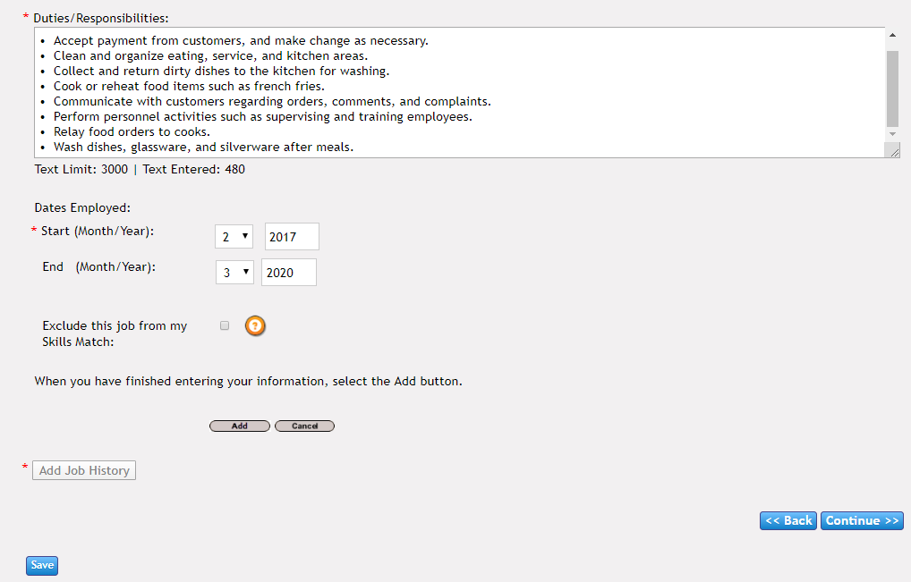
Notes:
Job History
Job duties that were “clicked”, appear in the Duties/Responsibilities section.
Enter Start and End Dates for the employment
“Click” Add

Slide 28
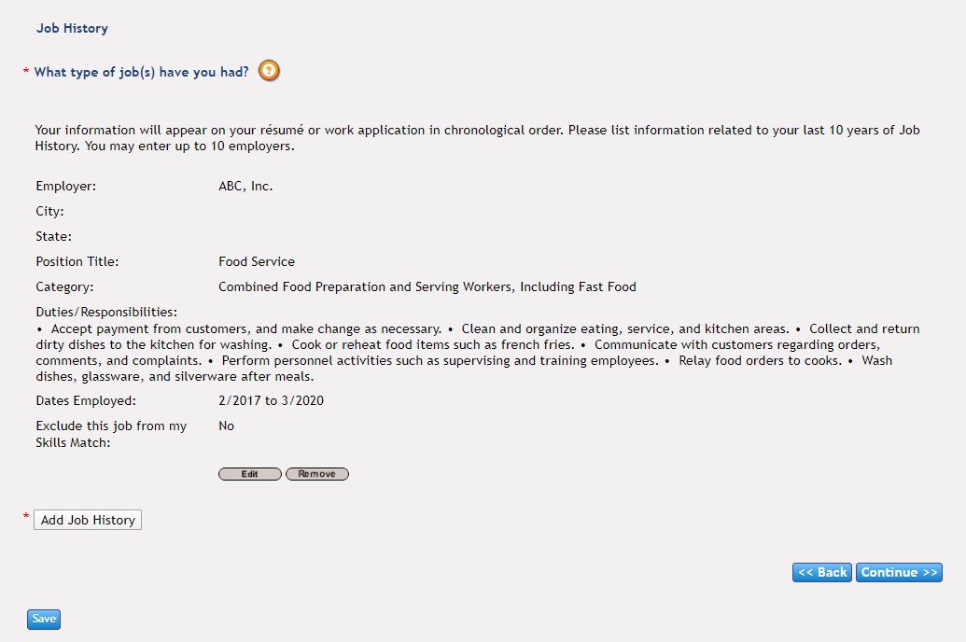
Notes:
This page is a snap-shot of the information that was entered in the Job History section.
Participants can enter additional jobs by “clicking” the Add Job History button.

Slide 29
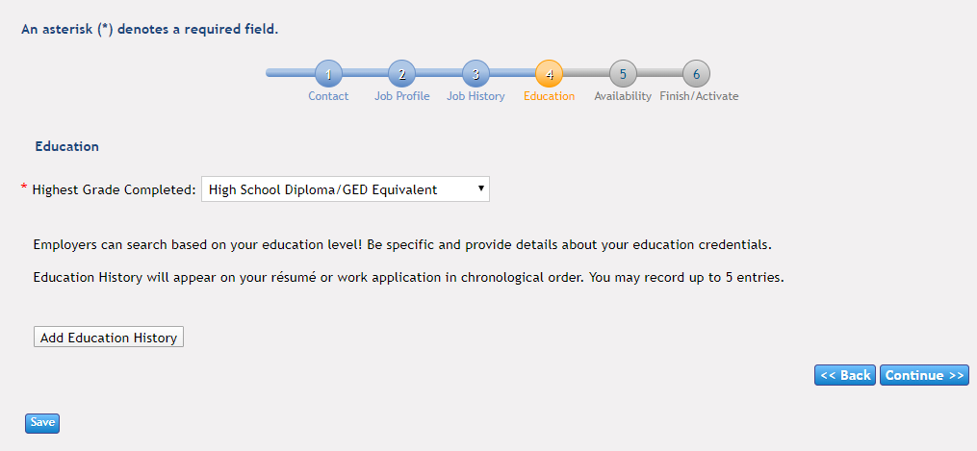
Notes:
Education
Sections with an asterisk need to be completed.
Participants can enter additional education information by “clicking” the Add Education History button.

Slide 30
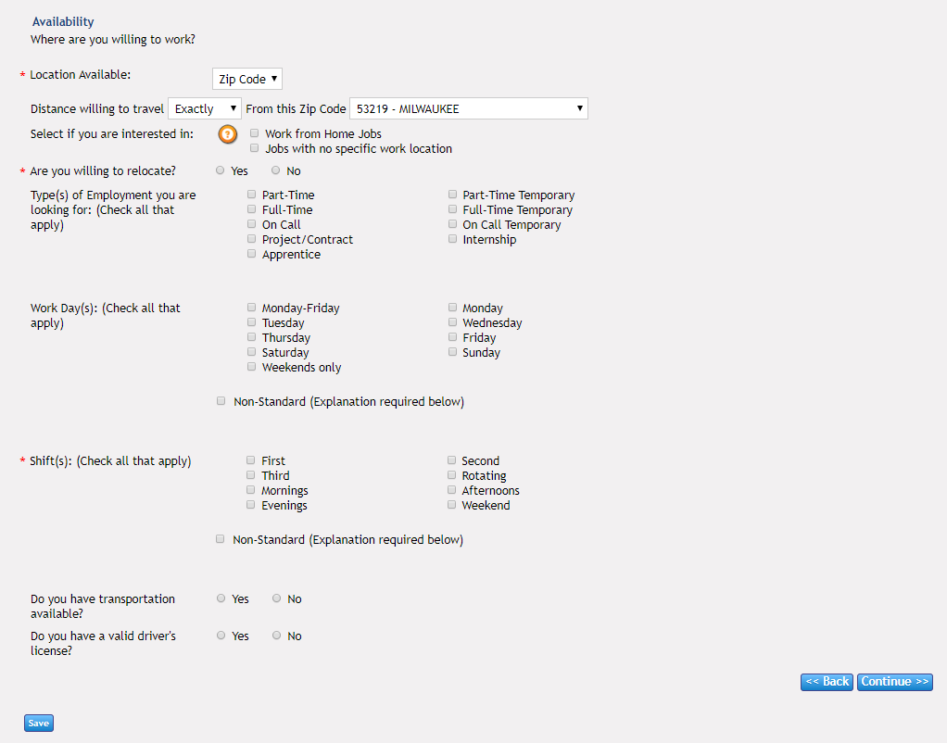
Notes:
Availability
Participants can enter information which will be used to let employers what their availability and their preferred work schedule.
Sections with an asterisk need to be completed.

Slide 31
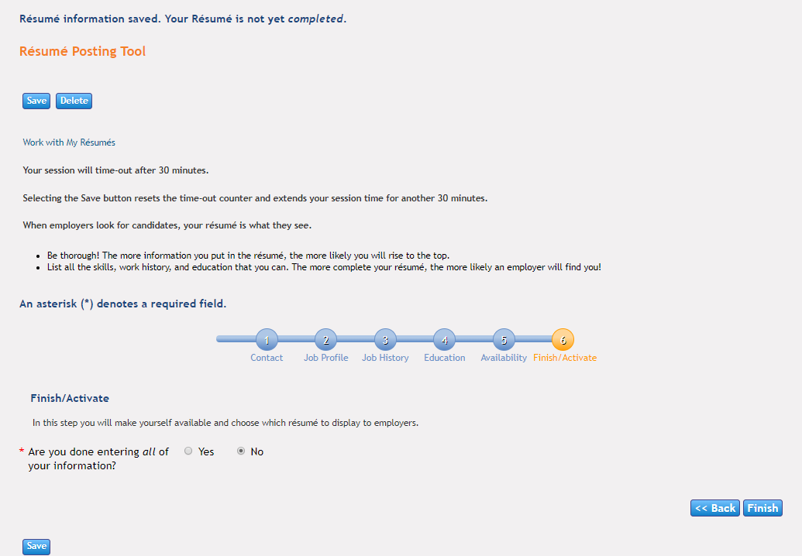
Notes:
Finish/Activate
If the participant has completed all the required sections and entered all the information, they can “click” Yes to proceed.

Slide 32
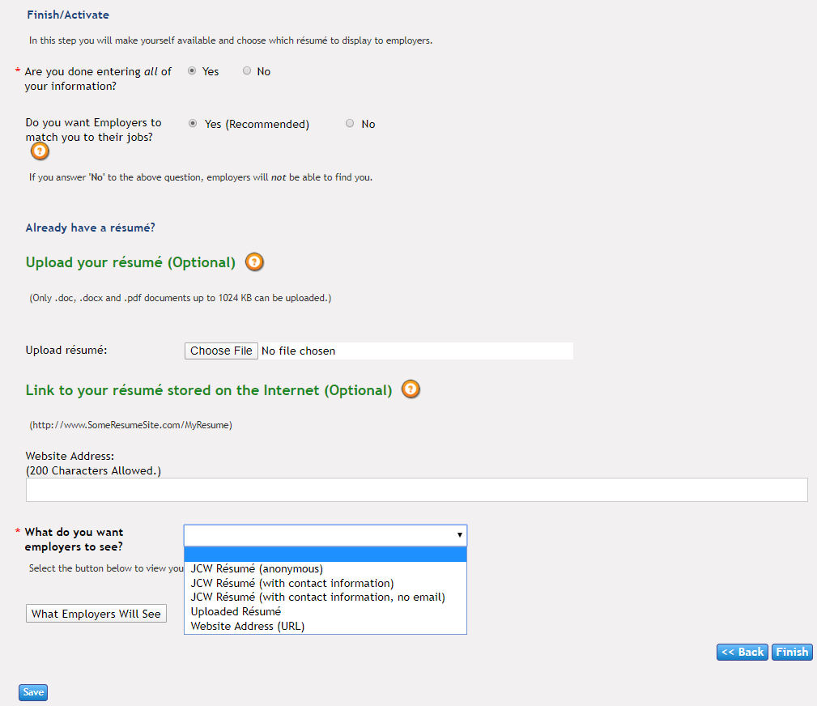
Notes:
Finish/Activate
Participant can choose to have their resume matched with employers job descriptions for compatibility.
Participants can upload their own resume
Participants can choose which resume will be visible to the employers

Slide 33
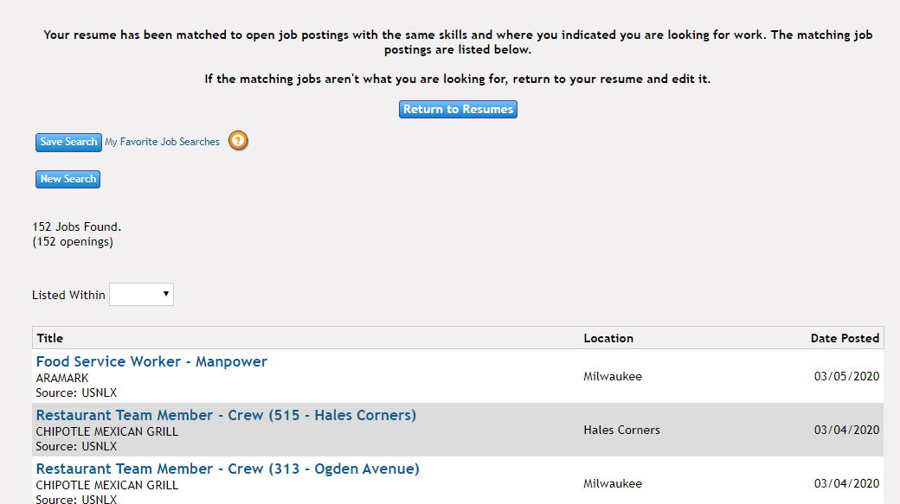
Notes:
This page will appear if the participant has entered all the required information and completed the resume.

Slide 34
Notes:
If a participant wants to view their progress, they can hover the curser over the Job Seekers tab and select My JCW.

Slide 35
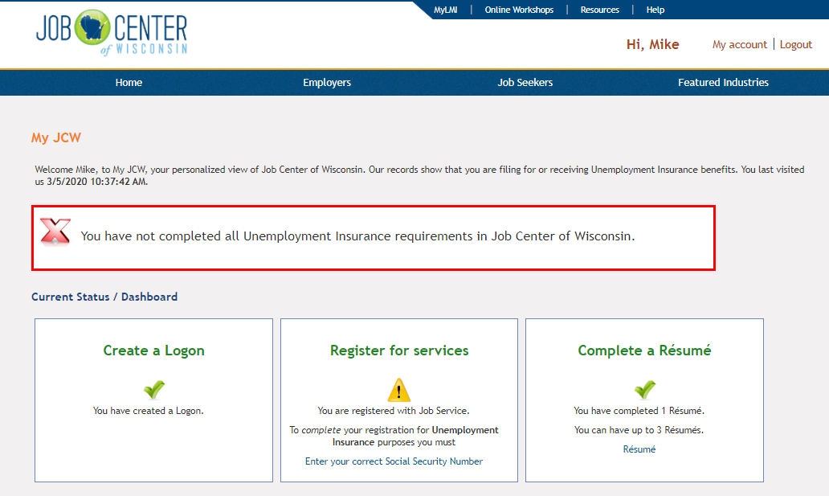
Notes:
An alert message indicates the action needs to be completed. I did not enter the Social Security number during the registration process. That will need to be entered if the participant files for unemployment benefits.
A green “Check Mark” indicated the action has been completed.

