Slide 1
Title Slide
Tracking Programs & Activities for the 2024 Annual Report
Melissa Aro
Analyst / Data Coordinator
December 2023

Slide 2


Sample Text + Image Slide
Learning Objectives
Understand the layout of the program & activity tracking tool
Learn how to enter programs, activities, attendance, presentation views, and participation
Understand how to produce accurate and complete statistics for the Annual Report

Slide 3
Sample Text Slide
Programming and Activity Count Tracker
Posted annually with a tab describing updates, this presentation covers the 2024 calendar year version
Use of this tracker is optional
Download from the Public Libraries / Data Reporting/ Annual Report webpage

Slide 4
Tour
Worksheet layout
Event Tracker tab
Annual Report Summary tab
Tips & Tricks

Slide 5
Sample Text Slide
Worksheet Tabs
Definitions – Review each collection year
ExcelTips – Tips for interacting with the spreadsheets
EventTracker – Primary entry screen
AnnualReportSummary – Summary and totals
Notes:
The EventTrackerEXAMPLE and AnnualReportSummaryEXAMPLE tabs are provided for reference purposes. These tabs include examples of program and activity entries in the EventTracker tab and the grouping and summing of statistics into the AnnualReportSummary tab.

Slide 6
Sample Text Slide
Event Tracker Example Tab
Blue columns are the program and activity detail which is summed automatically into the Annual Report Summary tab.
The grey columns are recommended to identify the specific program or activity and to capture local program details.
Notes:
The EventTrackerEXAMPLE and AnnualReportSummaryEXAMPLE tabs are provided for reference purposes. These tabs include examples of program and activity entries in the EventTracker tab and the grouping and summing of statistics into the AnnualReportSummary tab.

Slide 7
Sample Text Slide
Sample row, required columns
The 4 leftmost blue columns provide dropdowns to identify the event audience and format.
Date, time, duration, and local event name are recommended to identify individual programs

Slide 8
Sample Text Slide
Sample pre-recorded program
The remaining blue columns are conditionally required. Shading in the row will identify columns for which an entry is expected.
For example, for a pre-recorded program, only enter a count for the number of views within 30 days of post. Note that only one cell is shaded green.

Slide 9
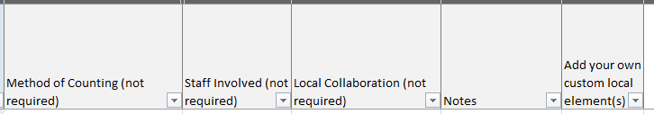
Sample Text Slide
Sample row, local use columns
The rightmost columns are not required. Consider adding detail for use in future planning or local use.

Slide 10
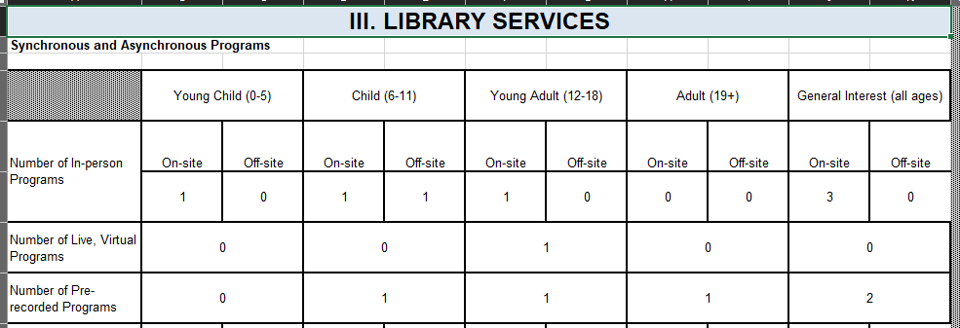
Sample Text Slide
Annual Report Summary Example
This tab uses the blue columns from the Event Tracker tab to automatically build totals.
Do not manually enter counts into this tab.
Notes:
The EventTrackerEXAMPLE and AnnualReportSummaryEXAMPLE tabs are provided for reference purposes. These tabs include examples of program and activity entries in the EventTracker tab and the grouping and summing of statistics into the AnnualReportSummary tab.

Slide 11

Sample Text + Image Slide
Tips and Tricks
Enter or select a value for all columns required for the selected format of delivery.
Enter a planned program and all detail even if it had 0 attendees or views.
Add local use columns to the far right of the worksheet.
Notes:
Tip for using the spreadsheet are found in the ‘ExcelTips’ tab of the tracking tool workbook.
Some users have inadvertently altered the workbook formatting which groups and sums information from the ‘EventTracker’ tab into the ‘AnnualReportSummary’ tab. To avoid this, use care with copy and paste.

Slide 12
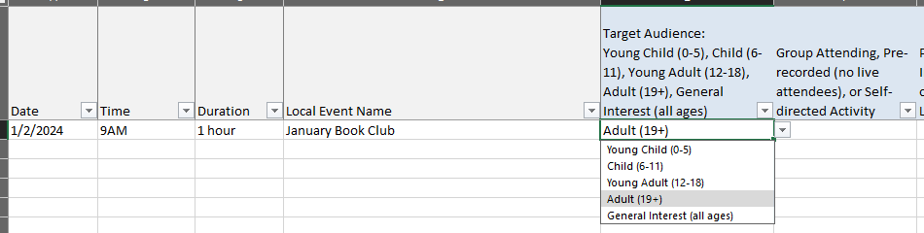
Sample Text Slide
Add a new event
Complete information for the first 4 columns.
Click the Target Audience column and select from the dropdown.
Tab to the next cell and select from the dropdown.

Slide 13
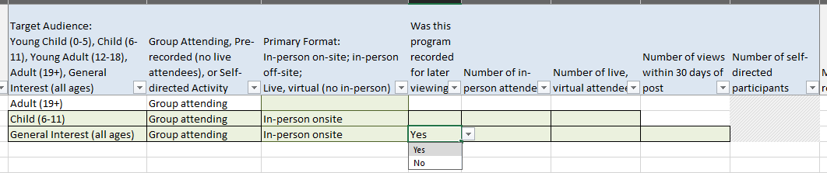
Conditionally required columns
As selections are made green shading and grey, hashed shading appear.
Green shading identifies that a value should be entered.
Do not enter a value in grey, hashed cells.

Slide 14
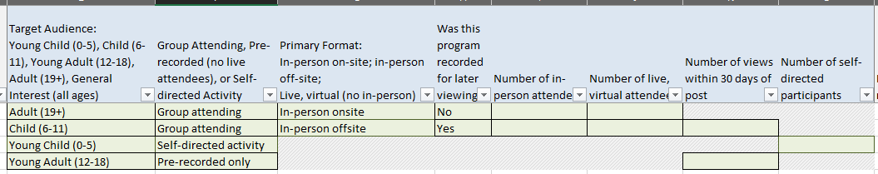
Do not leave blanks
Each green shaded cell should have a value.
If a program was offered but did not have attendees or views, then enter 0.

Slide 15
Sample Text Slide
Annual Report
Verify the total counts make sense. Review the basic validation checks in the lower left of the Annual Report Summary tab.
The totals from the Annual Report Summary tab are entered into Section III Library Services and Section XIII Self-directed Activities.
Do not leave a response blank when the value is known to be zero; enter a zero.

Slide 16
Sample Text Slide
Reporting missing counts
If your library is unable to collect attendance or capture the count of views of posted recordings, then check the ‘Not available’ box the on-line Annual Report. Do not enter a zero.
If the count is missing for only a few sessions, then enter the count and add a note to explain the partial reporting.

Slide 17

Review

Slide 18
Sample Text Slide
Learning Objective One
The Program and Activity Tracker is an optional tool to gather event information during the calendar year.
A new version of the tool should be downloaded for each calendar year.
The workbook contains a worksheet to record events, a summary sheet which calculates totals, and definitions and tips for using this tool.

Slide 19
Sample Text Slide
Learning Objective Two
Use the Event Tracker tab to record event detail. Include programs and activities offered even if there was no attendance or participation.
Enter the 4 rightmost grey columns to record basic information regarding the event.
Use the cell dropdown menu to select the appropriate value for the first 4 blue columns.
The remaining blue columns are conditionally required. Shading in the row will identify columns for which an entry is expected.

Slide 20
Sample Text Slide
Learning Objective Three
Verify the total counts on the Annual Report Summary tab make sense. Review the basic validation checks in the lower left of the Annual Report Summary tab.
Transfer the tab counts into the matching question in the on-line Annual Report. Do not leave a response blank when the value is known to be zero; enter a zero.
Within the on-line Annual Report, use the ‘Not available’ box to identify that though the program type was offered attendance, participation, or views are missing.

